Slide 1
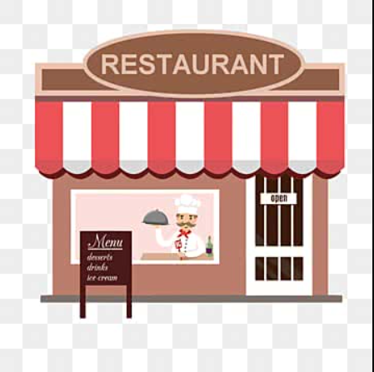

RESTAURANTS PROJECT
.

Slide 2
📌 PROJECT OVERVIEW
This project is an interactive SQL-based restaurant analysis project designed to explore restaurant operations using structured query language (SQL).
The project focuses on analyzing restaurant data to generate meaningful business insights through queries, reports, and data exploration.
Project use data to demonstrate how SQL can be used to analyze data, answer real-world questions.

Slide 3
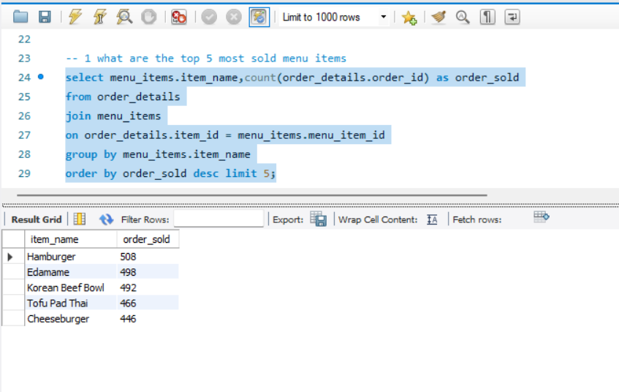
1. : What are the top 5 mostLY sold menu items?

Slide 4
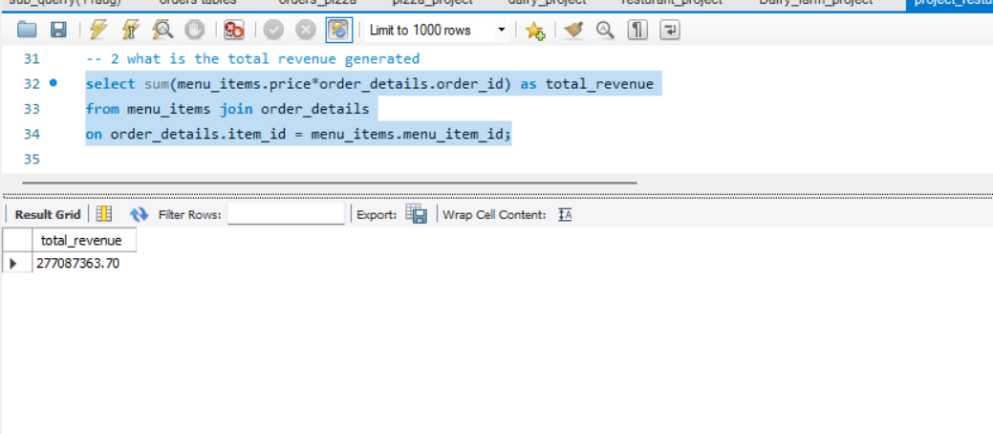
2. What is the total revenue generated?

Slide 5
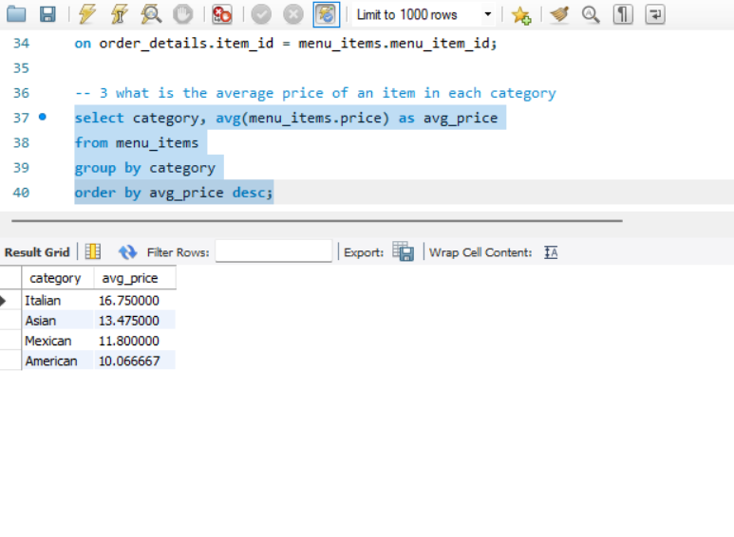
3. : What is the average price of an item in each category?

Slide 6
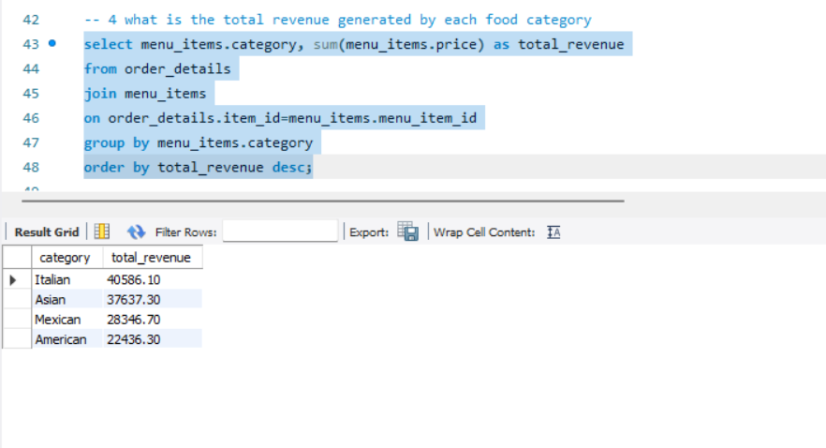
4. : What is the total revenue generated by each food category?

Slide 7
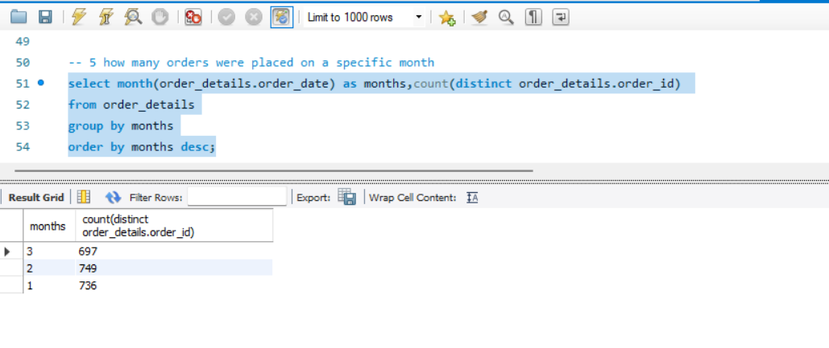
5. : How many orders were placed on a specific month

Slide 8
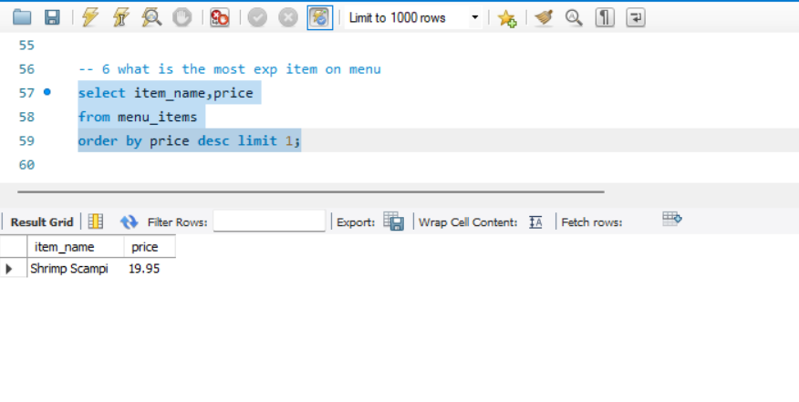
6. : What is the most expensive item on the menu?

Slide 9
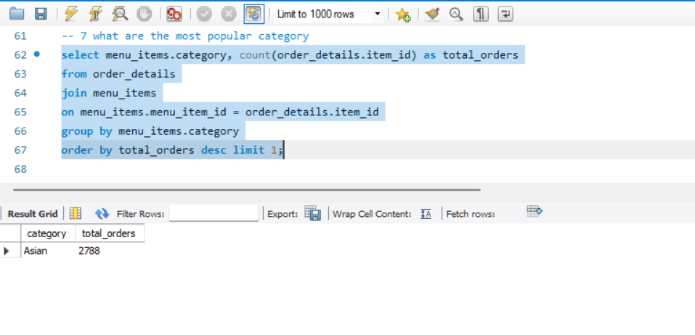
7. : What are the most popular categories?

Slide 10
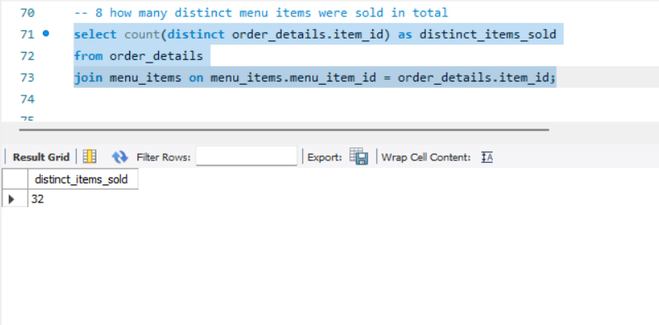
8. : How many distinct menu items were sold in total?

Slide 11
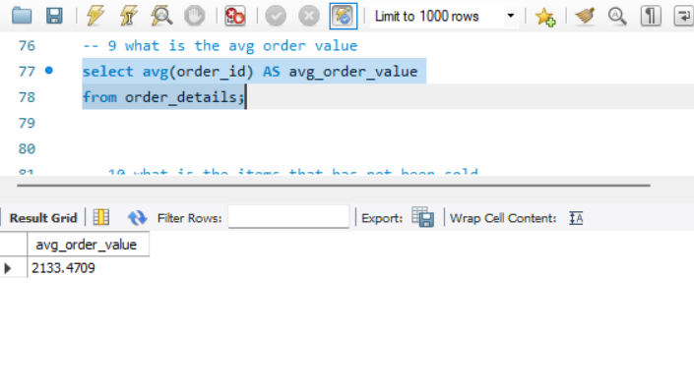
9. : What is the average order value?

Slide 12
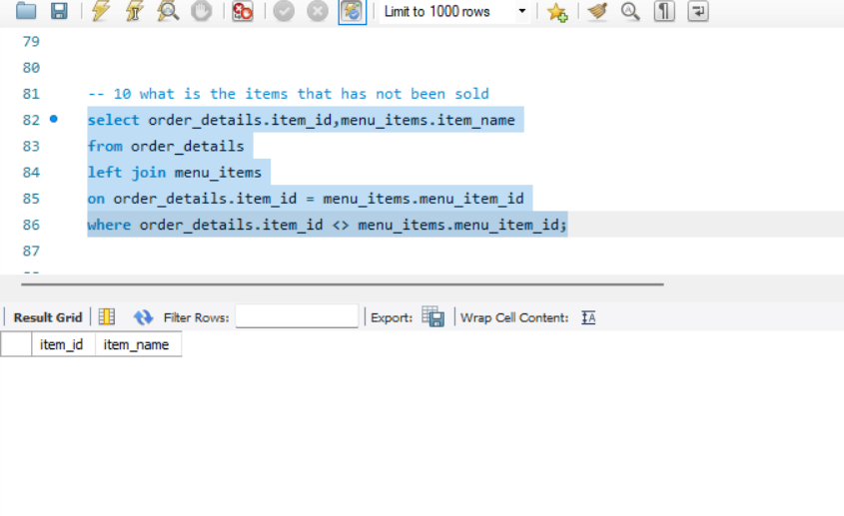
10. : What is the item that has not been sold?

Slide 13
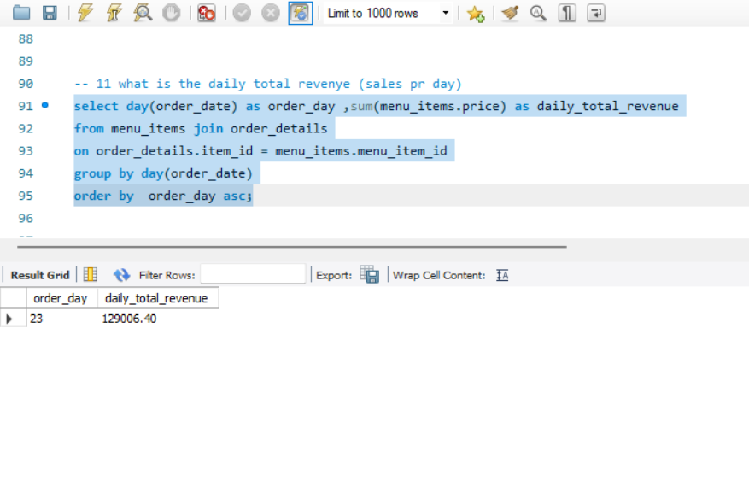
11. : What is the daily total revenue? (sales per day)

Slide 14
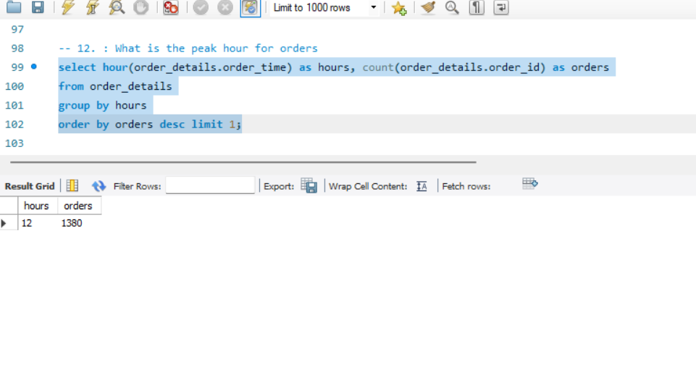
12. : What is the peak hour for orders?

Slide 15
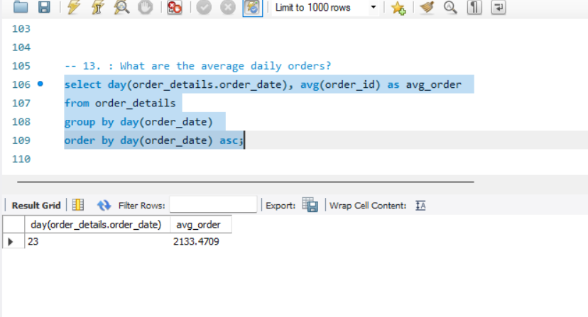
13. : What are the average daily orders?

Slide 16
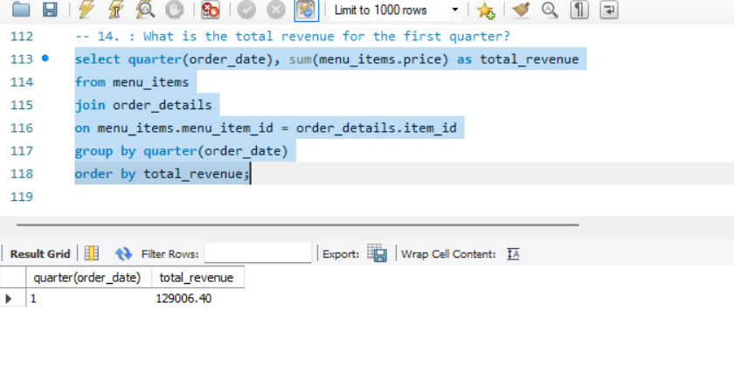
14. : What is the total revenue for the first quarter?

Slide 17
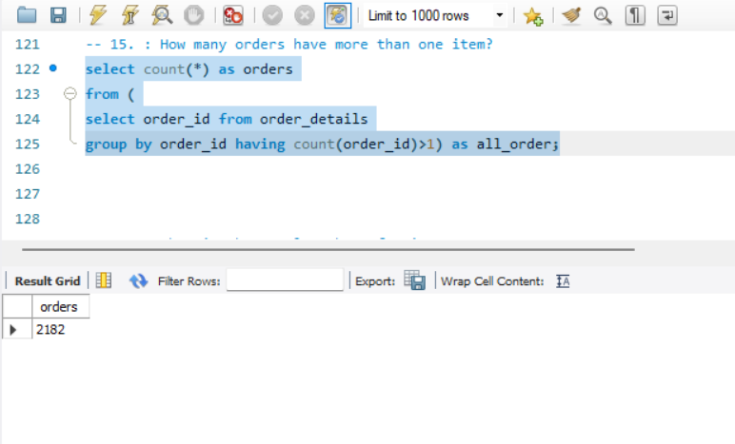
15. : How many orders have more than one item?

Slide 18
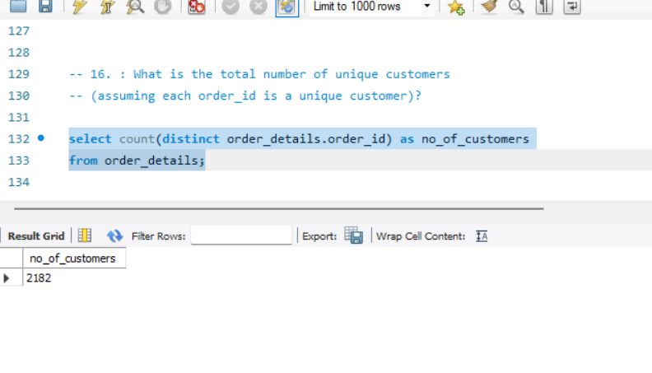
16. : What is the total number of unique customers

Slide 19
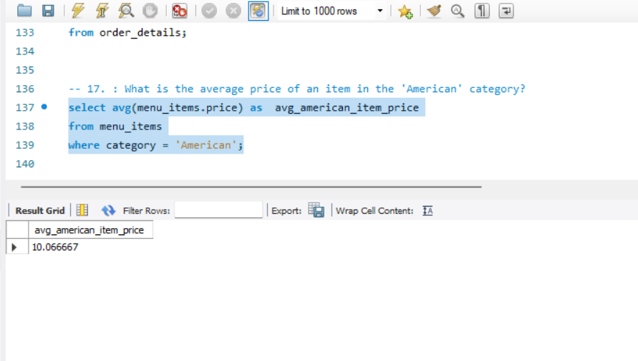
17. : What is the average price of an item in the 'American' category?

Slide 20
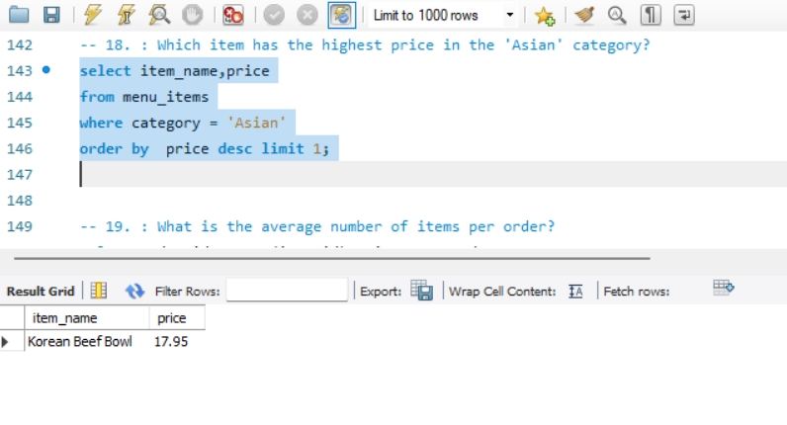
18. : Which item has the highest price in the 'Asian' category?

Slide 21
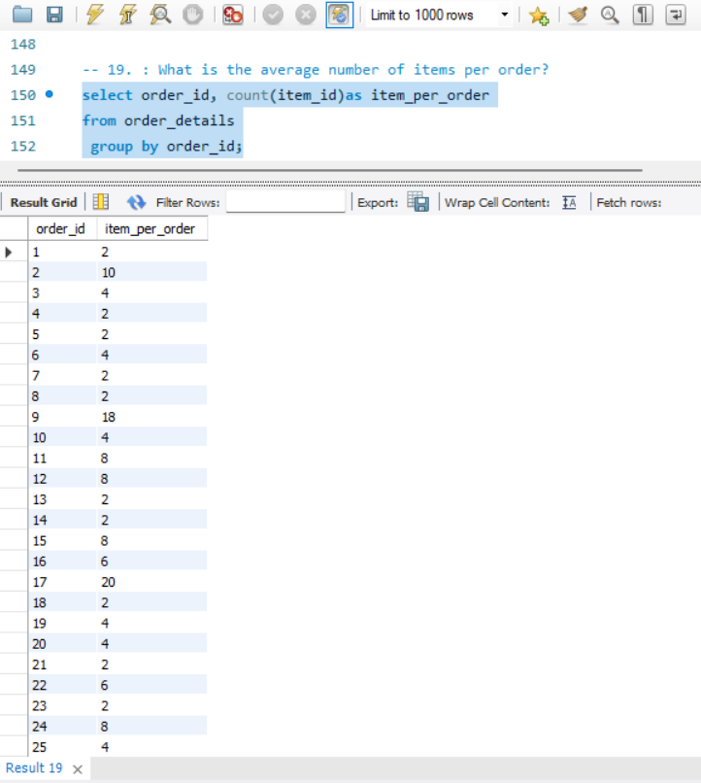
19. : What is the average number of items per order?

Slide 22
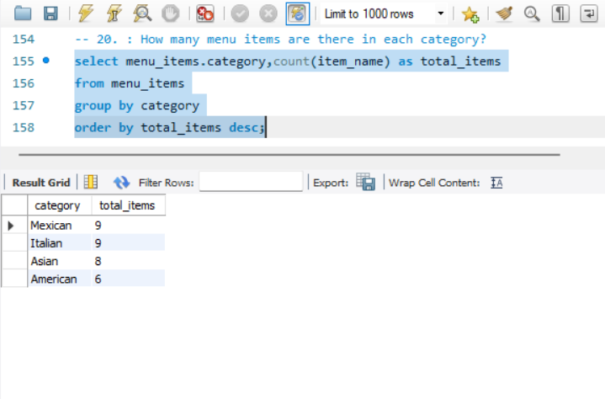
20. : How many menu items are there in each category?

Slide 23
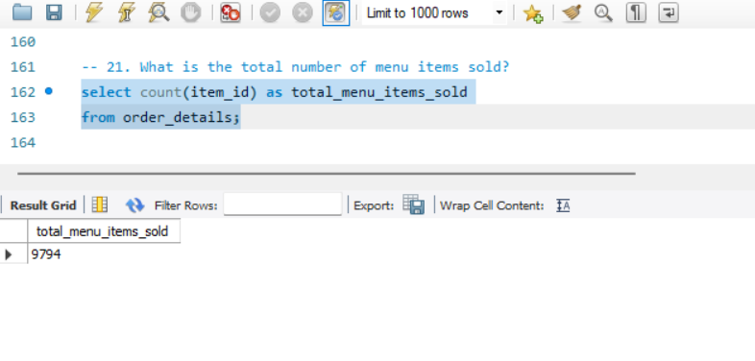
21. What is the total number of menu items sold?

Slide 24
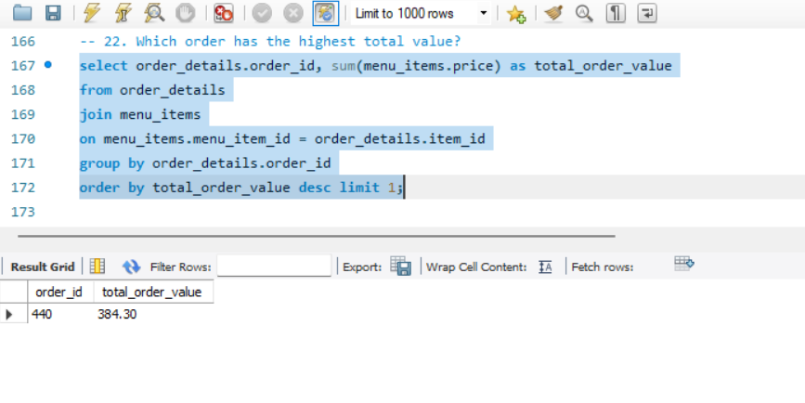
22. Which order has the highest total value?

Slide 25
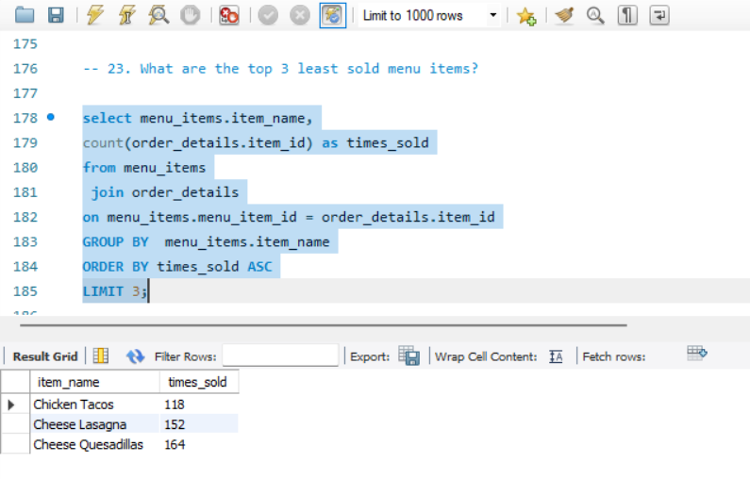
23. What are the top 3 least sold menu items?

Slide 26
📊 Key Business Insights –
- The restaurant generated a total revenue of 277,087,363, reflecting strong overall business performance.
A total of 9,794 menu items were sold during the analysis period.
The Asian category emerged as the most popular cuisine category among customers.
The average order value was approximately 2,133, indicating a healthy customer spending pattern.
All menu items were sold at least once, meaning there were no unsold items in the dataset.
The restaurant generated an average daily revenue of approximately 129,006.
The peak ordering hour was observed at 12:00 PM, highlighting lunchtime as the busiest period of the day.
The three least sold menu items were: -
Chicken Tacos
Cheese Lasagna
Cheese Quesadillas
The top three best-selling menu items were: -
Hamburger
Edamame
Korean Beef Bowl

Slide 27
🔮 Future Recommendations for Increasing Sales-
Focus more on the Asian category, as it is currently the most popular among customers. Introducing additional Asian dishes or combo meals may further increase revenue.
Promote the least sold menu items such as Chicken Tacos, Cheese Lasagna, and Cheese Quesadillas through discounts, special offers, or combo deals to improve their sales performance.
Since the peak ordering time is 12 PM, the restaurant can introduce: - Lunch special offers - Limited-time meal combos - Faster delivery services during lunch hours
Implement customer loyalty programs and personalized offers to encourage repeat purchases and increase customer retention.
Analyse customer ordering behaviour regularly to identify changing food preferences and seasonal trends.
- Introduce upselling strategies by recommending side dishes, beverages, or desserts along with
popular menu items.
Optimize menu pricing based on demand and item popularity to maximize profitability.
- Use predictive analytics to forecast future sales trends and improve inventory planning.
- Increase digital marketing and social media promotions to attract more customers and improve
brand visibility.

Slide 28
📌 Conclusion -
- This Restaurant SQL Analysis Project successfully demonstrated how SQL can be used to analyze restaurant sales data .
- By working with the `menu_items` and `order_items` datasets, valuable information related to customer behaviour, sales trends, menu performance, and revenue generation was identified.
- The analysis revealed that the restaurant generated strong overall revenue, with the Asian category emerging as the most popular among customers.
- Peak ordering activity was observed during lunchtime, while all menu items recorded at least one sale, indicating effective menu utilization.
Additionally, the project helped identify both top-performing and low-performing menu items, enabling data-driven recommendations for improving future sales and customer engagement.

Slide 29
⭐ THANK YOU

