Slide 1

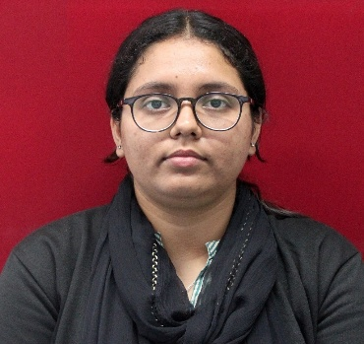
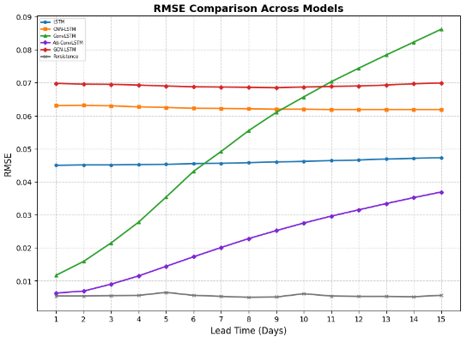
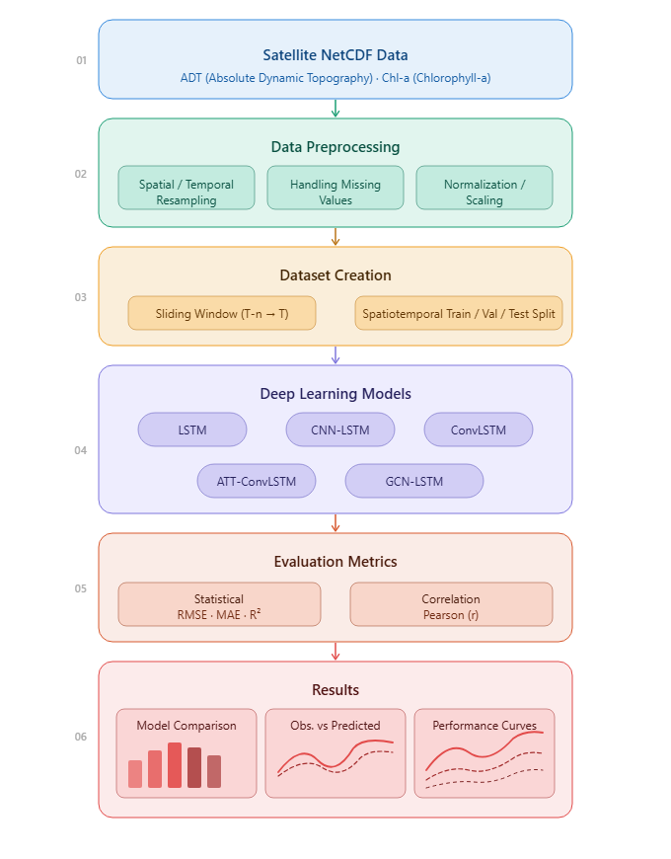
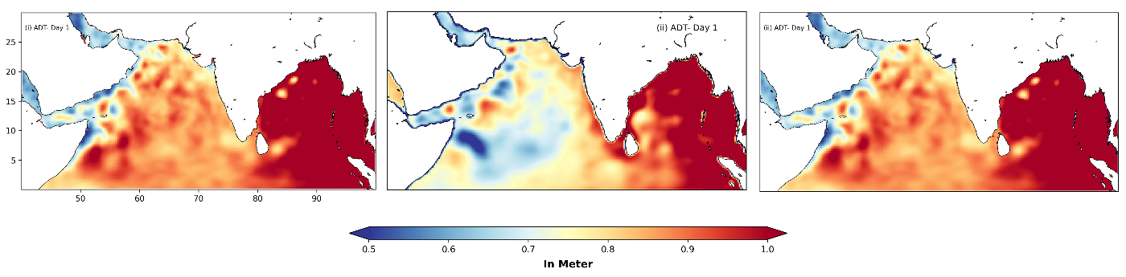
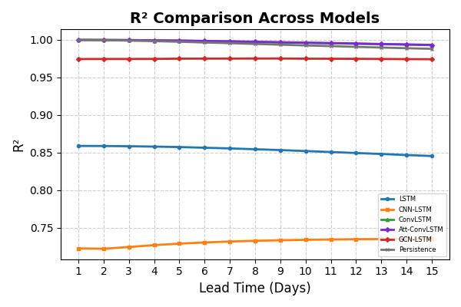
Performance Benchmarking of Deep Learning Architectures for
Independent Forecasting of Satellite-Derived Ocean Parameters
SRTD-RTMG-MISA
Name: KRITIKA MOHAN
Designation: RESEARCH INTERN
Institution: CENTRAL UNIVERSITY OF SOUTH BIHAR
Guide: DR. JAI KUMAR
Contact e-mail: kumarj@sac.isro.gov.in
PHOTO
MAJOR OBJECTIVES:
To conduct a rigorous performance evaluation of five deep learning architectures (LSTM, CNN-LSTM, ConvLSTM, Attention Based ConvLSTM, and GCN-LSTM) for short-to-medium term forecasting of ADT, and Chl-a treated as independent physical fields.
To investigate whether the optimal forecasting model is inherently parameter-dependent or if graph-based topologies consistently outperform grid-based methods across marine domains.
12 JAN 2026 to
30 JUN 2026
METHODOLOGY FLOW CHART:
RESULTS/MAJOR FINDINGS:
Variable-Dependent Optima: The framework proved predictive architectures are strictly parameter-dependent rather than universal.
Domain-Specific Models: ADT excel under grid-based Attention-ConvLSTM networks to preserve temporal memory, while Chl-a require GCN-LSTM graph configurations to prevent coastal land-mask distortions.
CONCLUSION: Physical parameters like ADT perform best under grid-based Attention-based ConvLSTM networks to preserve long-term temporal memory. Conversely, biological parameters like Chl-a strictly require GCN-LSTM graph configurations to prevent coastal land-mask spatial distortions.

