Slide 1
MF

Slide 2
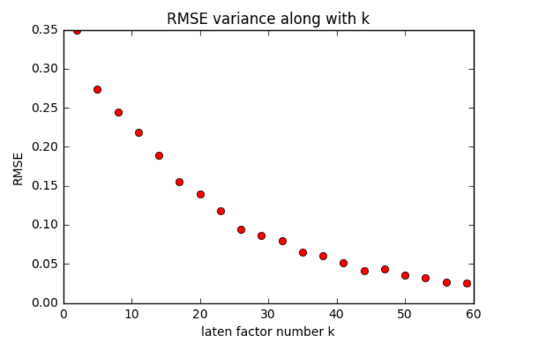

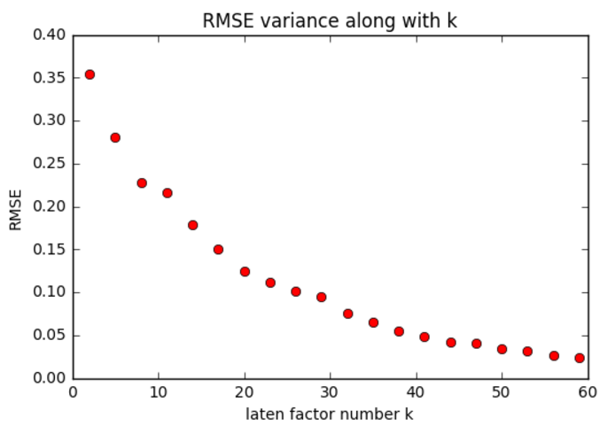

Basic MF
Basic MF uses SVD method to deposit the rating matrix into U*V
Predict unknown rating by U*V
The latent factor number K chosen 30

Slide 3
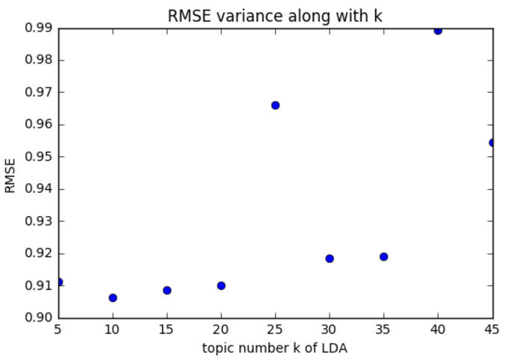
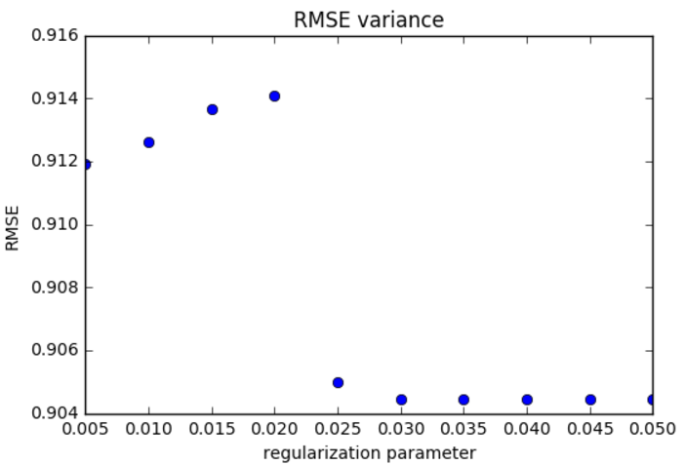

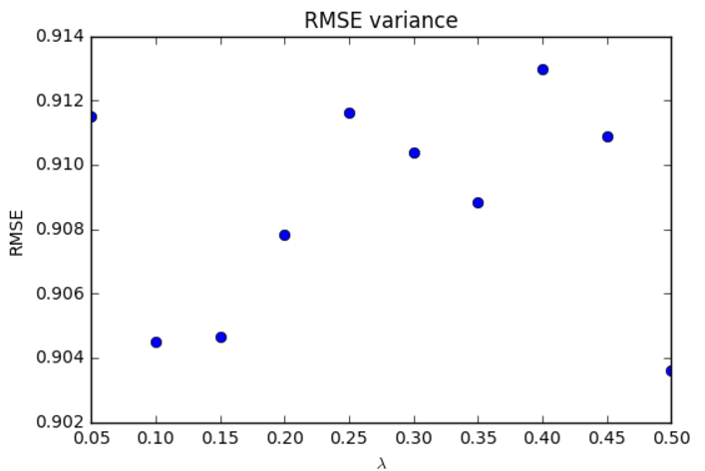
Topic MF
To get the topic distribution of reviews and words, LDA (Latent Dirichlet Allocation) is used
The model is trained as:
Result after parameter adjust, 0.907157138867

Slide 4

Social MF
Users are likely to ask for suggestions from their local friends
Users tend to seek suggestions from those with high reputations
Combined the two indication, social MF is modeled as:

