Slide 1
FINANCIAL SECURITY PLATFORM
FraudGuard AI
AI-Powered Real-Time Fraud Detection & Compliance System
🛡️ Real-time transactional risk scoring (0-100) with sub-second latency.
⚡ Multi-vector anomaly heuristics: amount velocity, cross-border locations, channel deviations.
🗄️ Production full-stack architecture: Spring Boot 4.1 + MySQL 8.0 + Modern Web UI.
Author: Kritika Perti | Date: October 2026 | GitHub: kritikaperti/AI-POWERED-FRAUD-DETECTION

Slide 2
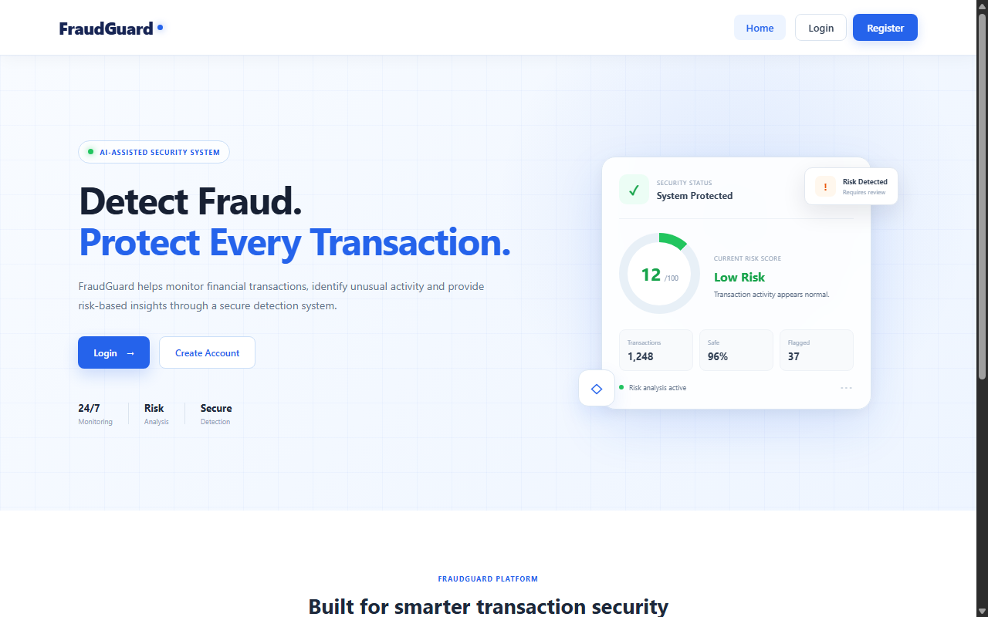
EXECUTIVE SUMMARY
Problem Statement & Proposed Solution
Modern digital payments require sub-second transaction evaluation without customer friction.
Financial Risk Surge: High volume of automated online fraud, chargebacks, and account takeovers requires real-time interception.
Legacy Bottlenecks: Traditional batch fraud analysis is too slow and lacks actionable explainability.
FraudGuard Solution: Combines deterministic thresholds with probabilistic risk scoring (0 to 100).
Transparency by Design: Delivers clear natural-language justifications for every flagged or blocked payment.
Dual Operation Mode: Connected live Spring Boot REST API mode + offline client-side fallback simulation.
Figure 1: FraudGuard Landing Page with Real-Time Security Health Meter

Slide 3
SYSTEM ARCHITECTURE
End-to-End Multi-Tier Architecture
Clean separation of presentation, security services, intelligence engine, and relational storage.
PRESENTATION TIER
Modern Web UI
HTML5 • CSS3 • JavaScript (ES6+)
• Responsive fintech user experience
• SVG dynamic risk gauges and meters
• Instant transaction testing interface
• Searchable historical ledgers
• Automatic localStorage fallback
SERVICE & API TIER
Spring Boot 4.1
Java 26 • Spring Security 6 • JWT
• Stateless REST controllers
• BCrypt salt-hashed credentials
• Role-Based Access Control (RBAC)
• Heuristic Fraud Scoring Engine
• Tomcat web container on port 8080
PERSISTENCE TIER
MySQL 8.0 Database
JPA / Hibernate 7.4 • InnoDB
• ACID compliant transactional storage
• Relational schema: users, txns, cases
• 1:1 foreign keys for investigations
• Automatic Hibernate schema updates
• Pre-seeded with admin credentials

Slide 4
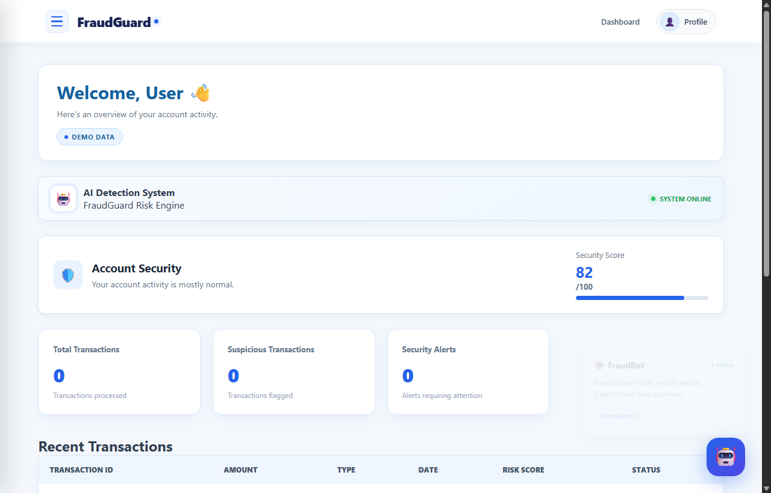
DEVELOPMENT PROGRESS
Key Accomplishments & Milestones
Major development goals accomplished across hosting, bug fixes, packaging, and version control.
Full Local Server Hosting: Spring Boot web server running live on port 8080 serving all frontend views and REST endpoints.
Form Submission Bug Fix: Corrected form submission event handlers in transaction.html to properly trigger AI analysis.
Production Executable JAR: Built and packaged self-contained fraud-detection-0.0.1-SNAPSHOT.jar with embedded Tomcat.
One-Click Windows Launcher: Created run-website.bat allowing instant execution without command line dependencies.
Full Engineering Documentation: Produced Architecture specs, API schemas, DB dictionary, and Deployment guides in docs/.
GitHub Repository Live: Initialized Git repository, cleanly filtered build artifacts, and published to GitHub.
Figure 2: User Dashboard with Personal Security Health and Action Items

Slide 5
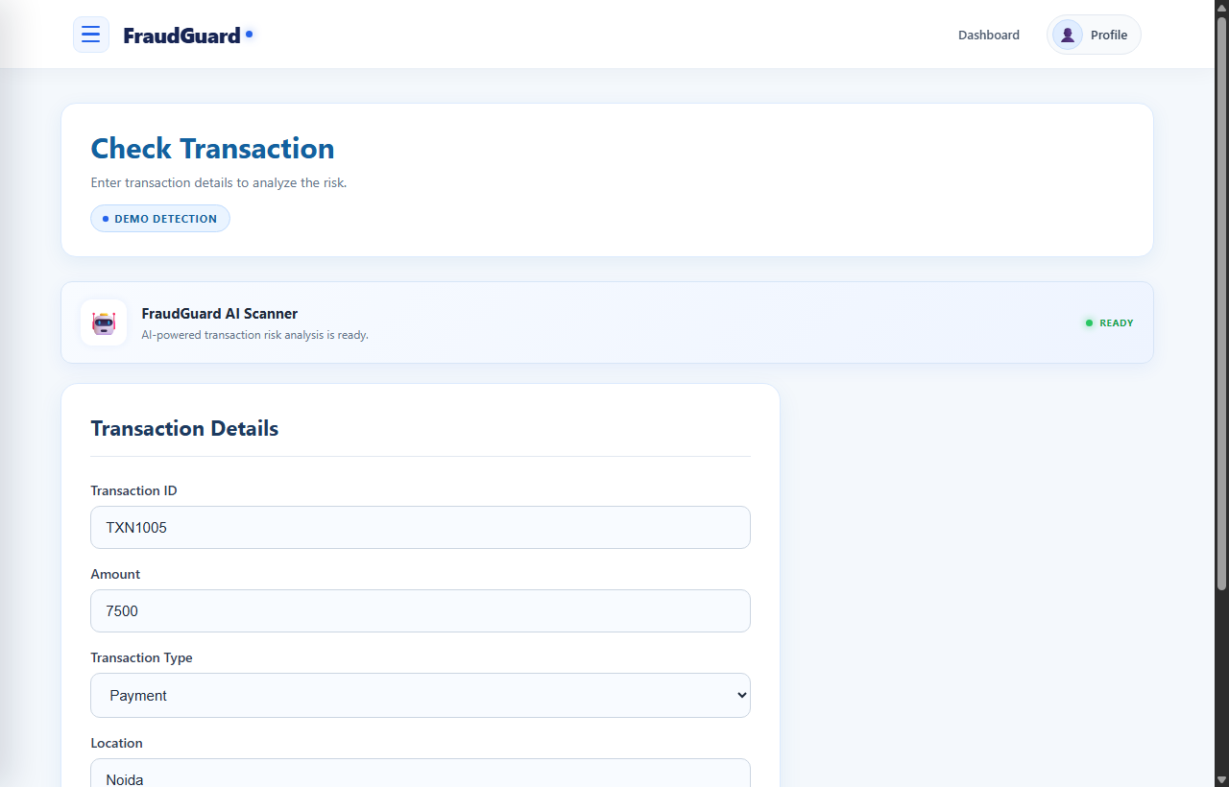
USER EXPERIENCE (UI/UX)
Real-Time AI Fraud Scanner
Interactive scanning interface evaluating payment parameters and returning immediate risk decisions.
Interactive Input Form: Users enter transaction ID, amount, channel (Payment/Transfer/Withdrawal), location, and recipient.
Real-Time Evaluation: Evaluates transaction against heuristics and returns risk classification in sub-second time.
Visual Risk Progress Bar: Color-coded progress bar visually mapping the computed risk score (0 to 100).
Clear Natural-Language Rationale: Explains specific trigger reasons (e.g. 'High amount >= 50,000; Location anomaly').
Instant Ledger Sync: Scanned transactions are automatically persisted to MySQL and appended to transaction history.
Figure 3: AI Fraud Scanner Testing Interface

Slide 6
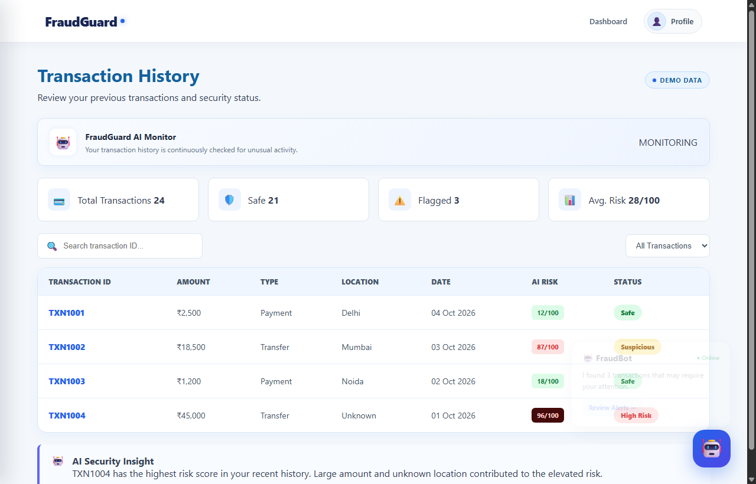
AUDIT & COMPLIANCE
Historical Transaction Ledger
Transparent, searchable audit trail providing users with complete transaction visibility.
Historical Transaction Table: Lists transaction ID, timestamp, merchant, transfer channel, and monetary value.
Status Tagging: Color-coded tags distinguishing SAFE (green), SUSPICIOUS (yellow), and BLOCKED (red) events.
Search & Filter: Allows instant searching by recipient name, transaction ID, or status type.
Dual Database Sync: Automatically syncs with MySQL backend or falls back seamlessly to localStorage.
Tamper-Evident Logs: Transaction records link directly to security case files for administrative oversight.
Figure 4: User Transaction History & Risk Score Audit Ledger

Slide 7
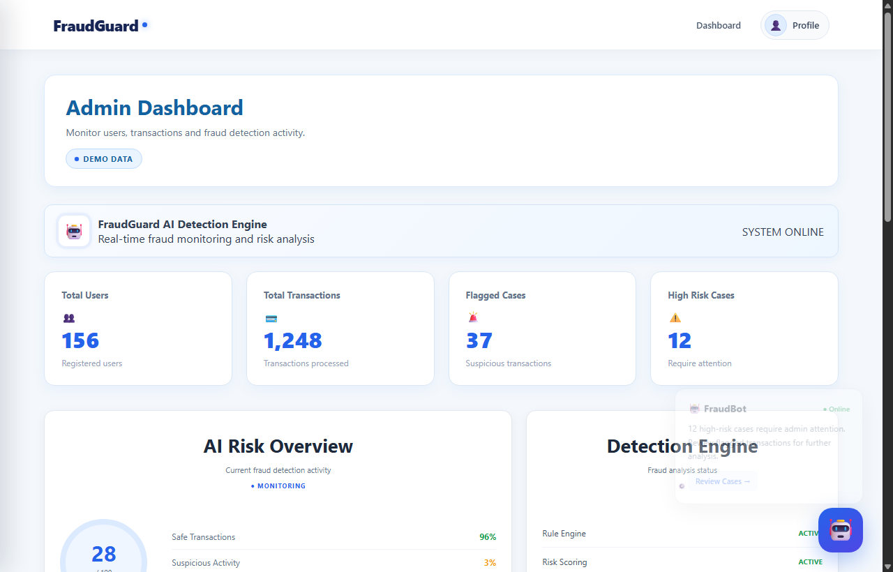
ADMINISTRATION & GOVERNANCE
Executive Dashboard & Alert Queue
Centralized surveillance console designed for risk managers and compliance officers.
Global KPI Cards: Live metrics displaying Total Monitored Transactions, Safe Rates (96%), and Flagged Cases.
Active Risk Overview: Visual donut breakdown representing current threat distribution across user accounts.
Detection Engine Status: Real-time telemetry monitoring rule engine status and risk scoring uptime.
Suspicious Alert Queue: Dedicated workflow allowing compliance officers to triage and resolve investigations.
Role-Based Access Control: Admin routes protected by Spring Security (requires ROLE_ADMIN authorization).
Figure 5: Administrator Executive Overview & Threat Telemetry

Slide 8
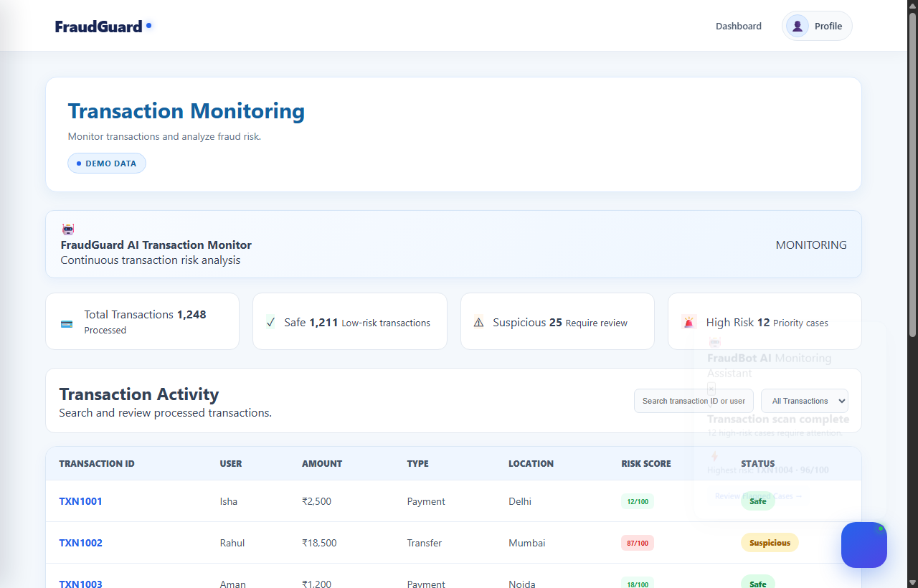
SURVEILLANCE & ANALYTICS
Live Monitoring & Risk Reporting
Continuous surveillance of bank-wide transaction streams with advanced analytics.
Live Transaction Feed: Displays all processed transactions across every registered account.
Risk Score Filtering: Instantly isolates high-risk outliers (score >= 70) for immediate intervention.
Loss Prevention Reports: Quantitative reports on financial capital saved through automated payment blocks.
User Role Management: Admin UI for reviewing registered accounts and modifying roles (USER to ADMIN).
Actionable Audit Logs: Immutable log records for regulatory reporting and forensic analysis.
Figure 6: Bank-Wide Live Transaction Monitoring Stream

Slide 9
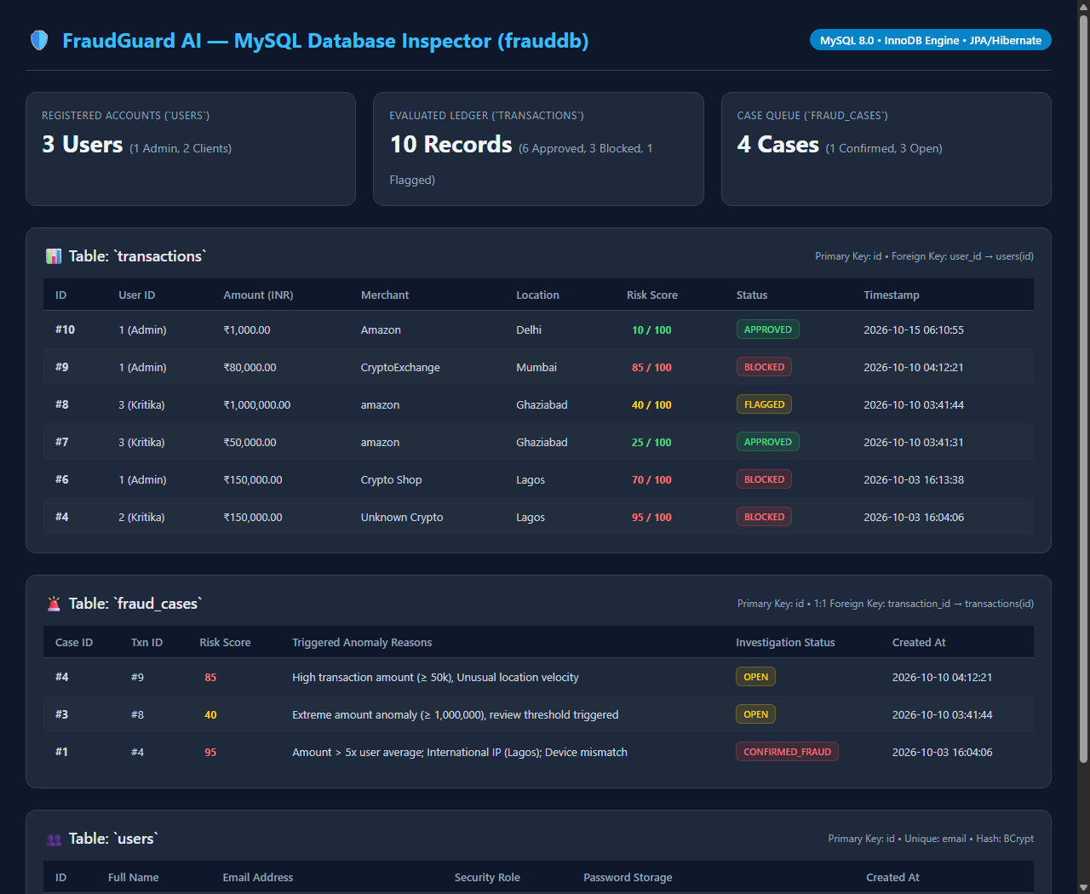
PERSISTENCE TIER
MySQL Relational Database Overview
Normalized relational database (`frauddb`) managed automatically via Spring Data JPA and Hibernate.
`users` Table: User profiles, security roles (ADMIN/USER), and 60-character BCrypt password hashes.
`transactions` Table: Transaction ledger storing amount, recipient, channel, location, timestamp, and risk score.
`fraud_cases` Table: Linked 1:1 with transactions for suspicious alerts; stores investigation notes and resolution statuses.
Referential Integrity: Foreign keys ensure transactions map accurately to registered users and case records.
Real Database Verification: Verified live rows across all tables in MySQL 8.0 server.
Figure 7: MySQL Database Live Inspector (users, transactions, fraud_cases)

Slide 10
FRAUD INTELLIGENCE
Fraud Detection Heuristics & Decision Matrix
Weighted multi-factor anomaly calculation evaluating risk dimensions.
Risk Factor Scoring Weights
Base Transaction Score [10 Points]: Base floor for all processed payments
Critical Amount (>= ₹40,000) [+60 Points]: High monetary value triggers immediate warning
Moderate Amount (>= ₹15,000) [+25 Points]: Above-average payment threshold addition
Unknown / New Location [+30 Points]: Geographical deviation or missing origin coordinates
High-Risk Transfer (>= ₹15k) [+20 Points]: Peer-to-peer or outbound high-value transfer
Large Cash Withdrawal (>= ₹20k) [+15 Points]: Elevated ATM / liquid cash withdrawal velocity
Risk Thresholds & Actions
SAFE / APPROVED
Score: 0 – 39
Transaction is verified safe. No anomalous deviation detected. Payment approved instantly.
SUSPICIOUS / FLAGGED
Score: 40 – 69
Transaction exhibits unusual patterns. Flagged for review; secondary 2FA verification recommended.
HIGH RISK / BLOCKED
Score: 70 – 100
Severe fraud probability detected. Transaction automatically blocked, and investigative record opened in fraud_cases.

Slide 11
STRATEGIC ROADMAP
Future Architecture & Enhancements
Planned feature iterations to scale FraudGuard AI into high-throughput production.
01
Machine Learning Pipeline
Integrate trained Python ensemble models (Random Forest, XGBoost, LightGBM) serialized into ONNX for high-speed inference.
02
Explainability (SHAP)
Incorporate SHAP waterfall charts directly in the administrative case view to show individual feature contributions to risk scores.
03
Kafka Stream Ingestion
Decouple synchronous HTTP calls with Apache Kafka event streaming to ingest and score 10,000+ transactions per second.
04
Cloud CI/CD & Deploy
Automate GitHub Actions pipelines for Docker containerization and one-click cloud hosting on Railway / Render / AWS ECS.

Slide 12
Thank You!
FraudGuard AI — Protecting Every Financial Transaction
Project Summary Highlights:
• Live Full-Stack Architecture running on Spring Boot 4 & MySQL 8.
• Real-Time Threat Evaluation with Multi-Vector Scoring (0-100).
• Comprehensive UI/UX with User & Administrative Surveillance Consoles.
• Complete Technical Documentation and Version Controlled on GitHub.
GitHub Repository: https://github.com/kritikaperti/AI-POWERED-FRAUD-DETECTION

