Slide 1
ssd
Solid
State
drive

Slide 2
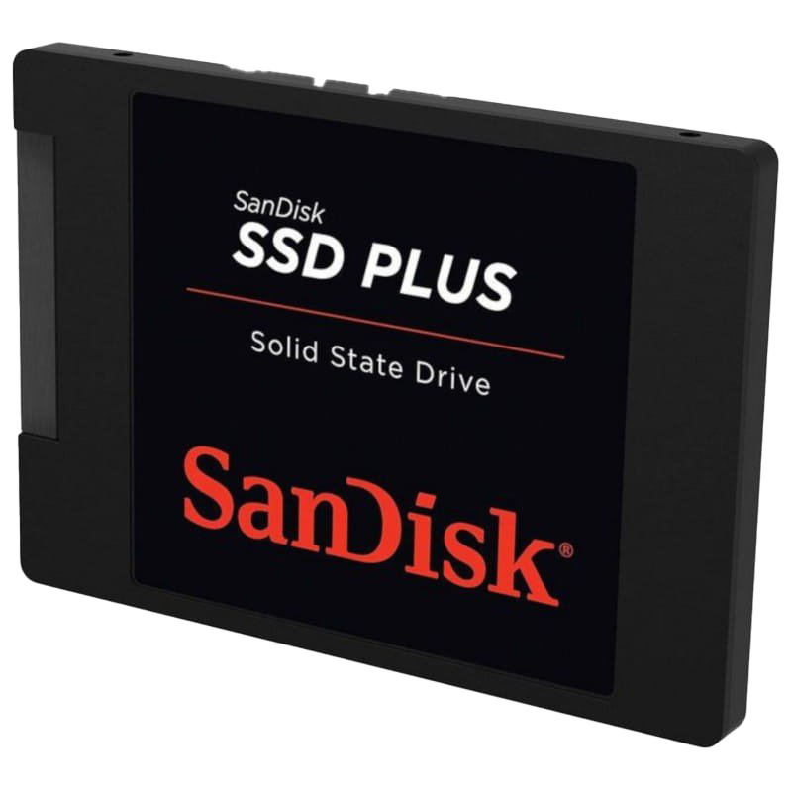
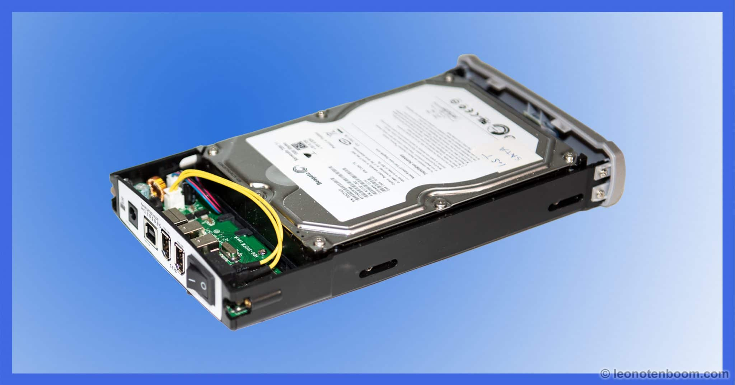
basic knowledge about of ssd a Solid State Drive, or SSD, is a type of data storage device that uses NAND-based flash memory to store digital information. Unlike the spinning disks of traditional Hard Disk Drives, SSDs have no moving parts.
This Photo by Unknown Author is licensed under CC BY-NC
This licensed under CC BY-NC-ND

Slide 3
Why SSD is better than HDDs
      SSDs are lighter in weight than HDDs, use less power, and have virtually no vibration - due to no moving parts. They can also survive an accidental drop better than an HDD. SSDs store data electronically on 'cells', which makes data access quicker than a spinning HDD.

Slide 4
Application of ssd
SSDs have found their way into a wide range of devices and applications. In laptops and desktops, they significantly improve overall system performance. Gamers benefit from faster loading times and smoother gameplay.

Slide 5
Types of solid state drive
SATA SSD
U.2 SSD
NVMe SSD
PCIe SSD
M.2 SSD

Slide 6
thank you

