Slide 1


KANTIPUR ENGINEERING COLLEGE (Affiliated to Tribhuvan University) Dhapakhel, Lalitpur
A Major Project Presentation on
’’Semantic Question Matching with Deep Learning”
PREPARED BY:
Ankit Kharel [95/BCT/2072]
Anshul Bikram Rana [96/BCT/2072]
Kritish Dhaubanjar [102/BCT/2072]
Pradyumna Subedi [110/BCT/2072]

Slide 2
1. Introduction
Understanding semantic relatedness of questions.
Identifying questions with same intent.
High Quality Q&A Knowledge Base.
“Two questions are semantically equivalent if they can be adequately answered by the exact same answer.”

Slide 3

2. Problem Statement
Lack of a sensible search.
Segregation of information.
Dull Redundancy but inadequacy of response to questioners.
Distribution of user based on varying level of activity.

Slide 4
3. Objectives
To develop a module:
To analyze and merge semantically same questions.
To mitigate the answer redundancy and support High Quality Q&A knowlegde base.

Slide 5
4. Features
Deep Learning to classify duplicates question pairs.
Selected highly dominant features from the questions.

Slide 6
5. Applications
Avoid frequently repeated questions from polluting user’s feed.
Improve search & discovery based on knowledge bases.
High Quality Q&A knowledge bases

Slide 7
6. Methodology

Slide 8
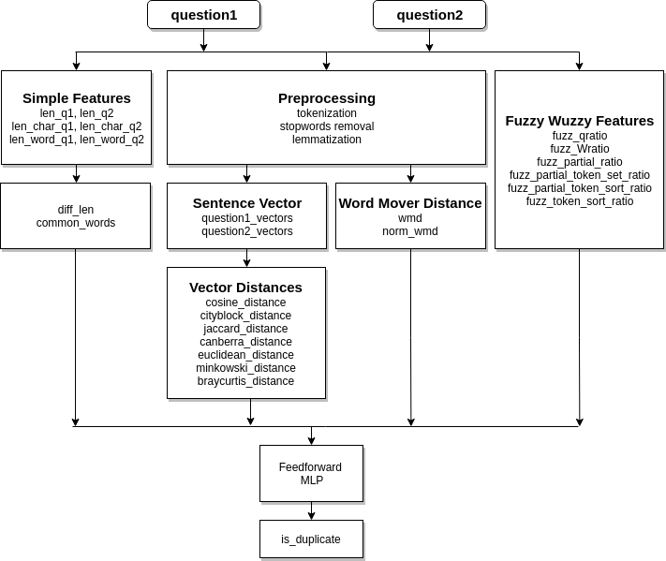
Fig: System Architecture

Slide 9
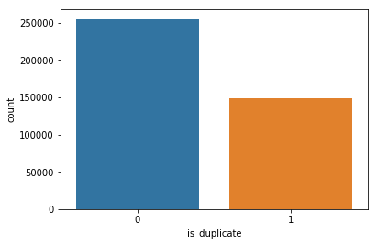
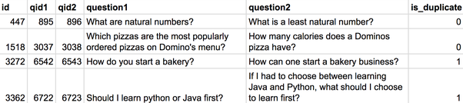
6.1 Data Acquisition and Dataset Description
404,290 question pairs released by Quora
255045 negative samples (non-duplicates)
149306 positive samples (duplicates)

Slide 10
6.2 Data Pre-processing
Tokenization:
“It Will Be Raining Tomorrow”
Removal of stop words:
Examples: “a”, “an”, “The”
Word lemmatization:
“Raining”
[“It” “Will” “Be” “Raining” “Tomorrow”]
“Rain”

Slide 11
7. Feature Extraction

Slide 12
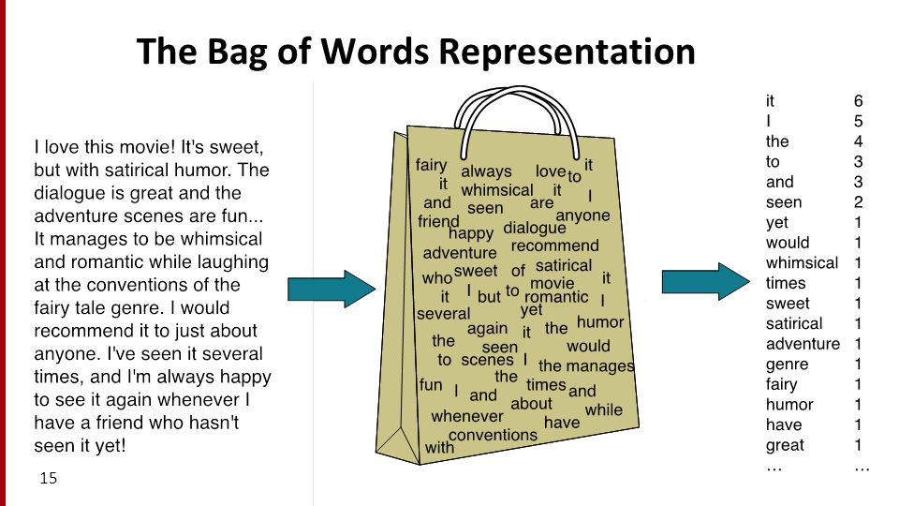
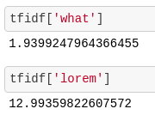
7.1 Traditional Bag of Words & TF-IDF

Slide 13
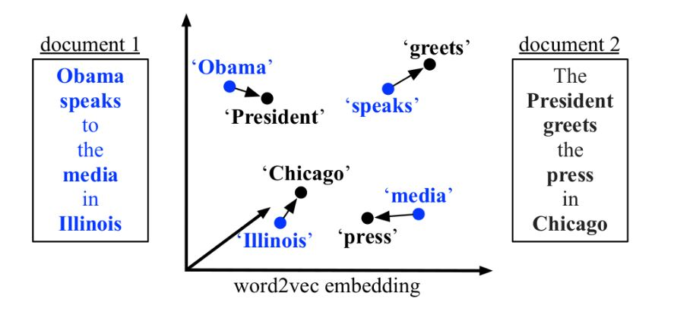
7.2 Word Embedding: word2vec
Collective term for models that learned to map a set of words or phrases in a vocabulary to vectors of numerical values.
Word2vec:
1) Continuous Bag-of-Words Model.
2)Continuous Skip-Gram Model.

Slide 14
8. Feature Engineering

Slide 15
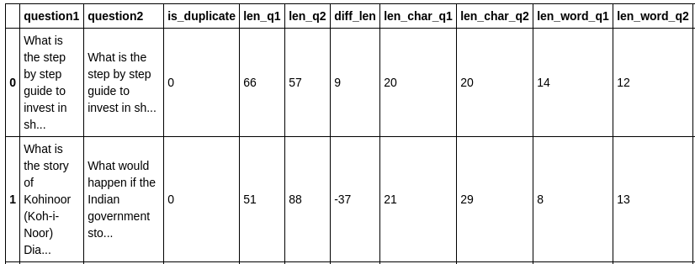
8.1 NLTK Library Groundworks

Slide 16
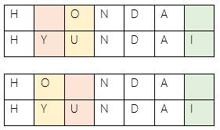
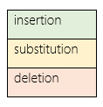
8.2 Fuzzy wuzzy Features (Levenshtein Distance)
minimum number of single-character edits (insertions, deletions or substitutions) required to change one word into the other.
Levenshtein distance between “HONDA” and “HYUNDAI” is 3.
Source: https://dzone.com/articles/the-levenshtein-algorithm-1

Slide 17



8.3 Metrics
Cosine Similarity :
Euclidean Distance:
Minkowski Distance:

Slide 18
9. Analysis & Visualization

Slide 19
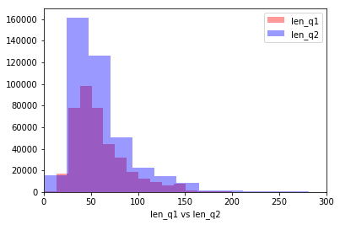
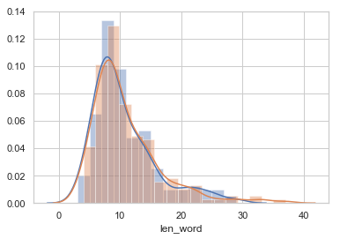
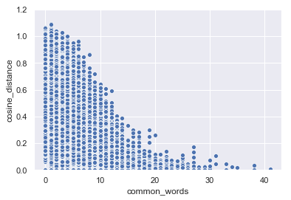
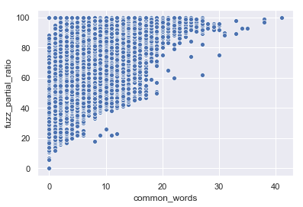

Slide 20
10. Supervised Machine Learning

Slide 21
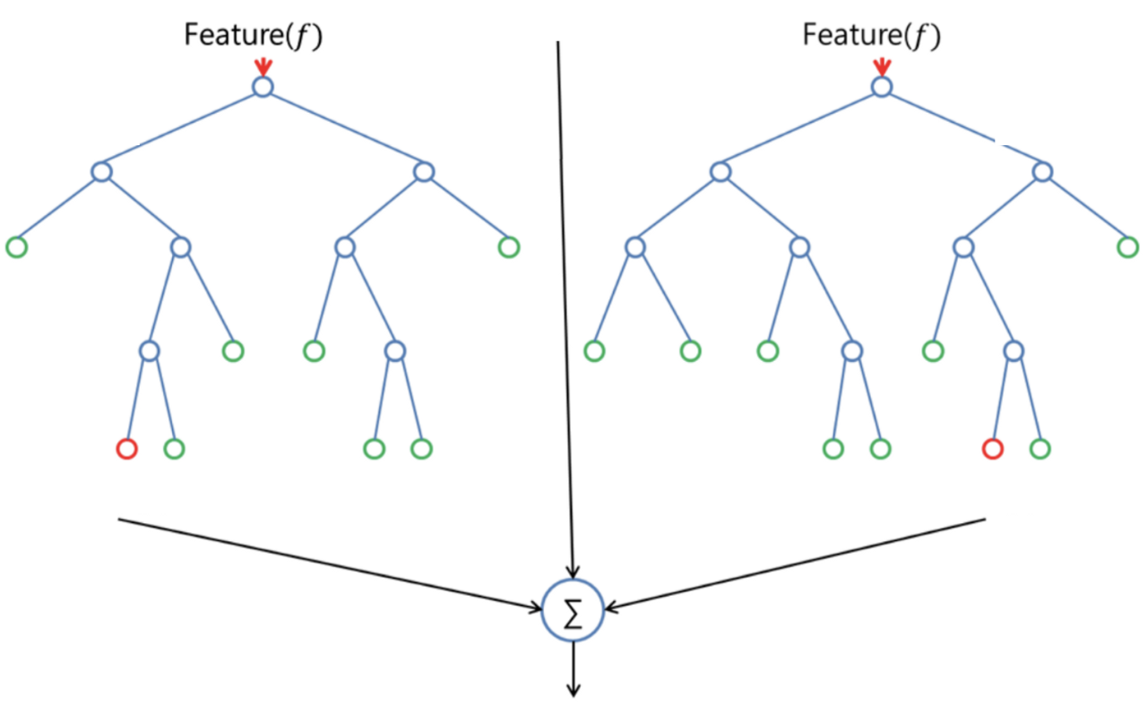
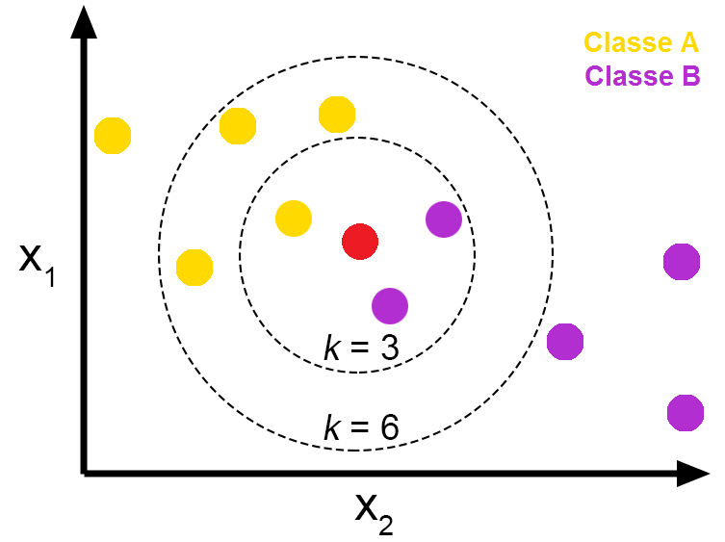
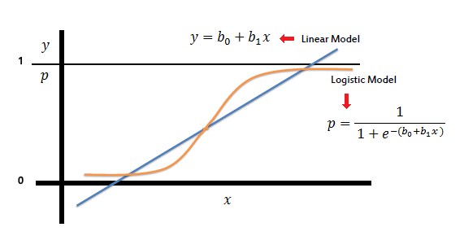
10.1 Random Forest, Logistic Regression, KNN

Slide 22
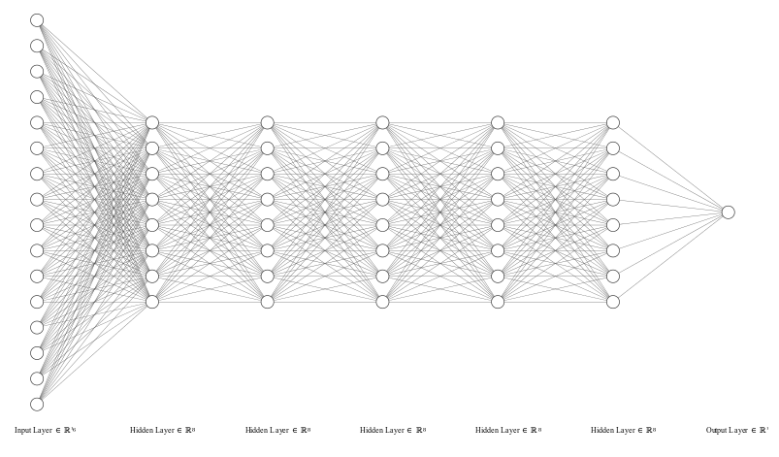
10.2 Artificial Neural Network

Slide 23
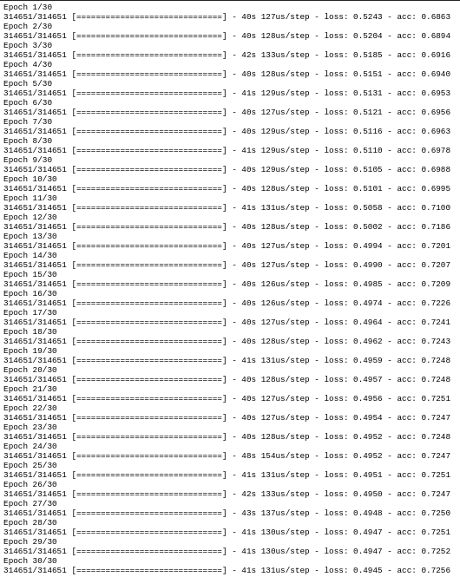
10.3 Training

Slide 24
11. Software Development

Slide 25
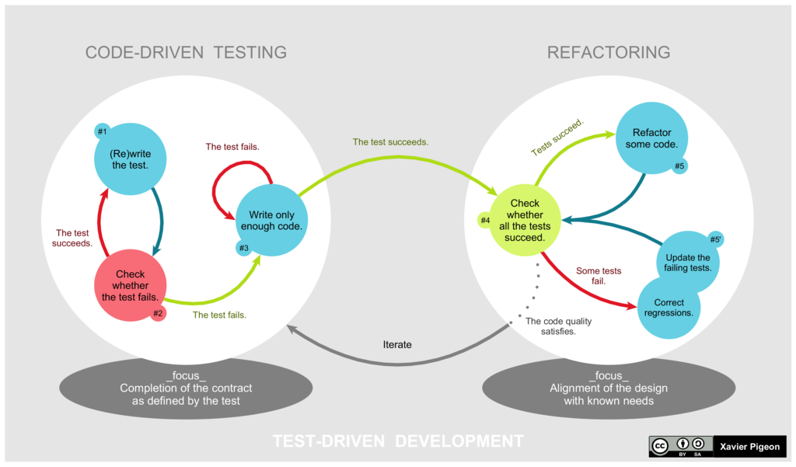
Test Driven Development
Source: Wikipedia

Slide 26
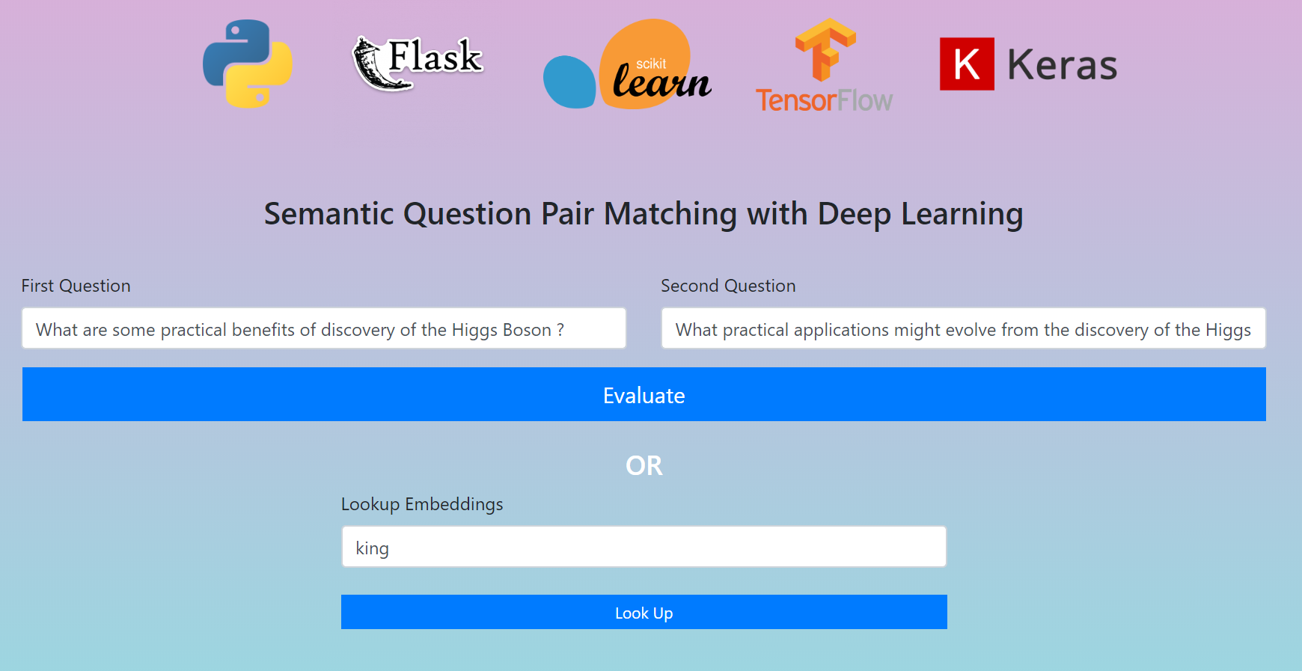
12. Output

Slide 27
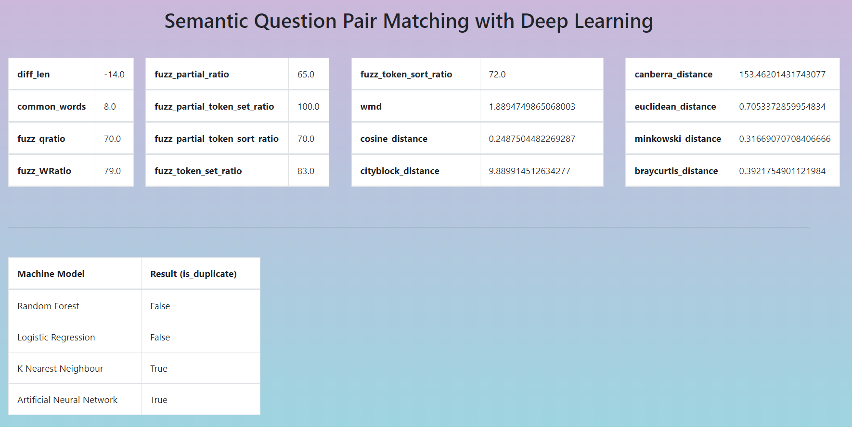

Slide 28
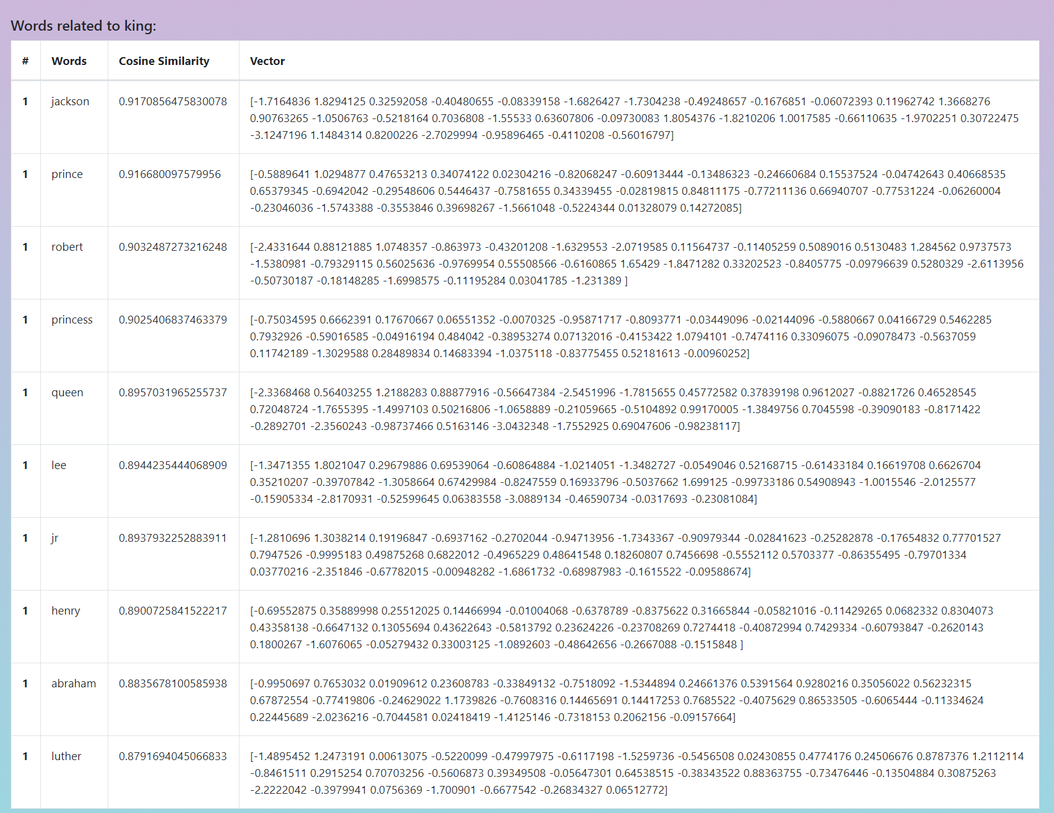

Slide 29
13. Results

Slide 30
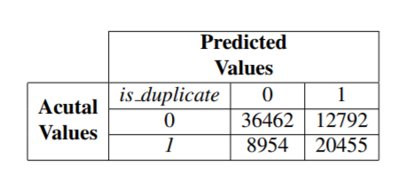
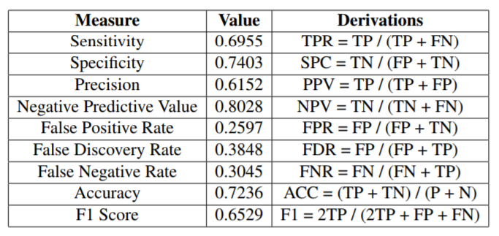
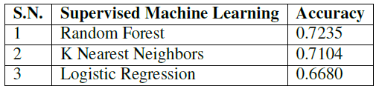

Slide 31
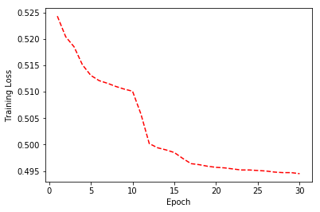
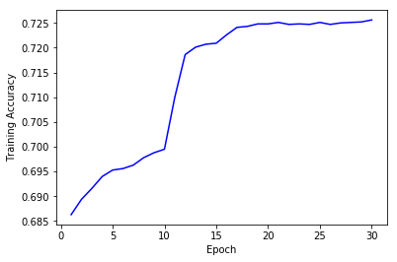
Training Loss
Training Accuracy

Slide 32
DEMO

Slide 33
THANK YOU

