Slide 1
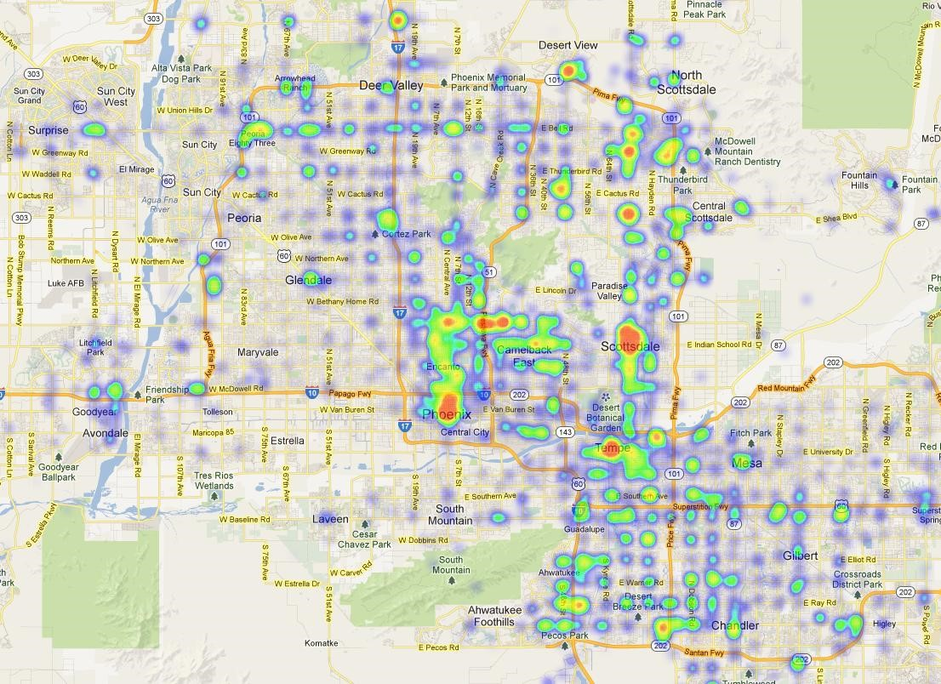
Yelp :Predicting future Business Attention
How much attention a business will receive in the next n months ?

Slide 2
Business Statistics as Features
Latitude and Longitude
Category
Temporal Data
- Maximum Number of Reviews in a day
- Number of Reviews
- Rating
- Days since last review
Number of businesses within one km found by geographical clustering.

Slide 3
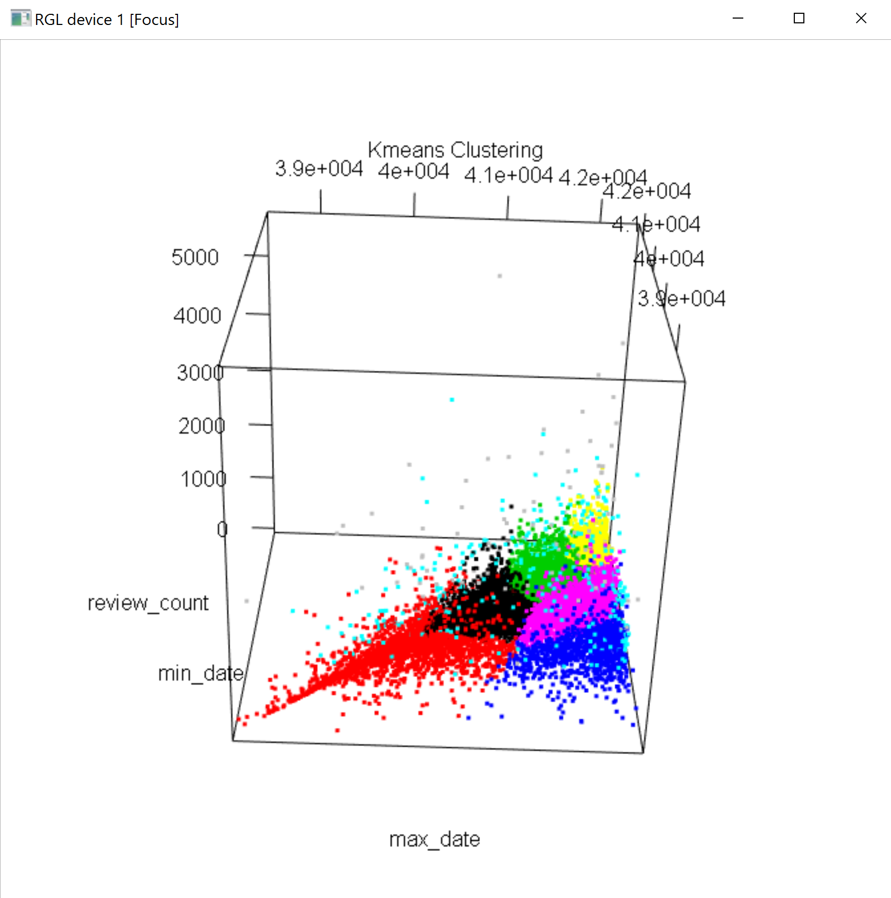
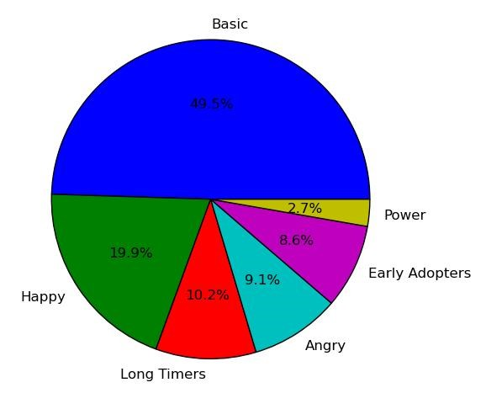
User Base Clustering

Slide 4
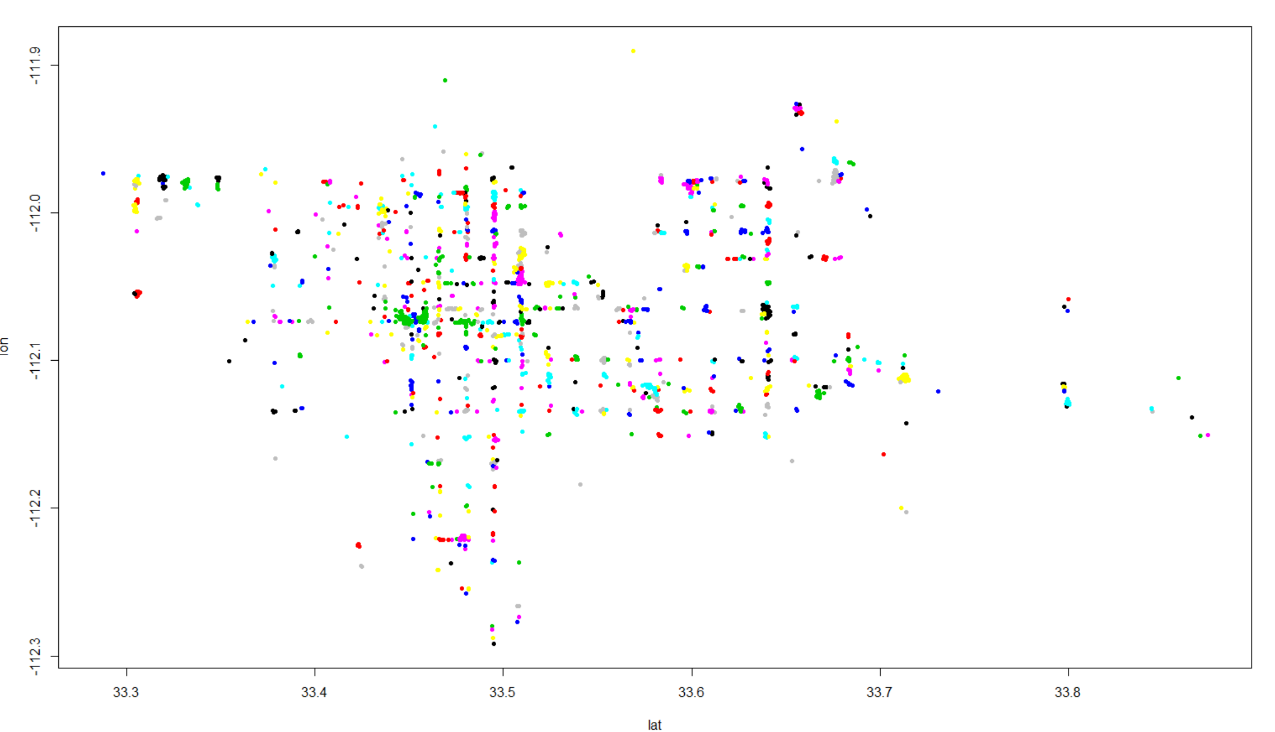
Geographical Clustering of Businesses

Slide 5
Review Text as Features
NLTK processing done on the review text
Removal of stopwords, punctuation etc.
Tokenize Sentences into words
Match the words from a positive text dictionary and negative text dictionary.
Get the positive, negative and neutral word count for all reviews logged in for a particular business id and use it as feature vectors to predict future attention.

Slide 6
Feature Selection and Analysis
Using domain knowledge to select subsets of features
Finding the best features using methods like
- PCA
- Univariate Feature Selection
- Random Forest Regressor
- Correlation between different features in terms of correlation ratio.

Slide 7
Prediction Models
Prediction using all Original Features
Prediction using Metadata about Business
Prediction using Review Text Features
Temporal Prediction done by employing the above prediction models using SVC and RandomForestPredictor and predicted the amount of attention a business will receive on a scale of 1 to 5 – 5 being the highest.

Slide 8
Feature Analysis
Picked up 25% of the features (10 out of 42)
Best Features Selected -
Number of reviews for a business
Max number of reviews logged on a particular day
Number of useful, funny and cool user votes
Star rating for the business
Number of positive word counts for the business
Number of negative word counts for the business.

Slide 9
Results

Slide 10
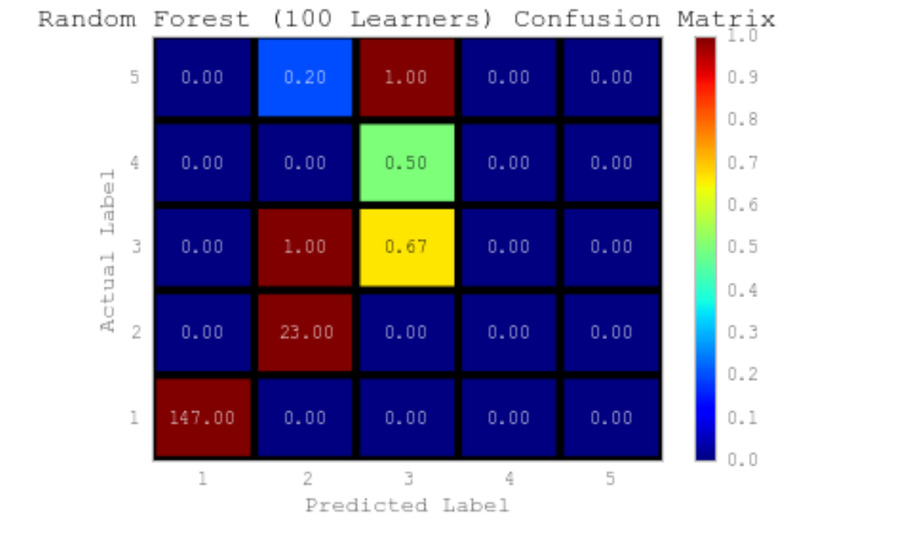
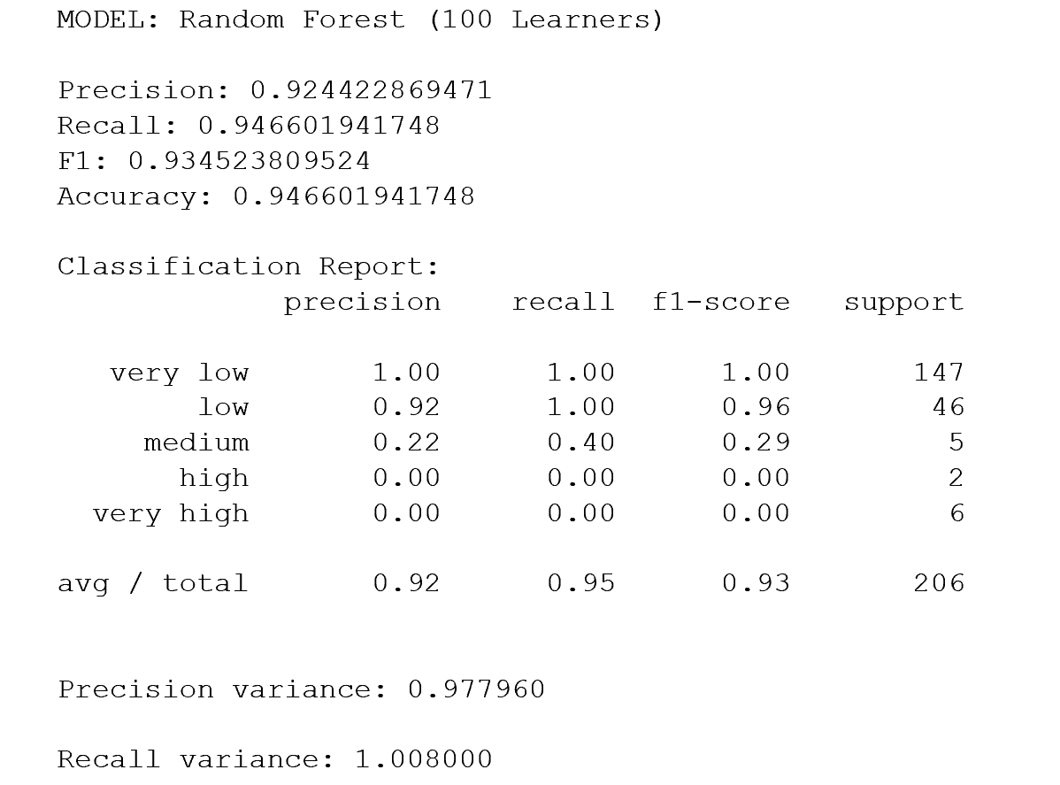
Confusion Matrix and Classification Report for one Prediction Model

Slide 11
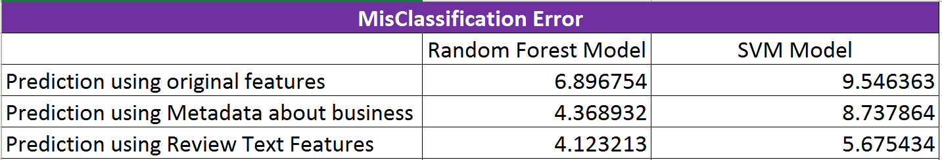
MisClassification Error Comparison

Slide 12
Thank You

