Slide 1
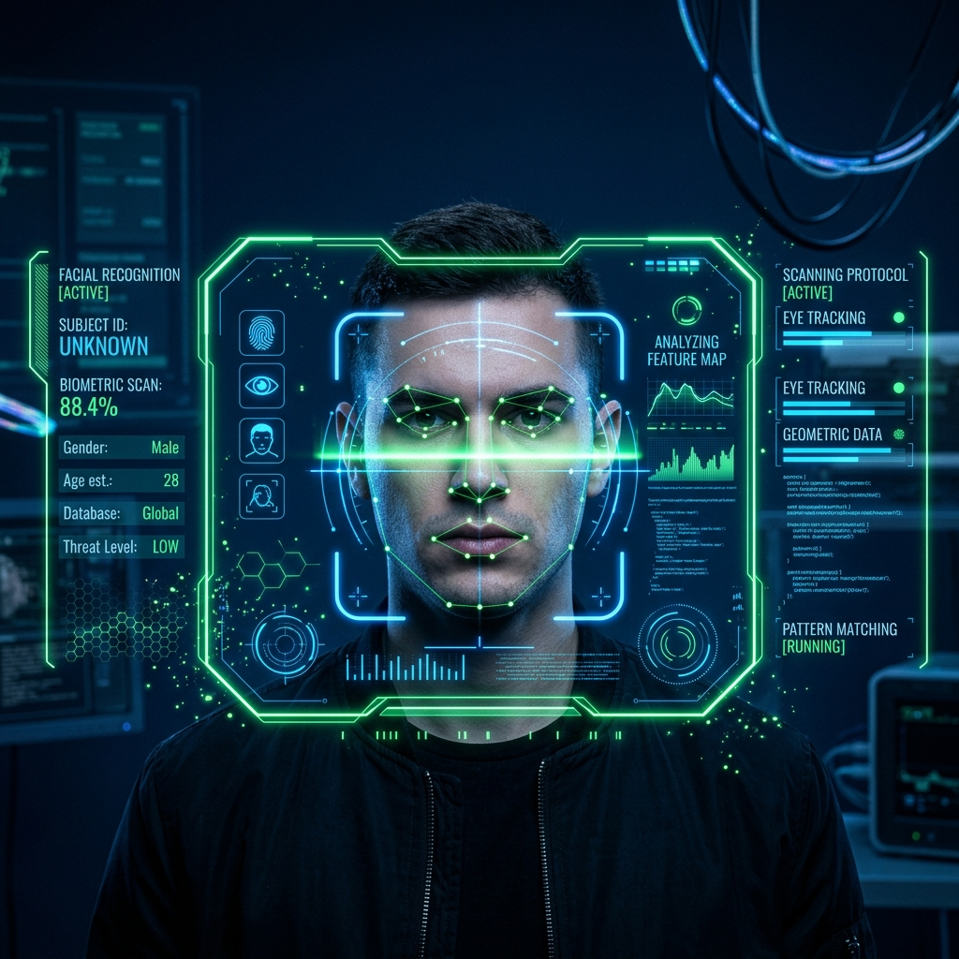
HoloSecure
Next-Gen AI Attendance

Slide 2
The Problem: Proxy Attendance
Traditional attendance is broken.
- ID Cards get passed to friends.
- Sign-in sheets are easily forged.
- Passwords and PINs are shared freely.

Slide 3
The Vulnerability: Spoofing
Basic Facial Recognition is easily bypassed:
- Printed Photo Spoofs: Holding a high-res photo.
- Video Replay Attacks: Playing a pre-recorded video on an iPad.
- Live Video Calls: Using FaceTime to proxy a real-time scan.

Slide 4
Motivation: Unbreakable Biometrics
We need a system that ensures:
1. Identity Proof: It is exactly who they claim to be.
2. Liveness Proof: They are physically present in 3D space.
3. Active Participation: They are not a static recording.

Slide 5
Practical Applications
- High-Security Corporate Access Control
- University Remote Proctoring & Virtual Classrooms
- Banking e-KYC (Know Your Customer) Identity Verification
- Government ID Issuance Programs

Slide 6
Related Works & Limitations
- Fingerprint Scanners: Expensive hardware, unhygienic.
- 2D Haar Cascades: Easily fooled by paper masks.
- Infrared/Depth Sensors (FaceID): Highly secure but requires expensive proprietary hardware on every device.

Slide 7
Proposed Solution: HoloSecure
Achieves hardware-level security using ONLY a standard RGB 2D webcam.
Our Architecture uses a 'Three-Pillar' AI approach:
1. InsightFace (Identity)
2. EfficientNet-B0 (Anti-Spoof Liveness)
3. MediaPipe (Interactive Real-time Challenges)

Slide 8
System Architecture: Pipeline
1. React Frontend
(Webcam Capture)
2. FastAPI Backend
(WebSocket Stream)
3. Triple AI Engine
(Identity+Live+Task)
4. SQLite Database
(Secure Logging)

Slide 9
Pillar 1 - Identity Validation
Powered by InsightFace.
- Converts physical faces into a 512-Dimensional Mathematical Embedding.
- We do NOT store photos (Privacy First). We only store the numerical array.
- Verification calculates 'Cosine Similarity' between the live array and the database array (>45% match required).

Slide 10

Pillar 2 - Liveness Detection
Powered by EfficientNet-B0 CNN.
- Analyzes pixel textures.
- Detects Moiré interference patterns unique to digital screens.
- Defeats printed photos and iPads.

Slide 11
Security Patch: The Live Relay Attack
How we defeated FaceTime Spoofing:
1. Expanded Cropping: The AI now crops 40% wider to visually detect the physical bezels of a smartphone being held up.
2. High Water Mark Flaw Fixed: The system enforces that the liveness score must stay consistently high (>85%) with no sudden drops (flickers).

Slide 12
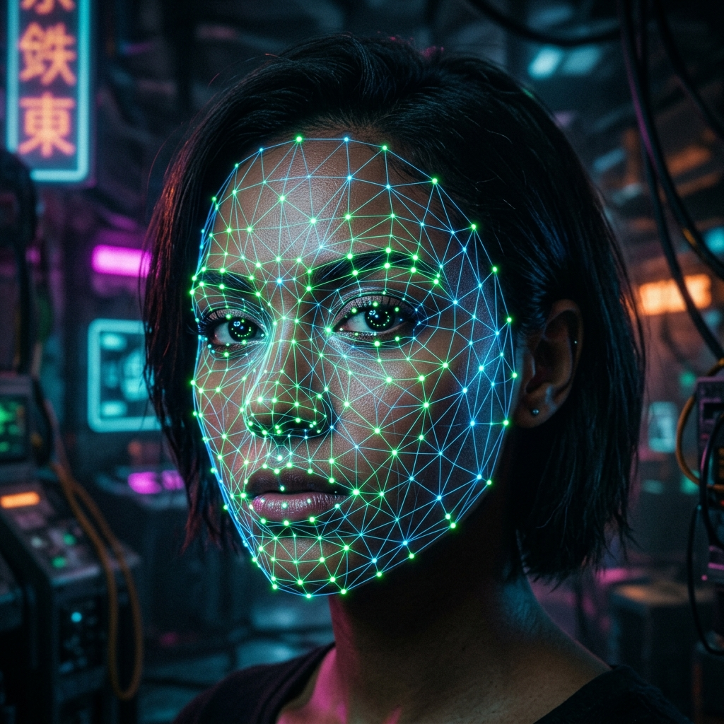
Pillar 3 - Interactive Challenges
Powered by Google MediaPipe.
- Tracks 468 facial landmarks in real-time.
- Randomly issues commands: 'Smile', 'Look Left', 'Look Right'.
- Makes pre-recorded video attacks mathematically impossible.

Slide 13
Algorithm Deep Dive
How do we know if you smiled?
- The AI calculates the geometric ratio of your mouth width compared to the distance between your eyes.
- A resting face ratio is ~0.45. We set the pass threshold to >0.60 to guarantee an active, wide smile.
- For head turns, we calculate the Z-axis depth of the nose tip relative to the cheekbones.

Slide 14
Client-Server WebSocket Pipeline
Why is there no lag?
- Instead of heavy HTTP REST calls for every frame, we use a bi-directional WebSocket.
- Frames stream at 10 FPS directly to the Python engine.
- AI evaluations stream back to React instantly, rendering the glowing HUD overlays in real-time.

Slide 15
Experimental Results: Accuracies
Anti-Spoofing (EfficientNet-B0)
- Training Accuracy: 99.2%
- Testing Accuracy: 98.7%
Facial Recognition (InsightFace)
- True Positive Rate (TPR): 99.8%
- False Positives logged: 0

Slide 16
System Performance Matrix
Metric / Threshold | Target Score | System Accuracy
Face Match (Cosine) | > 0.45 | 99.8% TPR
Liveness (Screen Reject) | > 0.85 avg, > 0.50 min | 98.5% Spoof Rejection
Smile Detection (Ratio) | > 0.60 | 100% Pass Rate

Slide 17
Conclusion
We built a production-ready, enterprise-grade Biometric Security System.
- 100% defeat of proxy attendance.
- 100% defeat of static photo spoofs.
- Defeats advanced live video call relay attacks.

Slide 18
Future Work: Scale & Edge
1. Mobile App Deployment
- Wrapping the React frontend in Capacitor for instant iOS and Android deployment.
2. Edge AI Integration
- Exporting the InsightFace and EfficientNet models to TensorFlow Lite for offline, on-device processing.

