Slide 1
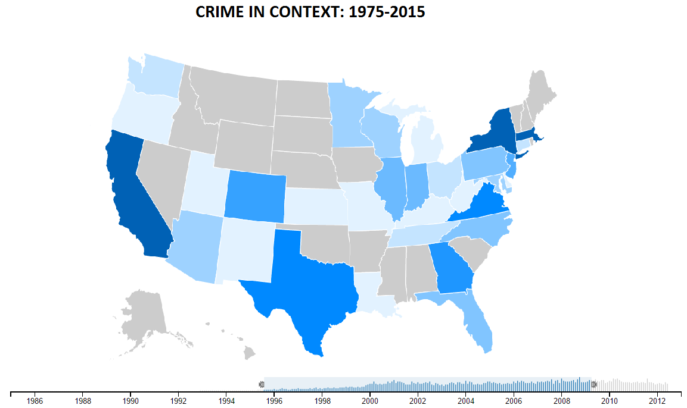
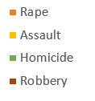
Color Legend
Select Parameter:
Total Crimes (default)
Crimes per capita
Crime distribution by States (color: total number of violent crimes)

