Slide 1
Initial Spotting of Lines
April 15, 2014

Slide 2
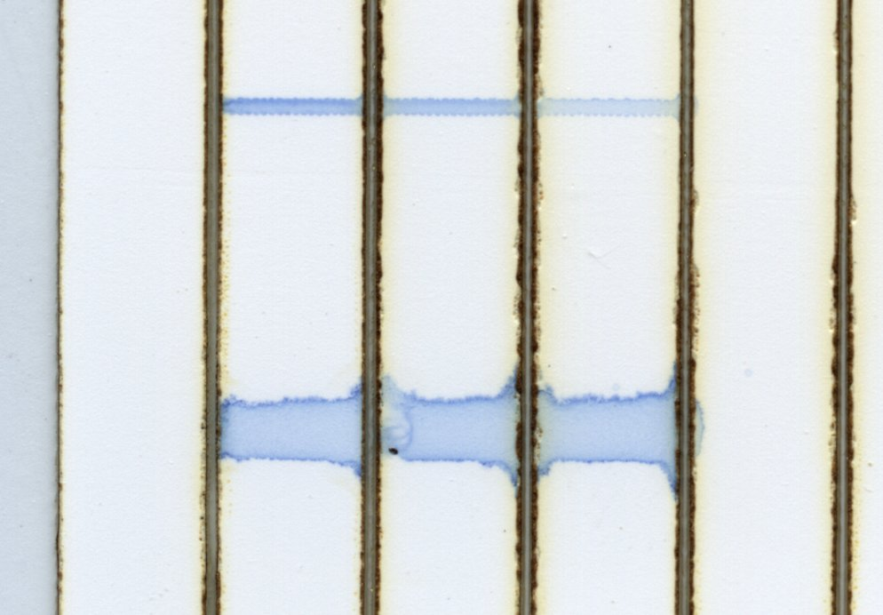
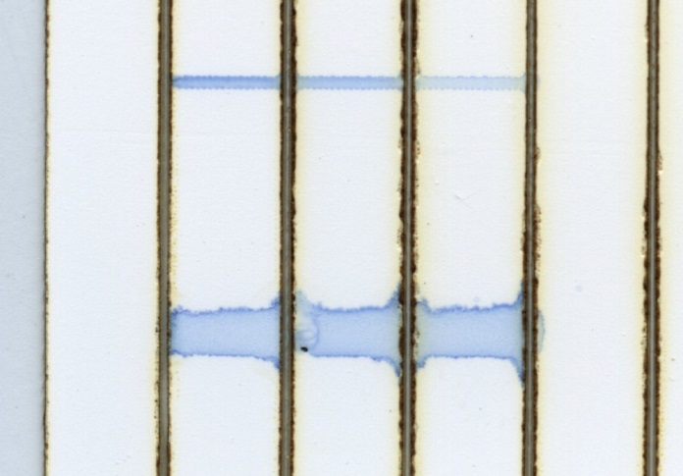

Slide 3
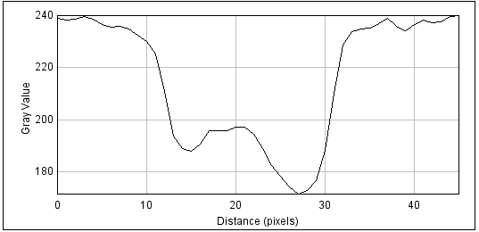
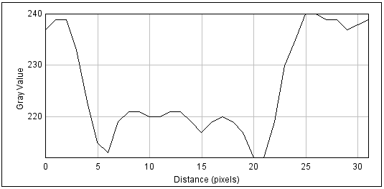
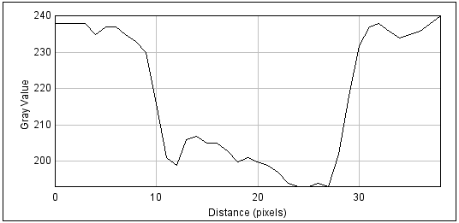
3
2
1
3
1
2

Slide 4
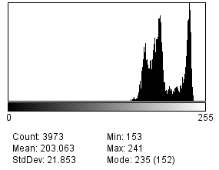
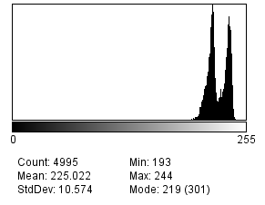
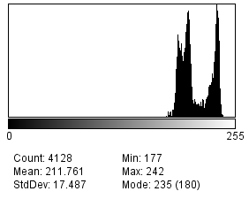
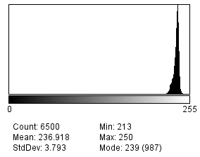
3
1
Sum to 227 = 2948
Sum to 227 = 2704
2
Plain nitrocellulose
Sum to 227 = 2744

Slide 5
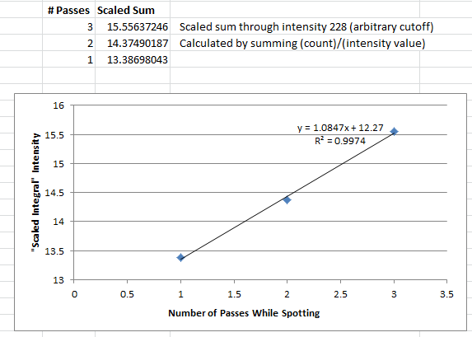
*Note
Taken from histogram data
Areas not exactly the same – arbitrarily drawn as similar as possible
Does not include edges of paper
All data from DRY test strips

Slide 6
Size Comparison
Standard lateral flow test line width= 0.64 – 0.67 mm
Spotted Lines width = ~0.5 mm at minimum, ~0.61 mm at maximum
- 2 “lines” dot pitch 250nm

