Slide 1

An Experimental Study for Semiconductor Loss Reduction in a Voltage Source Inverter under Sinusoidal Carrier-Based PWM Techniques
Krit Yodpradit

Slide 2
Power Converter & Efficiency Factors
Power Supply
Power Converter
Load
*PWM
PC
Control Unit
Feedback
PE Applications: Improve Eff. → Reduce Size, Cost
Topology
Switch Material
Control Unit
*PWM Techniques Fed to Turn On & Off Switches

Slide 3
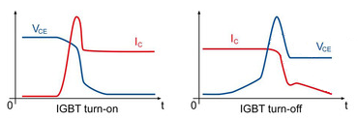
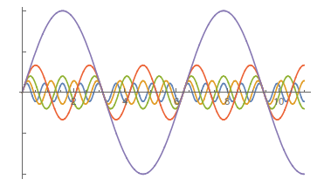
2 PWM Quality Indicators
Losses = Switching Loss + Conduction Loss
1
fundamental
Harmonic Distortion
2

Slide 4
Main Idea
Triangular Carrier Inverse Sinusoidal Carrier
Main Idea: Triangular vs. Inverse-Sinusoidal Carriers Regarding Semiconductor Loss & %THD
Condition : Each PWM Has the Same Number of Pulses per Cycle
Under the Same Current and Voltage

Slide 5
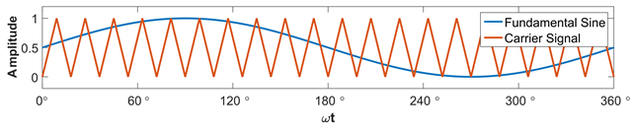
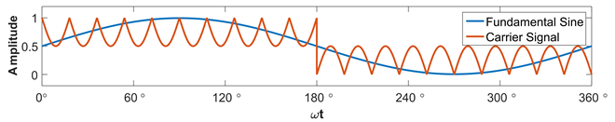
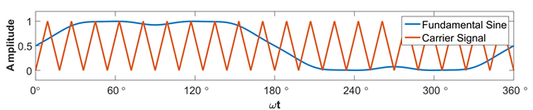
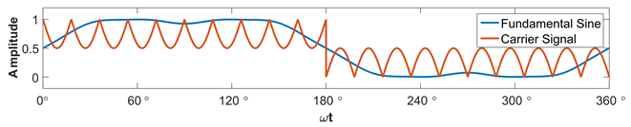
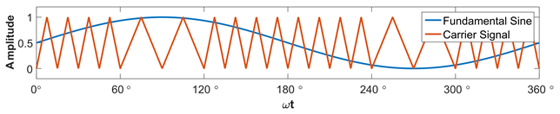
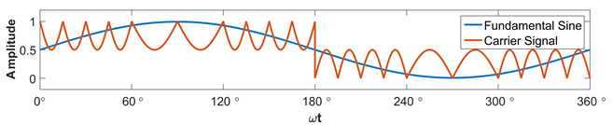
PWM Techniques
(a) SPWM (Sinusoidal PWM)
(d) ISPWM (Inverse-Sinusoidal-Carrier SPWM) [1]
(b) HI-SPWM (Harmonic Injection SPWM) [2]
(e) HI-ISPWM (Harmonic Injection ISPWM)
(c) VF-SPWM (Variable Frequency SPWM)
(f) VF-ISPWM (Variable Frequency ISPWM)
[1] H. M. Bassi, "A Novel PWM Scheme with Two Switching Frequencies and Wider Carrier to Improve the THD in Voltage Source Converters" Ph.D. dissertation, Swanson School Eng., Univ. Pittsburgh, Pittsburgh, PA, 2013
[2] M. A. Boost and P. D. Ziogas, "State-of-the-art carrier PWM techniques: a critical evaluation," IEEE Transactions on Industry Applications, vol. 24, pp. 271-280, 1988

Slide 6
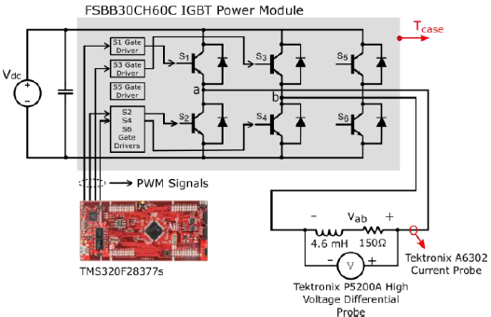
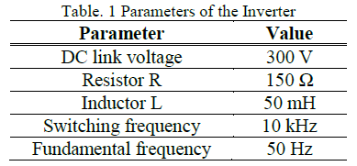
Setup and Condition
Observe Loss
through Temperature
Condition :
Each PWM Has the Same Number of Pulses per Cycle
Under the Same Fundamental Current and Voltage (m_{a} adjusted)
Observe Harmonics
through Current

Slide 7
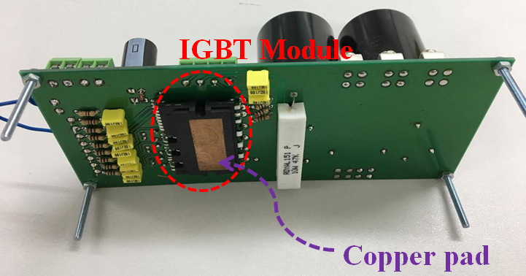
Case Temperature Measurement
By Thermometer

Slide 8
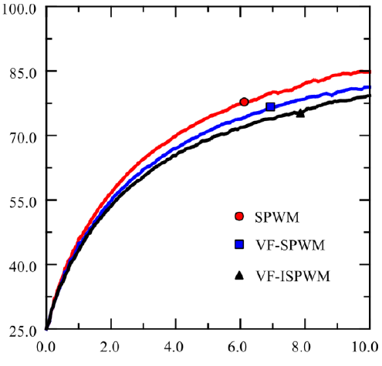
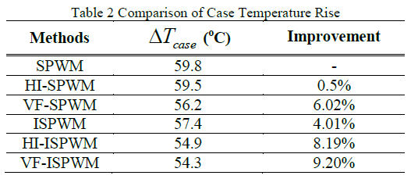
Case Temperatures of Selected PWMs
Case Temperature (°C)
Time (min)

Slide 9
Improvement of Semiconductor Loss Reduction
Triangle
Inverse
Sinusoid

Slide 10
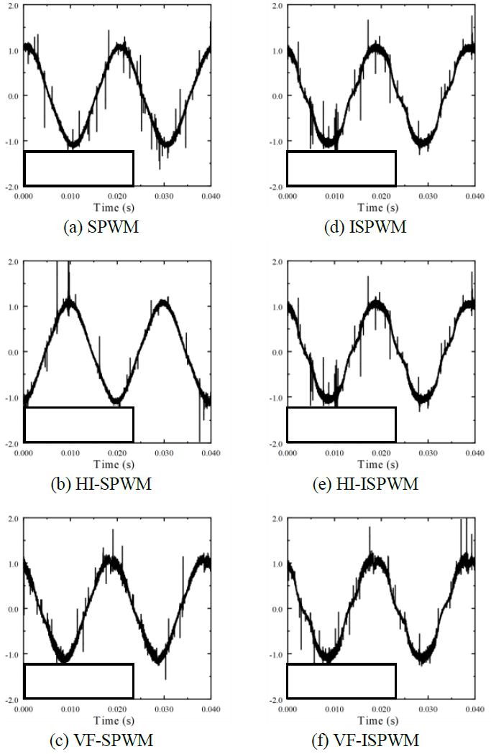
Load Current Waveforms & %THDs
SPWM
I₁ = 1.057 A
ISPWM
I₁ = 1.056 A
THD=3.56%
THD=7.21%
HI-SPWM
I₁ = 1.059 A
HI-ISPWM
I₁ = 1.068 A
THD=4.24%
THD=8.11%
VF-SPWM
I₁ = 1.058 A
VF-ISPWM
I₁ = 1.072 A
THD=4.76%
THD=8.31%

Slide 11
Conclusion
Improve Eff → PWM Techniques
Trade Off between Losses and Harmonics
Triangular vs. Inverse-Sinusoidal Carriers
  Loss → Inverse sinusoid is better
Careful PWM Selection Depends on Applications

Slide 12

Any questions?

Slide 13
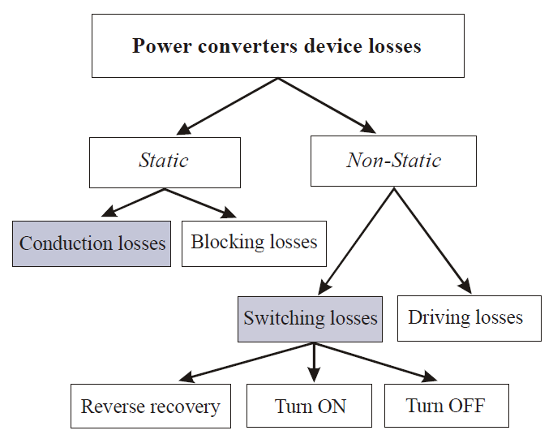
Losses in Semiconductor Devices
M. C. D. Piazza, M. Pucci, and G. Vitale, "Efficiency modeling in voltage source inverters with several PWM techniques: A unified approach," in IECON 2013 - 39th Annual Conference of the IEEE Industrial Electronics Society, 2013, pp. 700-705.

Slide 14
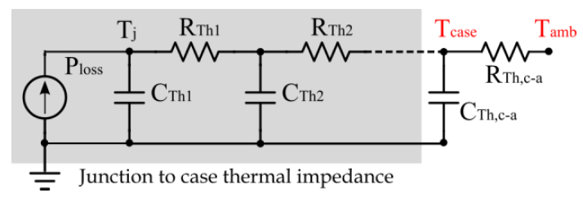
Cauer’s Thermal Impedance Model
R. Wu, H. Wang, K. B. Pedersen, K. Ma, P. Ghimire, F. Iannuzzo, et al., "A Temperature-Dependent Thermal Model of IGBT Modules Suitable for Circuit-Level Simulations," IEEE Transactions on Industry Applications, vol. 52, pp. 3306-3314, 2016.
O. Alavi, M. Abdollah, and A. H. Viki, "Assessment of thermal network models for estimating IGBT junction temperature of a buck converter," in 2017 8th Power Electronics, Drive Systems & Technologies Conference (PEDSTC), 2017, pp. 102-107.

Slide 15
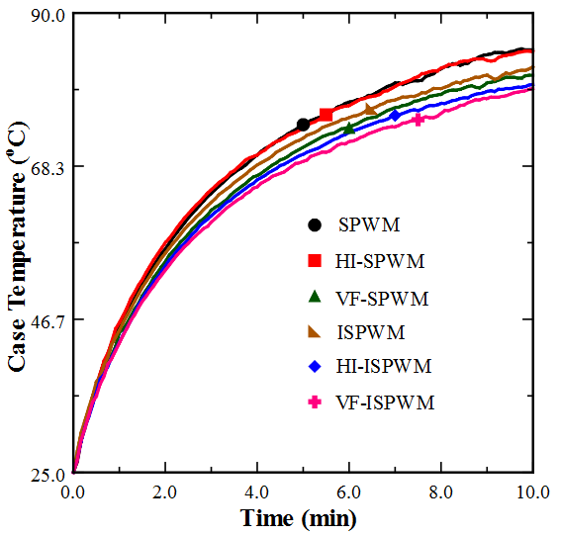
All Case Temperature Results

