Slide 1

Weather Data Analysis
Kritika Gehlot
Northeastern University – College of Professional Studies
ALY6000 – Introduction to Data Analytics
Professor: Kayal Chandrasekaran
Due Date : February 18,2023

Slide 2
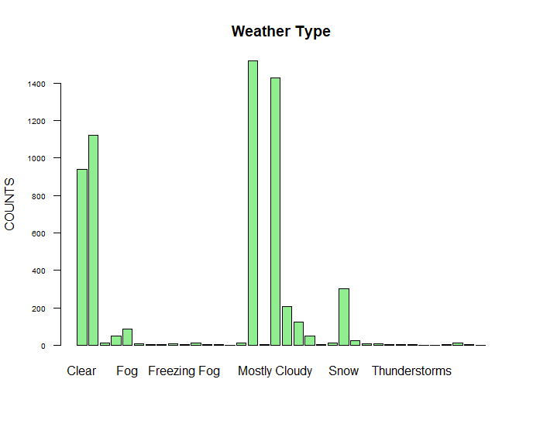
Introduction
This is a Weather Dataset from 1/1/2012 to 9/5/2012.
Variables present in the data are:
Date/Time
Temp_C
Dew Point Temp_C
Rel_Hum%
Wind Speed_Km/hr
Visibility_km
Press_kPa
Weather

Slide 3
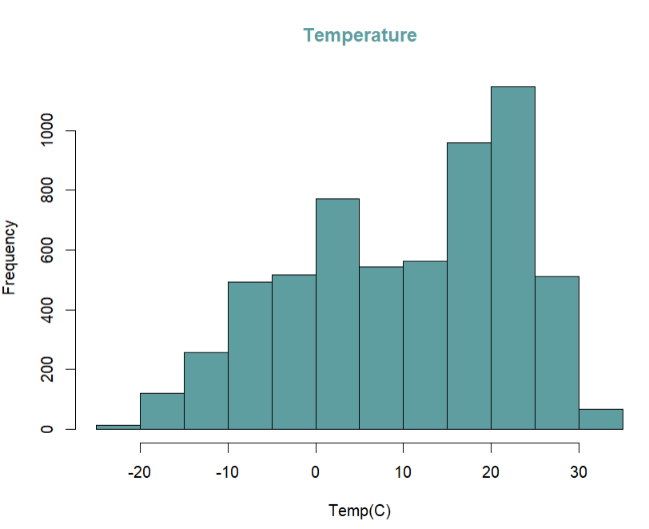
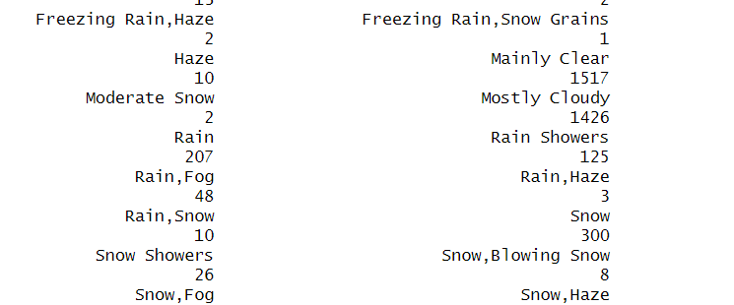
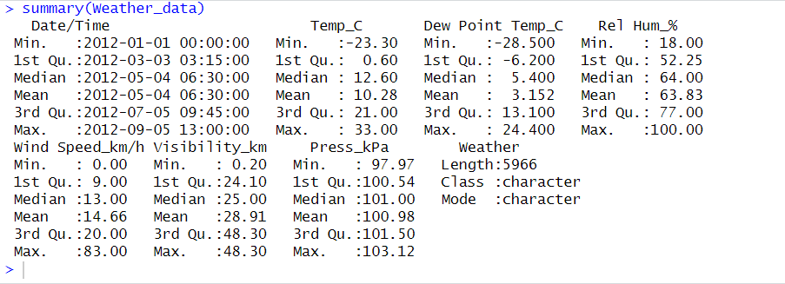
Key Analysis
With the help of a data summary, it can be seen minimum and maximum values of the Temp, Dew Point, Relative humidity, wind speed, and Pressure.
It can be seen that the weather is most of the time the weather is “mainly clear”.
The “Temperature” graph is negatively skewed which means the median is greater than the mean.

Slide 4
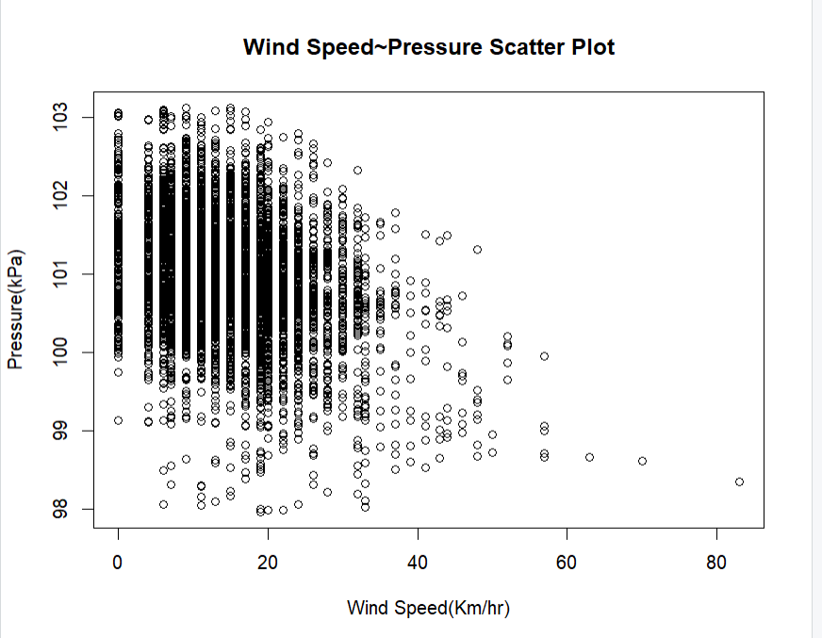
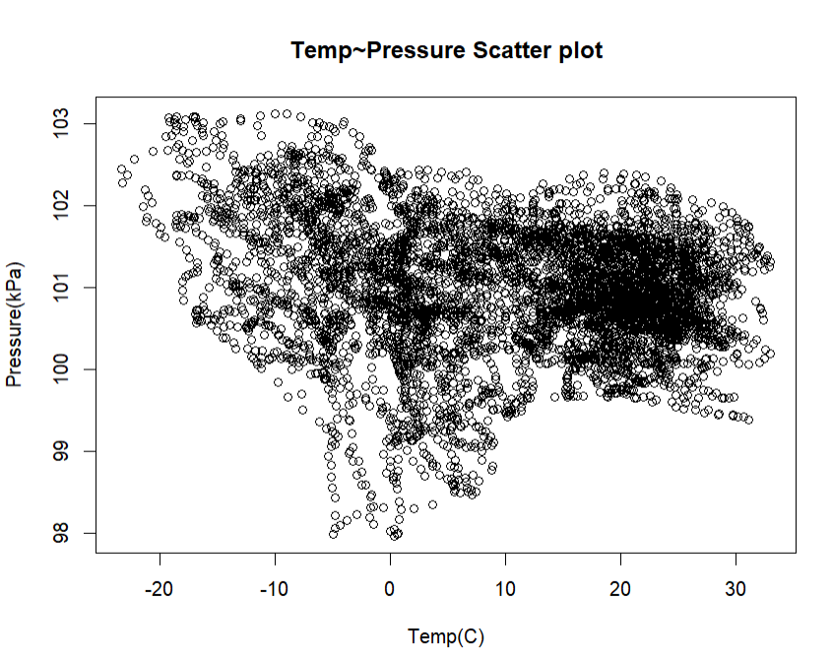
The correlation between Wind and Pressure is -0.3220345. Which shows there is a negative correlation between both variables.
-
The correlation between Temperature and Pressure is -0.1830303. Which shows there is a negative correlation between both variables.
The correlation between Wind Speed and Pressure is -0.3220345. Which shows there is a negative correlation between both variables.

Slide 5
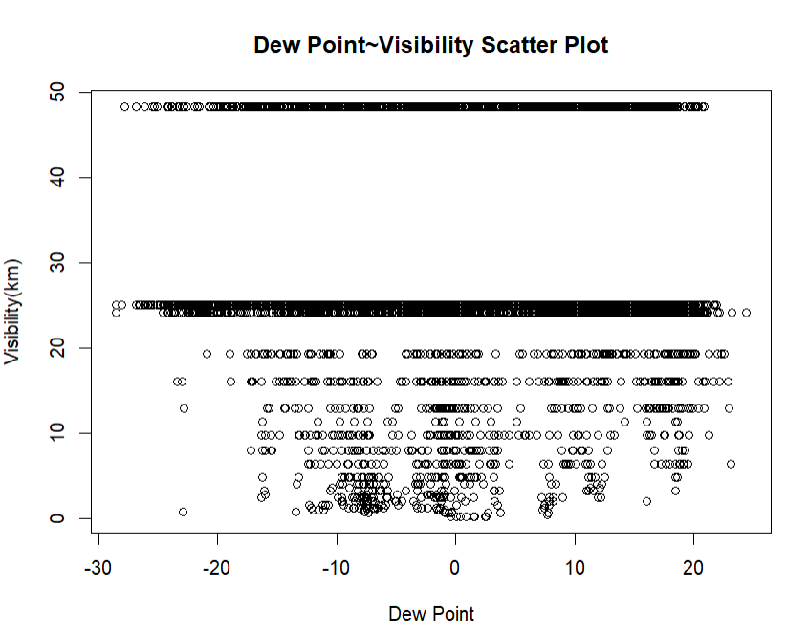
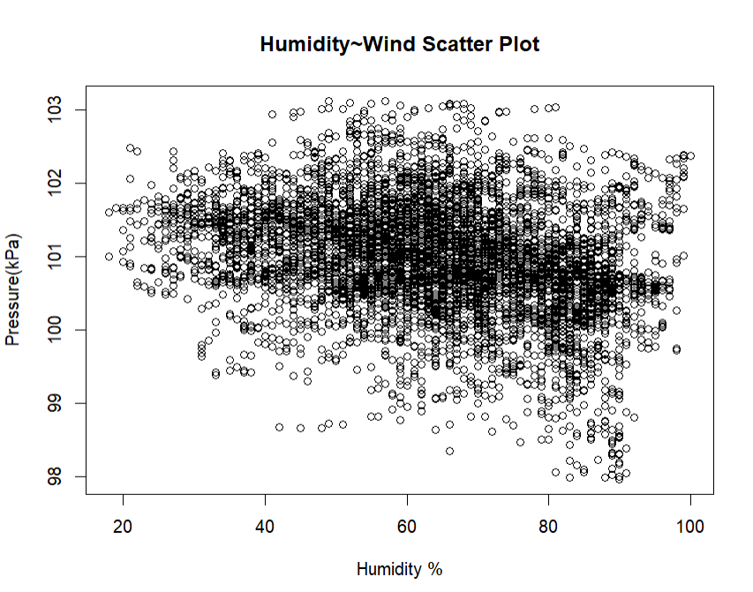
The correlation between Dew Point and Visibility is 0.05569263, which shows there is zero correlation between both variables.
The correlation between Humidity and Pressure is -0.2789908, which shows there is a negative correlation between both variables.

Slide 6
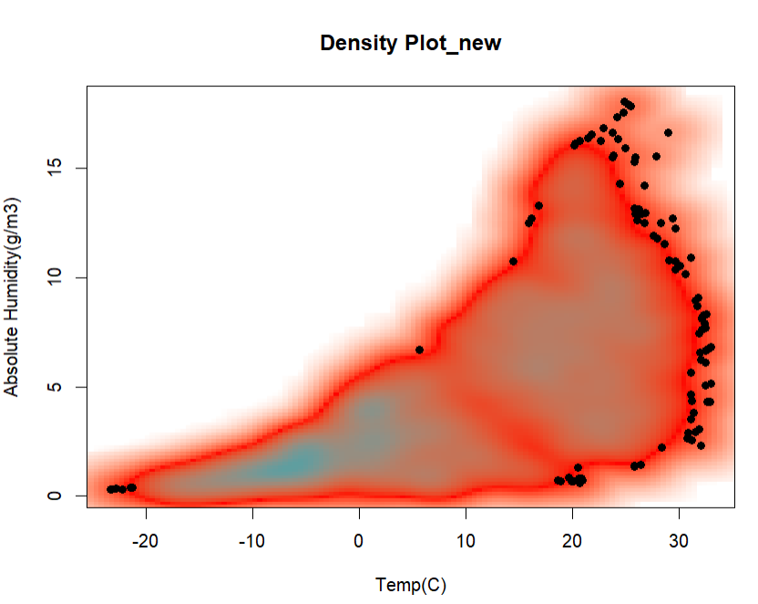
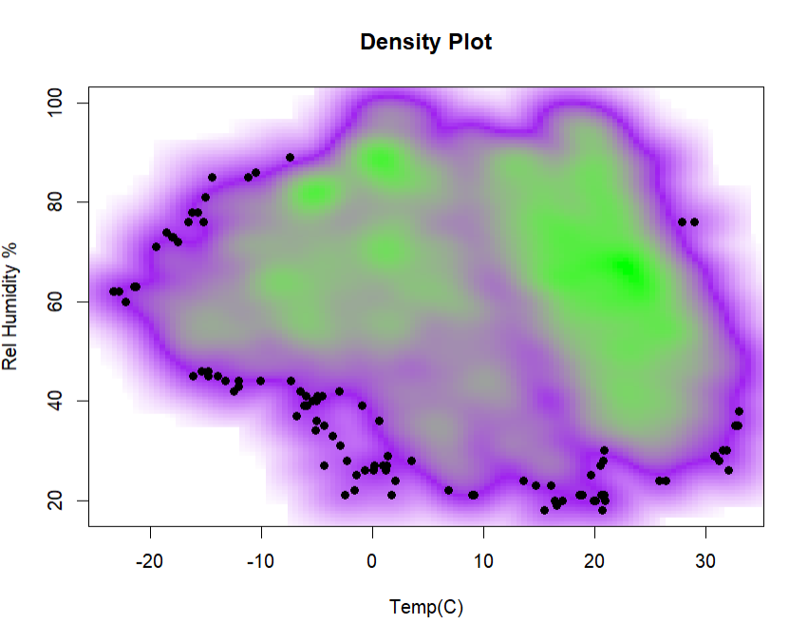
The “Density Plot” graph between Temp and Rel humidity provided vague information whereas upon adding a new variable called Absolute Humidity(g/m3) in the dataset shows more accurate information and shows the positive correlation(0.68) between two variables

Slide 7
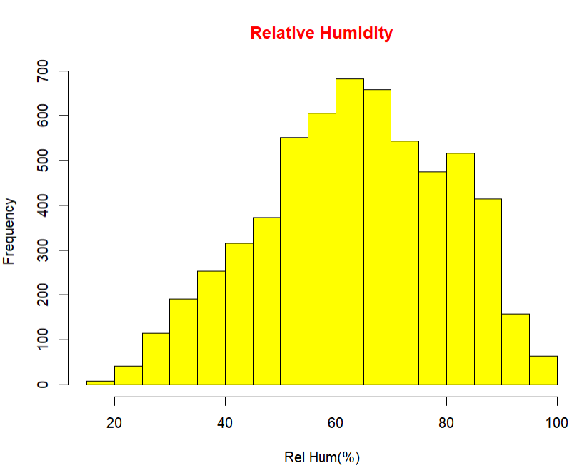
Summary
From the given data it has been observed that most of the time weather is clear and cloudy whereas the Thunderstorm and rain shower data is the least.
Relative Humidity measures the saturation level of air with water and the mean is 63% which means air is 63% saturated with water.
High winds mean low pressure & vice versa so, the negative correlation b/w wind and pressure shows a storm or high-pressure area.
The negative correlation between temperature and pressure is commonly observed on the surface area. For ex: In hot summer, atmospheric temp tends to be lower.

Slide 8
References
Rech, R. (2021, June 16). Barplot for two factors in R – step-by-step tutorial. statdoe. Retrieved February 18, 2023, from https://statdoe.com/barplot-for-two-factors-in-r/
Singh, P. (2023, February 14). Absolute humidity calculator. Omni Calculator. Retrieved February 18, 2023, from https://www.omnicalculator.com/physics/absolute-humidity
Air pressure and wind - National Weather Service. (n.d.). Retrieved February 18, 2023, from https://www.weather.gov/media/zhu/ZHU_Training_Page/winds/pressure_winds/pressure_winds.pdf
Data. (2021, June 28). Relationships. Data Visualization. Retrieved February 18, 2023, from https://datavizs21.classes.andrewheiss.com/example/07-example/

