Slide 1

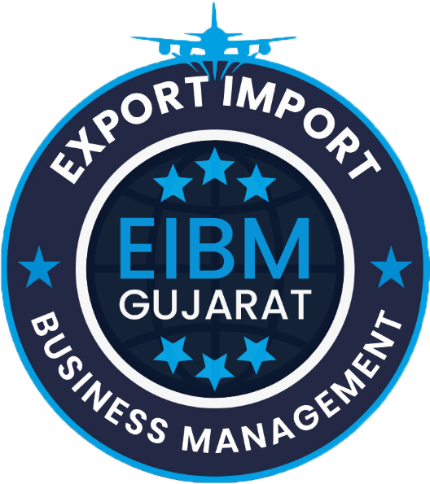
Government Benefits to Exporter

Slide 2
Government Benefits
Refund of Duty and Taxes on Exported Products Scheme (RoDTEP)
Duty Drawback (DBK)
Export of Apparel / Garments and Made-Ups (RoSCTL)
Export Promotion Capital Goods (EPCG) Scheme
Market Access Initiative (MAI)
Merchandise Exports from India Scheme (MEIS) Scheme
GST Related
Duty Exemption & Remission Scheme

Slide 3
Refund of Duty and Taxes on Exported Products Scheme (RoDTEP)
RoDTEP scheme is notified with an Objective to neutralize the taxes and duties suffered on exported goods which are otherwise not credited or remitted or refunded in any manner.
The benefit is given as percentage of FOB or fixed amount per unit of measurement as prescribed in the Appendix 4R to the Notification.
(https://www.dgft.gov.in/CP/?opt=RoDTEP )
It is issued as a scrip, which can be used to pay basic customs duties at the time of import.
RoDTEP scheme is notified based on the classification of the products as per tariff heading at 8-digit level.
Government released the guidelines and benefit rates under RoDTEP Scheme for 8555 tariff lines.
RoDTEP scheme is notified by the Department of Commerce. The Scheme shall be fully administered by the Department of Revenue. A separate RODTEP Policy Committee (RPC) chaired by DGFT is constituted to address residual issues related to the Scheme.

Slide 4
Refund of Duty and Taxes on Exported Products Scheme (RoDTEP)
The rebate rate varies from 0.5% to 4% of FOB value with a cap on value per unit on products where it is required.
It can be transferred to the other – It depends on the mutual understanding between other parties.
One can transferred from icegate (https://www.icegate.gov.in/)
For more detail: https://www.indiantradeportal.in/vs.jsp?lang=0&id=0,55,23222#:~:text=RoDTEP%20scheme%20is%20notified%20with,Appendix%204R%20to%20the%20Notification.

Slide 5
Duty Drawback (DBK)
The Duty Drawback Scheme (DBK) is a rebate program that is administered by the Department of Revenue. (a trusted and time-tested scheme administered by CBIC to promote exports.)
The scheme aims to help exporters get a refund on some of the costs accrued during the export process, particularly in the supply chain.
Duty Drawback provides essential support to exporters. The scheme comprises three categories, i.e. (i) All Industry Rate (ii) Brand Rate and (iii) Drawback on re-export of imported goods.
It rebates the incidence of Customs and Central Excise duties, chargeable on imported and excisable material respectively when used as inputs for goods to be exported. (Rate: 0.15% to 5.1%)
For more detail about duty drawback please visit:
https://www.cbic.gov.in/entities/cbic-content-mst/MTYzMzM%3D

Slide 6
Government Import Export Promotion Scheme
Advanced Authorization Scheme
Duty Free Import Authorization
Interest Equalization Scheme

Slide 7
Advanced Authorization Scheme
It allows duty free import of inputs, which are physically incorporated in an export product.
In addition to any inputs, packaging material, fuel, oil, catalyst which is consumed / utilized in the process of production of export product, is also be allowed.
Manufacturer and Merchant exporter both can take advantages
Minimum value addition 15%.
It is valid till 12 months from date of issue.
For More details:
https://www.dgft.gov.in/CP/?opt=adnavce-authorisation
https://www.indiantradeportal.in/vs.jsp?lang=0&id=0,55,284

Slide 8
Duty Free Import Authorization Scheme (DFIA)
It allows duty free import of inputs, basic custom duty is exempted under DFIA
It shall be issued on post export basis for products for which Standard Input Output Norms have been notified.
Manufacturer as well as Merchant exporter tied with supporting manufacture is eligible for the scheme.
Minimum value addition 20%.
It is valid till 12 months from date of issue.
For More details:
https://www.dgft.gov.in/CP/?opt=adnavce-authorisation
https://www.indiantradeportal.in/vs.jsp?lang=0&id=0,55,284

Slide 9
Interest Equalization Scheme
The Interest Equalisation Scheme for pre and post shipment rupee export credit is formulated to provide credit to the exporters at competitive rates.
It is a tool for reducing the high cost of credit incurred by Indian exporters viz-a-viz their foreign counterparts.
The rate of interest equalization shall be 2% for Manufacturers and Merchant Exporters exporting under specified 410 HS lines and 3% to the MSME manufacturers exporting under any HS line.
For More detail:
https://www.rbi.org.in/Scripts/NotificationUser.aspx?Id=12610&Mode=0#:~:text=The%20rate%20of%20interest%20equalization,exporting%20under%20any%20HS%20line.
https://www.dgft.gov.in/CP/?opt=rosctl
https://www.indiantradeportal.in/vs.jsp?lang=0&id=0,25,857,3901

Slide 10
Export of Apparel / Garments and Made-Ups (RoSCTL)
Scheme to rebate all embedded State and Central Taxes/levies for meant for exports of made-up articles & garments.
These scrips are granted based on the Free on Board (FOB) value of exports.
It can be transferred to the other – It depends on the mutual understanding between other parties.
One can transferred from icegate (https://www.icegate.gov.in/)
For more detail:
https://texmin.nic.in/sites/default/files/Gazette%20Notification%2009.02.2024.pdf
https://www.dgft.gov.in/CP/?opt=rosctl

Slide 11
Export Promotion Capital Goods (EPCG) Scheme
The objective of the Export Promotion Capital Goods (EPCG) Scheme is to facilitate import of capital goods for producing quality goods and services and enhance India's manufacturing competitiveness.
EPCG Scheme allows import of capital goods for pre-production, production and post-production at zero customs duty.
Capital goods imported under EPCG for physical exports are also exempt from IGST and Compensation Cess up to 31.03.2020. Alternatively, the exporter may also procure Capital Goods from domestic market in accordance with provisions of paragraph 5.07 of FTP.
The EPCG Scheme offers duty-free imports of products if a requirement of export obligation equivalent to six times the duty savings amount on capital goods is met within six years.
The EPCG license offers financial assistance to exporters by removing import charges.

Slide 12
Export Promotion Capital Goods (EPCG) Scheme
Capital goods for the purpose of the EPCG scheme shall include:
Capital Goods as defined in Chapter 9
Computer systems and software which are a part of the Capital Goods
Spares, moulds, dies, jigs, fixtures, tools & refractories
Catalysts for initial charge plus one subsequent charge
EPCG scheme covers manufacturer exporters with or without supporting manufacturer(s), merchant exporters tied to supporting manufacturer(s) and service providers.
To be eligible for the scheme, exporters must meet certain conditions, including having a valid export license and a registered company with minimum paid-up equity of ₹ 100 crores.
Exporters must certify that their exported capital goods will not be used for military purposes.

Slide 13
Export Promotion Capital Goods (EPCG) Scheme
Pre-Requisites for Applying for EPCG Scheme
To apply for an EPCG scheme, an IEC is required. Other pre-requisites as mentioned in the Chapter 5 of Foreign Trade Policy and Hand book of Procedures may be referred.
The Authorisation holder under the EPCG scheme shall, while maintaining the average export obligation, fulfill the specific export obligation over the prescribed block period in the following proportions:
For more details:
https://www.indiantradeportal.in/vs.jsp?lang=0&id=0,55,286
https://www.dgft.gov.in/CP/?opt=epcg
Period from the date of issue of Authorisation | Minimum Export Obligation fulfilled
Block of 1st to 4th year | 50%
Block of year 5th and 6th | Balance Export Obligation

Slide 14
Market Access Initiative (MAI)
Market Access Initiative (MAI) Scheme is an Export Promotion Scheme envisaged to act as a catalyst to promote India’s exports on a sustained basis.
The scheme is formulated on focus product-focus country approach to evolve specific market and specific product through market studies/survey.
The following activities will be eligible for financial assistance under the Scheme:
Marketing Projects Abroad
Capacity Building
Support for Statutory Compliances
Studies
Project Development
Developing Foreign Trade Facilitation web Portal
To support Cottage and handicrafts units

Slide 15
Market Access Initiative (MAI)
Market Access Initiative (MAI) Scheme is an Export Promotion Scheme envisaged to act as a catalyst to promote India’s exports on a sustained basis.
The funding for each project will be on cost-sharing basis with the sharing pattern ranging from 65% to 50% at the minimum.
It is administered by the Ministry of Commerce and Industry, Government of India, through the Directorate General of Foreign Trade (DGFT).
For More Details:
https://commerce.gov.in/international-trade/trade-promotion-programmes-and-schemes/trade-promotion-programme-focus-cis/market-access-initiative-mai-scheme/

Slide 16
Merchandise Exports from India Scheme (MEIS) Scheme
A scheme designed to provide rewards to exporters to offset infrastructural inefficiencies and associated costs. The Duty Credit Scrips and goods imported/ domestically procured against them shall be freely transferable. The Duty Credit Scrips can be used for:
Payment of Basic Customs Duty and Additional Customs Duty specified under sections 3(1), 3(3) and 3(5) of the Customs Tariff Act, 1975 for import of inputs or goods, including capital goods, as per DoR Notification, except items listed in Appendix 3A.
Payment of Central excise duties on domestic procurement of inputs or goods,
Payment of Basic Customs Duty and Additional Customs Duty specified under Sections 3(1), 3(3) and 3(5) of the Customs Tariff Act, 1975 and fee as per paragraph 3.18 of this Policy.
Objective of the Merchandise Exports from India Scheme (MEIS) is to promote the manufacture and export of notified goods/ products.

Slide 17
GST related
Eligible exported goods and services attract a zero GST rate, meaning no tax liability on export transactions.
Significantly reduces cost of exported goods, enhances competitiveness in international markets.
1% GST benefit for merchant exporters – Merchant exporters can get export goods from local suppliers at a 0.1% concessional GST rate.
Claim Input Tax Credit (ITC):
Exporters can claim ITC on eligible purchases made towards export production, reducing overall tax burden.
Improves cash flow, lowers production costs, and boosts profitability.

Slide 18
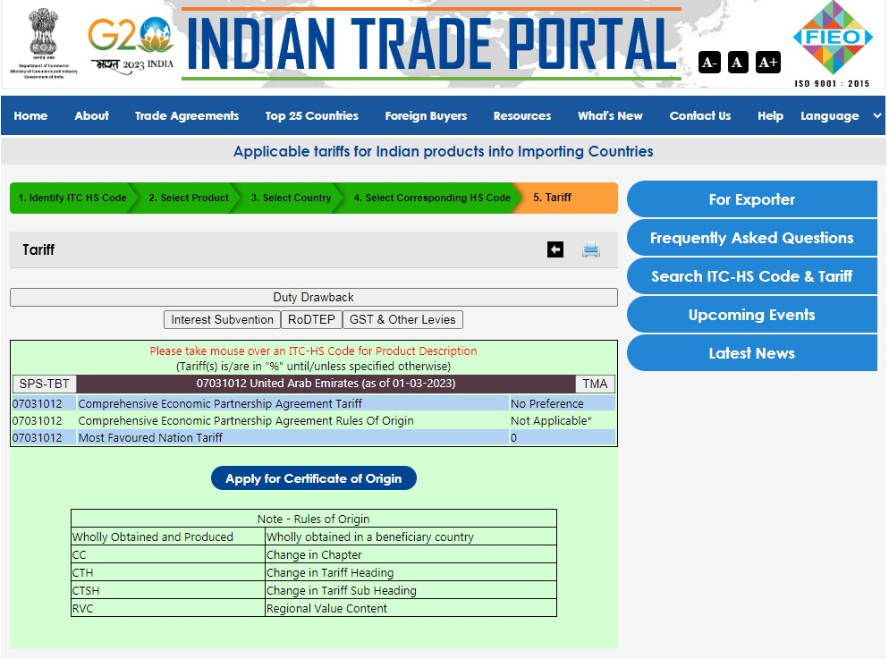
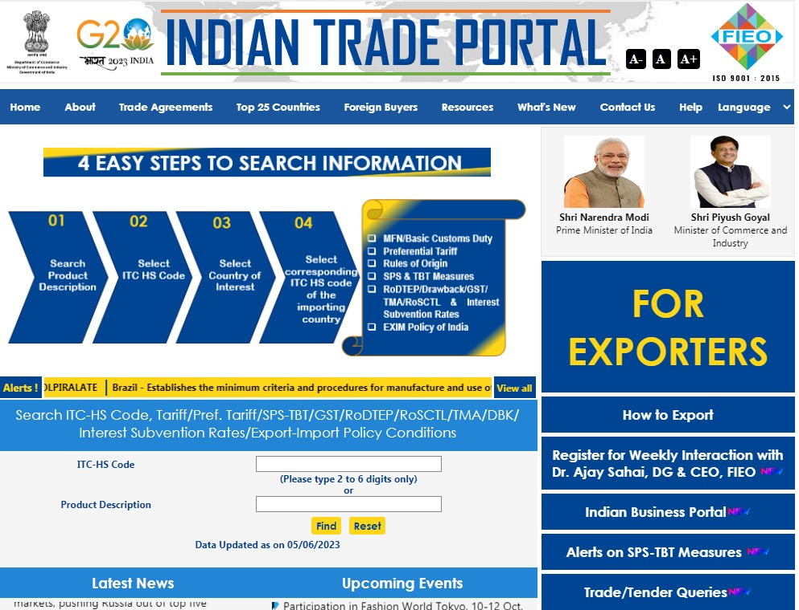

Slide 19
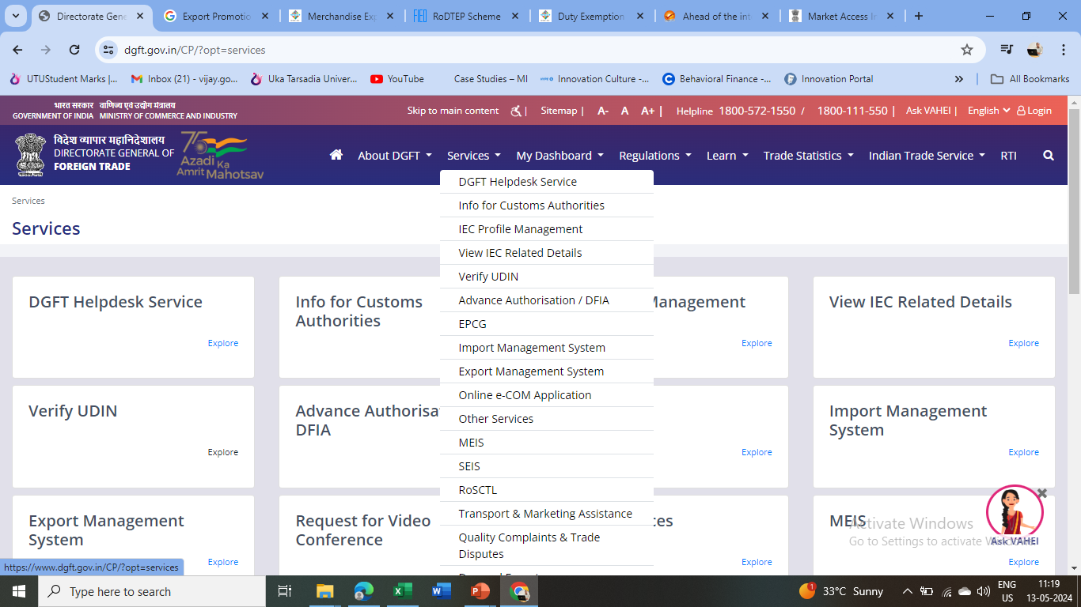

Slide 20
DGFT HELP
(a) Apart from above in case of Trade Dispute relating to export import, one can file online complain with DGFT on below link. Steps :
DGFT.GOV.IN
SERVICES
File quality / complain / Trade dispute
Continue
Fill up the form
If you fail to receive reply from above you may write to below email along with reference number: dgftedi@nic.in
(b) If you have any query related to DGFT:
DGFT.GOV.IN > Services > Contact@DGFT > Enter details > Continue > fill up the details and submit. DGFT also runs helpdesk from 2 pm to 4 pm

Slide 21
Export House Status Holder
As mentioned above, all goods, services, and technology exporters with an import-export code (IEC) number shall be eligible for recognition as a status holder.
Status recognition will depend on export performance.
An applicant shall be categorized as the status holder on achieving export performance during the current and previous three financial years.
For the Gems & Jewelry Sector, the performance during the current and previous two financial years shall be considered for recognition as status holders.
For granting status, export performance is necessary for at least two out of four years.

Slide 22
Export House Status Holder
Sr. No | Status Category | Export Performance FOB / FOR (as converted) Value (in US $ million)
1 | One Star Export House | 3
2 | Two-Star Export House | 25
3 | Three-Star Export House | 100
4 | Four Star Export House | 500
5 | Five Star Export House | 2000

Slide 23
Star Export House Benefits
On being recognized as a star export house, the exporter enjoys various benefits and privileges such as:
Authorization and customs clearance for imports and exports may be allowed on a self-declaration basis.
Exemption from the furnishing bank guarantee for Schemes under Foreign Trade Promotion unless specified otherwise.
Input-output norms may be fixed on priority within 60 days by the Norms Committee.
Exemption from compulsory negotiation of documents through banks. Remittances or receipts should, however, be received through banking channels.
Exporters involved in manufacturing would be eligible to self-certify their goods they originated from India.

Slide 24
Star Export House Benefits
Two-star and above export houses are permitted to establish export warehouses as per Department of Revenue guidelines.
Three-star and above export houses are permitted to get benefits of the Accredited Clients Programme, as per the Central Board of Excise and Customs guidelines.
Status holders would be entitled to preferential and priority treatment while handling consignments by concerned agencies.
Status holders are eligible to export freely exportable items on free of cost basis for export promotion subject to an annual limit of Rs.10 lakhs or 2% of average annual export realization during the proceeding three licensing years, whichever is higher.

Slide 25
Creativity is Import-Export Business

Slide 26
Thank You

