Slide 1



Slide 2
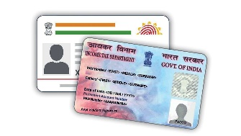

STEP#4
PAN CARD
It is necessary for every exporter and importer to obtain a PAN from the Income Tax Department
This is mandatory for filing one’s Income Tax Return and for all correspondence with any Income Tax authority.

Slide 3

STEP#5
GST ( GOODS AND SERVICES TAX )
Export of goods and services are zero rated under GST. Exporters can claim refund of input tax credit (ITC) of inputs/input services used in export of goods/services, subject to fulfilment of prescribed conditions.
MANDATORY FOR EACH AND EVERY EXPORTER AND IMPORTER

Slide 4

STEP#6
OPENING A BANK ACCOUNT
A current account with a Bank authorized to deal in Foreign Exchange should be opened.

Slide 5

Some Important Documents Required :-
Identity Proof: You need to submit any one of the following identity proof documents:
Aadhaar card
PAN card (Permanent Account Number)
Passport
Voter ID card
Driving license
Address Proof: You need to provide any one of the following address proof documents:
Aadhaar card
Passport
Utility bills (electricity bill, water bill, gas bill, etc.) in your name
Bank statement or passbook with address mentioned
Rental agreement or lease agreement

Slide 6

Passport-sized photographs
Business Proof:
Business-related documents, such as:
Partnership deed (in case of a partnership firm)
Memorandum and Articles of Association (in case of a company)
Certificate of incorporation (in case of a company)
KYC Documents:
which include:
Duly filled and signed KYC form provided by the bank
Personal details such as date of birth, occupation, etc.
Additionally, some banks may have their SPECIFIC REQUIREMENTS AND MAY ASK FOR ADDITIONAL DOCUMENTS based on their internal policies and procedures. It's always recommended to contact the bank where you intend to open the current account to get accurate information about the required documents and any other specific requirements they may have.

Slide 7

STEP#7
OBTAINING IMPORTER-EXPORTER CODE (IEC) NUMBER
As per the Foreign Trade Policy, it is mandatory to obtain IEC for export/import from India.
MANDATORY FOR EACH AND EVERY EXPORTER AND IMPORTER

Slide 8
OBTAINING IMPORTER-EXPORTER CODE (IEC) NUMBER
Import & Export Code is a 10 digit unique number.
Issued by the Directorate General of Foreign Trade (DGFT).
IEC registration certificate is mandatory for a business involved in import and export.
IE Code registration is permanent and valid for a lifetime.
Hence, before initiating an import of goods into India, an importer must ensure that the importing entity has GST registration and IE code – both of which are required to clear customs.
IEC may be applied on behalf of a firm which may be a Proprietorship, Partnership, LLP, Limited Company, Trust, HUF, and Society.
Notes:
Fees 500rs

Slide 9
DOCUMENTS REQUIRED FOR IEC CODE REGISTRATION
The list of scanned documents required for IEC Registration is listed as follows:
Proof of establishment/incorporation/registration: The following type of Firm needs to submit the establishment/incorporation/registration certificate:
Partnership
Registered Society
Trust
HUF
Other
Proof of Address: Proof of Address can be any one of the following documents:
Rent agreement
Lease deed
Electricity bill
Partnership deed

Slide 10
Other acceptable documents (for proprietorship only):
Aadhar card
Passport
Voter id
Note: In case the address proof is not in the Name of the applicant firm,
a no objection certificate (NOC) by the firm premises owner in favor of the Firm, along with the address proof, is to be submitted as a single PDF document.
Canceled Cheque
User should have an active DSC (Digital Signature Certificate)
Active Firm’s Bank accounts for entering its details in the Application and making online payment of the application fee.

Slide 11
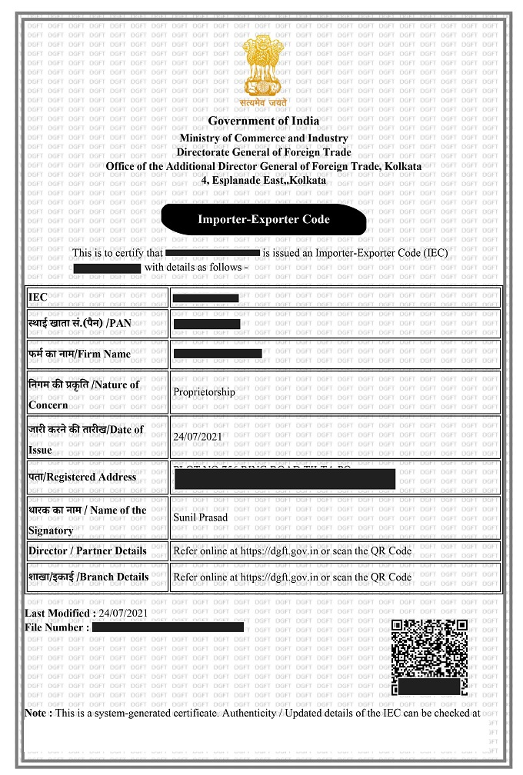

Slide 12
AD CODE REGISTRATION
An AD Code is a 14-digit code, which is given by the bank where the exporter maintains a business current account.
This code, printed with the bank letterhead, can be obtained after the exporter has registered for an Import Export Code (IEC) by the Director General of Foreign Trade (DGFT).
It has lifetime validity.
Here’s why an AD code is necessary in an export process.
A shipping bill is required for export customs clearance at the port. Without an AD code registration, a shipping bill cannot be generated.
An AD code registration also offers benefits like exemptions that are directly credited to the current account.

Slide 13
How do you apply for an AD Code?
Follow the below-mentioned steps to obtain an AD (Authorized Dealer) code:
Write a letter requesting for an AD code to the bank branch manager in the format given by the bank.
The bank will process your application and give you the AD code document with its letterhead in the format prescribed by DGFT.
Once you’ve received it, you can register your AD code at the port from where your consignment will be shipped by submitting your documents to the Customs House Agents (CHA).
You have to register your AD code at every port from where you want to clear customs and export your products. For instance, if your shipping consignment is from Vishakhapatnam and Mumbai, you have to register at both the ports.

Slide 14
How do you apply for an AD Code?
Documentation:
Contact the chosen Authorised Dealer Bank to understand their specific requirements for AD Code registration. While the requirements may vary slightly from one bank to another, the following are common documents needed:
A copy of the Memorandum and Articles of Association or Partnership Deed.
A copy of the company's PAN card.
Address proof for the registered office and principal place of business.
Bank statements for the last six months.
KYC documents of the company and its directors/partners.
Importer-Exporter Code (IEC) issued by the Directorate General of Foreign Trade (DGFT).
Other documents as specified by the bank.

Slide 15






STEP#8
REGISTRATION CUM MEMBERSHIP CERTIFICATE (RCMC)
For availing authorization to import/ export or any other benefit or concession under FTP 2015- 20, as also to avail the services/ guidance, exporters are required to obtain RCMC granted by the concerned Export Promotion Councils/ FIEO/Commodity Boards/ Authorities

Slide 16


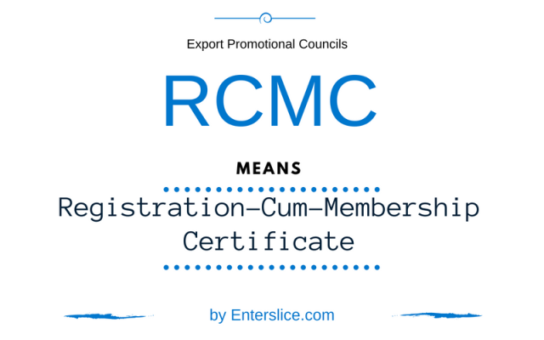

Slide 17
BENEFITS OF REGISTRATION EPC
You get a registration cum membership certificate (RCMC).
You can also update your website with this certificate.
You get regular update of the industry
You get to attend meeting and seminar
Exhibition information
EPC support- export pricing, supplier, buyer and packing also.
To claim govt. benefits, must have RCMC

Slide 18
Why is RCMC required?
Obtaining an RCMC will benefit your business in many ways : • Authorization to export or import restricted items • Ability to claim various benefits under the Foreign Trade Policy • Benefits offered by the customs department and central excise authorities • Export two or more products that fall under different categories • Ability to claim export incentives and subsidies under schemes
like Merchandise Export from India Scheme (MEIS), Rebate of State and Central taxes & Levies (RoSCTL), Remission of Duties & Taxes on Exported Products (RoDTEP) and Service Export from India Scheme (SEIS) • Letter of Undertaking (LUT) under GST for export of goods without payment of duty
Notes:
Apeda – 5year gov 6000
Tea board – 3 year gov 6000

Slide 19
International Body
ICC | International Chamber of Commerce (iccwbo.org)
World Trade Organization - Home page - Global trade (wto.org)
World Customs Organization (wcoomd.org)

Slide 20
Local Bodies
Ministry of Commerce & Industries :- Home – Mcommerce
DGFT – Director General of Foreign Trade :- Directorate General of Foreign Trade | Ministry of Commerce and Industry | Government of India (dgft.gov.in)
ECGC – Export Credit Guarantee Corporation of India :- ECGC - A Government of India Enterprise (ecgcltd.in)
Air /Sea port Authority of India :- AIRPORTS AUTHORITY OF INDIA | (A Miniratna - Category -1 Public Sector Enterprise) (aai.aero)
GST & Customs Act :- Welcome, CBIC!
Export Inspection council :- Export Inspection Council (eicindia.gov.in)

Slide 21
TRADE PROMOTION AGENCIES
Trade Associations :- List of industry trade groups / Associations in India (indiaexportnews.com)
Indian Trade Portal :- Indian Trade Portal
FIEO – Federation of Indian Exporter Organization :- Apex body of Indian Exporters (fieo.org)

Slide 22
Development Authorities (Mandatory)
Agricultural and Processed Products Export :- https://apeda.gov.in/apedawebsite/
Marine Products Export Development Authority :- https://mpeda.gov.in/`

Slide 23
Commodity Board (Mandatory)
Rubber Board :- Rubber Board Ministry of Commerce & Industry
Coffee Board :- Coffee Board of India (indiacoffee.org)
Tea Board :- The Official Website of Tea Board India
Tobacco Board :- Tobacco Board, Ministry of Commerce & Industries, Govt Of India
Spices Board :- Spices Board (indianspices.com)
Coconut Board :- https://coconutboard.gov.in/

Slide 24
List of Export Promotional Councils that provide RCMC
RCMC is issued to exporters by registering authorities under Director General of Foreign Trade (DGFT) like Export Promotion Councils (EPCs), Commodity Boards and Export Development Authorities. Some of the export councils that provide RCMC are: Export Promotion Councils :-
Chemicals & Cosmetics :- Basic Chemical Export Promotion Council, Dyes, Intermediates Exporters India-chemexcil.in
Chemicals & Allied Products :- https://www.chemicalsallied.com/
Leather Products :- Council for Leather Exports (leatherindia.org)
Gems & Jewellery Products :- Gem & Jewellery Export Promotion Council - GJEPC India
Service Export :- India Services (servicesepc.org)
Pharmaceuticals Products :- PHARMACEUTICALS EXPORT PROMOTION COUNCIL OF INDIA (pharmexcil.com)
Sports Goods Products :- :: SPORTS GOODS EXPORT PROMOTION COUNCIL :: (sportsgoodsindia.org)
Plastic Industry Products :- Welcome to Plexconcil
Cashew Products :- The Cashew Export Promotion Council Of India|cashew supplier in India|cashew producer (cashewindia.org)
Shellack Products :- SHEFEXIL
Notes:
15 day
7 day

Slide 25
Documents required for RCMC
While each EPC needs a different set of documents to apply for RCMC, there are some common requirements for exporters : • Duly filled and signed RCMC application form of the particular export council • IEC • Permanent Account Number (PAN) • Membership fee payment receipt of the respective export council • Self-certified copy of the company’s partnership deed • Self-Certified copy of the certificate that is issued by the Registrar of Companies • GST registration certificate

Slide 26


STEP#9
SELECTION OF SEGMENT (INDUSTRY)
All items are freely exportable except few items appearing in prohibited/ restricted list. After studying the trends of export of different Industry from India proper selection of the product(s) to be exported may be made.

Slide 27

LIST OF SEGMENT (Industry)
Textiles and Garments
Gems and Jewelry
Pharmaceuticals
Automobiles and Auto Parts
Agricultural Products (such as rice, tea, spices, and fruits)
Engineering Goods
Chemicals
Leather and Leather Goods
Information Technology and Software Services
Handicrafts and Home Decor Items
Many More…
SEGMENT(Industry) SELECTION FOR EXPORT

Slide 28
Why important Segment(Industry) selection for export

Slide 29
You can navigate market challenges more effectively and build stronger relationships with customers(buyer) within the chosen segment.
Segment selection allows you to deeper into understanding the target market's dynamics, consumer behavior, and market trends.
You can gain valuable insights into customer preferences, market size, growth potential, and competition.
This knowledge enables you to make informed decisions and identify opportunities within the chosen segment.

Slide 30



HOW TO SELECT RIGHT INDUSTRY
OPPORTUNITIES
YOUR INTEREST
YOUR BACKGROUND

