Slide 1



Slide 2


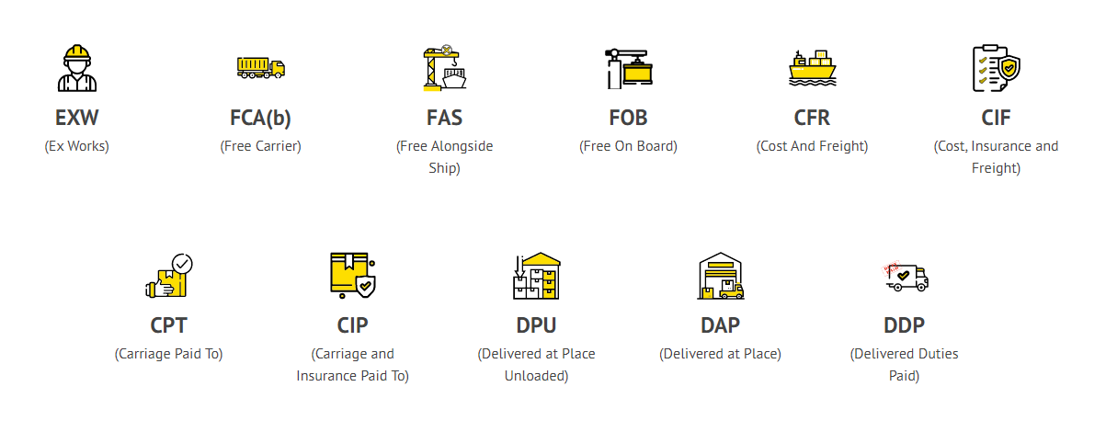

Product pricing is crucial in getting buyers’ attention and promoting sales in view of international competition. The price should be worked out taking into consideration all expenses from sampling to realization of export proceeds on the basis of terms of sale i.e. Free on Board (FOB), Cost, Insurance & Freight (CIF), Cost & Freight(C&F), etc. Goal of establishing export costing should be to sell maximum quantity at competitive price with maximum profit margin. Preparing an export costing sheet for every export product is advisable.
10
PRICING/COSTING
STEP

Slide 3
INCOTERMS®

Slide 4
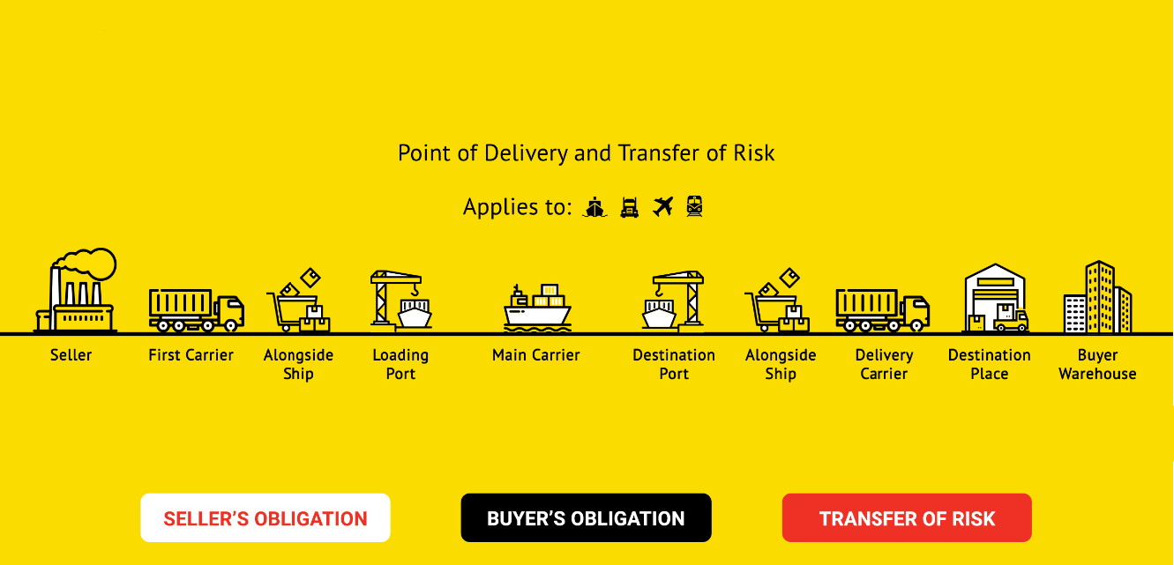

Slide 5
INCOTERMS MEAN ?
Incoterms are rules – set by the International Chamber of Commerce
That define the terms of trade for the sale of goods all around the world.
You can think of them as the common language of trade.
By understanding them better, you will be better equipped in importing and exporting goods with parties around the world.

Slide 6
What Incoterms do and don’t cover
What Incoterms do cover
They do define the obligations and costs between a buyer and seller
They do define the point at which the risk for cargo passes between buyer and seller
What Incoterms don’t cover
They don’t cover the passage of title or ownership
They don’t cover payment – this is negotiated separately.
They don’t cover insurance – only two Incoterms, CIF and CIP outline insurance as the seller’s responsibility.

Slide 7
What are the most common Incoterms ?

Slide 8
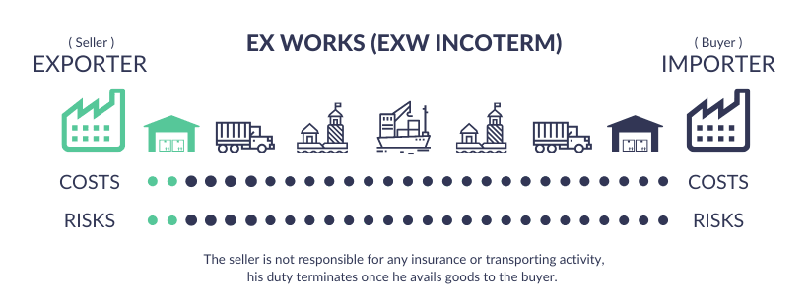
Ex Works (Place):

Slide 9
Ex Works (Place):
The buyer bears all the costs and risks in an Ex-Works arrangement.
The seller must only make the goods available for the buyer at their warehouse/factory. As soon as the goods are collected, buyer undertakes all other obligations.
Ex Works is an Incoterm used for all methods of shipping, irrespective of the mode, or legs of the transport.
Under Ex Works, the buyer undertakes all obligations of the shipment once the cargo is packed in export packaging and collected. Here, the buyer must arrange all transport, export documentation, cover all freight charges, and fulfil the importation and delivery process.

Slide 10
Ex Works (Place):
Having an EXW arrangement means that there is minimum obligation for the seller, whereby he is responsible only till the delivery of goods at the named place, and the buyer covers the entire shipping cost.
EXW appears to be more in favor of the seller as he has no charges to pay once the goods have left the premises.
However the buyer may have certain advantages, if he manages to reduce the transportation costs and handle the shipping process more efficiently.
To be more specific, it may still be necessary for the exporter to participate in the export reporting and clearance processes and cannot practically delegate them to the buyer.

Slide 11
Following are the ex works shipping terms 2020:
The seller is only responsible for maintaining goods at the initial stage.
The whole shipping procedure rests with the buyer.
Buyer is only responsible for loading goods from place of origin to ultimately his warehouse/factory.
All legal formalities are taken care of by the buyer.
All the charges, risk and responsibility of goods is again the buyer’s duty, from the warehouse to his place.

Slide 12
Insurance
Seller –
Seller has no obligation to provide any insurance cover. However, he may provide assistance to the buyer in arranging insurance cover for the goods while they are in transit, at buyer’s cost.
Buyer –
Risk of goods is the buyer's responsibility. Any damage of goods during the process will be borne by the buyer. So the decision of insuring goods rests with the buyer, and he may or may not insure the goods accordingly

Slide 13
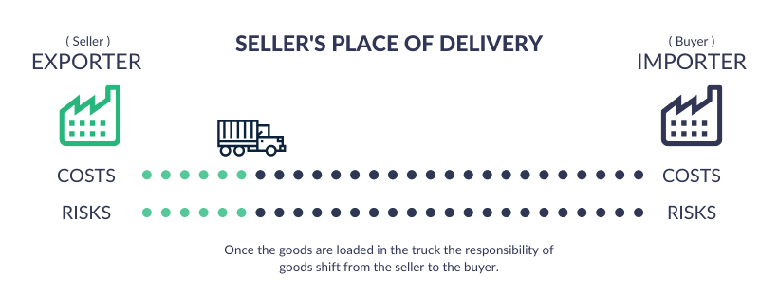
Free Carrier (Place):

Slide 14
Free Carrier (Place):
The seller is responsible for export clearance and delivering the goods to the carrier at the designated point of delivery in accordance with the Free Carrier (FCA) shipping terms.
Once the cargo is prepared to be put onto the carrier, the buyer takes responsibility for it.
FCA is applicable to all modes of transportation, including road, rail, sea, and air freight.
The buyer may arrange carriage at a lower cost than what their seller may offer.
FCA Incoterms Process Flow
There are usually two types of cases which will arise in an FCA transaction:

Slide 15
Case 1: Seller (exporter) delivers at seller’s (exporter’s) premises The exporter just loads the goods from his premises in the importer’s truck.
Seller’s place of delivery
In this scenario, the place of delivering goods before shipment is decided by the buyer.
The processing responsibility rests with the buyer.
The seller loads the goods, in a vehicle arranged by the buyer.
The goods are then transported to the place nominated by the buyer (even though it's the seller's place).
Responsibility of unloading goods totally rests with the buyer.

Slide 16
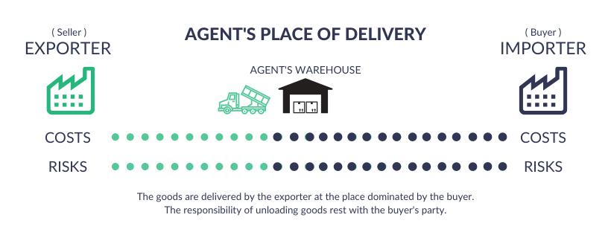
Case 2 : Seller (exporter) delivers at buyer’s (importer’s) location in seller’s (exporter’s) country itself Here, the exporter delivers the goods at the location nominated by the importer (terminal, transport hub, forwarding agent's warehouse, etc.).
Agent’s place of delivery
In (FCA) Free Carrier Incoterms, the place of delivering goods before shipment is decided by the buyer - nominating his own vessel, transport hub, forwarding agent, etc.
The processing responsibility rests with the exporter, till the agent’s warehouse.
The seller loads the goods & transports it till the warehouse.
Once the goods are transported to the agent’s warehouse, their responsibility shifts from the seller to the buyer.
The unloading of goods is also the responsibility of the buyer.

Slide 17
General Obligations
Seller’s Responsibility
Providing all the documents, in terms of commercial invoice, bill of lading, packing list, etc. and the equivalent documents mentioned during the period of contract, along with the loading of goods, supported with proper identification and verification.
The documents can be in any format, i.e., either paper or electronic form.
Buyer’s Responsibility
To pay the price of goods and all the transportation costs from seller’s place to buyer’s nominated place where the goods are unloaded by the seller.

Slide 18
Transfer of Risk
Seller’s Point
Case 1 - The seller bears the risk of goods upto the loading of goods.
Case 2 - The seller bears the risk & responsibility of goods upto the agent’s warehouse.
Buyer’s Point
The buyer bears all the risks concerning damage to the goods from the time goods have been delivered by the seller to the nominated place.

Slide 19
Insurance
Seller’s Responsibility
There is no risk beyond the loading of goods, so there is no obligation of insurance in a free carrier contract. However at the buyer’s request, the seller may also arrange for insurance.
Buyer’s Responsibility
All the risk and cost responsibilities from the point of delivery are transferred to the buyer as per FCA incoterm, hence there is no obligation on the seller to arrange for insurance. He may assist the buyer with getting insurance, as per the terms of agreement between them. It is the buyer's responsibility to insure the goods while in transit. If the goods are damaged while they are being transported, and the seller refuses to pay, then the buyer can claim insurance.

Slide 20
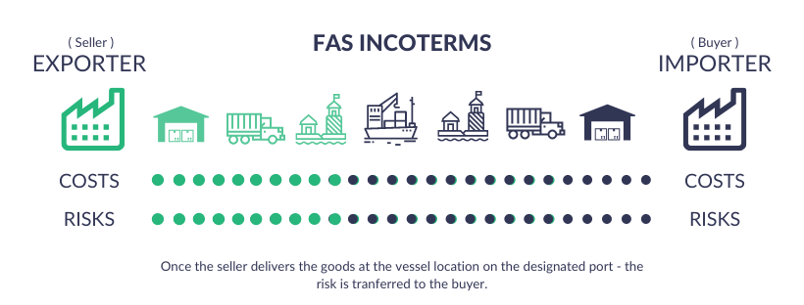
Free Alongside Ship (Port):

Slide 21
Free Alongside Ship (Port):
In FAS, the seller has well-defined instructions for the course of transportation till the port of destination and the buyer seizes responsibility for loading the goods -- and all charges -- after the goods reach the nominated port.
In practice, the FAS incoterm is restricted to sea and inland water transit, fairly suitable for bulk and non-containerized cargoes.
Bulk freight, like grain or oil, is a common use for it. The seller is in charge of getting the items to the chosen port, or the spot where the ship is.
The buyer is responsible for loading the cargo onto the vessel at the scheduled port.

Slide 22
Free Alongside Ship (Port):
The seller(expoter) is responsible for the delivery of goods till the location where the vessel is at, i.e., the designated port.
Insurance proceedings are carried out by the buyer -- he may pay for the additional insurance during carriage of goods, i.e., insuring goods even during the seller's trade process.
The risk of goods is transferred at the vessel location.
The responsibility of loading of goods onto the vessel at the designated port is the responsibility of the buyer.

Slide 23
Transfer of Risk in Free Alongside Ship
Seller’s –
Risk of goods is moved from the seller to the buyer when the goods arrive next to the nominated vessel. Accordingly, the seller bears the damage responsibility of goods until the goods reach the agreed upon destination.
Buyer’s –
As the risk is transferred at the nominated vessel, the buyer will be chargeable for the risk factors till the ultimate place of destination.
Also, if he fails to instruct the seller in accordance with the location/place of the vessel, he’ll be responsible for all the loss.
The risk and damage factor of goods stays till the ultimate destination, as the buyer carries out the whole freight and transportation process after the designated port.

Slide 24
Insurance
Seller’s –
The seller has no obligation for getting insurance.
Even if he does execute the insurance proceedings, it will be at the buyer's cost and risk, because the seller’s responsibility is only till the nominated vessel, after which all the charges are borne by the buyer.
Buyer’s –
The buyer is responsible for the whole freight proceedings, so the insurance responsibility rests with him.
The risk and damage of goods factor stays with him so he’ll be responsible if anything goes wrong in the process.
He’ll have to carry Ocean Freight insurance/marine insurance, as the goods will be moved through sea and inland waterways.

Slide 25

Free on Board (FOB):

Slide 26
Free on Board (FOB):
It stands for “Free on Board” or “Freight on Board”, and
it defines shipping terms specific to transit by sea and inland waterways –
it is not applicable to air, rail and road transit.
The place of delivering the goods before shipment is agreed upon by both the parties.
In FOB, the seller is responsible from the point of origin i.e. maintaining goods and transporting them till the delivery point.
The loading of goods at the destination port is done by the seller.
The processing responsibility after the delivery point rests with the buyer.
Responsibility of risk and insurance is decided based on whatever the two parties have agreed upon.

Slide 27
Seller’s Responsibilities
The trade transit for the seller involves inland transportation which is from the warehouse to the arrival port.
Costs for maintaining goods in the warehouse are borne by the seller
Fees of freight forwarding agent, who has been handling his logistics
Charges for loading goods on the port
Payment for freight from FOB origin, i.e., the place agreed by both parties till the port
In FOB, the custom clearance responsibility for the seller involves export proceedings from the place of origin to the delivery harbor. And since the obligation of the seller is only till the port, the export customs is the seller's outlook. They’ll be the one carrying out export custom procedures and bearing all the related charges.
In short, all FOB charges from point of origin till the goods are loaded at the port.

Slide 28
Insurance
Seller’s –
Typically, the seller has no obligation to the buyer for insurance. Yet, as a part of discipline it can be agreed upon as a seller's matter of concern till the port.
Likewise, at the buyer’s request, the seller may contribute his assistance to the buyer for insurance and customs provisions.
Buyer’s -
As discussed earlier, FOB may include insurance with regards to parting responsibilities for damage risk, so the buyer has to take care of insurance of goods after the risk and responsibilities for the goods are transferred to him.

Slide 29
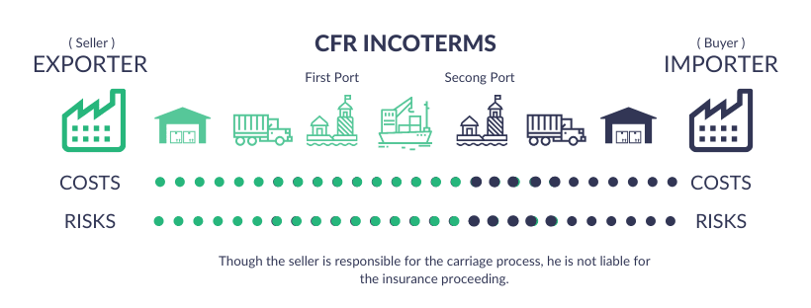
CFR (Cost & Freight) :

Slide 30
CFR (Cost & Freight) :
Under CFR shipping terms, though the seller is responsible till the named place of port, the risk of goods is transferred to the buyer once the goods are loaded onboard, i.e., before freight proceeding.
The buyer is responsible for all payment charges after the designated port, including insurance coverage of goods.
Additionally, unlike the CIF incoterm, which requires the seller to provide insurance coverage, in CFR the seller has no such obligatory commitments.
The seller is responsible for the delivery of goods till the designated port.
The risk of goods is transferred at the first port (i.e., exporting country’s port).
Insurance and carriage proceedings are carried out by the buyer.
All charges after the target port are borne by the buyer.

Slide 31
Risk Transfer
Seller’s -
Although the seller is liable for the delivery of goods till the designated port, he is not responsible for the risk of goods after the first port.
The risk of goods is transferred to the buyer as soon as the goods are loaded on board by the seller.
As such, any extraneous charges or levies imposed on the goods due to neglect or delays, such as shipping demurrage charges, unforseen taxes etc are to be borne by the importer.
Buyer’s
The risk of goods is moved to the buyer as soon as the goods are loaded onboard by the seller at the first port.
Also, the insurance risk stays with the buyer since the initial stage of the trade process.
If the buyer fails to guide the seller in reference to the delivery port, the loss will be the buyer's responsibility.

Slide 32
Insurance
Seller’s -
Typically, the seller has no obligation to insurance.
Though he’s responsible for the delivery, he is not accountable for insurance.
However, at the buyer’s risk and cost, he may provide his assistance to insurance or even carry out the coverage procedure.
Buyer’s -
As discussed above, the buyer pays for insurance in CFR.
He’ll be liable for the goods right from the place of origin. He could perhaps take the seller’s assistance in the analysis process, but if the trade doesn’t go as planned, the seller will not be held responsible for any damage coverage.

Slide 33
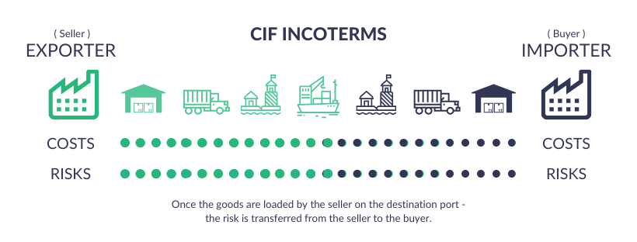
CIF (Cost, Insurance & Freight) :

Slide 34
CIF (Cost, Insurance & Freight)
CIF stands for Cost, Insurance and Freight, a commercial rule under incoterms 2020 wherein the expenses are borne by the seller -- from delivering goods and bearing settlement charges for carriage and insurance till the designated port.
CIF Incoterm cannot be used for air, rail and road transit.
The use of CIF is restrained to sea and inland water transportation
Under CIF shipping terms, the seller stays responsible till the goods are loaded onto the shipping vessel; post that the risk and responsibility moves from the seller to the buyer.
In the CIF terms, the place of destination is acknowledged by both parties.
The seller is responsible for transit and freight till the importing country’s port.
The loading of goods at the terminal port is the seller’s responsibility.
The processing duty after the goods reach the destination port rests with the buyer.

Slide 35
Transfer of Risk
As the transit process is carried out by the seller, from the point of origin to the target port, the risk of goods resides with the seller for this duration.
Once the seller loads the goods on the shipping vessel bound for the importer’s country, from that time itself the risk is transferred to the buyer.
If the buyer fails to instruct the seller regarding destination port, the damage and loss is borne by him.

Slide 36
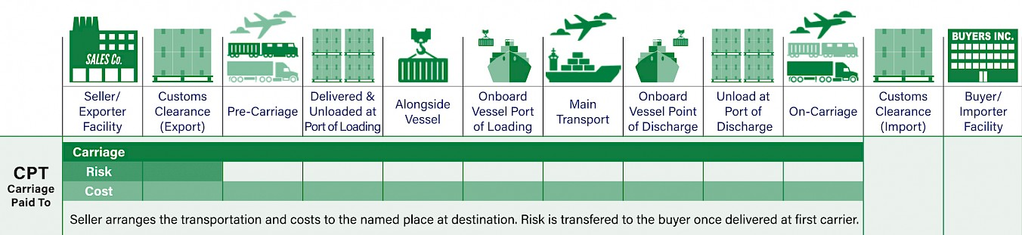
CPT (Carriage Paid To) :

Slide 37
CPT (Carriage Paid To) :
Carriage Paid To (CPT) is an international commercial term (Incoterm) denoting that the seller incurs the risks and costs associated with delivering goods to a carrier to an agreed-upon destination.
With multiple carriers, the risks and costs transfer to the buyer upon delivery to the first carrier.
CPT costs include export fees and taxes.
In a CPT transaction, the seller must clear the goods for export and deliver them to a carrier or appointed person at a mutually agreed-upon (between the seller and buyer) destination.
Also, the seller pays the freight charges to transport the goods to the specified destination.
The risk of damage or loss to the goods is transferred from the seller to the buyer as soon as the goods have been delivered to the carrier.
The seller is responsible only for arranging freight to the destination and not for insuring the shipment of the goods during transport.
The term CPT is typically used in conjunction with a destination.
The CPT price might include Terminal Handling Charges (THC) in their freight rates.
The carrier could be the person or entity responsible for the carriage (by sea, rail, road, etc.) of the goods or the person or entity enlisted to procure the performance of the carriage.

Slide 38
Transfer of Risk
The risk is transferred from the seller to the buyer as soon as the goods are delivered to the first carrier, even if multiple means of transportation (land, then air, for example) are employed.
This can put the buyer at some risk in that the seller has an incentive to find the cheapest means of transportation without any special concern for the safety of the product while in transit.
To offset this risk, the buyer may consider a Carriage and Insurance Paid To (CIP) agreement, by which the seller also insures the products during transit.
The seller may also choose an interim place to deliver the goods, rather than to the buyer’s final destination, provided it has been mutually agreed upon beforehand by the seller and buyer.
The seller only pays freight charges for delivery to this interim place.
Carriage Paid To (CPT) places the majority of the responsibility and cost on the seller, as it stipulates that the seller must absorb all costs and risks until the goods are transported to the first carrier in the transportation chain.

Slide 39
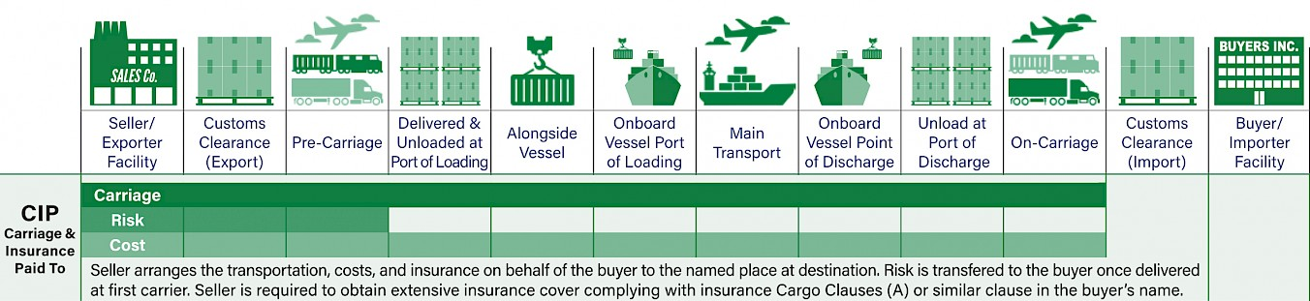
Carriage and Insurance Paid to (CIP) :

Slide 40
Carriage and Insurance Paid to (CIP) :
The term “carriage and insurance paid to (CIP)” signifies that the seller will pay freight and insurance in sending goods to someone chosen by the seller at a mutually agreeable location.
The seller must insure the goods being sent for 110% of their contract value.
It requires the seller to pay for both freight and insurance costs in sending goods to a buyer chosen by the seller at a mutually agreed-upon location.
As soon as the goods are delivered, the risk of damage or loss becomes the buyer’s.
If buyers want better insurance coverage than 110% of the contract value, they must pay for it themselves.
Any form of recognized transport can be used, including road, rail, sea, inland waterway, air, and any combination thereof.

Slide 41
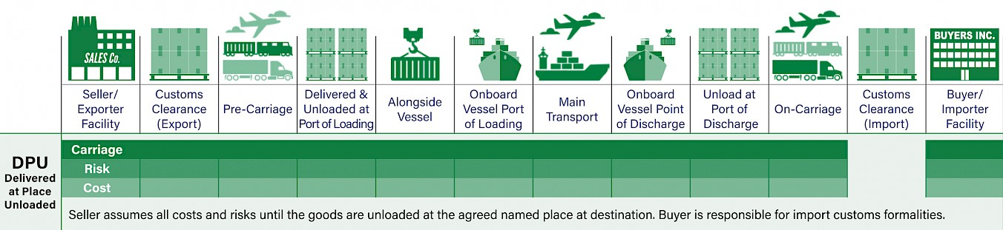
Delivery at Place Unloaded (DPU) :

Slide 42
Delivery at Place Unloaded (DPU) :
With the DPU Incoterm, the seller assumes all costs and risks until the goods are unloaded at the agreed named place at destination.
In this case, the buyer is responsible for import customs formalities.
DPU can apply to any mode of transport or multiple modes of transport.
The buyer and seller should specify and agree upon a named place of destination.
The incoterm DPU "Delivered at Place Unloaded" was formally known as DAT for “Delivered at Terminal” prior to 2020 version was released.

Slide 43
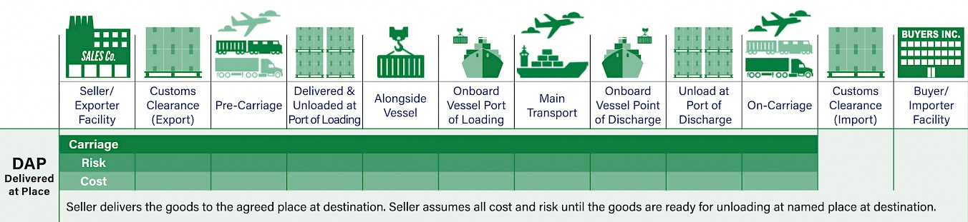
Delivery at Place (DAP) :

Slide 44
Delivery at Place (DAP) :
Under this rule, the seller is responsible to prepare and transport goods to the buyer's location and paying for the shipment as well as any losses that may result during transport.
Under DAP, a seller agrees to pay all costs and suffer any potential losses of moving goods sold to a specific location.
In simpler terms, the seller takes on all the risks and costs of delivering goods to an agreed-upon location under DAP rules.
This means they are responsible for anything associated with packaging, documentation, export approval, loading charges, and ultimate delivery.
The buyer, in turn, takes over the risk and responsibility for unloading the goods and clearing them for import.
The buyer, on the other hand, must bear the cost of taxes, duties, and levies, and must unload the shipment upon arrival.
The buyer assumes all the risk and responsibility once the shipment arrives at the destination.

Slide 45
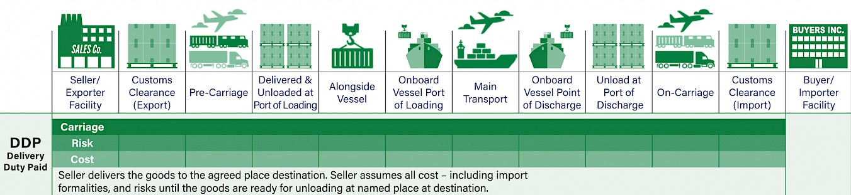
Delivered Duty Paid (DDP) :

Slide 46
Delivery at Place (DAP) :
Delivered duty paid (DDP) is a delivery agreement whereby the seller assumes all of the responsibility, risk, and costs associated with transporting goods until the buyer receives or transfers them at the destination port.
This agreement includes paying for shipping costs, export and import duties, insurance, and any other expenses incurred during shipping to an agreed-upon location in the buyer's country.
The risk transfers to the buyer once the goods are made available to the buyer at the port of destination.
The benefits of DDP lean in favor of the buyer as they assume less liability and fewer costs in the shipping process, this, therefore, places a great deal of burden on the seller.
However, the seller is not responsible for unloading the goods.

Slide 47
