Slide 1

Network Traffic Management in SDN
Reg. no: CS17B1042
Name: Muthukuru Sai Krishna
Guide: Dr. Narendran Rajagopalan.
Congestion Detection in SDN.

Slide 2
Need of Network Traffic Management in SDN
With the latest developments in mobile and network use of internet advanced rapidly.
With the live apps that lets us control devices we need high speed internet and low latency.
With the help of SDN security gets increases and provides additional functionalities.
Additional improvements include provide customizable route path, scheduled maintenance and low latency.
These improves our daily experience.

Slide 3
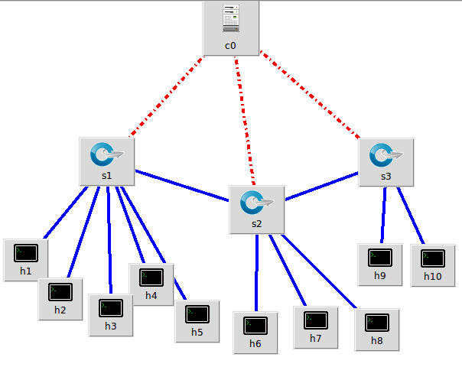
An idea of how SDN Controller works

Slide 4
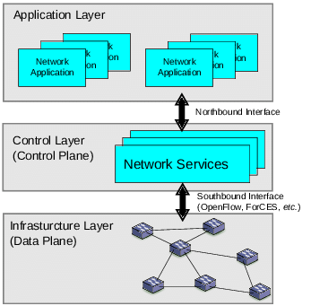
I am working with the OpenFlow protocols in the south bound interface.

Slide 5
Previous projects – Literature Study
In my research I came with projects that use bandwidth estimation to move the nodes into different network that can offer such bandwidth.
This is similar to Content Centric Networking.

Slide 6
Types of Network Traffic
Burst Traffic
(Download Files, FTP etc.)
Interactive Traffic
(Priority over less essential traffic)
Latency Sensitive Traffic
(Streaming, Video Conference, etc.)
Non-Real Time Traffic
(Emails, web surfing, etc.)

Slide 7
How
Collect network traffic data in the network environment.
Apply a ML algorithm that processes the data and classify the data.
Show and save the result after each processing.
Establish Mininet environment.

Slide 8
Why do we need to understand cooperation between network operators and content provides ?
Have full access and visibility into end-to-end connectivity.
01
Dynamically control traffic flows.
02
Monitor end-users for Quality of Experience and Service.
03

Slide 9
When do we need to control traffic flow
If the network conditions are poor.
If we identify a bottle neck situation in the flow.
If we experience degradation of quality of the network packets received by the end node.
When a custom path is needed.

Slide 10
Tools Used
Mininet
POX controller
WireShark
Data Classifier Algorithms
PyShark

Slide 11
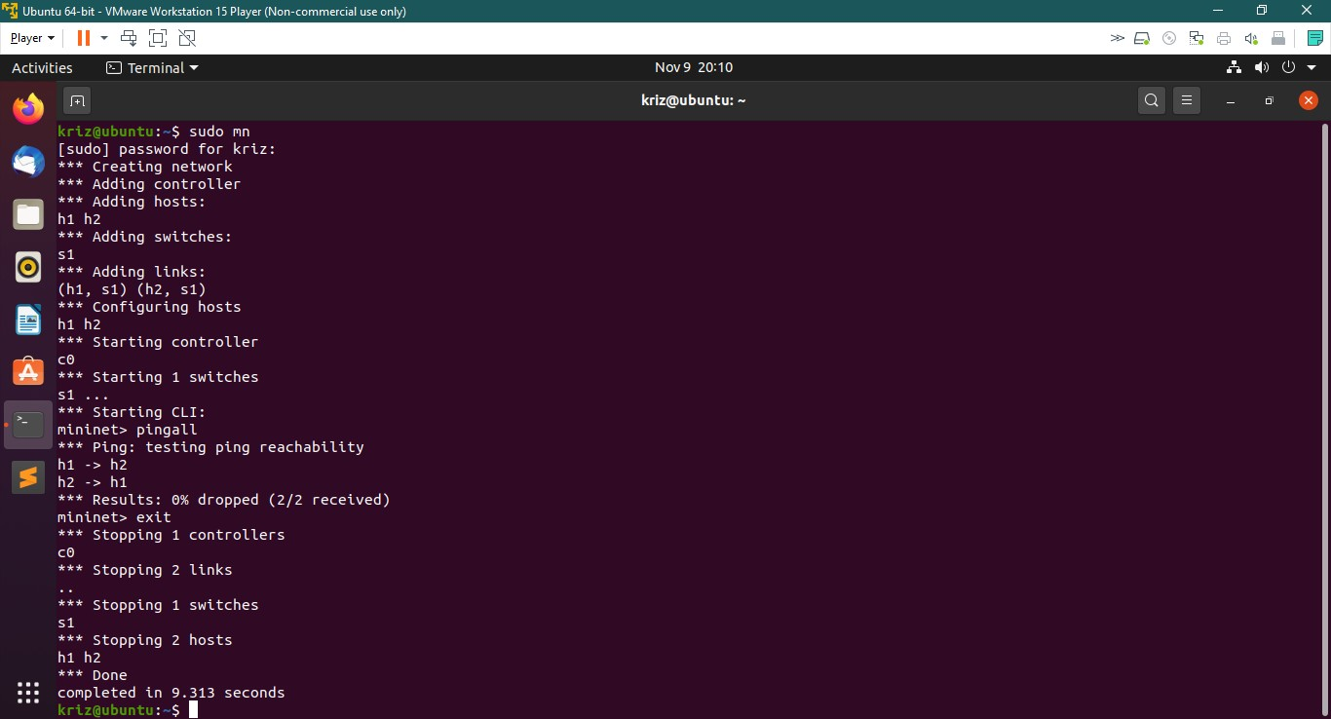
Mininet environment setup successful

Slide 12
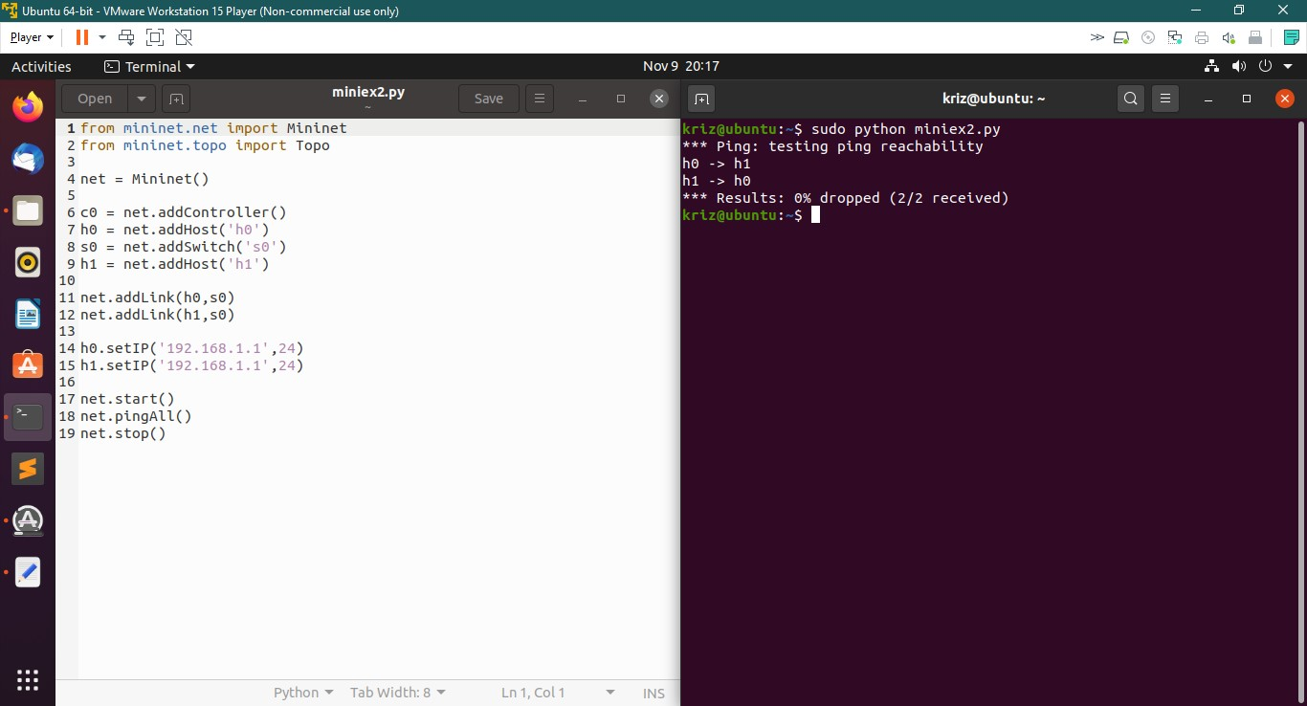

Slide 13
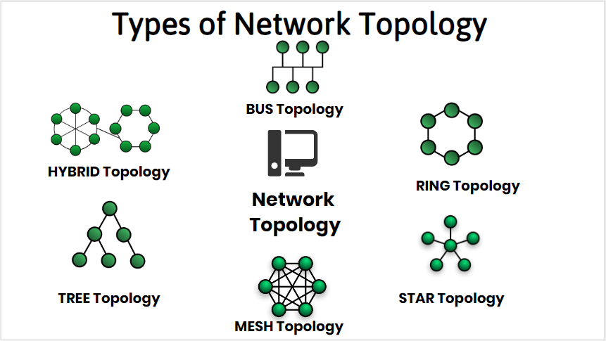
Network topologies

Slide 14
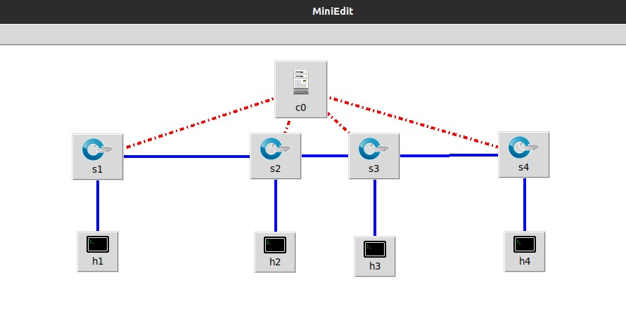
Topology Selected

Slide 15

POX Controller
POX is a python based SDN controller. It lets the application of SDN concepts easier.

Slide 16
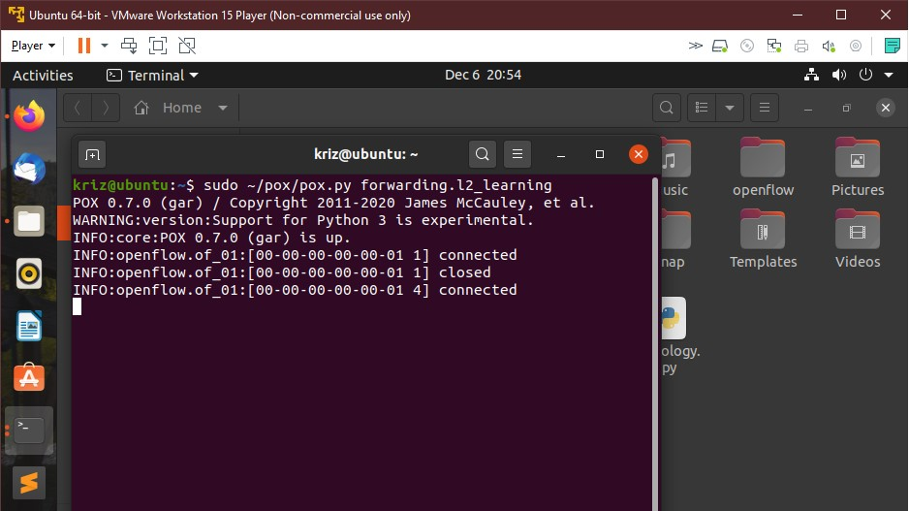
POX controller initialization

Slide 17
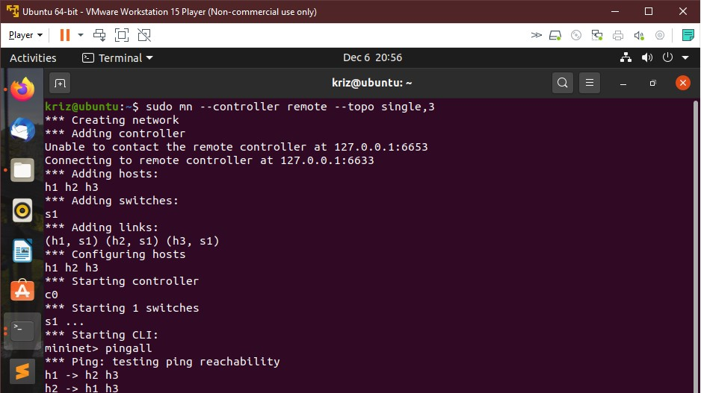
MININET topology with POX controller

Slide 18
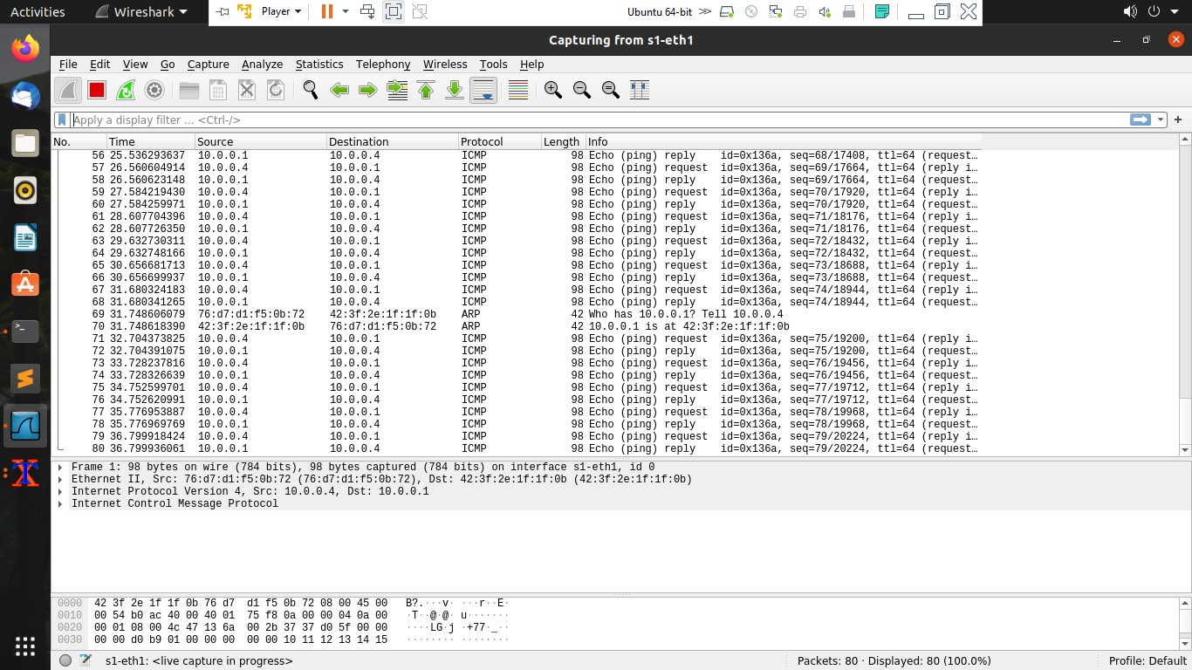
Network Traffic monitoring using Wireshark

Slide 19
Tools to send packets:
SCAPY
Hping
WireEdit

Slide 20
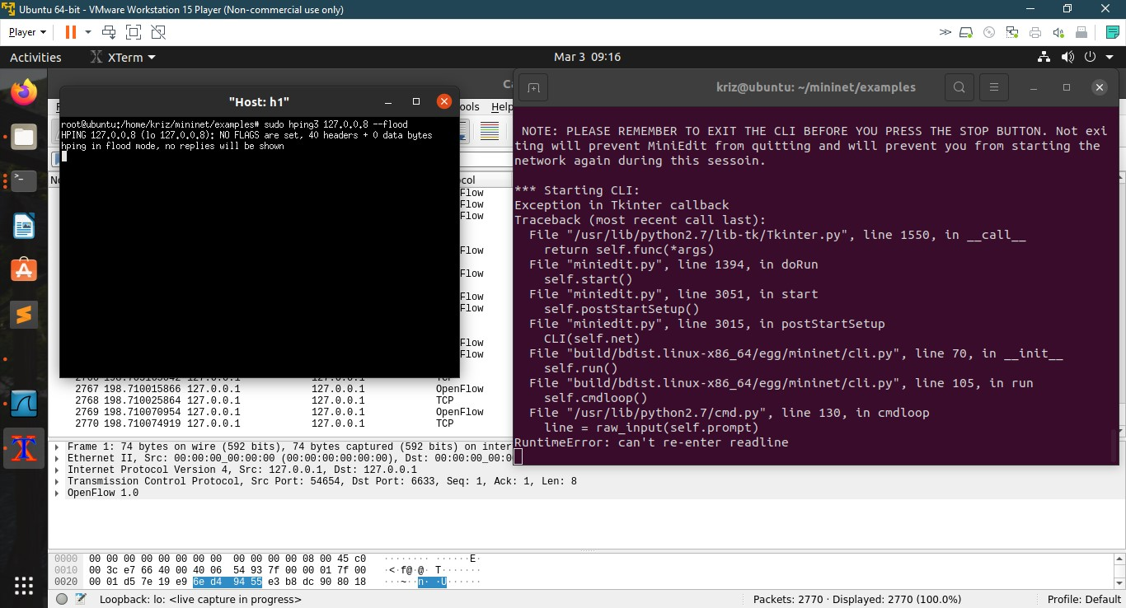
hping is a tool used to generate and send network packets to test network.
I used hping to send traffic between nodes and capture the data through Wireshark.
hping

Slide 21
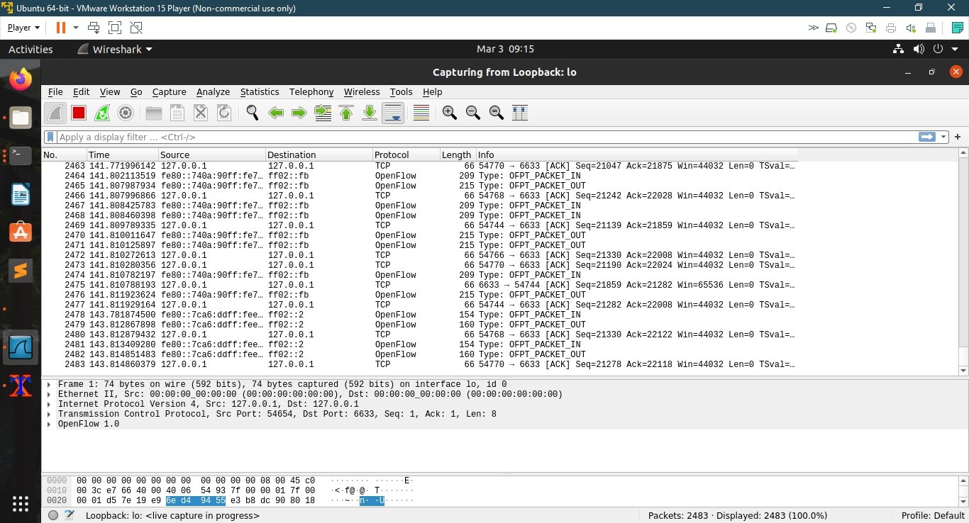
Though it is not displaying the content in the xterm window Wireshark monitored the traffic

Slide 22
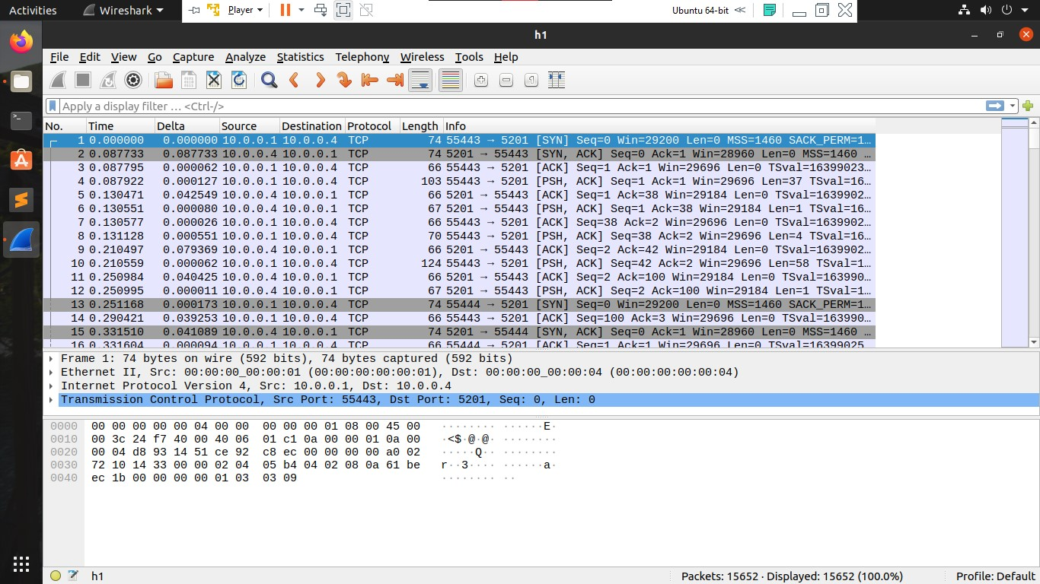
Data Collected
Data is collected as pcaps using wireshark and then exported as CSV files to read using python for preprocessing.

Slide 23
Attributes considered
Length of packet
Inter Arrival Time
Delay time
Round Trip Time

Slide 24
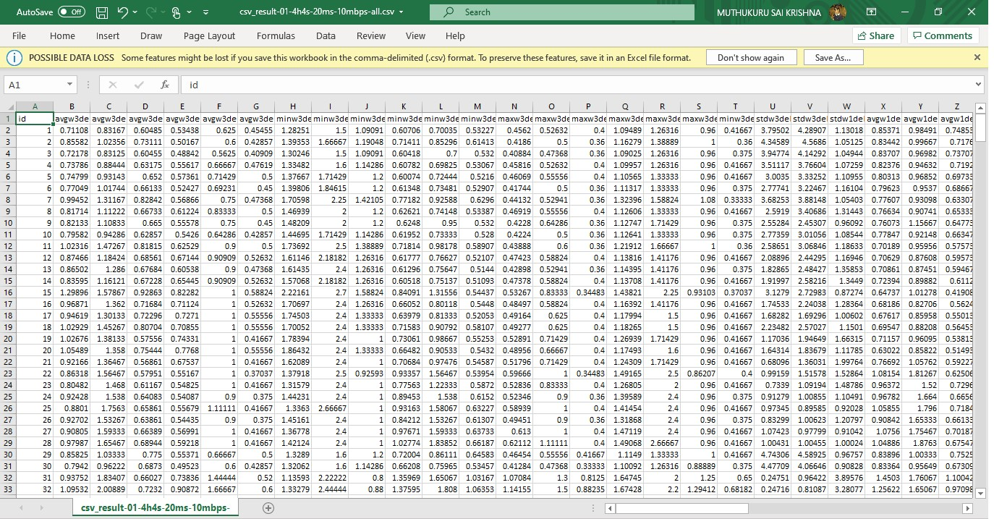
Data after preprocessing

Slide 25
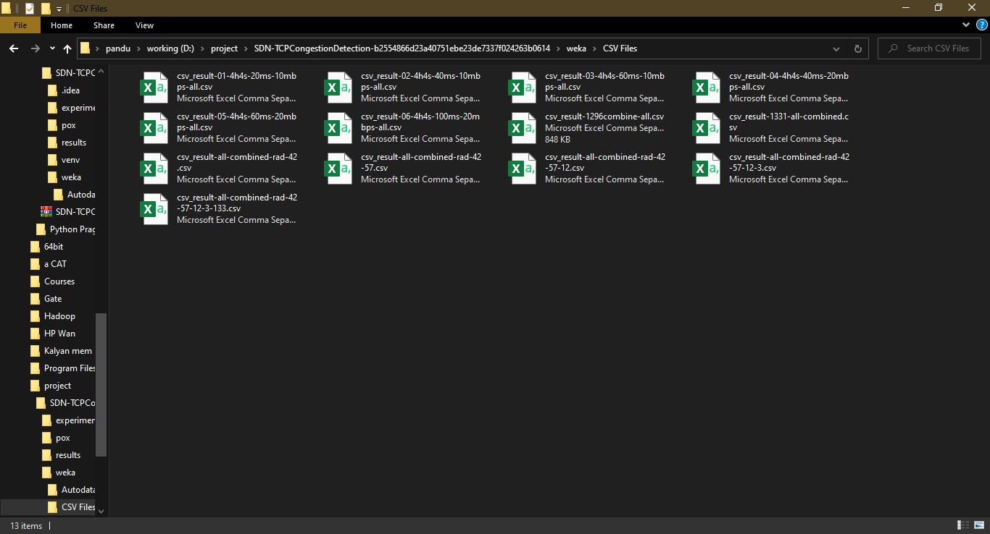
I collected all the data in
the form of CSV files

Slide 26
Classifying data
In my experiment I altered the flow such that the h4 is not reachable.
So the data collected from eth-1 of Switch 4 is considered as congestion and given label ‘c’.
The remaining data is considered as non-congestion and is given label ‘n’.

Slide 27
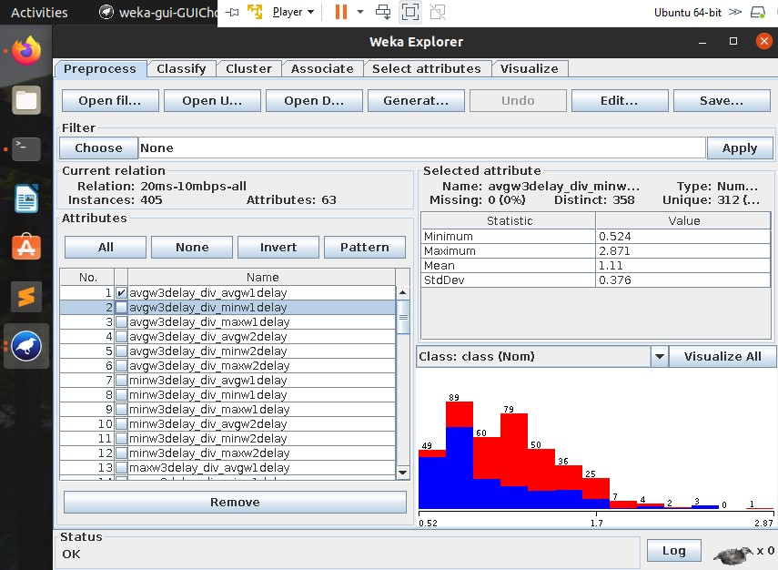
I used weka to visualize the data
to find outliers

Slide 28
Model Training
The algorithms used to train the data are:
1) Bagging
2) AdaBoost
After looking at the statistics we will decide on which algorithm to use.

Slide 29
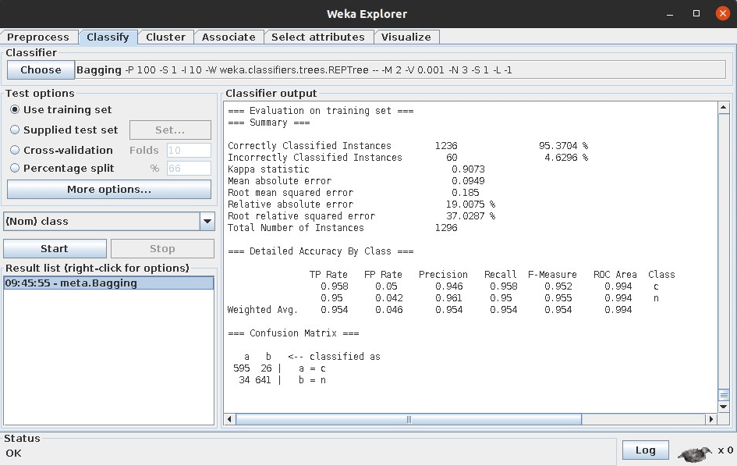
Bagging
The accuracy obtained through bagging is 95%

Slide 30
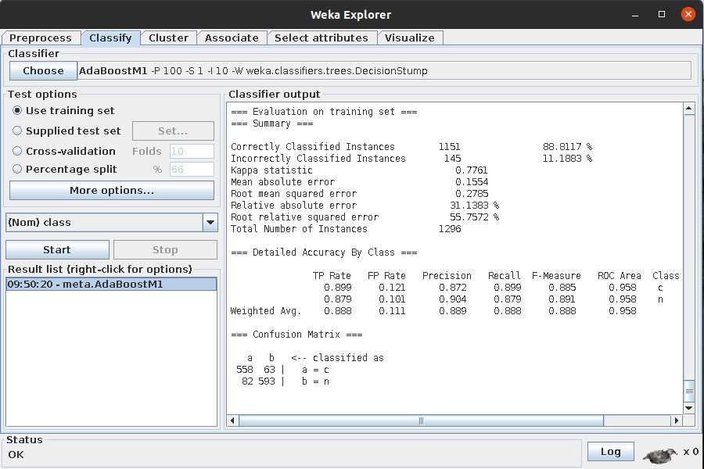
AdaBoost
The accuracy obtained through AdaBoost model is 88.9%.

Slide 31
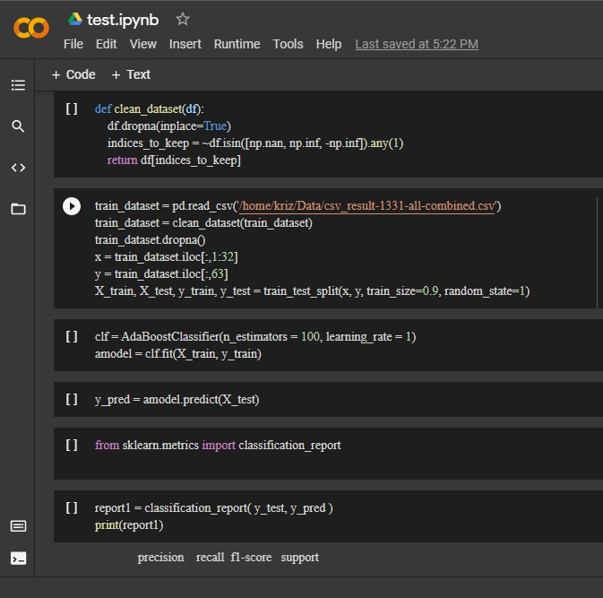
Choosing model
Though the accuracy of adaboost is less than bagging, I choose adaboost because it doesn't over-fit, and we need not think about variance.

Slide 32
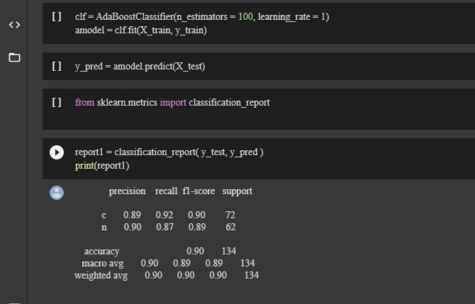
Training results

Slide 33
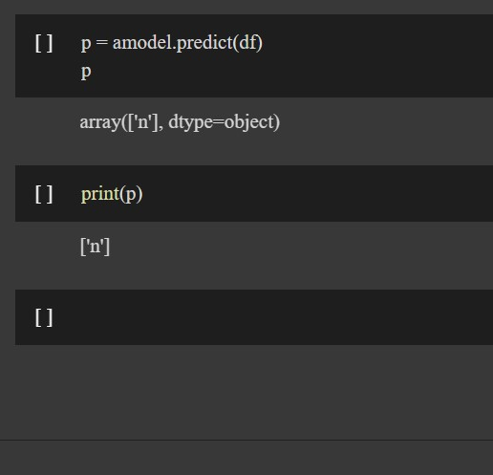
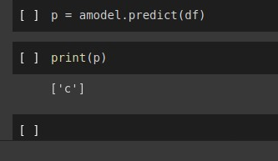
Prediction

Slide 34





My plan to complete the project
Setup Mininet environment.
Establish a custom topology.
Write a program to monitor the data traffic and QoE.
Store data and analyse the flow.
Predict if the current flow is experiencing Congestion.

Slide 35
References
Intelligent traffic management in SDN
https://www.ijert.org/research/intelligent-traffic-management-in-sdn-IJERTV6IS050410.pdf
POX controller
http://sdnhub.org/tutorials/pox/
Scapy python module
https://scapy.readthedocs.io/en/latest/introduction.html
Mininet python API
https://github.com/mininet/mininet/wiki/Introduction-to-Mininet
Pyshark python API
pyshark · PyPI

Slide 36
Thank you

