Slide 1
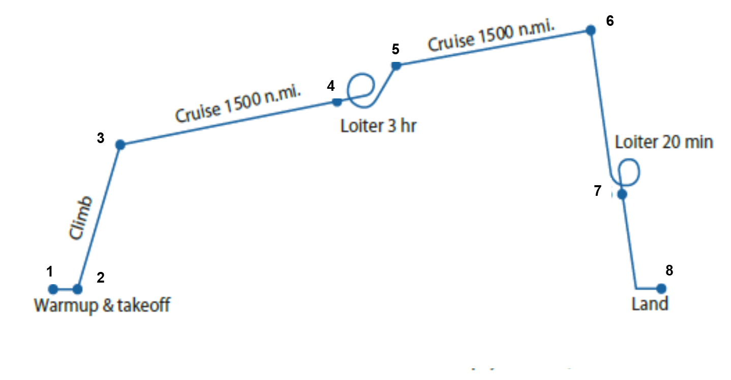
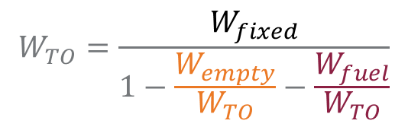

Step-by-Step Example: Notional ASW Aircraft
Mission Requirements
Loiter for three hours at 1500 nm from takeoff point, then return to base after another 20 min. loiter
Cruise Mach number: 0.6
Mission Equipment weight: 10,000 lbs.
Four-man crew totaling 800 lbs.
Mission Profile
$$W_{TO}=\frac{W_{fixed}}{1−\frac{W_{empty}}{W_{TO}}−\frac{W_{fuel}}{W_{TO}}}$$
$W_{fixed}$ is known: 10,000 lbs + 800 lbs = 10,800 lbs

Slide 2
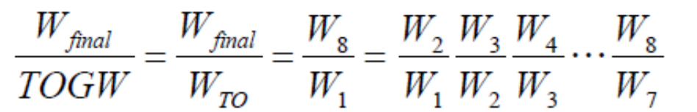

Step-by-Step Example: Fuel Fraction, $\frac{W_{fuel}}{W_{TO}}$ ,Estimation
Mission Fuel Fraction (MFF)
ASSUMPTION: weight change due to fuel consumption only

Slide 3



Fuel Fraction Estimation by Mission Segments
For Cruise (Segment 3 & 5)
Endurance (Loiter) (Segments 4 & 6)
Other mission segments, use following estimates of W_{i+1}/W_{i}
Warmup and takeoff 0.97
Climb 0.985
Descent (consider part of Cruise) 1.0
Landing 0.995
For the ASW concept
Warmup and takeoff: W₂ / W₁ = 0.97
Climb: W₃ / W₂ = 0.985
Cruise (Segment 3): W₄ / W₃ = e^{{ – R*sfc/V(L/D)}}

Slide 4
Cruise Segment
Cruise (Segment 3): W₄ / W₃ = e^{{ – R*sfc/V(L/D)}}
Given: R = 1500 nm = 9,114,000 ft
M = 0.6
Assume: Typical cruise altitude = 30,000 ft.
Estimate: Speed of sound = 994.8 ft/s
V = 596.9 ft/s
Assume: High bypass ratio turbofans for efficiency
Estimate: sfc = 0.5 lb/hr/lb = 0.000139 lb/s/lb
Assume: AR = 7 (Combined Wing and Canard)
Estimate: S_{wet}/S_{ref} =5.5
Wetted Aspect Ratio = 7/ (5.5) = 1.27
L/D_{max} = 16
Assume: Cruise L/D = 0.866 (L/D)_{max}
Estimate: L/D = 13.9
Cruise (Segment 3) fuel fraction: W₄ / W₃ = 0.8584
Cruise (Segment 5) fuel fraction:
W₆ / W₅ = e^{{ – R*sfc/V(L/D)}}
W₆ / W₅ = 0.8584

Slide 5
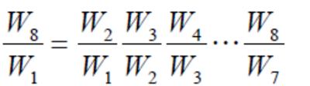
Loiter and Land Segments
Loiter (Segment 4): W₅ / W₄ = e^{{ – E*sfc/(L/D)}}
Given: E = 3 hrs = 10,800 sec
Estimate: sfc = 0.4 lb/hr/lb = 0.000111 lb/s/lb
L/D = L/D_{max} = 16
W₅ / W₄ = 0.9278
Loiter (Segment 6): W₇ / W₆ = e^{{ – E*sfc/(L/D)}}
Given: E = 20 min = 1,200 sec W₇ / W₆ = 0.9917
Landing (Segment 7): W₈ / W₇ = 0.995
Therefore W₈ / W₁ = 0.6444 from
Mission Fuel Fraction = (1 – W₈ / W₁ )
Fuel [Weight] Fraction: W_{fuel} / W_{TO} = (1 + 0.05 + 0.01) (1 – 0.6441)
= 0.3768

Slide 6

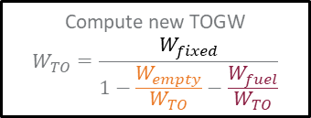
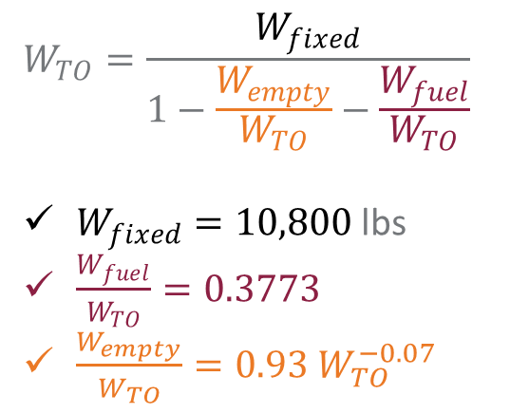



TOGW Iterations
$$W_{TO}=\frac{W_{fixed}}{1−\frac{W_{empty}}{W_{TO}}−\frac{W_{fuel}}{W_{TO}}}$$
$W_{fixed}=10,800$ lbs
$\frac{W_{fuel}}{W_{TO}}=0.3773$
$\frac{W_{empty}}{W_{TO}}=0.93 W_{TO}^{−0.07}$
Mission Profile
Aerodynamic Characteristics
Propulsive Characteristics
Initialize by guessing
Compute mission fuel: $W_{fuel}$
$$W_{TO}$$
Compute empty weight fraction: $\frac{W_{empty}}{W_{TO}}$
$$W_{fixed}$$
Stop when converged
Compute new TOGW
$$W_{TO}=\frac{W_{fixed}}{1−\frac{W_{empty}}{W_{TO}}−\frac{W_{fuel}}{W_{TO}}}$$
TOGW | W-fixed | Fuel fraction | Weight fraction | Empty weight | TOGW | Difference
50000 | 10800 | 0.3773 | 0.44 | 21803.44 | 57868
57868 | 10800 | 0.3773 | 0.43 | 24977.66 | 56524 | -1344
56524 | 10800 | 0.3773 | 0.43 | 24437.64 | 56735 | 211
56735 | 10800 | 0.3773 | 0.43 | 24522.47 | 56701 | -34
56701 | 10800 | 0.3773 | 0.43 | 24508.97 | 56707 | 5
56707 | 10800 | 0.3773 | 0.43 | 24511.12 | 56706 | -1
Is it a reasonable estimate?

Slide 7
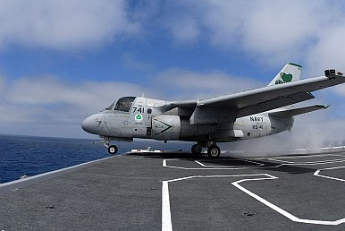
Sanity Check
W_{TO} = 52,539 lbs.
We are in the “right ballpark”

