Slide 1

Giving Computers the Ability to Learn from Data
Cost Function & Gradient Descent

Slide 2

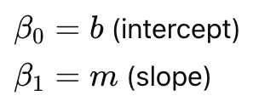

What We Know So Far?
Linear regression models a linear relationship between feature/s and target
Simple linear regression: The simplest case (one feature)
Ordinary least square: Solved directly for
Works well for one feature
But becomes unscalable with many features
We can represent data in matrix form → This leads to a generalized model for prediction

Slide 3

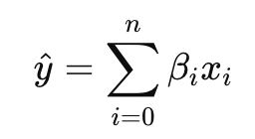



General Linear Regression Model
Prediction formula:
Each feature has a corresponding coefficient
Goal: Find the best values for
A best-fit model, minimizes the error between predictions and true values
We define error using cost (loss) function

Slide 4
Why Not using OLS?
Analytical solutions (like ordinary least squares) work for a single feature.
Expanding to multiple features makes analytical solutions quickly unscalable.
For multiple features, we shift focus to minimizing a cost function.
Gradient descent is the preferred method to minimize the cost function efficiently.

Slide 5

Residual Error & Cost Function
Residual error measures the mistake for a single data point:
It represents the difference between the true value and the model prediction
To evaluate the model as a whole, we combine all residuals
Cost function aggregates residual errors across the dataset
A loss function (Cost function or Objective function) measures how wrong the model is
It gives the model a score → lower is better
Common Loss Functions
Mean Squared Error (MSE) → Regression (continuous predictions)
Mean Absolute Error (MAE) → Regression, less sensitive to outliers
Cross-Entropy Loss → Classification problems

Slide 6
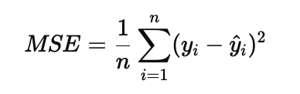

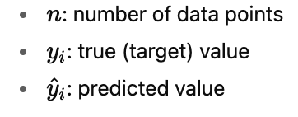
Mean Squared Error (MSE)
Measures the average of the squared differences between the predicted and the actual values.
Square: ensures all errors are positive and punishes large errors more.
Mean: averages the errors across all samples
Intuition: On average, how far are our predictions from the truth?
Notes:
💡 Why Square?
If we only took raw errors (yi−y^iy_i - \hat{y}_iyi​−y^​i​), positives and negatives cancel out.
Squaring ensures every mistake counts, and big mistakes hurt more.
The 1/2 is for mathematical convenience
When taking derivatives: The 2 cancels cleanly The term is just added for our convenience and will make it easier to derive the gradient of the loss
another nice property of this loss function is that it is convex; thus, we can use a very simple yet powerful optimization algorithm called gradient descent to find the weights that minimize our loss function to classify the examples in the Iris dataset.
Convex Loss Function
A convex function is shaped like a bowl (U-shape).
This means there is only one lowest point (the global minimum).
If you roll a ball inside the bowl, it will always settle at the bottom.
In ML, this bottom is the best weights for your model
Why Convex is Nice
No tricky “traps” (local minima) to get stuck in.
Guarantees gradient descent can find the best solution.

Slide 7
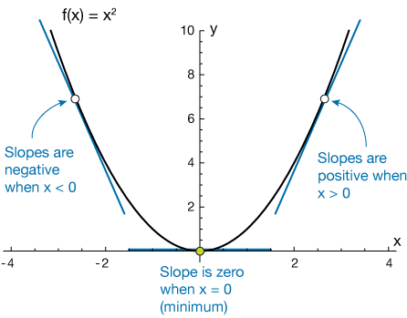
Minimizing the Cost Function
Suppose we randomly chose some values for the coefficients.
After computing the MSE, we ask:
Which coefficient should change, and by how much, to reduce the error?
From calculus:
To minimize a function → take derivatives → Set to zero
Notes:
Why does “minimize a function” mean take the derivative and set it equal to zero?
1. What the derivative tells us
The derivative of a function measures its slope
Slope answers the question: If I move slightly to the right, does the function go up or down?
2. Behavior at a minimum
At a minimum point:
The function is decreasing before the point
The function is increasing after the point
That means:
The slope transitions from negative → positive
Exactly at that point: slope=0
4. Simple visual intuition
Imagine a valley:
Walking downhill → slope is negative
Walking uphill → slope is positive
At the bottom of the valley:
You are not going up or down
Slope = 0
Convex Loss Function
A convex function is shaped like a bowl (U-shape).
This means there is only one lowest point (the global minimum).
If you roll a ball inside the bowl, it will always settle at the bottom.
In ML, this bottom is the best weights for your model
Why Convex is Nice
No tricky “traps” (local minima) to get stuck in.
Guarantees gradient descent can find the best solution.

Slide 8


What is a Derivative?
A derivative measures how fast a function changes when its input changes.
Suppose we have a function , The derivative is written as
It answers the question:
If I increase x by a tiny amount, how much will y change?
Think of driving a car.
Position tells you where you are.
Speed tells you how fast your position changes.
Similarly,
A function tells you the value.
The derivative tells you how quickly that value changes.
Geometric Meaning:
The derivative is simply the slope of the curve at a particular point.
Notes:
Why does “minimize a function” mean take the derivative and set it equal to zero?
1. What the derivative tells us
The derivative of a function measures its slope
Slope answers the question: If I move slightly to the right, does the function go up or down?
2. Behavior at a minimum
At a minimum point:
The function is decreasing before the point
The function is increasing after the point
That means:
The slope transitions from negative → positive
Exactly at that point: slope=0
4. Simple visual intuition
Imagine a valley:
Walking downhill → slope is negative
Walking uphill → slope is positive
At the bottom of the valley:
You are not going up or down
Slope = 0
Convex Loss Function
A convex function is shaped like a bowl (U-shape).
This means there is only one lowest point (the global minimum).
If you roll a ball inside the bowl, it will always settle at the bottom.
In ML, this bottom is the best weights for your model
Why Convex is Nice
No tricky “traps” (local minima) to get stuck in.
Guarantees gradient descent can find the best solution.

Slide 9

Why Do We Need Derivatives in Machine Learning?
Our goal is to minimize the loss function (for example, the MSE)
The loss depends on the model parameters.
For linear regression, , We want to know:
If I change one coefficient slightly, what happens to the MSE?
The derivative answers exactly that question.
The derivative tell us the slope of the MSE curve.
Notes:
Why does “minimize a function” mean take the derivative and set it equal to zero?
1. What the derivative tells us
The derivative of a function measures its slope
Slope answers the question: If I move slightly to the right, does the function go up or down?
2. Behavior at a minimum
At a minimum point:
The function is decreasing before the point
The function is increasing after the point
That means:
The slope transitions from negative → positive
Exactly at that point: slope=0
4. Simple visual intuition
Imagine a valley:
Walking downhill → slope is negative
Walking uphill → slope is positive
At the bottom of the valley:
You are not going up or down
Slope = 0
Convex Loss Function
A convex function is shaped like a bowl (U-shape).
This means there is only one lowest point (the global minimum).
If you roll a ball inside the bowl, it will always settle at the bottom.
In ML, this bottom is the best weights for your model
Why Convex is Nice
No tricky “traps” (local minima) to get stuck in.
Guarantees gradient descent can find the best solution.

Slide 10


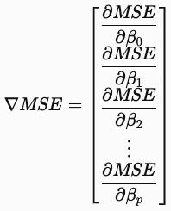
What is the Gradient?
A normal derivative is used when a function has one variable.
But machine learning models usually have many parameters.
To see how the MSE changes with respect to only one coefficient, we use a partial derivative.
For example, means "Only change β2​. Keep every other coefficient fixed."
The gradient is simply all of the partial derivatives collected into one vector.
Gradient = multi-dimensional derivative
The gradient tells us:
How the MSE changes with respect to every coefficient simultaneously.
Notes:
Why does “minimize a function” mean take the derivative and set it equal to zero?
1. What the derivative tells us
The derivative of a function measures its slope
Slope answers the question: If I move slightly to the right, does the function go up or down?
2. Behavior at a minimum
At a minimum point:
The function is decreasing before the point
The function is increasing after the point
That means:
The slope transitions from negative → positive
Exactly at that point: slope=0
4. Simple visual intuition
Imagine a valley:
Walking downhill → slope is negative
Walking uphill → slope is positive
At the bottom of the valley:
You are not going up or down
Slope = 0
Convex Loss Function
A convex function is shaped like a bowl (U-shape).
This means there is only one lowest point (the global minimum).
If you roll a ball inside the bowl, it will always settle at the bottom.
In ML, this bottom is the best weights for your model
Why Convex is Nice
No tricky “traps” (local minima) to get stuck in.
Guarantees gradient descent can find the best solution.

Slide 11
Connecting It to Machine Learning
The MSE is a function of the coefficients:
The derivative (or partial derivative) tells us
"How will the MSE change if I adjust one coefficient?"
The gradient tells us
"How will the MSE change if I adjust all coefficients?"
For multiple coefficients:
Gradient become complex & solving it hard
Closed-form solutions are impractical
Instead, we use a computational approach; Gradient Descent
Finally, Gradient Descent uses these information to update the coefficients:
Notes:
Why does “minimize a function” mean take the derivative and set it equal to zero?
1. What the derivative tells us
The derivative of a function measures its slope
Slope answers the question: If I move slightly to the right, does the function go up or down?
2. Behavior at a minimum
At a minimum point:
The function is decreasing before the point
The function is increasing after the point
That means:
The slope transitions from negative → positive
Exactly at that point: slope=0
4. Simple visual intuition
Imagine a valley:
Walking downhill → slope is negative
Walking uphill → slope is positive
At the bottom of the valley:
You are not going up or down
Slope = 0
Convex Loss Function
A convex function is shaped like a bowl (U-shape).
This means there is only one lowest point (the global minimum).
If you roll a ball inside the bowl, it will always settle at the bottom.
In ML, this bottom is the best weights for your model
Why Convex is Nice
No tricky “traps” (local minima) to get stuck in.
Guarantees gradient descent can find the best solution.

Slide 12
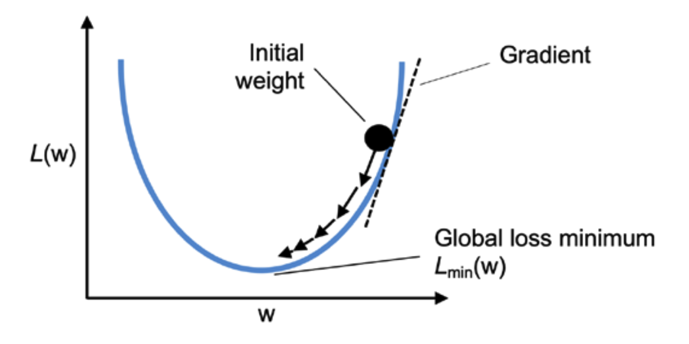
Gradient Descent
A method to find the minimum of a function (like our loss function).
An iterative optimization algorithm, move towards the minimum of the cost function
Think of it as going downhill to reach the lowest point.
Intuitive Analogy
Imagine standing on a hilly landscape in the fog.
Your goal: reach the bottom of the valley.
You can’t see far, but you can feel the slope.
Strategy:
Step downhill,
Recalculate slope,
Repeat until ground is flat
Notes:
Why We Do It
The loss function tells us “how wrong we are.”
Gradient descent gives us a systematic way to adjust weights so the model improves over time.
Without minimizing loss, the model would just guess randomly and never learn.
"We don’t see the square in the code because we’re not directly minimizing the error — we’re minimizing its square. When you take the derivative, the square cancels one power out, leaving just the error term in the update rule."

Slide 13


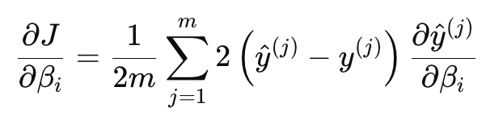

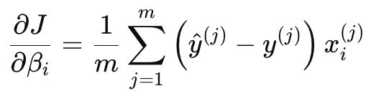

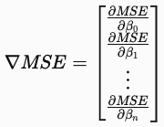
Gradient Descent
Recall
Compute Gradient: Take derivatives w.r.t coeffs:
Substitute back
We do that for each
Then collect all partial derivatives into one object
Notes:
yi​ is constant w.r.t w, so derivative = 0
−(w⋅xi​+b) derivative w.r.t w = −xi​

Slide 14
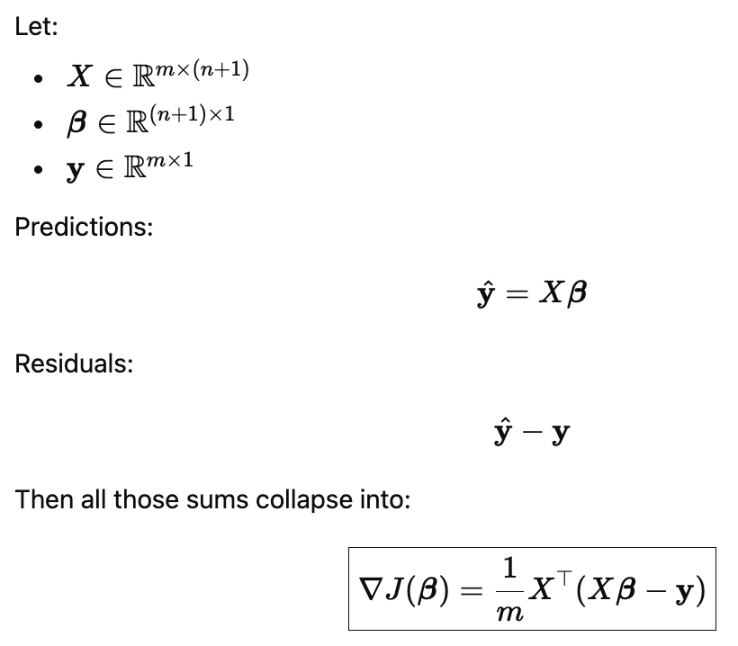
The Matrix Form of Gradient Descent
Notes:
yi​ is constant w.r.t w, so derivative = 0
−(w⋅xi​+b) derivative w.r.t w = −xi​

Slide 15
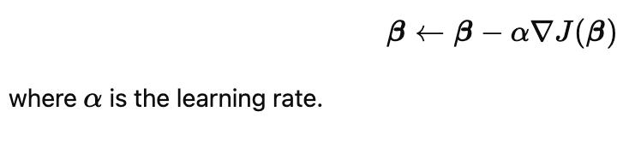
Interpretation & Update Rule
Gradient = multi-dimensional derivative
Each partial derivative tells us how one coefficient affects error
The gradient combines all and tells us how to move all coefficients at once to reduce the cost.
That direction is the steepest increase
Gradient descent moves in the negative gradient direction
Gradient descent updates parameters using:
Notes:
Why We Do It
The loss function tells us “how wrong we are.”
Gradient descent gives us a systematic way to adjust weights so the model improves over time.
Without minimizing loss, the model would just guess randomly and never learn.
"We don’t see the square in the code because we’re not directly minimizing the error — we’re minimizing its square. When you take the derivative, the square cancels one power out, leaving just the error term in the update rule."

Slide 16
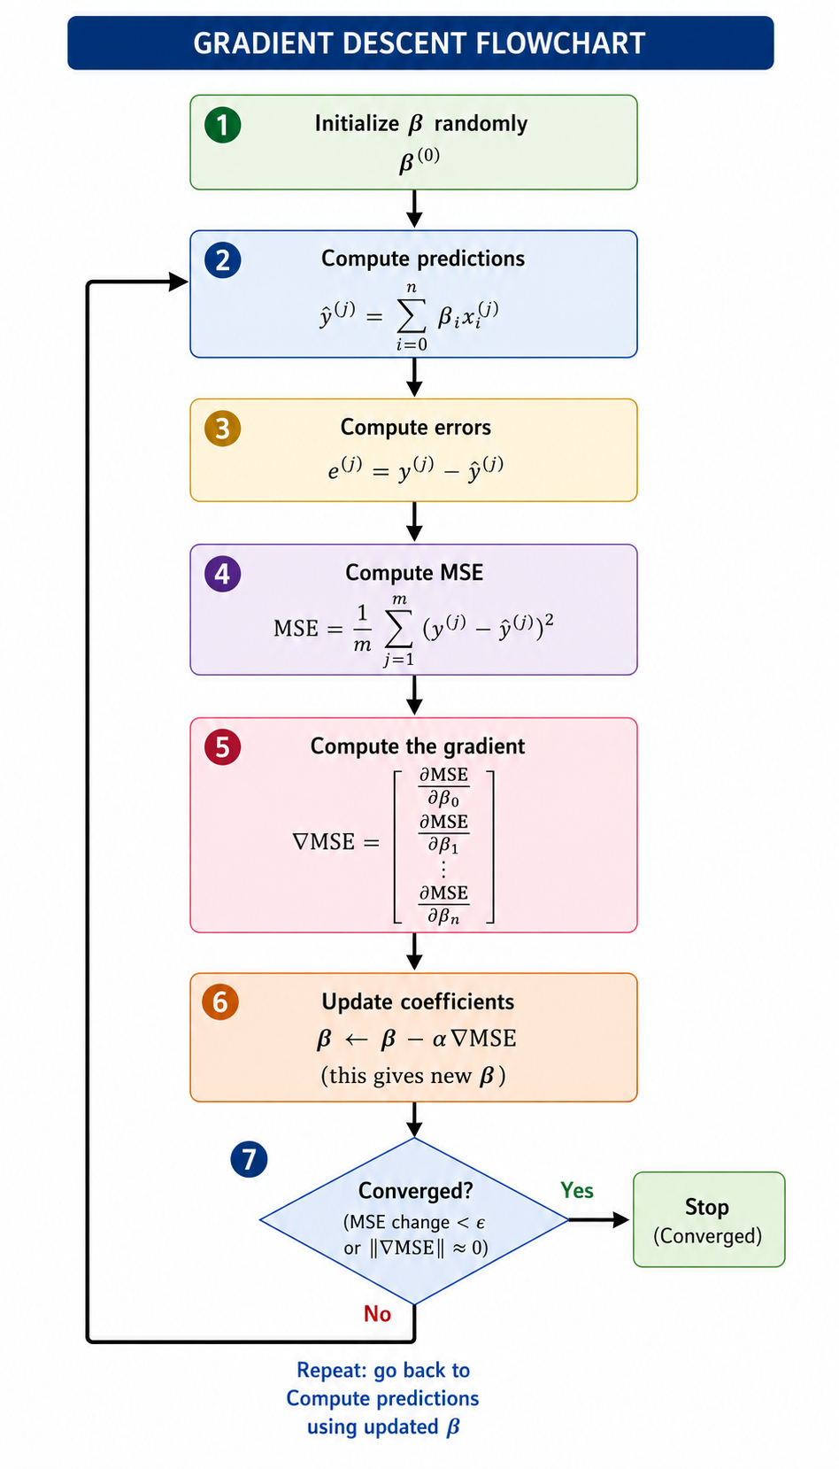
Gradient Descent Flowchart
Notes:
Why We Do It
The loss function tells us “how wrong we are.”
Gradient descent gives us a systematic way to adjust weights so the model improves over time.
Without minimizing loss, the model would just guess randomly and never learn.
"We don’t see the square in the code because we’re not directly minimizing the error — we’re minimizing its square. When you take the derivative, the square cancels one power out, leaving just the error term in the update rule."

Slide 17
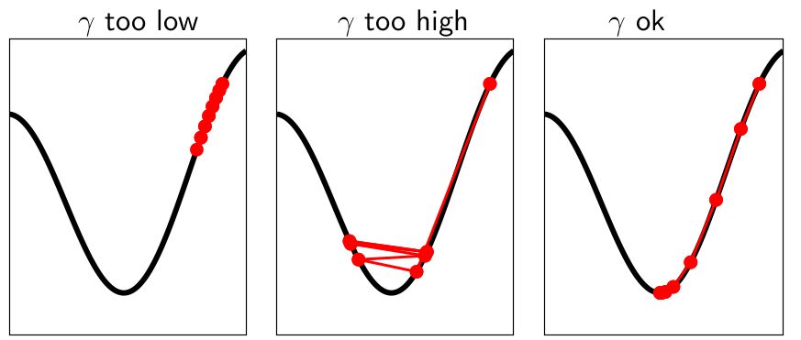

Choosing Learning Rate
Learning Rate Controls Step Size
Too small:
Updates are tiny → convergence is very slow
Might take forever to reach minimum
Too large:
Updates overshoot minimum → divergence
Loss may oscillate or explode
J(β)
β
β
β

Slide 18
Implementing Gradient Descent in Python

