Slide 1
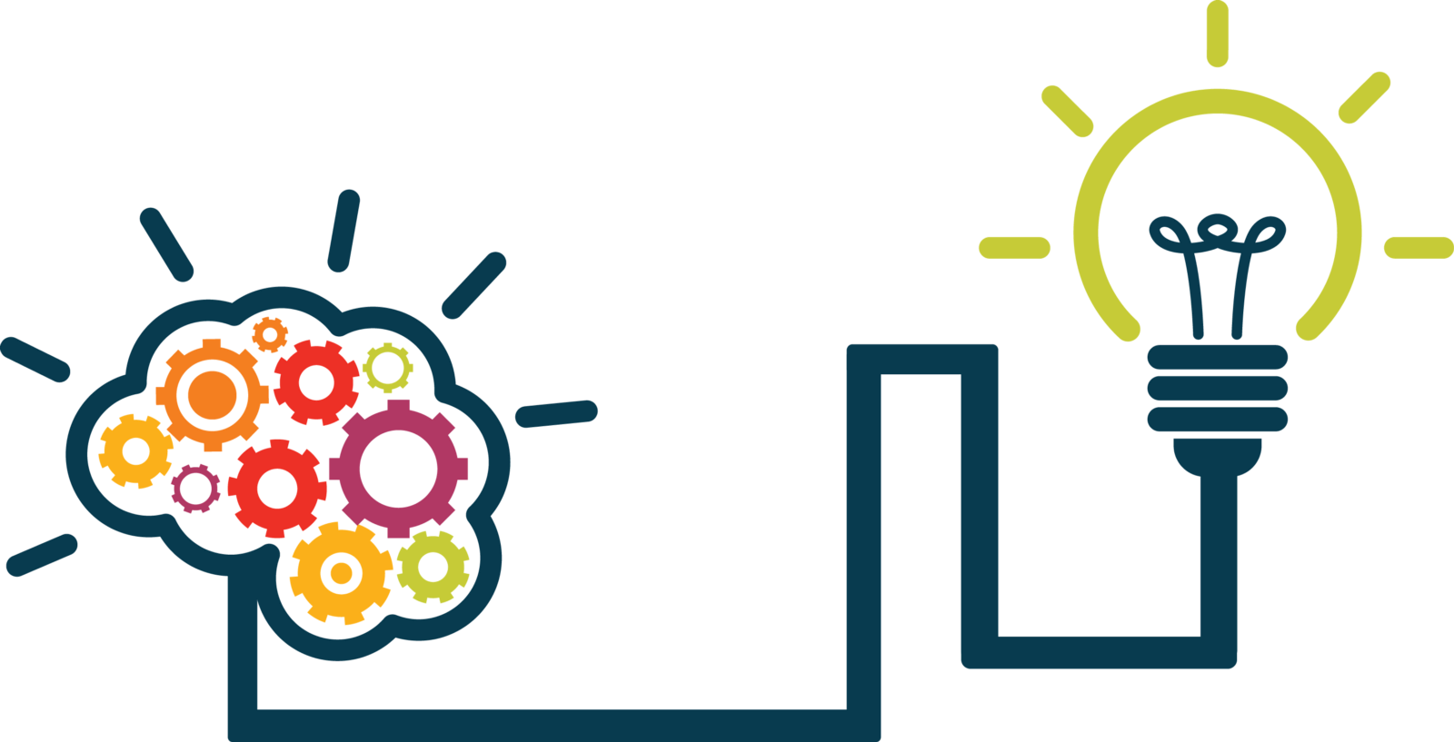
Giving Computers the Ability to Learn from Data
Concept & Pathway

Slide 2
A Refresher
Computer Science is about studying how to use Algorithms to solve problems
Algorithms: Sequences of instruction that does a task and leads to a solution.
Program: Algorithms expressed in a language the computer can understand.
Artificial Intelligence:
Capability of computer systems to perform tasks typically associated with human intelligence
Programming is Thinking, not Typing.
AI vs Programming:
While traditional programmes follow fixed instructions,
AI has the ability to learn, adapt, and make decisions based on the data it processes

Slide 3
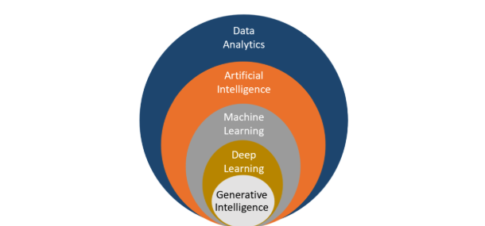
How it all fits together!
Uses various techniques, including machine learning & deep learning, to create systems that mimic human-like intelligence, reasoning, & problem-solving.
The process of examining, cleaning, transforming, and interpreting data to discover useful insights and support decision-making.
Focuses on neural networks with many layers. It excels at tasks involving unstructured data like images, audio, and natural language.
Involves the use of algorithms to enable computers to learn from data and make predictions or decisions.
Focuses on creating systems capable of generating new and creative content, such as text, images, or music, in a human-like manner.

Slide 4
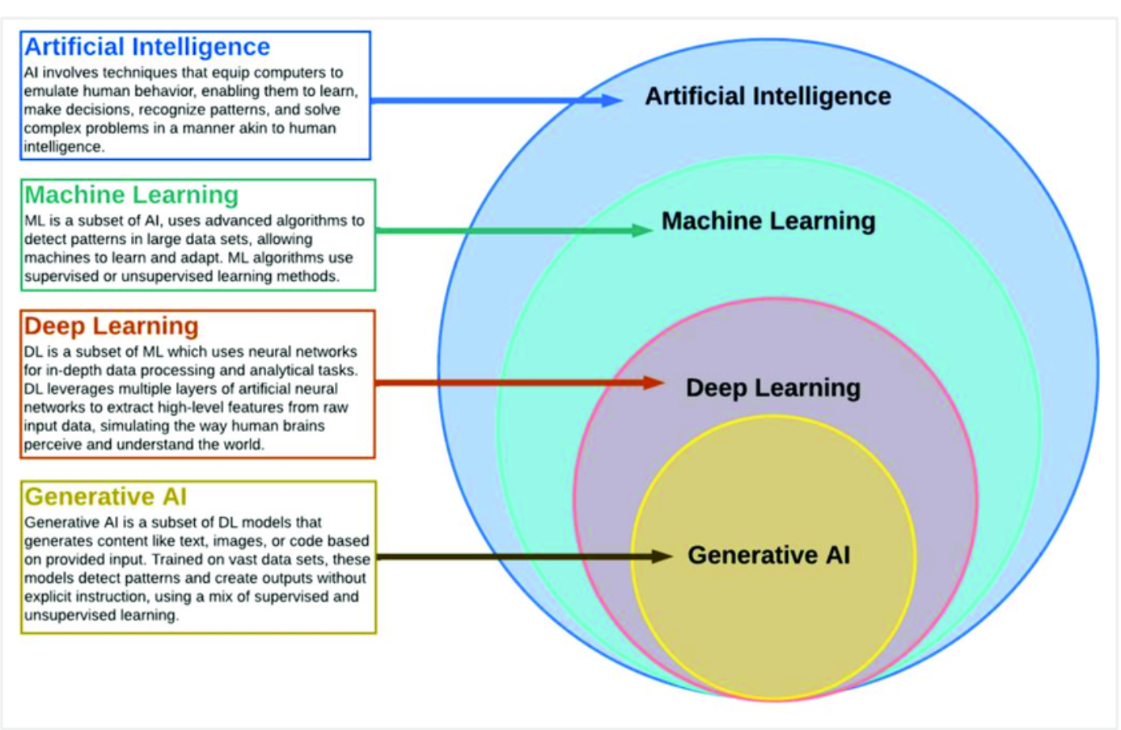
AI, ML, Deep Learning, & Generative AI: How They Relate

Slide 5
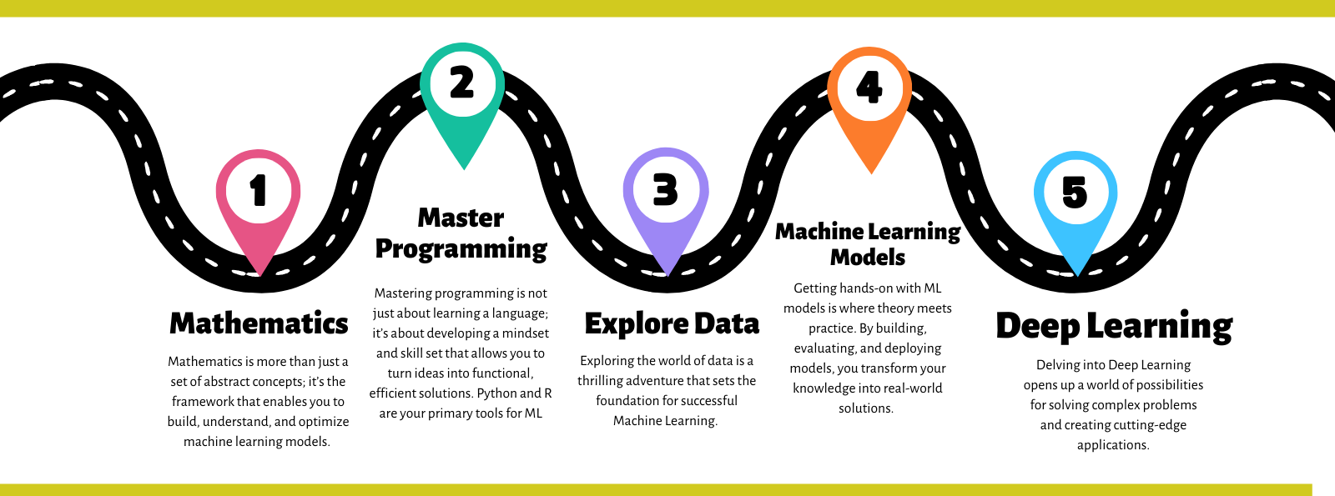
AI Pathway

Slide 6








ML Pathway
Machine Learning
(ML Scientist/ML Engineer/Data Scientist)
Data Engineering
(Data Engineer)
Data Analysis
(Data Analyst/ Data Scientist)
Real World Problem
Raw Data:
Sensors,
Simulations,
Experiments,
Surveys,
Web,
etc.
Process & Store Data:
SQL DBs,
Excel,
CSV Files,
etc.
Clean & Organize Data:
Recognize Data, Restructure Data, Dealing with Missing Data
etc.
Exploratory Data Analysis:
Statistical Analysis, Visualization,
etc.
ML Models:
Predict an Outcome,
Discover Patterns in Data
etc.
Reports,
Visualization,
Mobile Apps,
Websites,
etc …

Slide 7
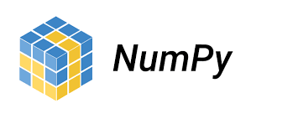


Python Data Science/Data Analytics Libraries
Numpy: It is a Python library used for working with arrays
Pandas: A Python library used for working with data sets
Matplotlib: A plotting library for Python programming

Slide 8
Question?

Slide 9
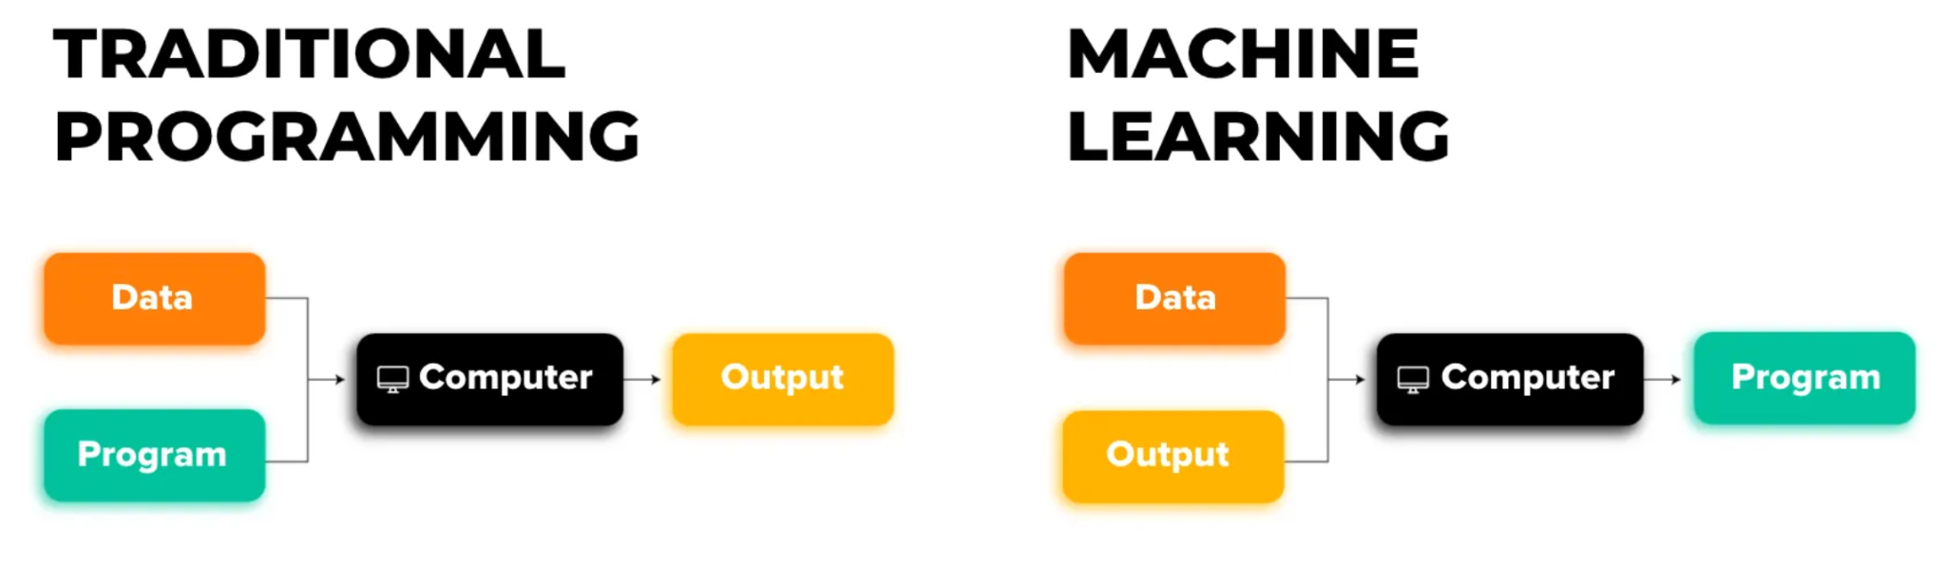
What is Machine Learning?
Computers learning from data
Algorithms improve with experience
Not explicitly programmed with rules

Slide 10
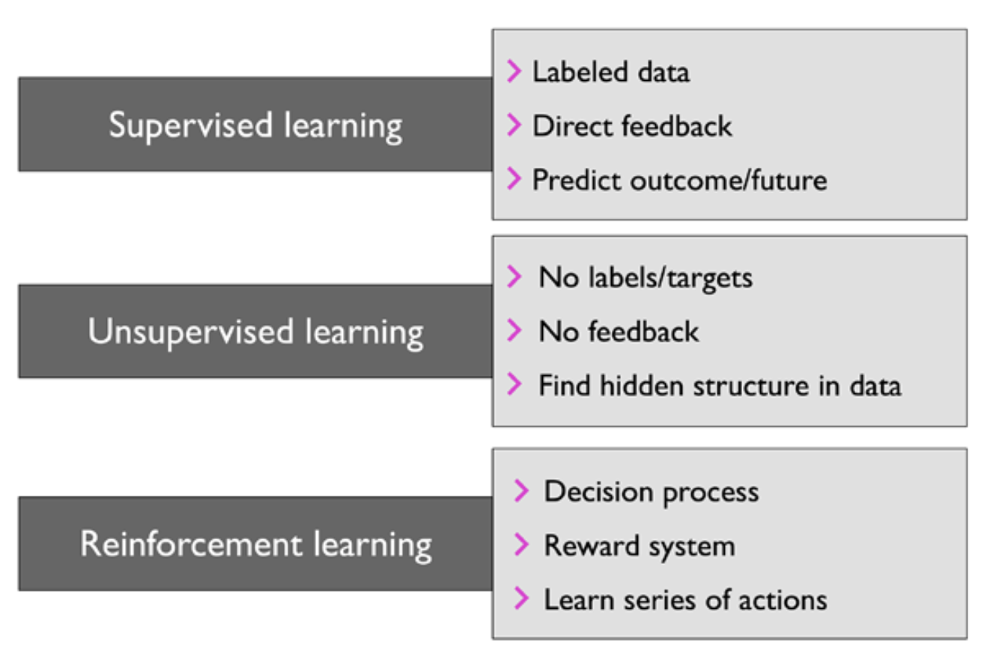
Types of Machine Learning

Slide 11
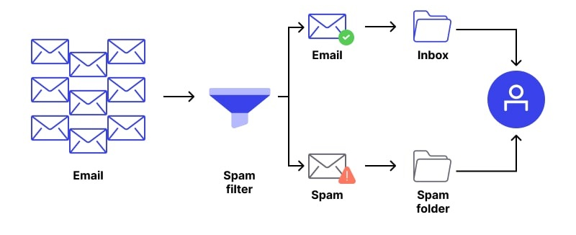
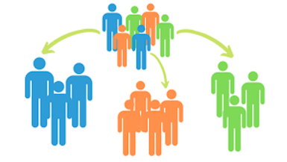
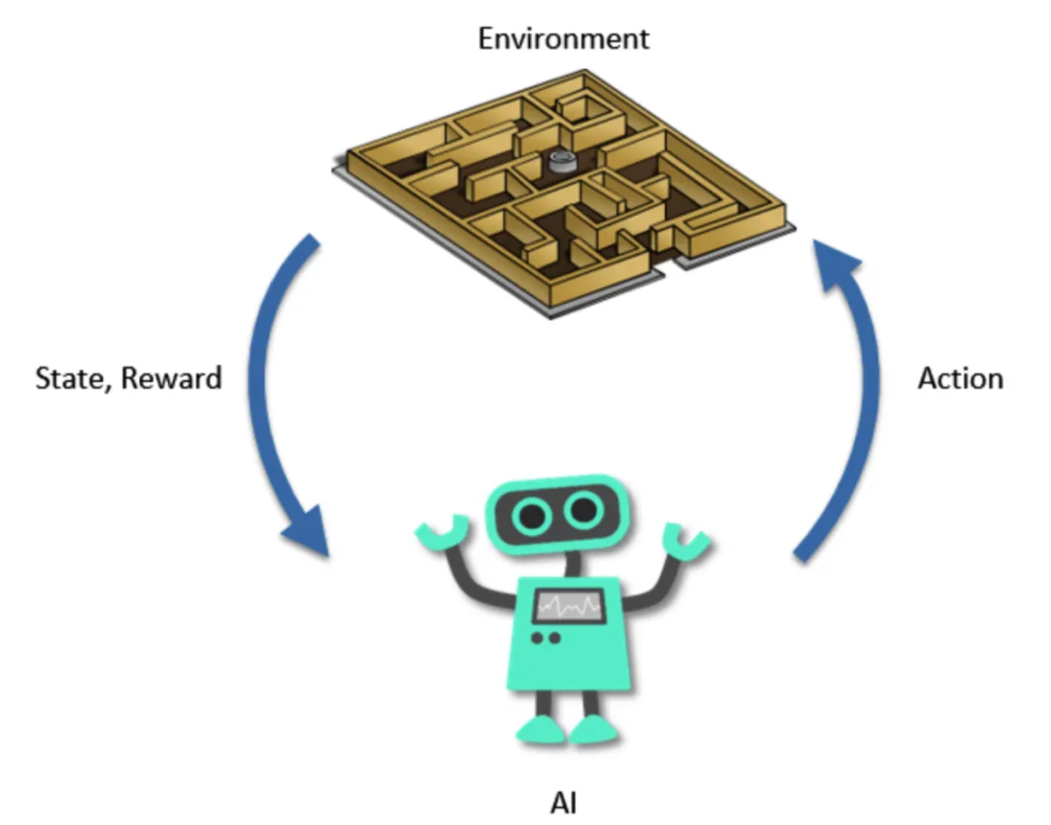
Types of Machine Learning Example
Supervised Learning:
Classification (spam or not spam)
Regression (predicting house prices)
Unsupervised Learning:
Clustering (grouping customers by shopping habits)
Dimensionality reduction (data compression)
Reinforcement Learning
Game playing, self-driving cars

Slide 12
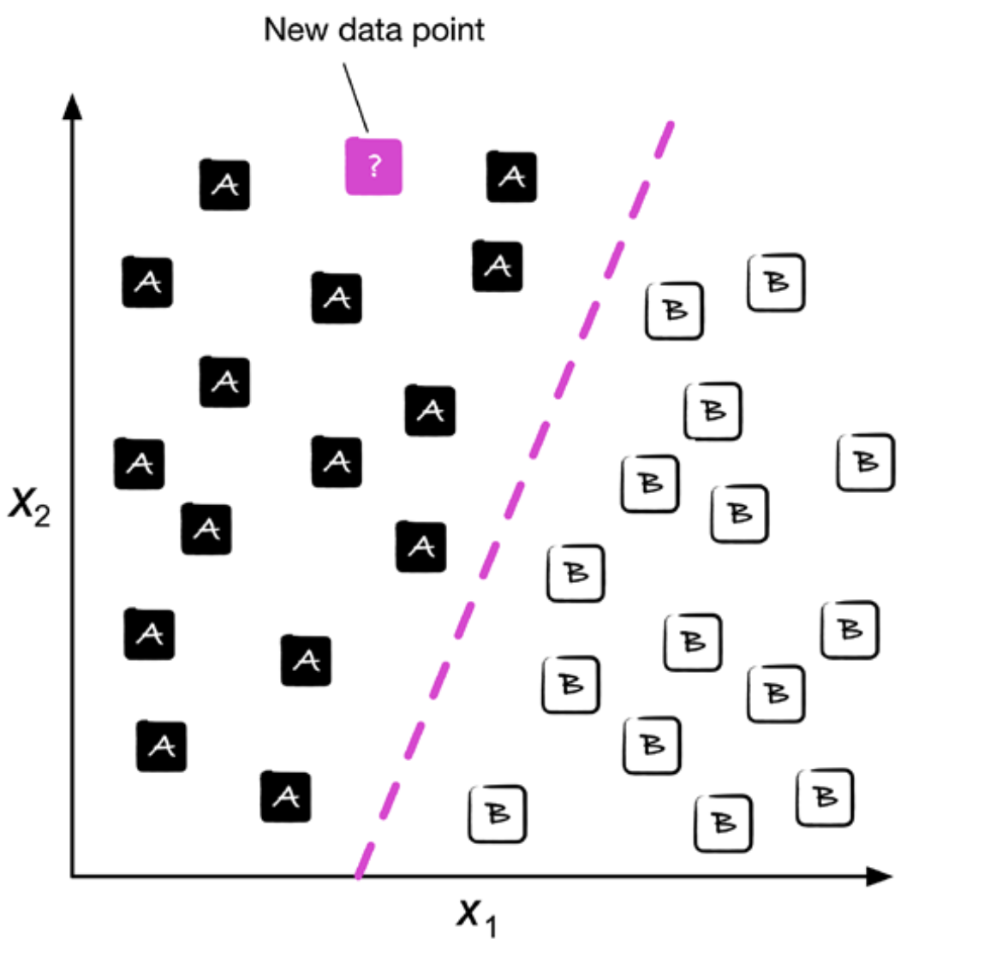
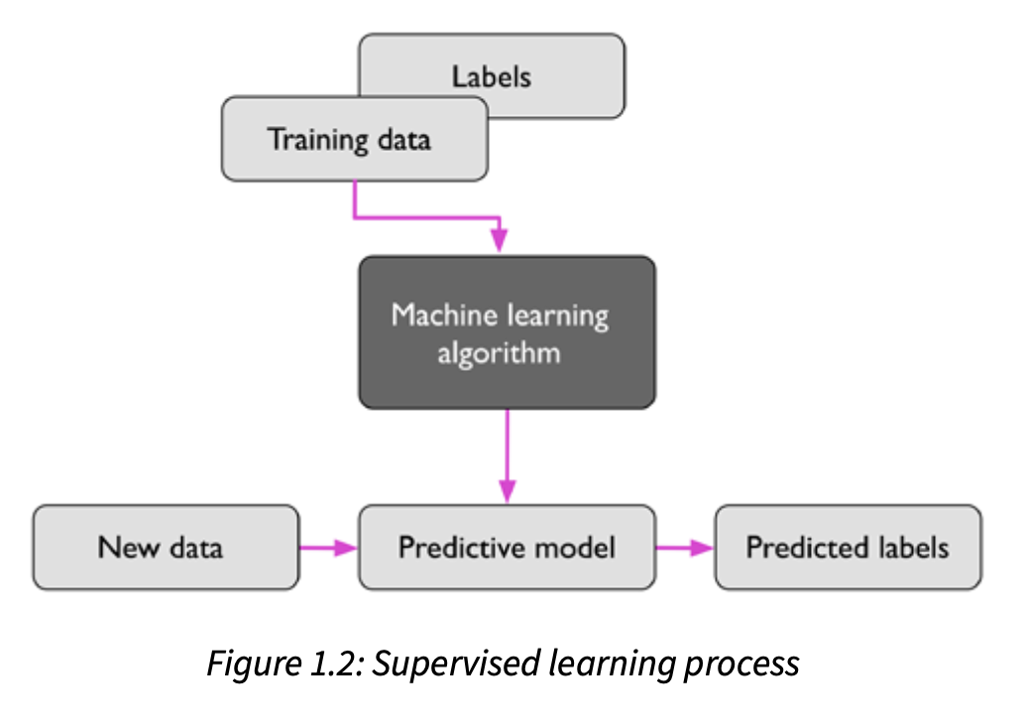
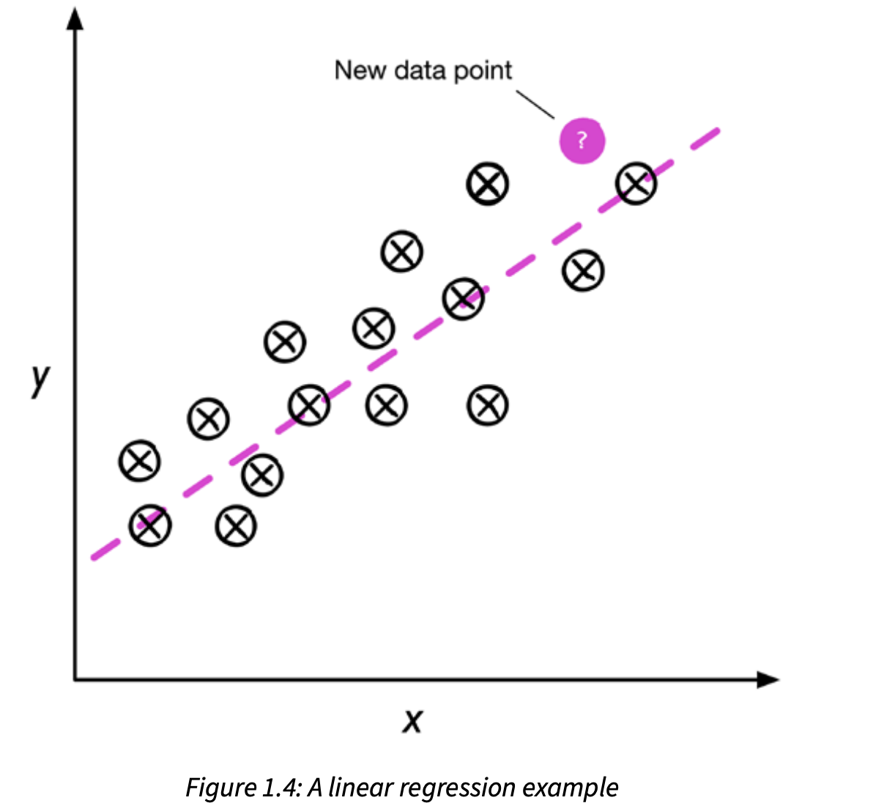
Supervised Learning
Process of modeling the relationship between the input data & labels to make predictions about unseen or future data.
Classification: Supervised learning task with discrete class
Regression: Supervised learning task where outcome is a continuous value

Slide 13
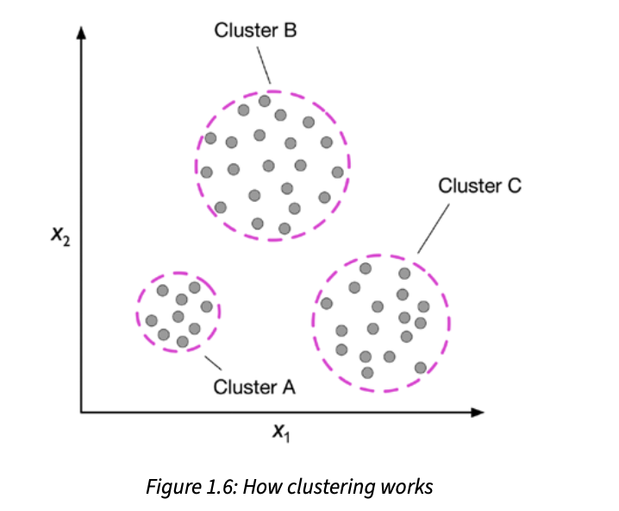
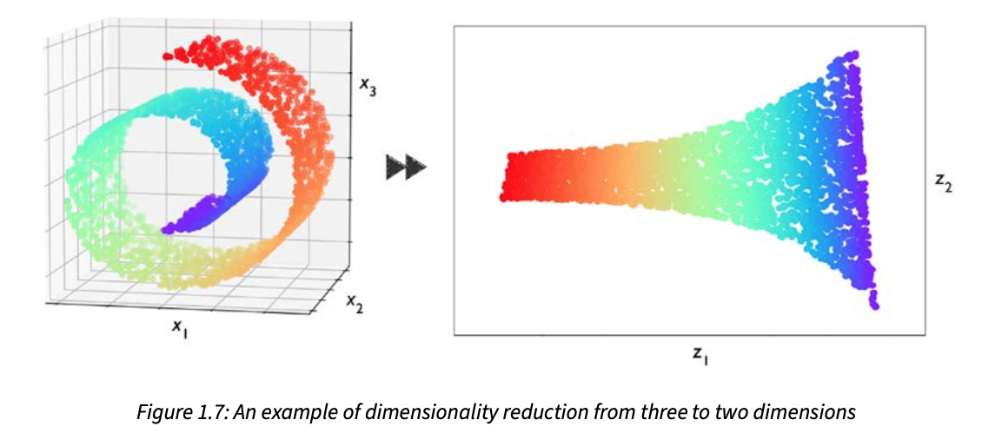
Unsupervised Learning
Deals with unlabeled data, aims to explore the structure of data to extract meaningful information without the guidance of a known outcome.
Clustering: Organize data into meaningful subgroups without having any prior knowledge of their group
Dimensionality reduction: Compresses data into smaller dimension while retaining most of relevant information

Slide 14
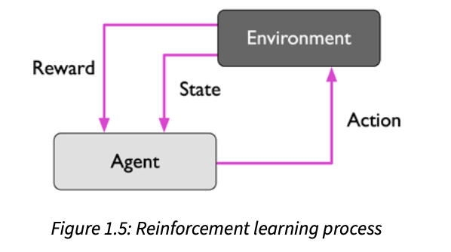
Reinforcement Learning
The goal is to develop a system (agent) that improves its performance based on interactions with the environment.
Action: Interaction with the environment
Reward/Feedback: Measure of how well the action was

Slide 15
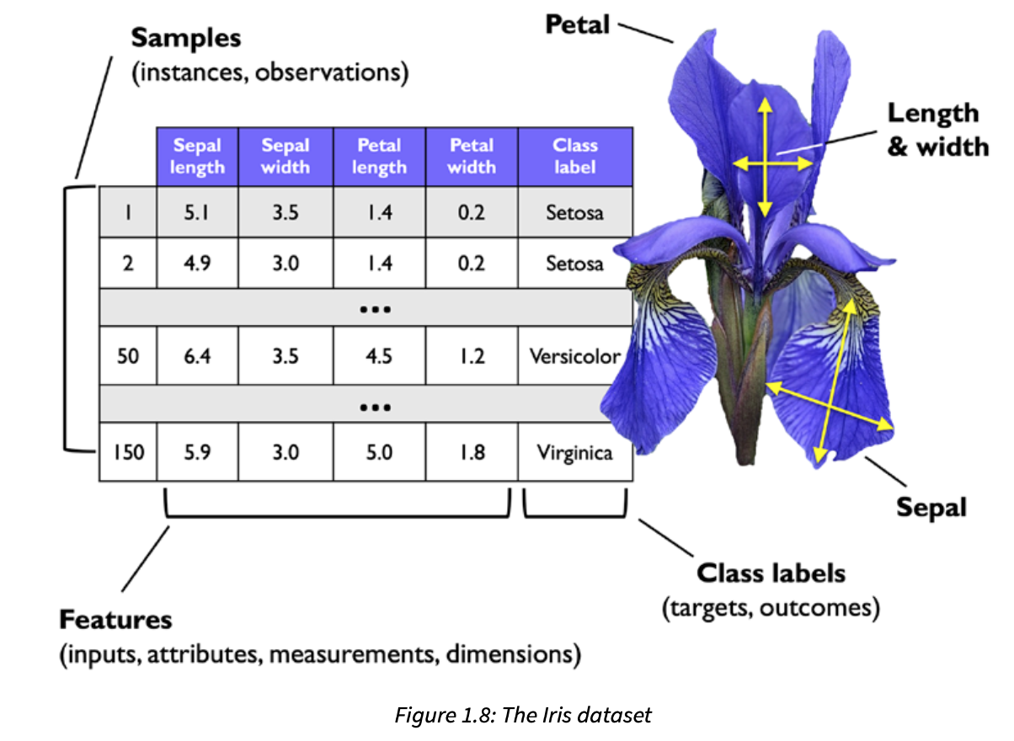
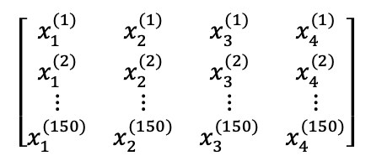
Example of Tabular Data
Sample (Instance, Observation):
Each row in the dataset, which is an example of data
Feature (Measurement, Attributes, Variable, Predictor ):
Each column of the dataset which describe an example
Label (Target, Outcome, Class, Dependent variable):
Target variable that model is trained to predict
Matrix notation
of data:

Slide 16
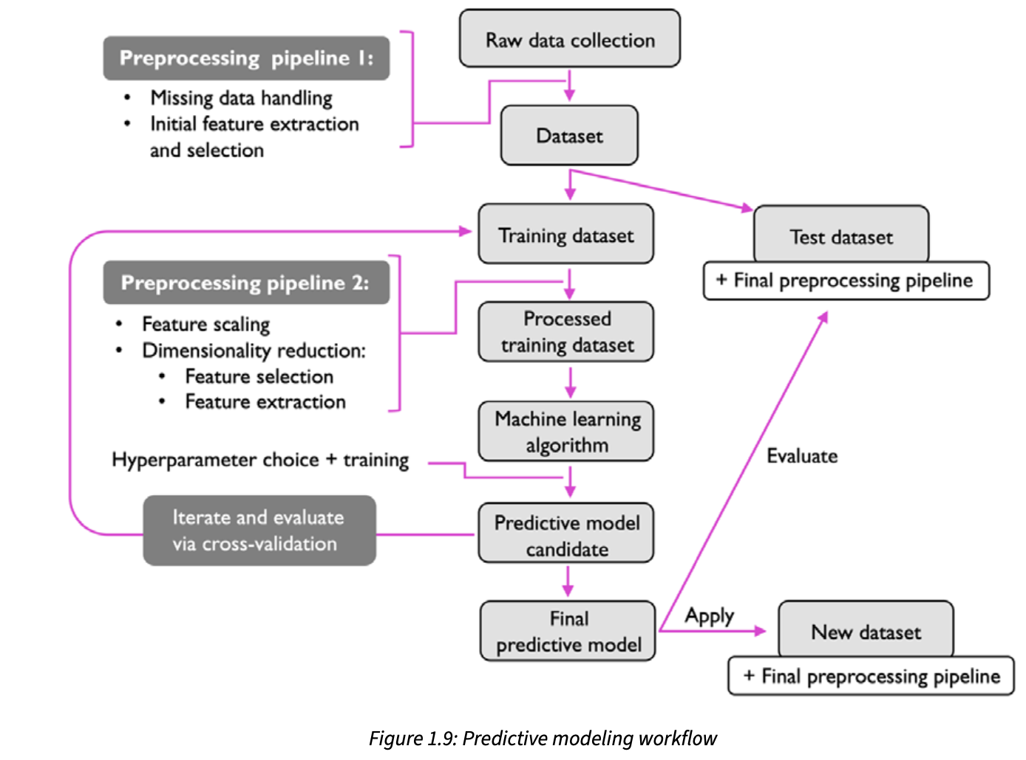
Roadmap for Building ML System
Preprocessing – clean and prepare data.
Training – selecting a model & fit it to data
Evaluation – test how well it works
Prediction – use model for future cases

