Slide 1
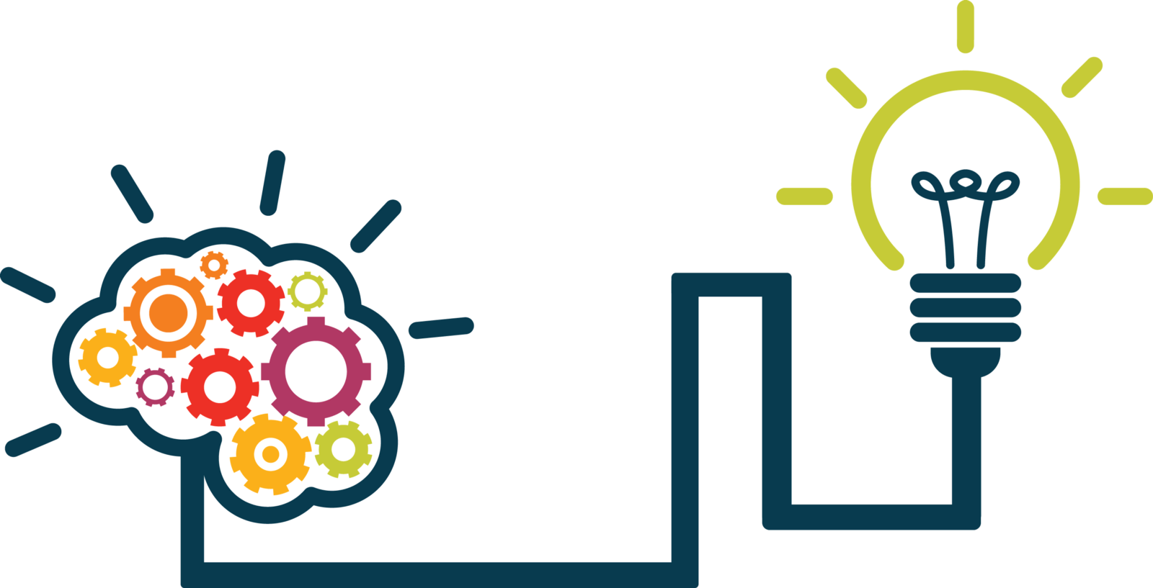
Giving Computers the Ability to Learn from Data
Concept & Pathway

Slide 2
A Refresher
Computer Science is about studying how to use Algorithms to solve problems
Algorithms: Sequences of instruction that does a task and leads to a solution.
Program: Algorithms expressed in a language the computer can understand.
Artificial Intelligence:
Capability of computer systems to perform tasks typically associated with human intelligence
Programming is Thinking, not Typing.
AI vs Programming:
While traditional programmes follow fixed instructions,
AI has the ability to learn, adapt, and make decisions based on the data it processes

Slide 3
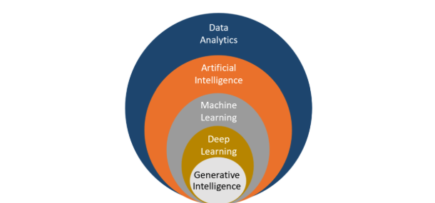
How it all fits together!
Uses various techniques, including machine learning & deep learning, to create systems that mimic human-like intelligence, reasoning, & problem-solving.
The process of examining, cleaning, transforming, and interpreting data to discover useful insights and support decision-making.
Focuses on neural networks with many layers. It excels at tasks involving unstructured data like images, audio, and natural language.
Involves the use of algorithms to enable computers to learn from data and make predictions or decisions.
Focuses on creating systems capable of generating new and creative content, such as text, images, or music, in a human-like manner.

Slide 4
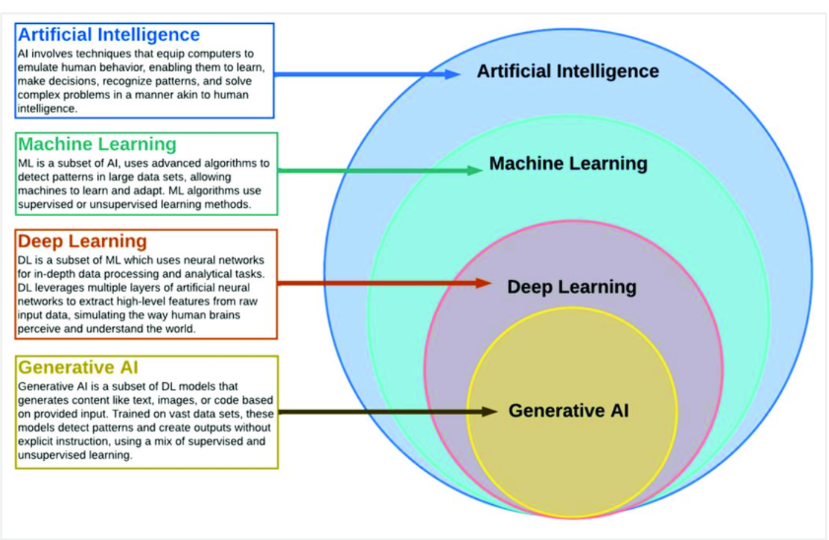
AI, ML, Deep Learning, & Generative AI: How They Relate

Slide 5
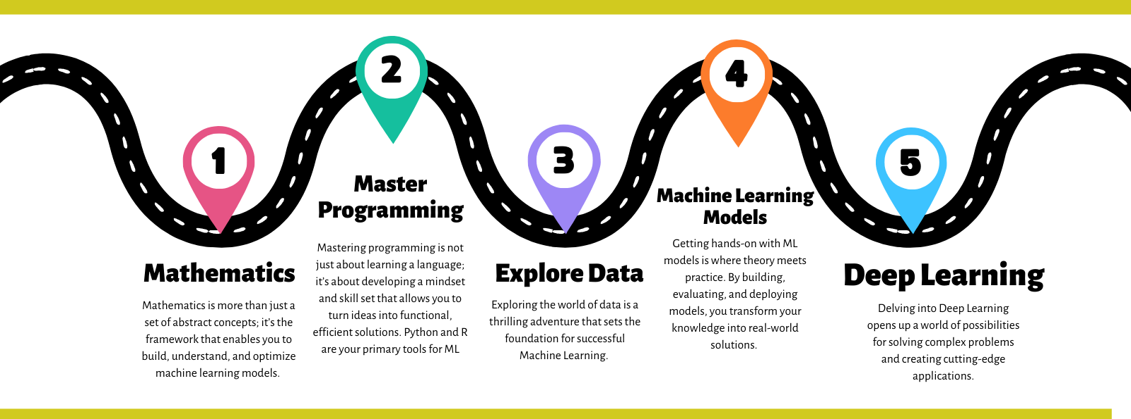
AI Pathway

Slide 6



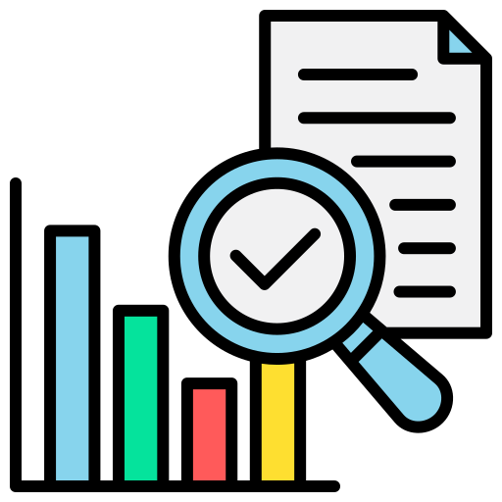

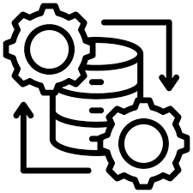

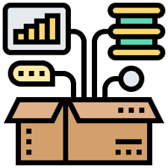
ML Pathway
Machine Learning
(ML Scientist/ML Engineer/Data Scientist)
Data Engineering
(Data Engineer)
Data Analysis
(Data Analyst/ Data Scientist)
Real World Problem
Raw Data:
Sensors,
Simulations,
Experiments,
Surveys,
Web,
etc.
Process & Store Data:
SQL DBs,
Excel,
CSV Files,
etc.
Clean & Organize Data:
Recognize Data, Restructure Data, Dealing with Missing Data
etc.
Exploratory Data Analysis:
Statistical Analysis, Visualization,
etc.
ML Models:
Predict an Outcome,
Discover Patterns in Data
etc.
Reports,
Visualization,
Mobile Apps,
Websites,
etc …

Slide 7
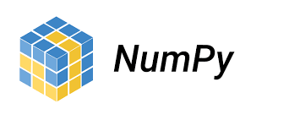


Python Data Science/Data Analytics Libraries
Numpy: It is a Python library used for working with arrays
Pandas: A Python library used for working with data sets
Matplotlib: A plotting library for Python programming

Slide 8
Question?

