Slide 1
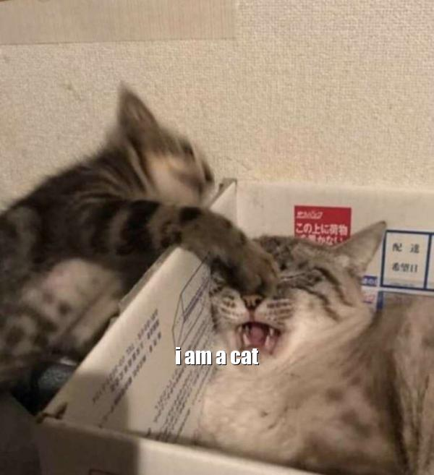

Slide 2

Nothing to see here…

Slide 3

Ok, look inside me

