Slide 1
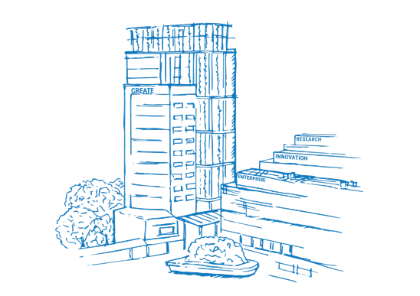
Agentic AI Workshop
Week 2 — From LLMs to Agents: why language models work, and the ladder that turns one into an agent.
Dr. Kerem Delikoyun · TUMCREATE · 3 June 2026

Slide 2
RECAP · 5 MIN
Where we left off
Last week: a brief history of computers and human-machine interaction, AI coding agents and Organon for scientific discovery and workflows
Today we’ll look under the hood….
03/06/2026
kerem.delikoyun@tum-create.edu.sg | Agentic AI Workshop W2
2

Slide 3
Week 1 recap, in one slide
What Week 1 covered
Where Week 2 goes
▪ Foundations — two long paths (a 200-yr abstraction staircase + an 80-yr AI road) converge at natural language
▪ Claude Code — the CLI-native coding agent + its primitives: CLAUDE.md, tools, skills, sub-agents, MCP, hooks
▪ Organon — an agentic OS for scientists; memory, identity & skills as files on disk
▪ The equation: agent = LLM + primitives (memory, identity, tools, learnings)
1. Open the box — why and how LLMs work
2. Climb the ladder — bare model -> tools -> reasoning
3. Pick up a framework — LangChain
4. Give it memory — RAG
Five Colab notebooks back every idea on the right. You'll run them as we go.
03/06/2026
kerem.delikoyun@tum-create.edu.sg | Agentic AI Workshop W2
3

Slide 4

PART 1 · WHY AND HOW LLMS WORK
Opening the Pandora’s box
What a language model actually is — so it’s not “magic” and "agent" isn’t the rabbit inside the hat.
03/06/2026
kerem.delikoyun@tum-create.edu.sg | Agentic AI Workshop W2
4

Slide 5
The unlock: one architecture, three exponentials
For long years, modeling the human language was hand-built rules and narrow methodologies. Three things changed at once:
THE BITTER LESSON
General methods that scale with compute beat clever hand-crafted ones. The Transformer was the first language architecture that kept getting better the more data and compute you fed it — no plateau in sight.
▪ Architecture — the Transformer (2017): attention replaces recurrence, so training parallelizes across a whole sequence
▪ Scale — parameters from millions -> hundreds of billions
▪ Data + compute — train on GW scale datacenters with entire web and proprietary dataset
"Attention Is All You Need", Vaswani et al. 2017 — one of the five papers in today's RAG corpus.
03/06/2026
kerem.delikoyun@tum-create.edu.sg | Agentic AI Workshop W2
5

Slide 6
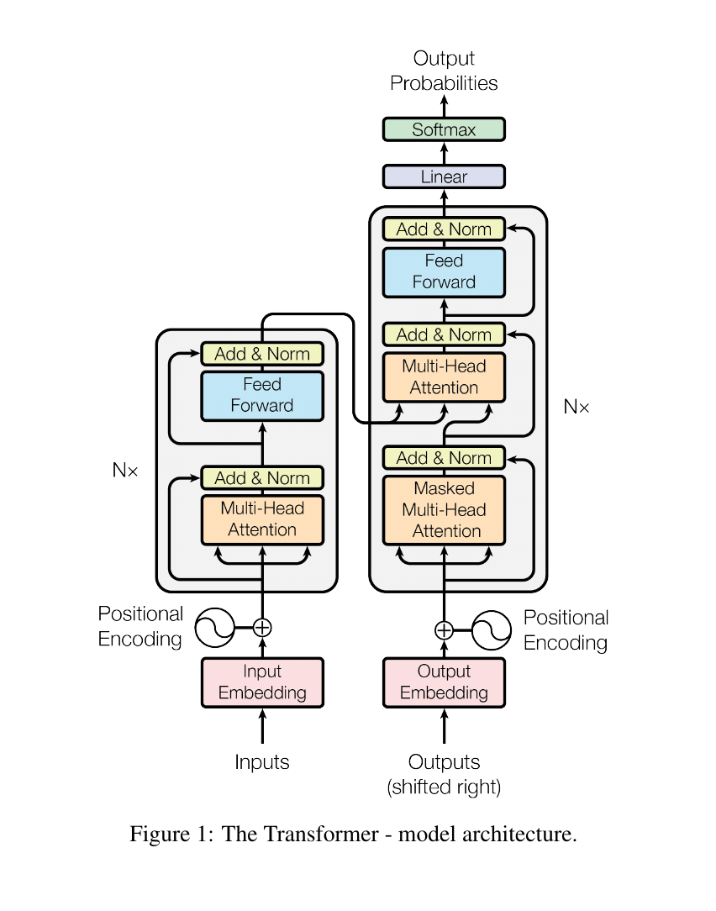
Under the hood: the Transformer (2017)
Every modern LLM is built from this architecture. Two stacks of identical blocks; each block is just three ideas:
▪ Multi-Head Attention — every token weighs what's relevant in all the others (the engine from the last slide)
▪ Feed-Forward — a small per-token network on top
▪ Add & Norm — residuals + normalisation that keep deep stacks trainable
Add embeddings + positional encoding and stack it N×.
Most of LLMs are decoder-based stacks (auto-regressive).
WHY IT MATTERED
No recurrence: the whole sequence is processed in parallel — what made web-scale training possible, and the T in Generative Pre-trained Transformer.
Figure 1, "Attention Is All You Need", Vaswani et al. 2017 — paper #2 in today's RAG corpus.
03/06/2026
kerem.delikoyun@tum-create.edu.sg | Agentic AI Workshop W2
6

Slide 7
One dumb objective: predict the next token
The capital of France is ____
Why this is enough.
P(next token)
To predict the next token well across all of human text, the model is forced to learn grammar, facts, translation, arithmetic, code, and a little reasoning.
“ Paris”
0.91
“ a”
0.02
“ home”
0.01
COMPRESSION ≈ UNDERSTANDING
Predicting well means modelling the structure that generated the text. Squeezing the web into weights forces useful abstractions to fall out.
Train on trillions of tokens with a single self-supervised target: guess the next token. No labels, no human annotation: just learn the pattern in the text.
03/06/2026
kerem.delikoyun@tum-create.edu.sg | Agentic AI Workshop W2
7

Slide 8
How text becomes math: tokens -> embeddings
Tokenisation — text is split into sub-word tokens.
Meaning becomes geometry: tokens with similar meaning sit close together.
"agentic" -> ["agent", "ic"]
"RAG" -> ["R", "AG"]
king - man + woman ~ queen
Paris - France + Japan ~ Tokyo
Embedding — each token maps to a vector in a high-dimensional space (hundreds–thousands of dims).
WHY IT MATTERS TODAY
The same embedding idea powers RAG retrieval in Notebook 03 — we embed text chunks and find the nearest ones to a question.
For visualized entire processing flow through Transformer: https://github.com/krmdel/Transformer-From-Scratch/blob/main/transformer_whiteboard_explanation.png
03/06/2026
kerem.delikoyun@tum-create.edu.sg | Agentic AI Workshop W2
8

Slide 9
The engine: attention as learned relevance
The scientist read the paper because it was ___
Two properties that changed everything:
▪ Parallel — the whole sequence is processed at once (RNNs went word-by-word). This is what made web-scale training feasible.
▪ Long-range — a token can attend to anything in the context window, not just its neighbours.
what “it” attends to — by learned relevance:
paper
0.70
scientist
0.20
Each token builds its meaning by attending to the other tokens that matter — weighting them by learned relevance. Stack this dozens of times and you get rich, context-aware representations.
A Transformer block = attention + a small feed-forward network, repeated N times.
03/06/2026
kerem.delikoyun@tum-create.edu.sg | Agentic AI Workshop W2
9

Slide 10
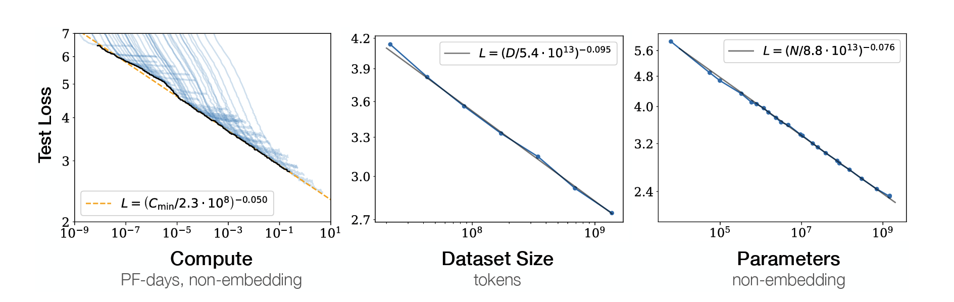
Scaling laws & emergence
Performance improves predictably with model size, data, and compute — smooth power-law curves (Kaplan 2020; Hoffmann/Chinchilla 2022).
Emergence — some abilities are absent in small models and appear, fairly abruptly, past a scale threshold:
CHINCHILLA, COMPUTE-OPTIMAL
For a fixed compute budget, scale parameters and data together — about 20 training tokens per parameter. Most early models were badly under-trained.
▪ in-context learning (learn from examples in the prompt, no weight update)
▪ multi-step arithmetic
▪ following instructions
▪ chain-of-thought reasoning
Chinchilla is paper #3 in today's RAG corpus — you'll retrieve this exact claim in Notebook 03.
The capabilities we build on this week emerged from scale — nobody hand-coded them.
https://arxiv.org/abs/2001.08361
03/06/2026
kerem.delikoyun@tum-create.edu.sg | Agentic AI Workshop W2
10

Slide 11
Why this architecture fits us so well
Language is humanity's API. We already encode knowledge, intent, and reasoning in text. A model fluent in text plugs straight into how we work — no new interface to learn.
SYSTEM 1 VS SYSTEM 2 (KAHNEMAN)
System 1 — fast, automatic, intuitive. A raw next-token answer is System-1-like: one fluent pass, no deliberation.
System 2 — slow, effortful, step-by-step. We elicit it by asking the model to reason out loud.
In-context learning ≈ working memory. Put examples or facts in the prompt and behaviour adapts on the spot, like a person holding instructions in mind for one task.
That single idea — make the fast model slow down and deliberate — is the seed of every reasoning pattern in Part 2.
Analogy, not a claim that models literally think. It's a useful map for why the patterns work.
It’s also a huge debate whether we need language to be able to think…
https://www.nytimes.com/2024/06/19/science/brain-language-thought.html
03/06/2026
kerem.delikoyun@tum-create.edu.sg | Agentic AI Workshop W2
11

Slide 12
PART 2 · SINGLE AGENTS
The agentic ladder
From a bare model to a reasoning, tool-using agent — one step at a time. All single-agent this week; multi-agent is Week 3.
03/06/2026
kerem.delikoyun@tum-create.edu.sg | Agentic AI Workshop W2
12

Slide 13
The ladder — what we climb today
L3
Multi-agent systems specialists + orchestration
→ Week 3
L2
+ Reasoning CoT · ToT · ReAct
today
L1
+ Tool use the model acts on the world
today
L0
Bare LLM one prompt, one answer
today
Each level adds one capability to the rung below. Nothing here is a new model — it's the same LLM with more scaffolding (aka harnessing) around it.
THE THREAD
L0 answers. L1 lets it act. L2 lets it deliberate. The "agent" is the loop you wrap around the model — not the model itself.
03/06/2026
kerem.delikoyun@tum-create.edu.sg | Agentic AI Workshop W2
13

Slide 14
Anatomy of an agent
LLM
the brain
Tools
APIs · DBs · code · functions
Memory
context window + RAG
Control loop
you write this!
Tools = capability. Memory = state. Loop = agency. Take away the loop and you have an LLM call. Take away tools and you have a chatbot. Take away memory and you have amnesia.
03/06/2026
kerem.delikoyun@tum-create.edu.sg | Agentic AI Workshop W2
14

Slide 15
L0 — the bare LLM
One prompt in, one answer out. Brilliant at language; blind beyond its training.
user -> LLM -> answer
THE CEILING
A bare LLM is a brilliant improviser with no hands, no memory of today, and no scratchpad. Everything above this rung removes one of those limits.
What it cannot do:
▪ Know anything after its training cut-off
▪ Look up a fact it didn't memorise
▪ Do anything in the world (send mail, query a DB, run code)
▪ Reliably do long exact arithmetic
▪ Tell you why it's confident
03/06/2026
kerem.delikoyun@tum-create.edu.sg | Agentic AI Workshop W2
15

Slide 16
L1 — tool use: give the model hands
A tool is just a function the model may ask you to call. The loop:
Function calling. Modern models are fine-tuned to pick a tool and fill its arguments from a schema you provide.
1
LLM reads the question + tool list
WHO CARRIES THE RESPONSIBILITY?
The vendor trained the tool-selection skill. You own writing clear tool names + descriptions. Get those right and the model routes well.
2
LLM requests a call: calculator (17×25)
3
YOUR code runs the function
loop
4
feed the result back to the LLM
Suddenly the model can fetch fresh facts, query data, and act — L0's ceiling is gone.
5
repeat until the LLM is done
The model never runs anything. It requests; your code executes and returns the result.
03/06/2026
kerem.delikoyun@tum-create.edu.sg | Agentic AI Workshop W2
16

Slide 17
L2 — reasoning: make the fast model slow down
The jump from L1 to L2 is System 1 -> System 2. Same model, but we change the prompt so it deliberates before it answers or acts.
CHAIN-OF-THOUGHT
Think in a straight line, out loud.
REACT
Reason and act — interleave thinking with tool calls.
TREE-OF-THOUGHTS
Branch, evaluate, search — don't bet on the first idea.
CoT is the base. ToT searches over it. ReAct couples it to L1's tools. The next four slides take each in turn.
03/06/2026
kerem.delikoyun@tum-create.edu.sg | Agentic AI Workshop W2
17

Slide 18
Chain-of-Thought (CoT)
Five words change the answer: "Let's think step by step."
The model uses its own intermediate tokens as a scratchpad — deliberate reasoning, summoned by a prompt.
Q: A juggler has 16 balls. Half are golf balls,
and half of those are blue. How many blue
golf balls?
DIRECT: 4 (right or wrong, no trace)
STEP BY STEP:
16 balls -> half golf = 8 golf balls
8 golf -> half blue = 4 blue golf balls
Answer: 4 (visible, checkable)
WHY IT WORKS
Hard problems need intermediate steps. Forcing the model to write them spends compute before the answer, instead of guessing in one pass.
CoT is System 2, on demand. It's the building block ReAct extends.
https://medium.datadriveninvestor.com/3-prompting-techniques-for-reasoning-in-llms-ff1b7c62413c
03/06/2026
kerem.delikoyun@tum-create.edu.sg | Agentic AI Workshop W2
18

Slide 19
Tree-of-Thoughts (ToT)
CoT commits to one branch of reasoning. If an early step is wrong, all gets messy. However, ToT treats reasoning like a search problem by allowing the model to explore multiple reasoning paths, self-evaluate intermediate steps, and backtrack when necessary, mimicking human trial-and-error cognition.
Propose -> evaluate -> expand the best, with backtracking out of dead ends.
THE TRADE
ToT spends a lot more compute (many model calls) to buy accuracy on problems where one CoT chain routinely fails — planning, puzzles, proof search.
problem
Notebook 02 shows one propose/evaluate level live on the Game of 24.
branch
✓ sure
branch
~ maybe
branch
✗ dead
expand
prune
https://medium.datadriveninvestor.com/3-prompting-techniques-for-reasoning-in-llms-ff1b7c62413c
03/06/2026
kerem.delikoyun@tum-create.edu.sg | Agentic AI Workshop W2
19

Slide 20
ReAct = Reason + Act
CoT thinks. L1 acts. ReAct interleaves them in one loop (Yao et al. 2022): a Thought, an Action (tool call), the Observation it returns — repeat.
Answer the question. Tools: {tools}
Question: the input question
Thought: reasoning about what to do next
Action: one of [{tool_names}]
Action Input: the input to the action
Observation: the result of the action
... (repeat) ...
Thought: I now know the final answer
Final Answer: ...
THE MECHANISM
Stop the model right after "Action Input". Run the tool yourself. Append the real "Observation". Re-prompt. The model never hallucinates a result — it reads the one your code returned.
03/06/2026
kerem.delikoyun@tum-create.edu.sg | Agentic AI Workshop W2
20

Slide 21
What a ReAct trace looks like
Thought: I need the authors of the ReAct paper first.
Action: web_search
Action Input: ReAct paper LLM reasoning acting authors
Observation: Yao et al., ICLR 2023 (arXiv:2210.03629).
Thought: Now the year of the transformer paper.
Action: web_search
Action Input: transformer paper Attention Is All You Need year
Observation: Published in 2017 (Vaswani et al.).
Thought: I have both. 2023 - 2017.
Action: calculator
Action Input: 2023 - 2017
Observation: 6
Thought: I now know the final answer.
Final Answer: ReAct (Yao et al., 2023) came six years after
the transformer paper (Vaswani et al., 2017).
Thought -> Action -> Observation, repeat. That loop is the agent. You'll build it by hand in Notebook 02.
03/06/2026
kerem.delikoyun@tum-create.edu.sg | Agentic AI Workshop W2
21

Slide 22
Two ways to pick a tool
ReAct agent
Function-calling agent
Tool choice lives in the prompt you write. The model emits Action: / Action Input: as text; you parse it with a regex.
Tool choice is the model vendor's native capability. It returns a structured tool call; no parsing.
▪ Less control, much less headache
▪ Robust; needs a modern tool-calling model
▪ High control — read and edit every step
▪ Brittle parsing; works even on models with no native tool API
"WHERE DO WE SHIFT THE RESPONSIBILITY?"
ReAct keeps tool selection in your prompt; the function-calling agent shifts it to the vendor. Most production agents use function calling; ReAct remains the clearest way to understand what an agent is.
03/06/2026
kerem.delikoyun@tum-create.edu.sg | Agentic AI Workshop W2
22

Slide 23
PART 3 · THE FRAMEWORK
A short intro to LangChain
We've climbed the ladder by hand. LangChain is the standard toolkit that implements every step — so you don't re-write the loop each time.
03/06/2026
kerem.delikoyun@tum-create.edu.sg | Agentic AI Workshop W2
23

Slide 24
What LangChain is (and isn't)
A thin, vendor-neutral layer over "call a model, give it a prompt, maybe tools, parse the output." The same code runs on Anthropic, OpenAI, Google.
LCEL — the pipe. Connect components with |, like a Unix pipe:
chain = prompt | llm | parser
chain.invoke({"concept": "embeddings"})
Five pieces, one operator:
Piece | Class
Model wrapper | ChatGoogleGenerativeAI
Messages | SystemMessage / HumanMessage
Prompt template | ChatPromptTemplate
Output parser | StrOutputParser
Tool | @tool
IT ISN'T MAGIC
Everything we built by hand — the tool loop, the ReAct parse — LangChain wraps in one call. Because you built the primitive first, the abstraction is transparent.
03/06/2026
kerem.delikoyun@tum-create.edu.sg | Agentic AI Workshop W2
24

Slide 25
LangChain implements the ladder
Rung | By hand (Parts 1-2) | In LangChain
L0 bare model | client.messages.create(...) | ChatGoogleGenerativeAI(...).invoke(...)
L1 tool use | your for loop + regex | create_tool_calling_agent + AgentExecutor
L2 ReAct | your prompt + parse_action | create_react_agent + AgentExecutor
Memory (RAG) | manual chunk + embed + search | loaders + splitters + vector stores + retrievers
We pin the classic LangChain 0.3.x line — the last with AgentExecutor. LangGraph (the newer agent runtime) is the Week 3 reveal.
03/06/2026
kerem.delikoyun@tum-create.edu.sg | Agentic AI Workshop W2
25

Slide 26
Structured output: function calling, aimed at the answer
from pydantic import BaseModel, Field
from typing import Literal
class ClaimCheck(BaseModel):
verdict: Literal["true", "false", "uncertain"]
confidence: Literal["low", "medium", "high"]
reason: str = Field(description="<= 15 words")
checker = llm.with_structured_output(ClaimCheck)
result = checker.invoke("The transformer paper is from 2017. True?")
result.verdict # -> "true" (a typed object, not a string)
Point a schema at the answer instead of a tool, and the model fills it in. You get back a validated Python object — no regex, no "please respond in JSON".
SAME MACHINERY
It's the exact function-calling mechanism from the tool-calling agent. Reach for it whenever an agent's output feeds the next pipeline step and must have predictable fields.
Run live in Notebook 01.
03/06/2026
kerem.delikoyun@tum-create.edu.sg | Agentic AI Workshop W2
26

Slide 27
From demo to production
REAL TOOLS — TAVILY
Our notebooks mock web_search so they run offline. In production, drop in a hosted search built for agents — same tool interface, real results:
OBSERVABILITY — LANGSMITH
Set two env vars and every agent run is traced step-by-step — each Thought, Action, tool latency, token count — with no code change:
search = TavilySearchResults(max_results=3)
agent = create_react_agent(llm, [search], prompt)
LANGCHAIN_TRACING_V2 = "true"
LANGCHAIN_API_KEY = "ls-..."
langchain_community.tools.tavily_search
You debug an agent by watching the trace, not guessing.
03/06/2026
kerem.delikoyun@tum-create.edu.sg | Agentic AI Workshop W2
27

Slide 28
Hands-on: three notebooks, back to back
NOTEBOOK 00 · LANGCHAIN IN 15 MIN
Model wrapper, messages, prompt templates, the LCEL pipe, first @tool.
NOTEBOOK 02 · REACT, COT, TOT
CoT -> hand-built ReAct loop -> create_react_agent -> ToT -> the function-calling-vs-ReAct contrast.
NOTEBOOK 01 · TOOL USE
The smallest agent, three ways: hand-rolled -> native tool-use -> LangChain tool-calling agent.
Same model. Same loop you just saw on slides. Now you watch it run, step by step.
▶ Switch to Colab — Notebooks 00, 01, 02
03/06/2026
kerem.delikoyun@tum-create.edu.sg | Agentic AI Workshop W2
28

Slide 29
PART 4 · MEMORY
RAG end-to-end
Retrieval-Augmented Generation gives the agent memory it can cite. Two parts — both visible — compared three ways.
03/06/2026
kerem.delikoyun@tum-create.edu.sg | Agentic AI Workshop W2
29

Slide 30
RAG in one diagram
INDEX (once)
📄 PDFs
📝 text
✂️ chunks
🔢 embeddings
🗄️ vector store
QUERY (every question)
❓ question
🔢 embed
🔎 top-k chunks
🧩 prompt + chunks
🤖 LLM
✅ answer + citations
Two halves. Retrieval finds the relevant chunks (same embedding idea from Part 1). Augmentation stuffs them into the prompt. The model's job becomes "answer from this context, and cite it."
03/06/2026
kerem.delikoyun@tum-create.edu.sg | Agentic AI Workshop W2
30

Slide 31
Build it with LangChain pieces
Each pipeline stage is one LangChain class:
FAISS vs Chroma — both local, both .as_retriever():
Stage | Class
Load PDFs | PyPDFLoader
Split | RecursiveCharacterTextSplitter
Embed | HuggingFaceEmbeddings
Store (dense) | FAISS · Chroma
Store (sparse) | BM25Retriever
Fuse | EnsembleRetriever
FAISS
Fastest pure-vector index, lives in RAM. Great default.
CHROMA
A small persistent local DB — write once, reopen later, no re-embedding.
Same retriever interface — the rest of the pipeline doesn't care which you pick.
03/06/2026
kerem.delikoyun@tum-create.edu.sg | Agentic AI Workshop W2
31

Slide 32
Three retrieval strategies
Dense (FAISS / Chroma)
Hybrid (EnsembleRetriever)
▪ Embed query + chunks, cosine similarity
▪ Great for paraphrase & synonyms
▪ "What does X mean?"
▪ Fuses both with Reciprocal Rank Fusion
▪ Catches paraphrase and exact-term
▪ Usually wins on section-level hit
Sparse (BM25)
NOTEBOOK 04 APPENDIX
The same recipe on real Elasticsearch with native RRF — production substrate, same idea.
▪ Classical keyword scoring, no embeddings
▪ Great for exact terms
▪ "What about RLAIF?"
03/06/2026
kerem.delikoyun@tum-create.edu.sg | Agentic AI Workshop W2
32

Slide 33
The dirty secret of RAG: chunking dominates
Fixed-window — split every N chars
NOTEBOOK 03 · CHUNK + OVERLAP
137 pages -> 676 chunks at 800 chars / 100 overlap.
Chunk size and overlap usually move retrieval quality more than the choice of embedding model. Sweep them on your own corpus.
▪ Fast; breaks sentences mid-thought
Recursive — paragraph -> sentence -> word
▪ Respects boundaries; LangChain default
▪ Better for dense and sparse
For the workshop we use recursive — the cheapest win.
Semantic — split on embedding-distance jumps
▪ Slowest, sometimes best for narrative; we mention, don't build
03/06/2026
kerem.delikoyun@tum-create.edu.sg | Agentic AI Workshop W2
33

Slide 34
Comparison: hit@5 on five questions
Test set — 5 questions, each labelled with its ground-truth paper + section keywords. Two metrics:
Notebook 03 run (5-paper corpus):
 | paper-hit | section-hit
Dense | 5/5 | 5/5
BM25 | 5/5 | 5/5
Hybrid | 5/5 | 5/5
▪ paper-hit@5 — right paper in the top 5?
▪ section-hit@5 — right part of it?
The first is easy; the second is honest.
On a small, clean corpus all three nail it. On a big messy one, hybrid pulls ahead — it catches both query types.
Metric | What it measures | In our eval (k = 5)
Precision@5 | Of the top 5 chunks, how many are relevant? | e.g. 3 of 5 on-topic → 0.60
Recall@5 | Of all answer-bearing chunks, how many are in the top 5? | did we miss a relevant chunk?
Hit Rate@5 | Did ≥ 1 relevant item appear in the top 5? (yes / no) | → our paper-hit@5 / section-hit@5
NDCG@5 | Hit rate, but rewards items ranked higher | a hit at rank 1 beats one at rank 5
03/06/2026
kerem.delikoyun@tum-create.edu.sg | Agentic AI Workshop W2
34

Slide 35
RAG vs raw LLM — same question
RAW LLM
"The ReAct loop interleaves reasoning and action..."
No citation. Possibly wrong on specifics. Sounds confident either way.
RAG
"...interleaving reasoning, action and observation improves groundedness [react_yao_2022.pdf#540]."
Every claim points to a chunk you can re-read.
Citations are the killer feature — not prompt-engineering magic, just retrieval plus telling the model to cite its source.
▶ Switch to Colab — Notebook 03 (run the comparison, then ask a grounded question)
03/06/2026
kerem.delikoyun@tum-create.edu.sg | Agentic AI Workshop W2
35

Slide 36
PART 5 · 10 MIN
What's next — Week 3
A single ReAct + RAG agent covers a lot but not all.
03/06/2026
kerem.delikoyun@tum-create.edu.sg | Agentic AI Workshop W2
36

Slide 37
Limits of the single-agent pattern
Limit | Symptom | Fix in W3
Context overflow | Long reasoning traces exhaust the window | Hand subtasks to specialists
No specialisation | One prompt does everything, none of it well | Planner / Retriever / Writer split
Sequential bottleneck | Parallel-decomposable work runs serially | Graph orchestration
Hard to evaluate | Can't isolate which step failed | Per-node metrics
These are the L3 rung — multi-agent systems — that we deliberately left off the ladder today.
03/06/2026
kerem.delikoyun@tum-create.edu.sg | Agentic AI Workshop W2
37

Slide 38
Today's retriever becomes a W3 tool node
LangGraph orchestrator
user query
Planner
Retriever
Writer
hybrid_retriever() — straight from Notebook 03
The retrieval function doesn't change — the orchestrator around it does. Same with your ReAct loop: it becomes a node in a graph.
03/06/2026
kerem.delikoyun@tum-create.edu.sg | Agentic AI Workshop W2
38

Slide 39
What to read before Week 3
▪ LangGraph quickstart — langchain-ai/langgraph repo
▪ Anthropic's "Building effective agents" — the workflows-vs-agents section
▪ GPT-Researcher — a production multi-agent deep-research pattern
▪ Your Notebook 02 ReAct trace — bring it back; we'll convert it to a graph
03/06/2026
kerem.delikoyun@tum-create.edu.sg | Agentic AI Workshop W2
39

Slide 40
WRAP-UP
Take it home
Five notebooks, one mental model: the loop is the agent.
03/06/2026
kerem.delikoyun@tum-create.edu.sg | Agentic AI Workshop W2
40

Slide 41
What you take home
▪ Notebook 00 — LangChain in 15 minutes
▪ Notebook 01 — tool use, three ways (hand-rolled -> native -> tool-calling agent)
▪ Notebook 02 — CoT, ReAct from scratch & via create_react_agent, ToT, FC-vs-ReAct
▪ Notebook 03 — full RAG with FAISS + Chroma + hybrid retrieval
▪ Notebook 04 — optional Elasticsearch appendix
All open in Colab from Agentic AI for Scientists Workshop’s Repo
03/06/2026
kerem.delikoyun@tum-create.edu.sg | Agentic AI Workshop W2
41

Slide 42
One sentence to remember
THE WEEK 2 TAKEAWAY
A language model predicts the next token. An agent is the loop you wrap around it: tools give it hands, reasoning gives it a scratchpad, RAG gives it memory it can cite.
AN AGENT = THE LOOP YOU WRAP AROUND THE MODEL
LLM
predicts the next token
Tools
give it hands — act on the world
Reasoning
a scratchpad — CoT · ToT · ReAct
RAG
memory it can cite
03/06/2026
kerem.delikoyun@tum-create.edu.sg | Agentic AI Workshop W2
42

Slide 43
Questions?
Kerem Delikoyun · TUMCREATE
kerem.delikoyun@tum-create.edu.sg · github.com/krmdel/agentic-ai-workshop

