Slide 1

Interactive Map Builder and Authoring Platform
Cross browser, cross API, mobile ready, HTML5/JavaScript, interactive map builder
Krithika Mohan | Tech Report | LA 558

Slide 2
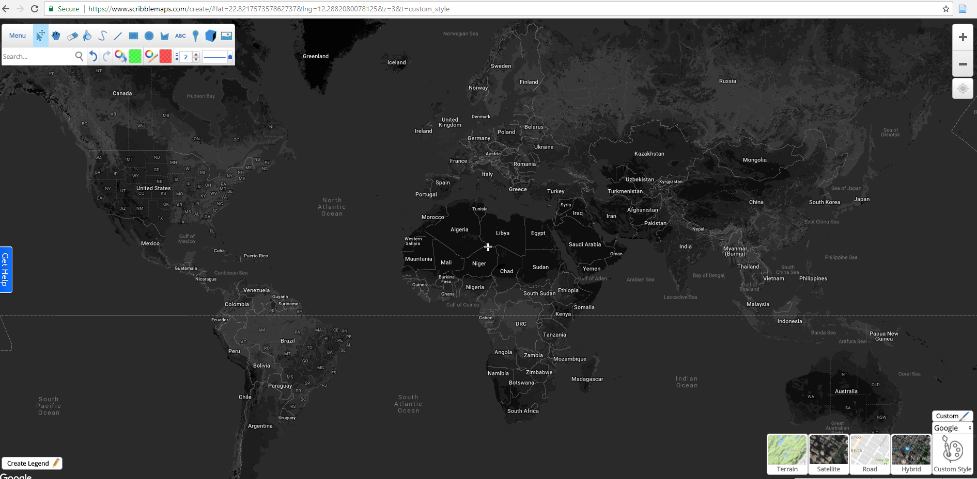
Introduction to Scribble Maps
Scribble Maps is an interface used to easily create and share maps.
Maps can be emailed, printed or embedded into websites.
This interface may also be used to convert spreadsheets to visualizations.

Slide 3
Key Features
The basic editor contains features such as Measure, Drag, Erase, Fill, Draw, Line, Flight Line, Rectangle, Circle, Polygon, Label, Marker and Image Overlay.
Base maps are customizable. Choose between Google, Mapbox, Leaflet etc.
Create a legend easily using this editor

Slide 4
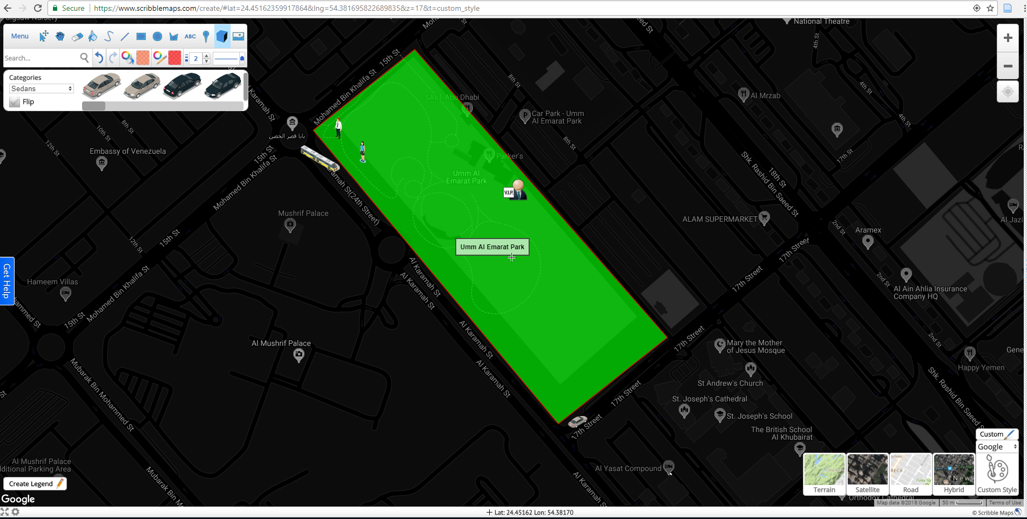
Friendly interface with cool custom features

Slide 5
Features shown earlier can be used in your website!
Scribble Maps API can be used directly in a web based app and the web data that you create can be stored or converted to another format.
The entire interface is CSS stylable and can be easily modified. The editor experience that you provide in you web app can be customized to fit the design!
This API uses a proprietary rendering engine. However, it is still compatible with all major mapping APIs.

Slide 6
Core Concepts
Loading the base API-
The API loader first checks for a projectID and the base API key associated with the project. It can be specified at manage.scribblemaps.com
Note: If interactivity is required, the Scribble Maps API should be used exclusively. Other API can be used along with this as long as they are used only for visualization.
Drawing and Overlays-
You don’t need to create new instances of objects to add overlays as using this API is similar to using a canvas.
Note: Global style applies to shapes and markers. To change a style, it needs to be specified in an draw operation. For example-
var sm = new ScribbleMap('scribblemapdiv')
sm.draw.setStyle({
lineColor: '#FF0000',
lineOpacity: 1,
});
sm.draw.line([[0, 0], [-43, -24]]);
sm.draw.line([[0, 0], [43, 24]], { lineColor: "#0000FF" });

Slide 7
Core Concepts
Overlay Interactivity-
Draw operations return the overlay with chainable functions.
For example-
var sm = new ScribbleMap('scribblemapdiv')
sm.draw.line([[0, 0], [-43, -24]])
.click(function() {})
.mouseover(function() {})
.mouseout(function() {});
Tool Based Views-
As shown in the slides before, the user interface enables a variety of tools. To enable use of 2 tools at the same time, you would need to define a custom tool. Selecting a new tool, automatically deselects the previous tool.

Slide 8
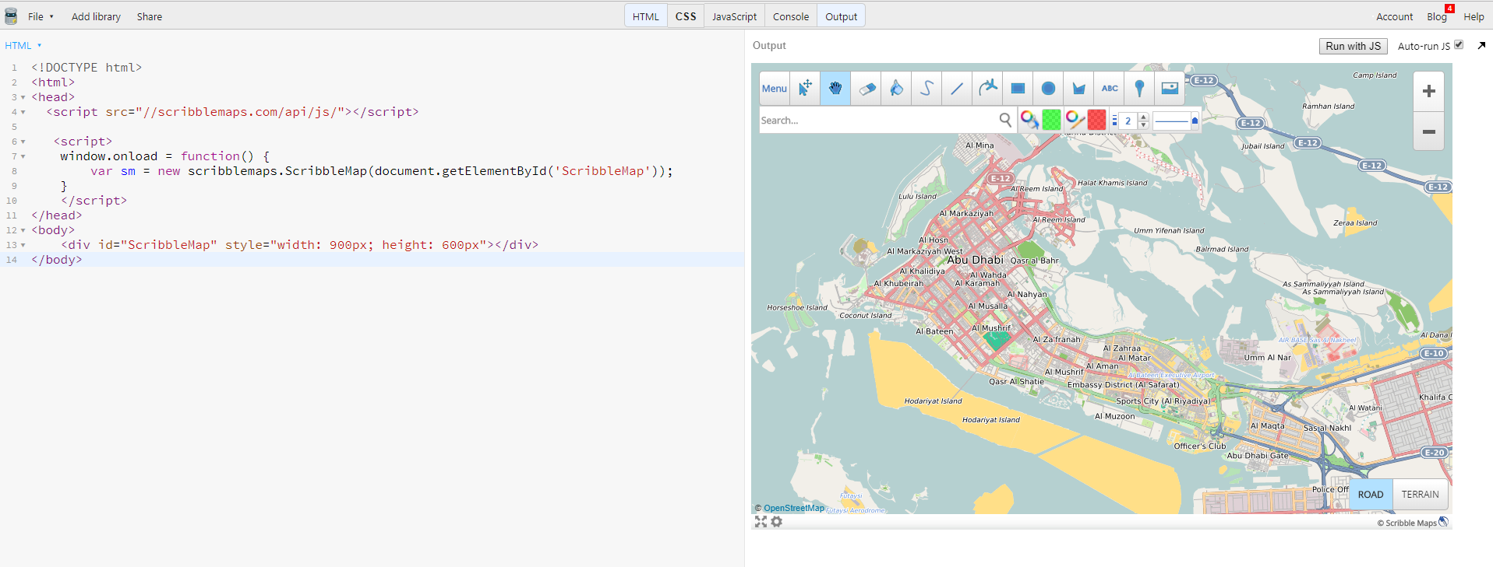
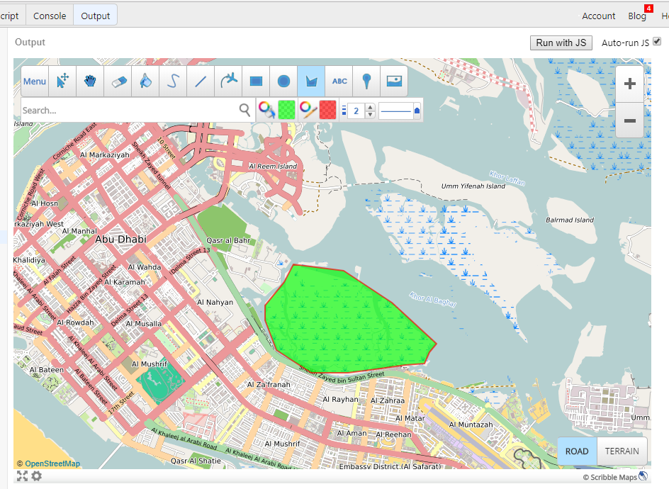
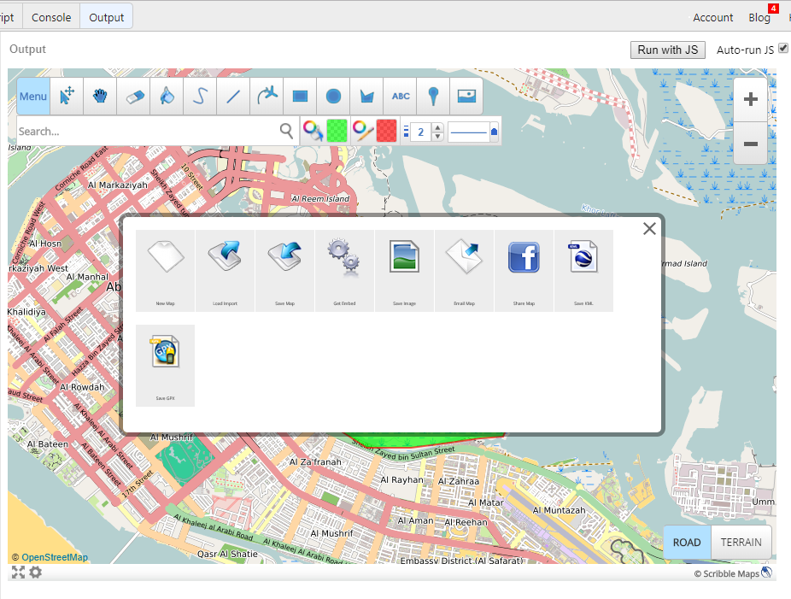
Getting started with basic code in JSBin-
This is done without using an API to get the basic editor on the website.

Slide 9
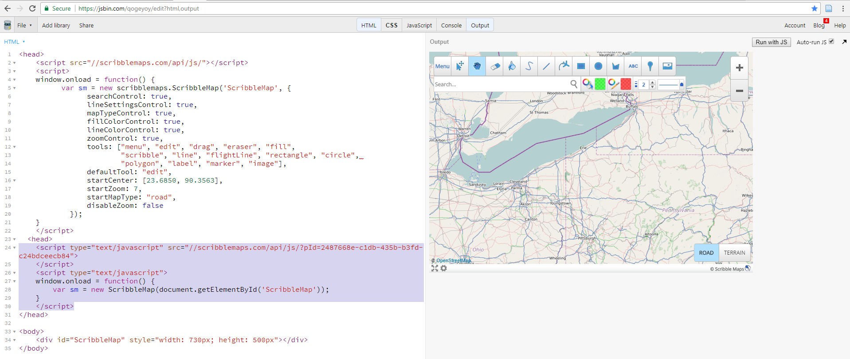
Project Setup
Use this to define a project Id

Slide 10
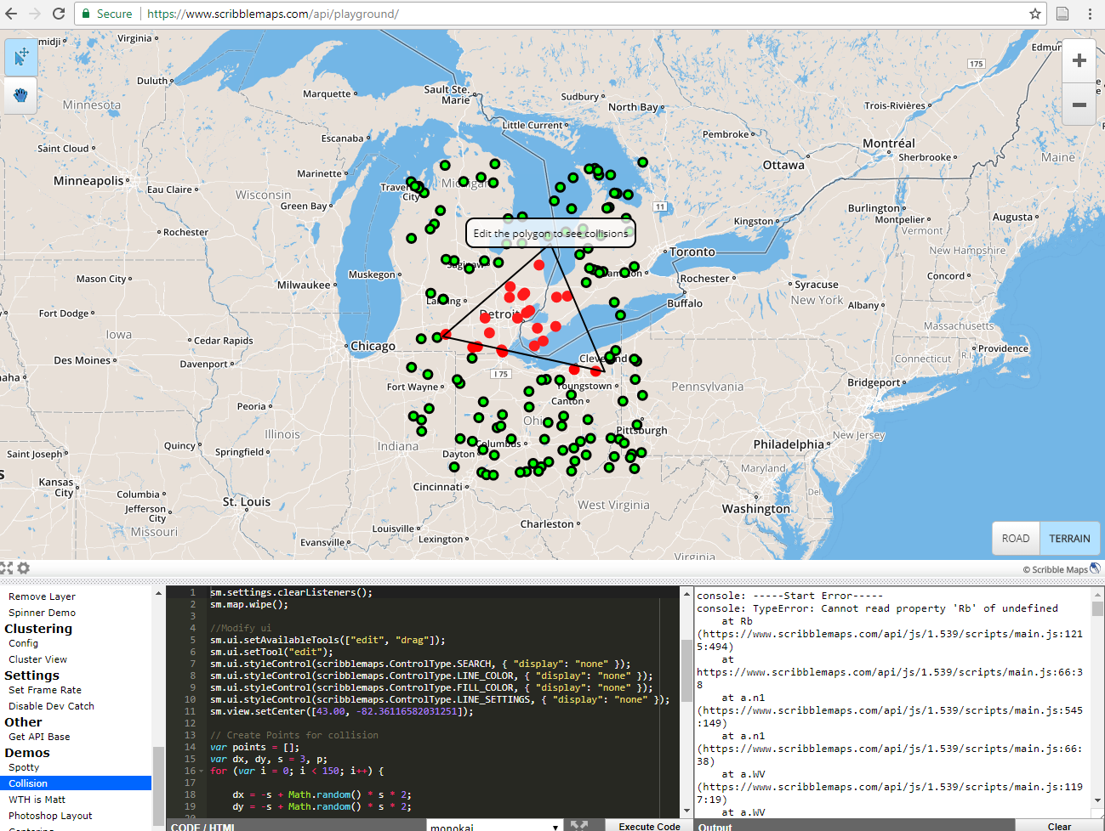
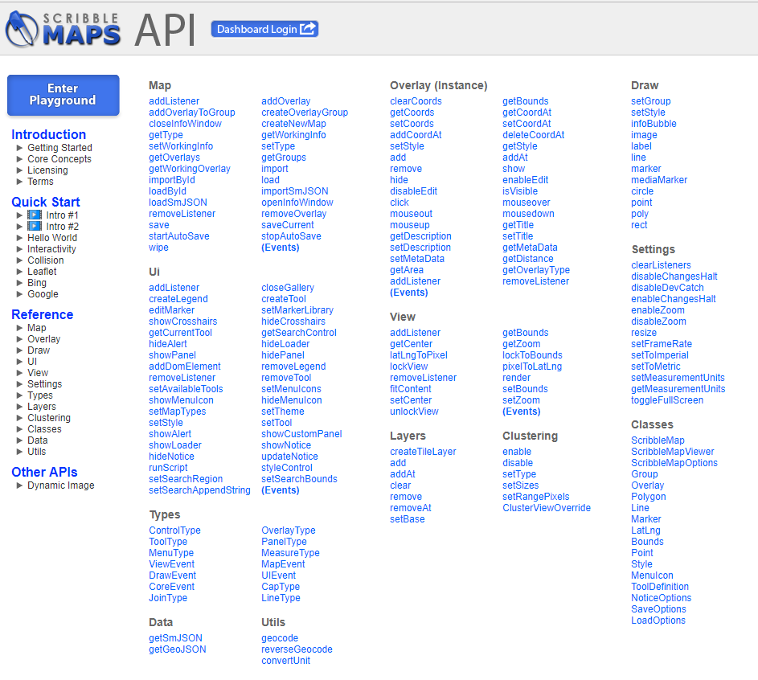
Scribblemaps API Playground is similar to the interface of JSFiddle.
The console enables you to switch between Map, Data, View, Draw, UI, Layers, Clustering and Settings. They have also provided demos to get started with.
More references as shown below-

