Slide 1

Analysis of Citibike Activity in 2019 & 2020
Group 7
Isi, Elizabeth, Eug, Kristin, Jenna
Notes:
Isi

Slide 2


Questions for Analysis
Who are Citibike's users?
What is the gender breakdown of our users?
Do subscribers or casual users take more rides?
What is the average age/age distribution of our users?
What are the demographics of our subscribers as compared to our casual users?
How are Citibikes being used?
How has the number of trips and trip duration changed?
What are the most popular stations and routes?
What are the most popular times of day to travel?
Has monthly bike usage changed?
Notes:
Elizabeth

Slide 3



Understanding Citibike’s Users
We found that the primary Citibike demographic is:
Subscribers
Males
In their 30s
Subscribers, or membership holders, composed 70%+ of Citibike users in ‘19-’20
The lowest proportion of subscribers was in May ‘20
Males have composed anywhere between 55-75% of Citibike users in ‘19-’20
The greatest dip in the male user population was also in May ‘20
While the mean age of riders in ‘19-’20 was 39yo, we saw that the age distribution suggests the most popular group has been ~30yo
We saw an abnormally large number of users aged ~50 over ‘19-’20
Notes:
Elizabeth

Slide 4
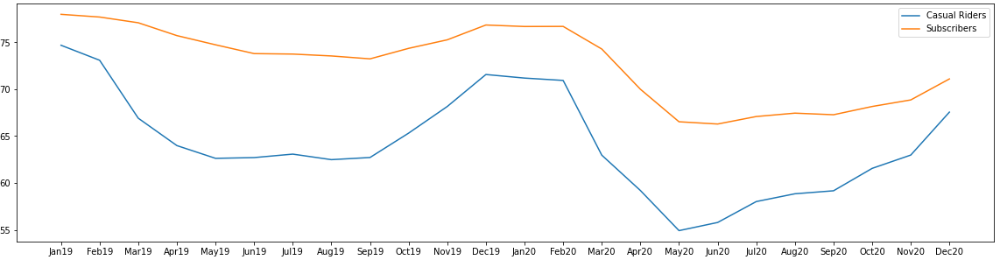
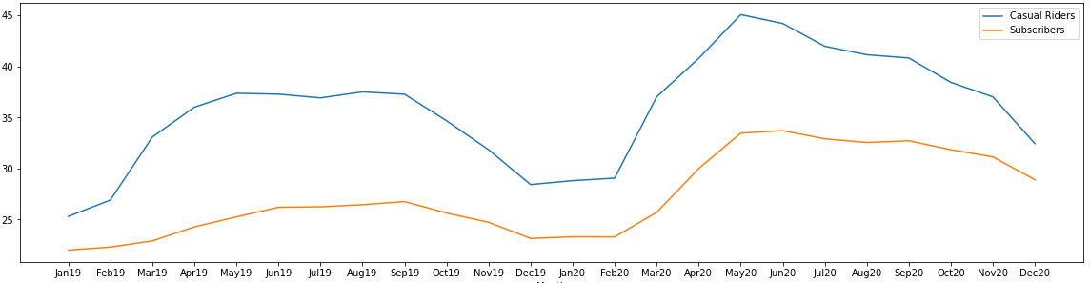
Citibike Subscribers vs. Customers
Men as % of Customers
Key Takeaways
Men consistently make up a larger percentage of subscribers
Women consistently make up a larger percentage of casual riders
Men account for a larger percentage of riders during the winter months. Women seem to ride less during the winter than men
% of Riders
Month
Women as % of Customers
% of Riders
Month

Slide 5
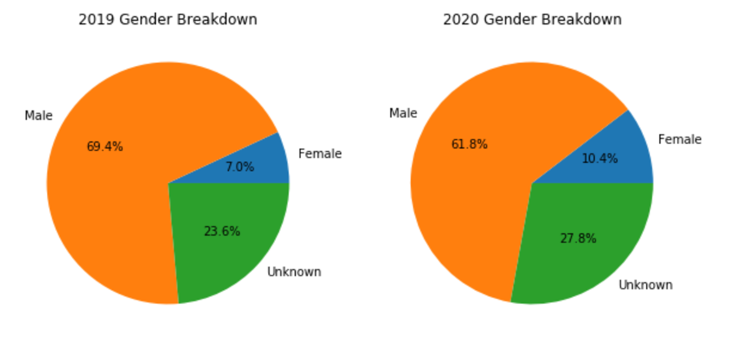
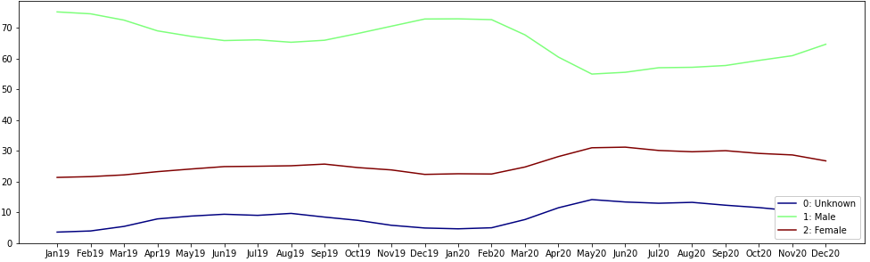
Citibike Riders by Gender
Men make up the majority of Citibike riders
Men accounted for a smaller percentage of Citibike riders in 2020 than they did in 2019 (69.4% down to 61.8%)
Women and Unknown experienced an increase as a percent of total riders between January and May of 2020
Women rose from around 22.5% to 31%, while Unknown rose from 4.06% to 14.09%
Gender Distribution
% of Riders
Month

Slide 6
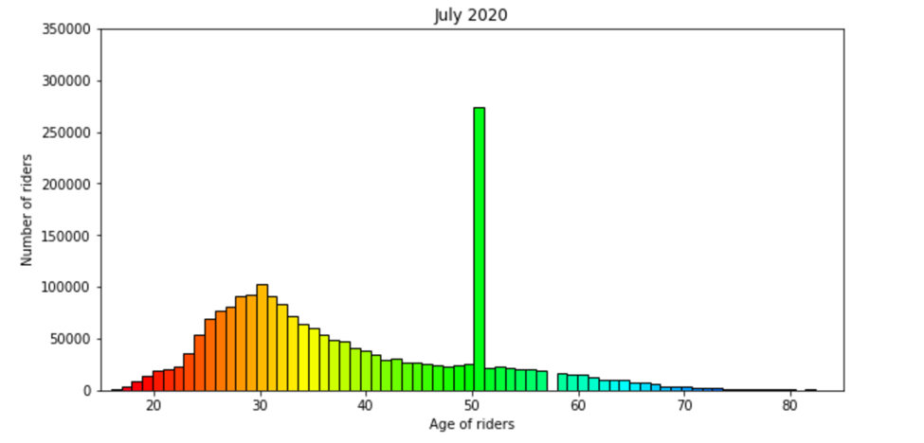
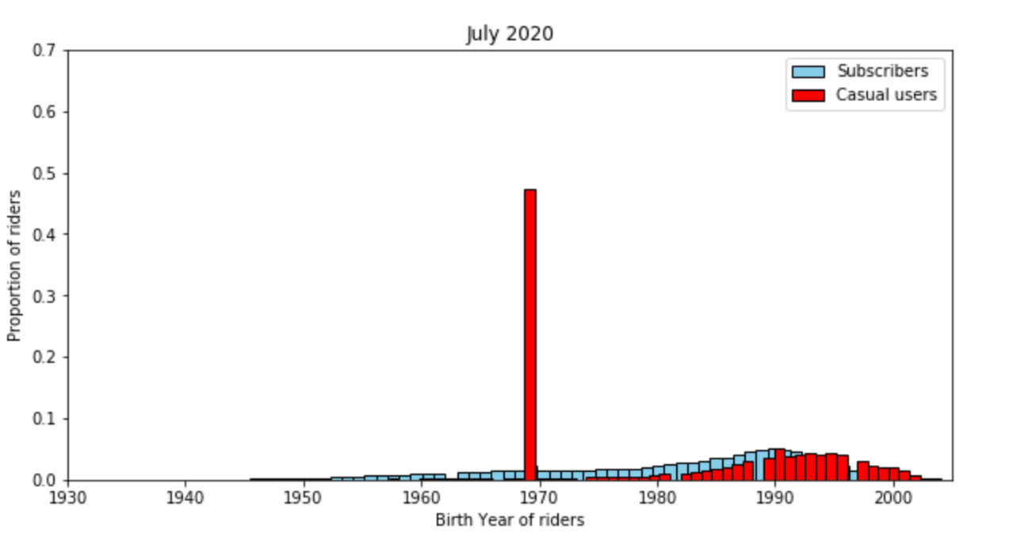
Citibike Users by Age
There was a spike in the birth year 1969 every single month between 2019 and 2020
This spike is predominantly in the data for casual riders
We theorized that missing birth year values are being converted to Unix time at some point and missing values are being treated as the start of Unix time, which is December 31st, 1969 for the Western Hemisphere
Notes:
Eug

Slide 7
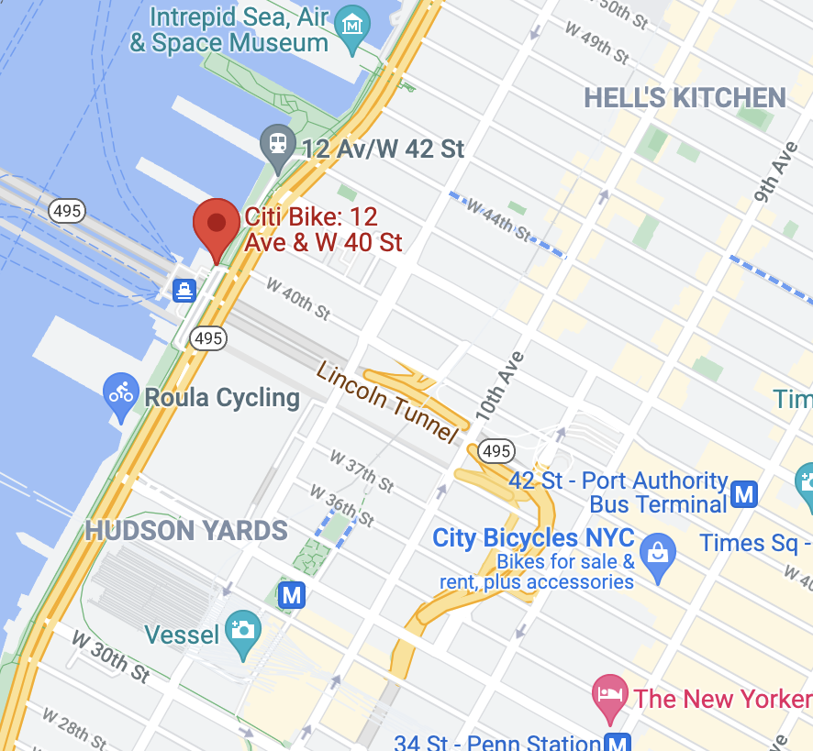
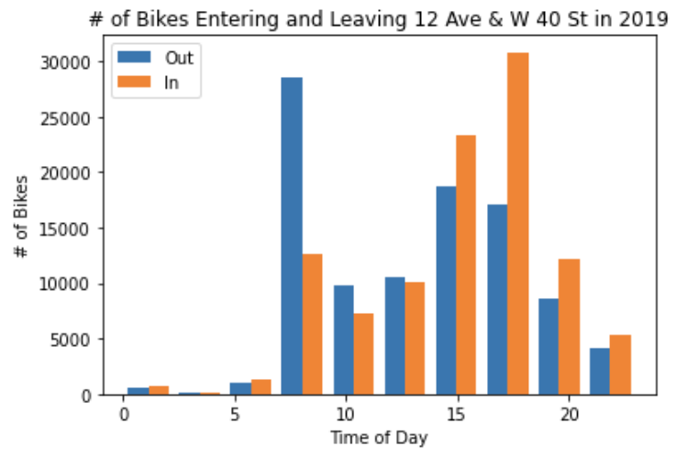
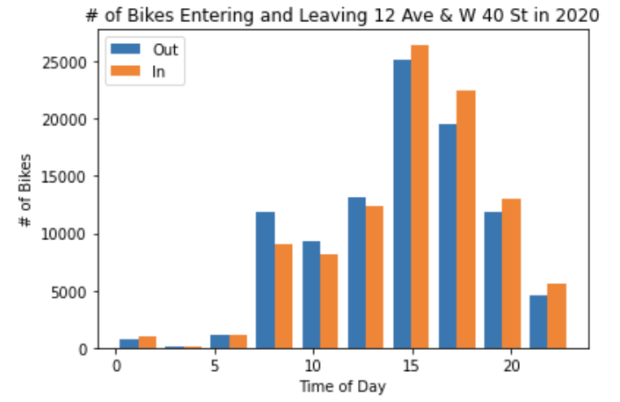
Station Traffic
2019: Commuter Station (second most popular June & July)
2020: One of the most popular stations (top station May - August)
If commuter traffic returns to 2019 levels in the future, we recommend Citibike expand this station or add an additional station in the vicinity
Notes:
Jenna
We also looked into the traffic of some of our most popular stations.
We compared the 2019 and 2020 station traffic for a few of the most popular stations. One of which was the station located at 12 Ave and W 40 St. In 2019, this was a heavy commuter station with a large portion of bikes leaving in the morning and returning in the afternoon. In 2020 it balanced out but the station itself grew in popularity. Therefore, if commute traffic returns to 2019 levels in the future, we recommend that Citbike expands this station or adds an additional station in the vicinity.

Slide 8
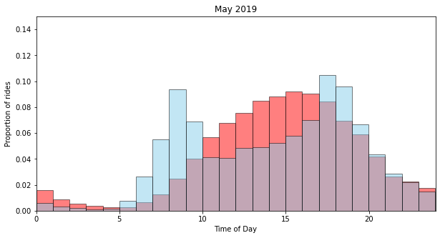
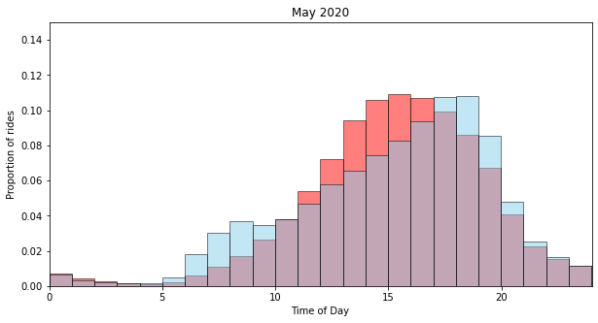
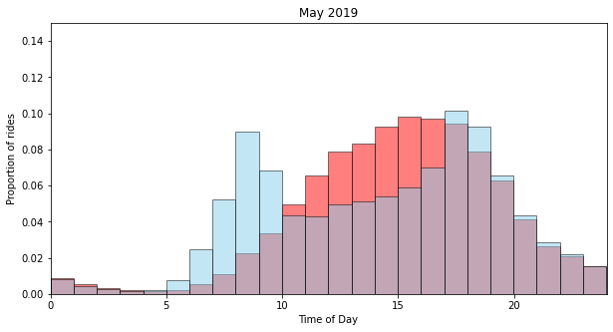
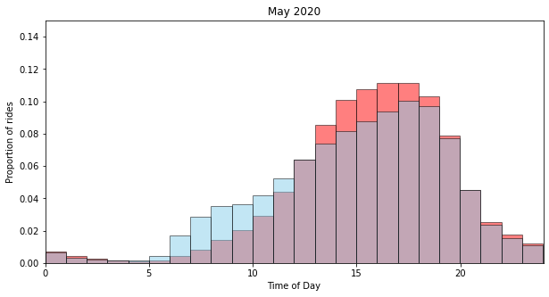
Hourly Distribution of Bike Traffic
Hourly Bike Traffic Distribution by
Weekend vs Weekday
Weekend Bike Traffic
Weekday Bike Traffic
Hourly Bike Traffic Distribution by
Rider User Type
Casual User Bike Traffic
Subscriber Bike Traffic
Notes:
Isi Looking at most popular travel times, we theorized that bike traffic might look different on weekend vs weekdays. The two top graphs are hourly distributions by weekend vs weekday of May 2019 and May 2020. The May 2019 graph, displays a bimodal distribution for weekday that aligns with work commute hours and is representative of all of the month up until April 2020 when the pandemic hit after which weekday hourly distribution lost its bimodality and converged towards the more normal distribution of weekend traffic as in May 2020. A likely explanation for this change is the shift towards remote work due to Covid 19.
The 2 bottom graphs show the hourly distribution bike traffic by user type for the same months. As you can see, they closely mirror that of weekend vs weekday suggesting that subscribers use citibike for daily commute on weekdays while casual users align with weekend ridership.
Its worth noting that the weekday and subscriber distribution After May 2020 never completely returned to the distinctly bimodal dist prepandemic likely due to the continued presence of remote and hybrid work.

Slide 9
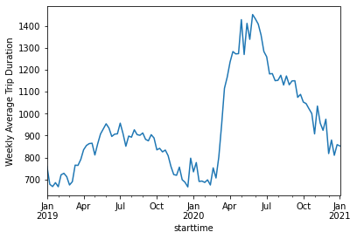
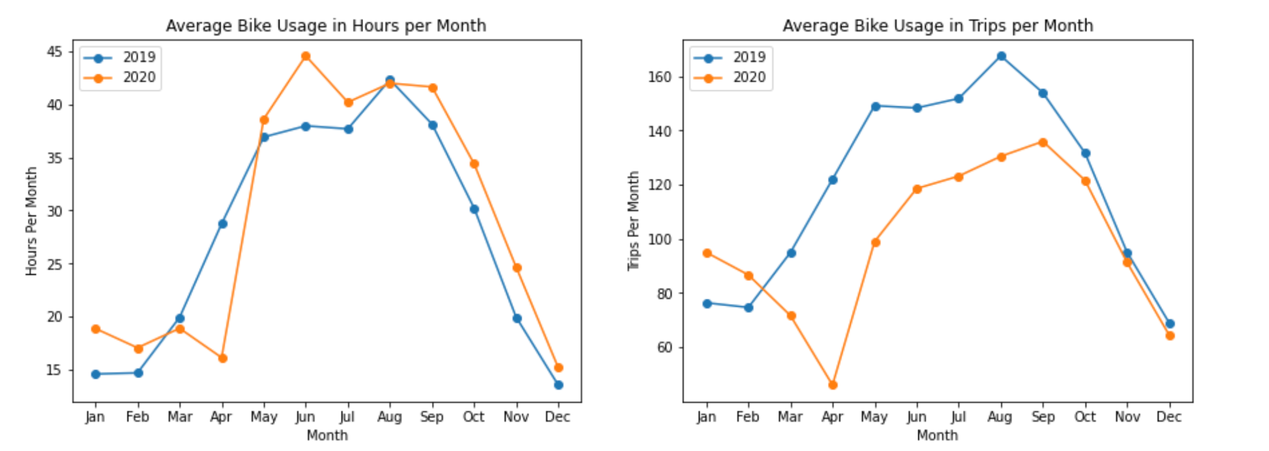
Trip Trends
A comparison of average bike usage in 2019 vs. 2020:
Overall, bike usage in terms of hours increased while trips decreased in 2020
Trip duration specifically doubled from winter to spring 2020 -- likely due to both seasonality factors and an uptick in Citibike popularity
We saw an interesting trend -- a significant drop in Citibike activity with the onset of Covid, followed by a spike in May/June as people may have picked up biking recreationally
Notes:
Eug

