Slide 1

PROP
Backprop’s back, ALRIGHT!

Slide 2


Backprop’s back, ALRIGHT!

Slide 3
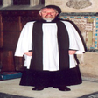
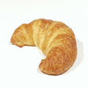
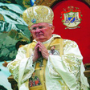
INITIAL ATTEMPT
Labeled Data
Self-Supervised
Custom Resnet50
Supervised
Faster R-CNN
Trained Object Detection Model
Priest
Unlabeled Data
Priest
Avg Precision:
Avg Recall:

Slide 4
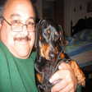
TROUBLESHOOTING
Labeled Data
Self-Supervised
Pre-trained Resnet50
Supervised
Faster R-CNN
Trained Object Detection Model
Priest
Unlabeled Data
Priest
Avg Precision:
Avg Recall:

Slide 5
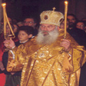
MORE TROUBLESHOOTING
Dog

Slide 6
FINAL MODEL
Labeled Data
Self-Supervised
Pre-trained Resnet50
Supervised
Faster R-CNN
Trained Object Detection Model
Priest
Unlabeled Data
Priest
Avg Precision:
Avg Recall:

Slide 7
RESULTS AND NEXT STEPS

