Slide 1
Predicting Purchases
Presented by:
Karan Jain

Slide 2
PageValues is the most important feature in predicting purchases.

Slide 3
What is Predicting Purchase?
Everytime a customer shops, they either buy something or they don’t.
During these sessions, customer’s activity is tracked.
Given past shopping activity, predict a (new) shopping trip’s outcome.

Slide 4
Why Predict Future Purchases?
Methods of predicting purchases can inform why a purchase was made.
This information can help intervention - Convert ‘sessions’ to purchases.
Realtime
Send offer(s) to user
Send price changes to user
Send reminder to user
Longterm
Improve interfaces - Website, App
Improve Services
Improve Product
Sell more products by informing where to display recommended products.
Personalize ‘experiences’ to individual customers
To improve bottom line of business - More profit.

Slide 5
How to Predict Future Purchases?
Build Predictive Models.
Following models were built:
1. | Random Forest Classifier
2. | K Nearest Neighbor
3. | Logistic Regression - Baseline Model
With 90% Accuracy, Random Forest Classifier performed the best.

Slide 6
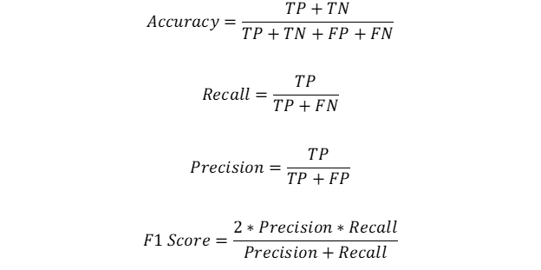
Performance Metric - Accuracy
Optimizing for Accuracy automatically optimizes for better F1, Precision, Recall

Slide 7
Dataset
Dataset has data points for 12330 shopping visits.
Dataset has 10 numerical, 7 categorical features and one target variable.
Various train:validation:test splits were tried before arriving at 60:20:20.
train:validation:test splits were stratified.
Final classifier was selected by comparing performance on Validation Set.
If accuraries were tied, classifier with best F1 Score was picked.

Slide 8
Features Used
A+I+PR | numerical
Ad+Id+PRd | numerical
BounceRates | numerical
PageValues | numerical
SpecialDay | numerical
Month | categorical
OperatingSystems | categorical
Browser | categorical
Region | categorical
TrafficType | categorical
VisitorType | categorical
Weekend | categorical
ExitRates | numerical
Legend
Generated
Original
Deleted
A+I+PR, Ad+Id+PRd are measures of time spent on website.

Slide 9
Random Forest Classifier - Model Specification
parameters = {
'class_weight': [None, 'balanced', 'balanced_subsample'],
'n_estimators': [5, 50, 75, 100],
'max_depth': [2, 10, 20, None]
}
All combinations of following parameters were Cross Validated.
Highest CV accuracy of 90% for 'class_weight': None, 'max_depth': 10, 'n_estimators': 75

Slide 10
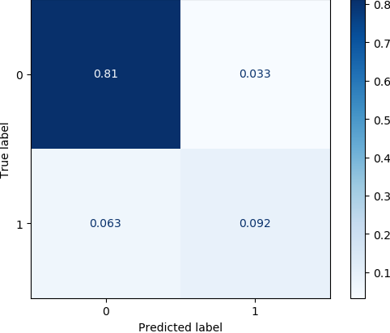
Random Forest Classifier - Performance - Validation Set
At 90%, Highest Accuracy Among All Classifiers.

Slide 11
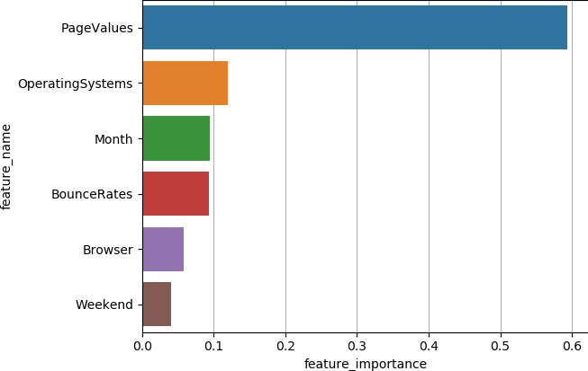
Random Forest Classifier - Features
PageValues is the most important feature.

Slide 12
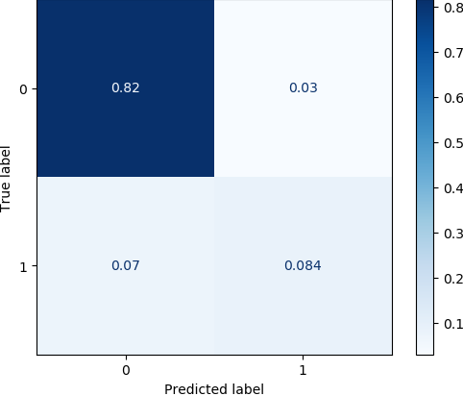
Random Forest Classifier - Performance - Test Set
90% Accuracy on Test Set.

Slide 13
Logistic Regression - Model Specification
parameters = {
'class_weight': [None, 'balanced'],
'C': np.arange(0.1,1.05,0.05),
}
All combinations of following parameters were Cross Validated.
Highest CV accuracy of 88% for 'C': 0.45, 'class_weight': None

Slide 14

Logistic Regression - Performance - Validation Set
At 88%, Lowest Accuracy Among All Classifiers.

Slide 15
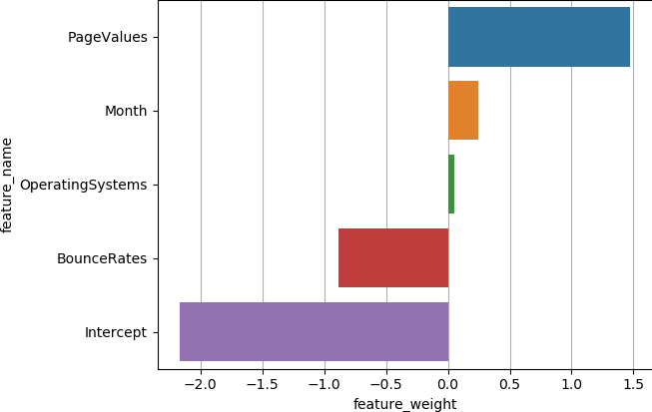
Logistic Regression - Features
PageValues is the most important feature.

Slide 16

Logistic Regression - Features - Interpretation
Unit change in a predictor gives change in Ln(odds) when all other predictors are constant.

Slide 17
K Nearest Neighbors - Model Specifications
parameters = {
'weights': ['uniform', 'distance'],
'p': np.arange(1,3,1),
'n_neighbors': np.arange(1,20,1)
}
All combinations of following parameters were Cross Validated.
Highest CV accuracy of 89% for 'n_neighbors': 18, 'p': 2, 'weights': 'uniform'.

Slide 18
K Nearest Neighbors - Features
PageValues
BounceRates
Month
OperatingSystems
Legend
Most Significant
Significant
Least Significant
Most of the features were dropped during feature selection.

Slide 19

K Nearest Neighbors - Performance - Validation Set
At 89%, Second Highest Accuracy Among All Classifiers.

Slide 20
Insights From Exploratory Data Analysis
Only 15.4% of the shopping trips resulted in Revenue (target variable).
PageValues is correlated with Revenue.
ExitRates and BounceRates are highly correlated.
ProductRelated and ProductRelated_Duration are highly correlated.
Administrative, Informational, ProductRelated correlated with each other.
Durations of Administrative, Informational, ProductRelated also correlated.
<page_type> and <page_type>_Durations were moderately Correlated, where <page_type> is either of Administrative or Informational.
Among Month, Nov had the highest conversion rate of 25%.
Among Month, Mar had most visits however conversion rate of only 12%.
Among Visitors, New_Visitors had the highest conversion rate of 25%.

Slide 21
Conclusions
PageValue is the most important feature in predicting purchases.
BounceRate is the second most important feature in predicting purchases.
RFC’s accuracy was 5.4% better than Dumb Model (always predict 0).
Performance on RFC > KNN > LR
Higher values of PageValues promote Revenue.
Lower values of BounceRates promote Revenue.
While Month, OperatingSystem, Browser, Weekend are predictor of Revenue, they much less significant than PageValues, BounceRates.
Region, TrafficeType, VisitorType do not significantly affect purchases.

Slide 22
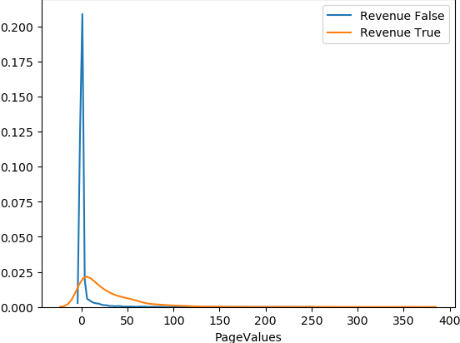
Business Outcomes - PageValues
Shopping trips with low PageValues are more likely to have no Revenue.
Further dissect PageValues when Revenue was True. Work to increase PageValues.

Slide 23
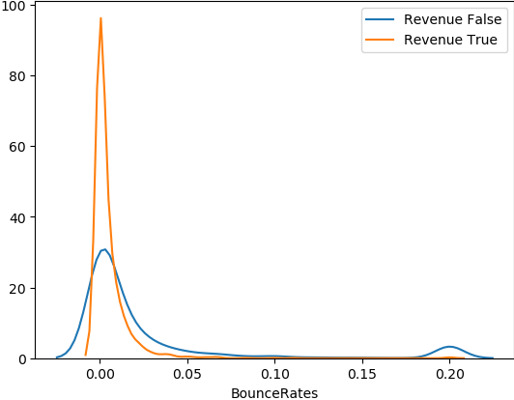
Business Outcomes - BounceRates
Shopping trips with low BounceRates were more likely to have Revenue.
Further dissect BounceRates when Revenue was True. Work to decrease BounceRates.

Slide 24
Business Outcomes - Month, OS, Browser, Weekend
Selectively run promotions in Oct and Nov.
Prioritize/Selectively roll out updates to apps/services for OSs 1 & 2.
Prioritize/Selectively roll out updates to apps/services for browsers 1 & 2.
Since probabilities of Revenue are comparable for Weekend or not, selectively run promotions on weekdays to take advantage of more visits.

Slide 25
Appendix

Slide 26
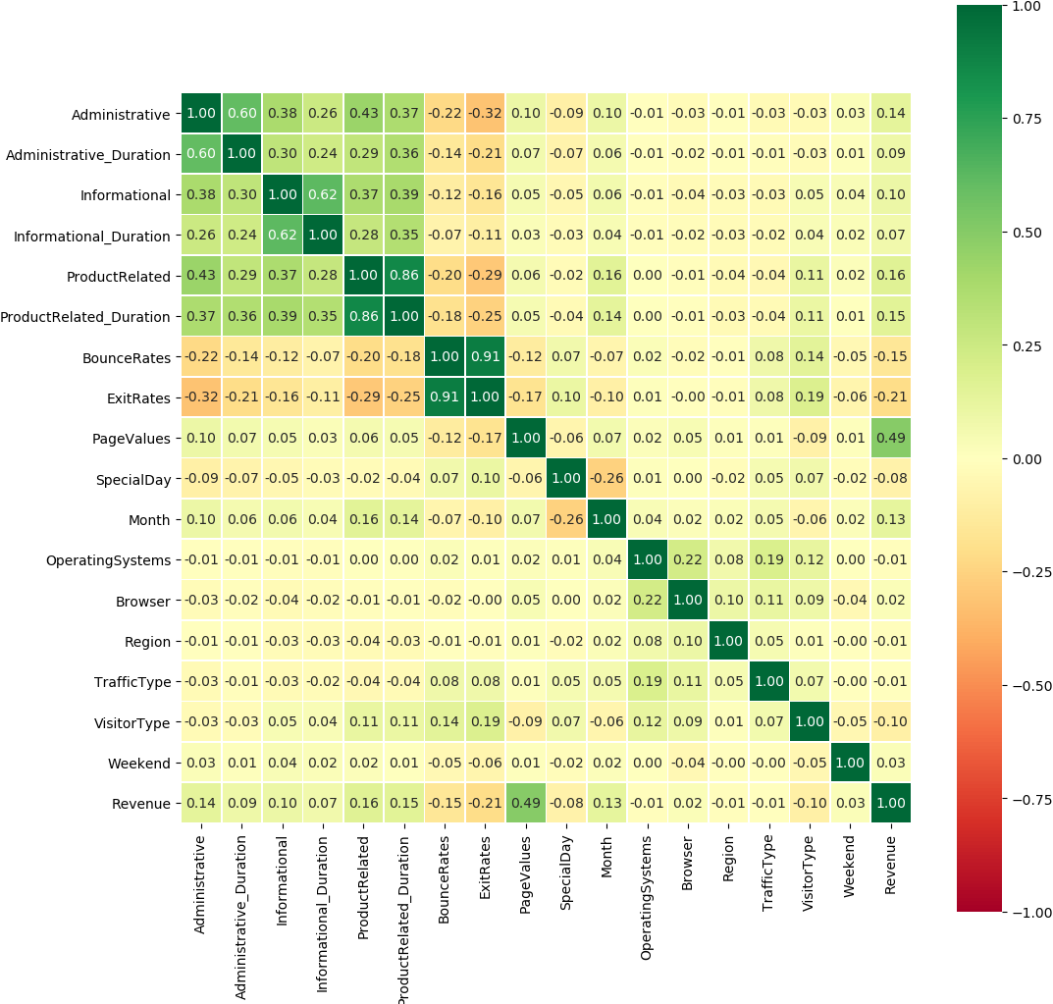
Correlation Matrix

Slide 27
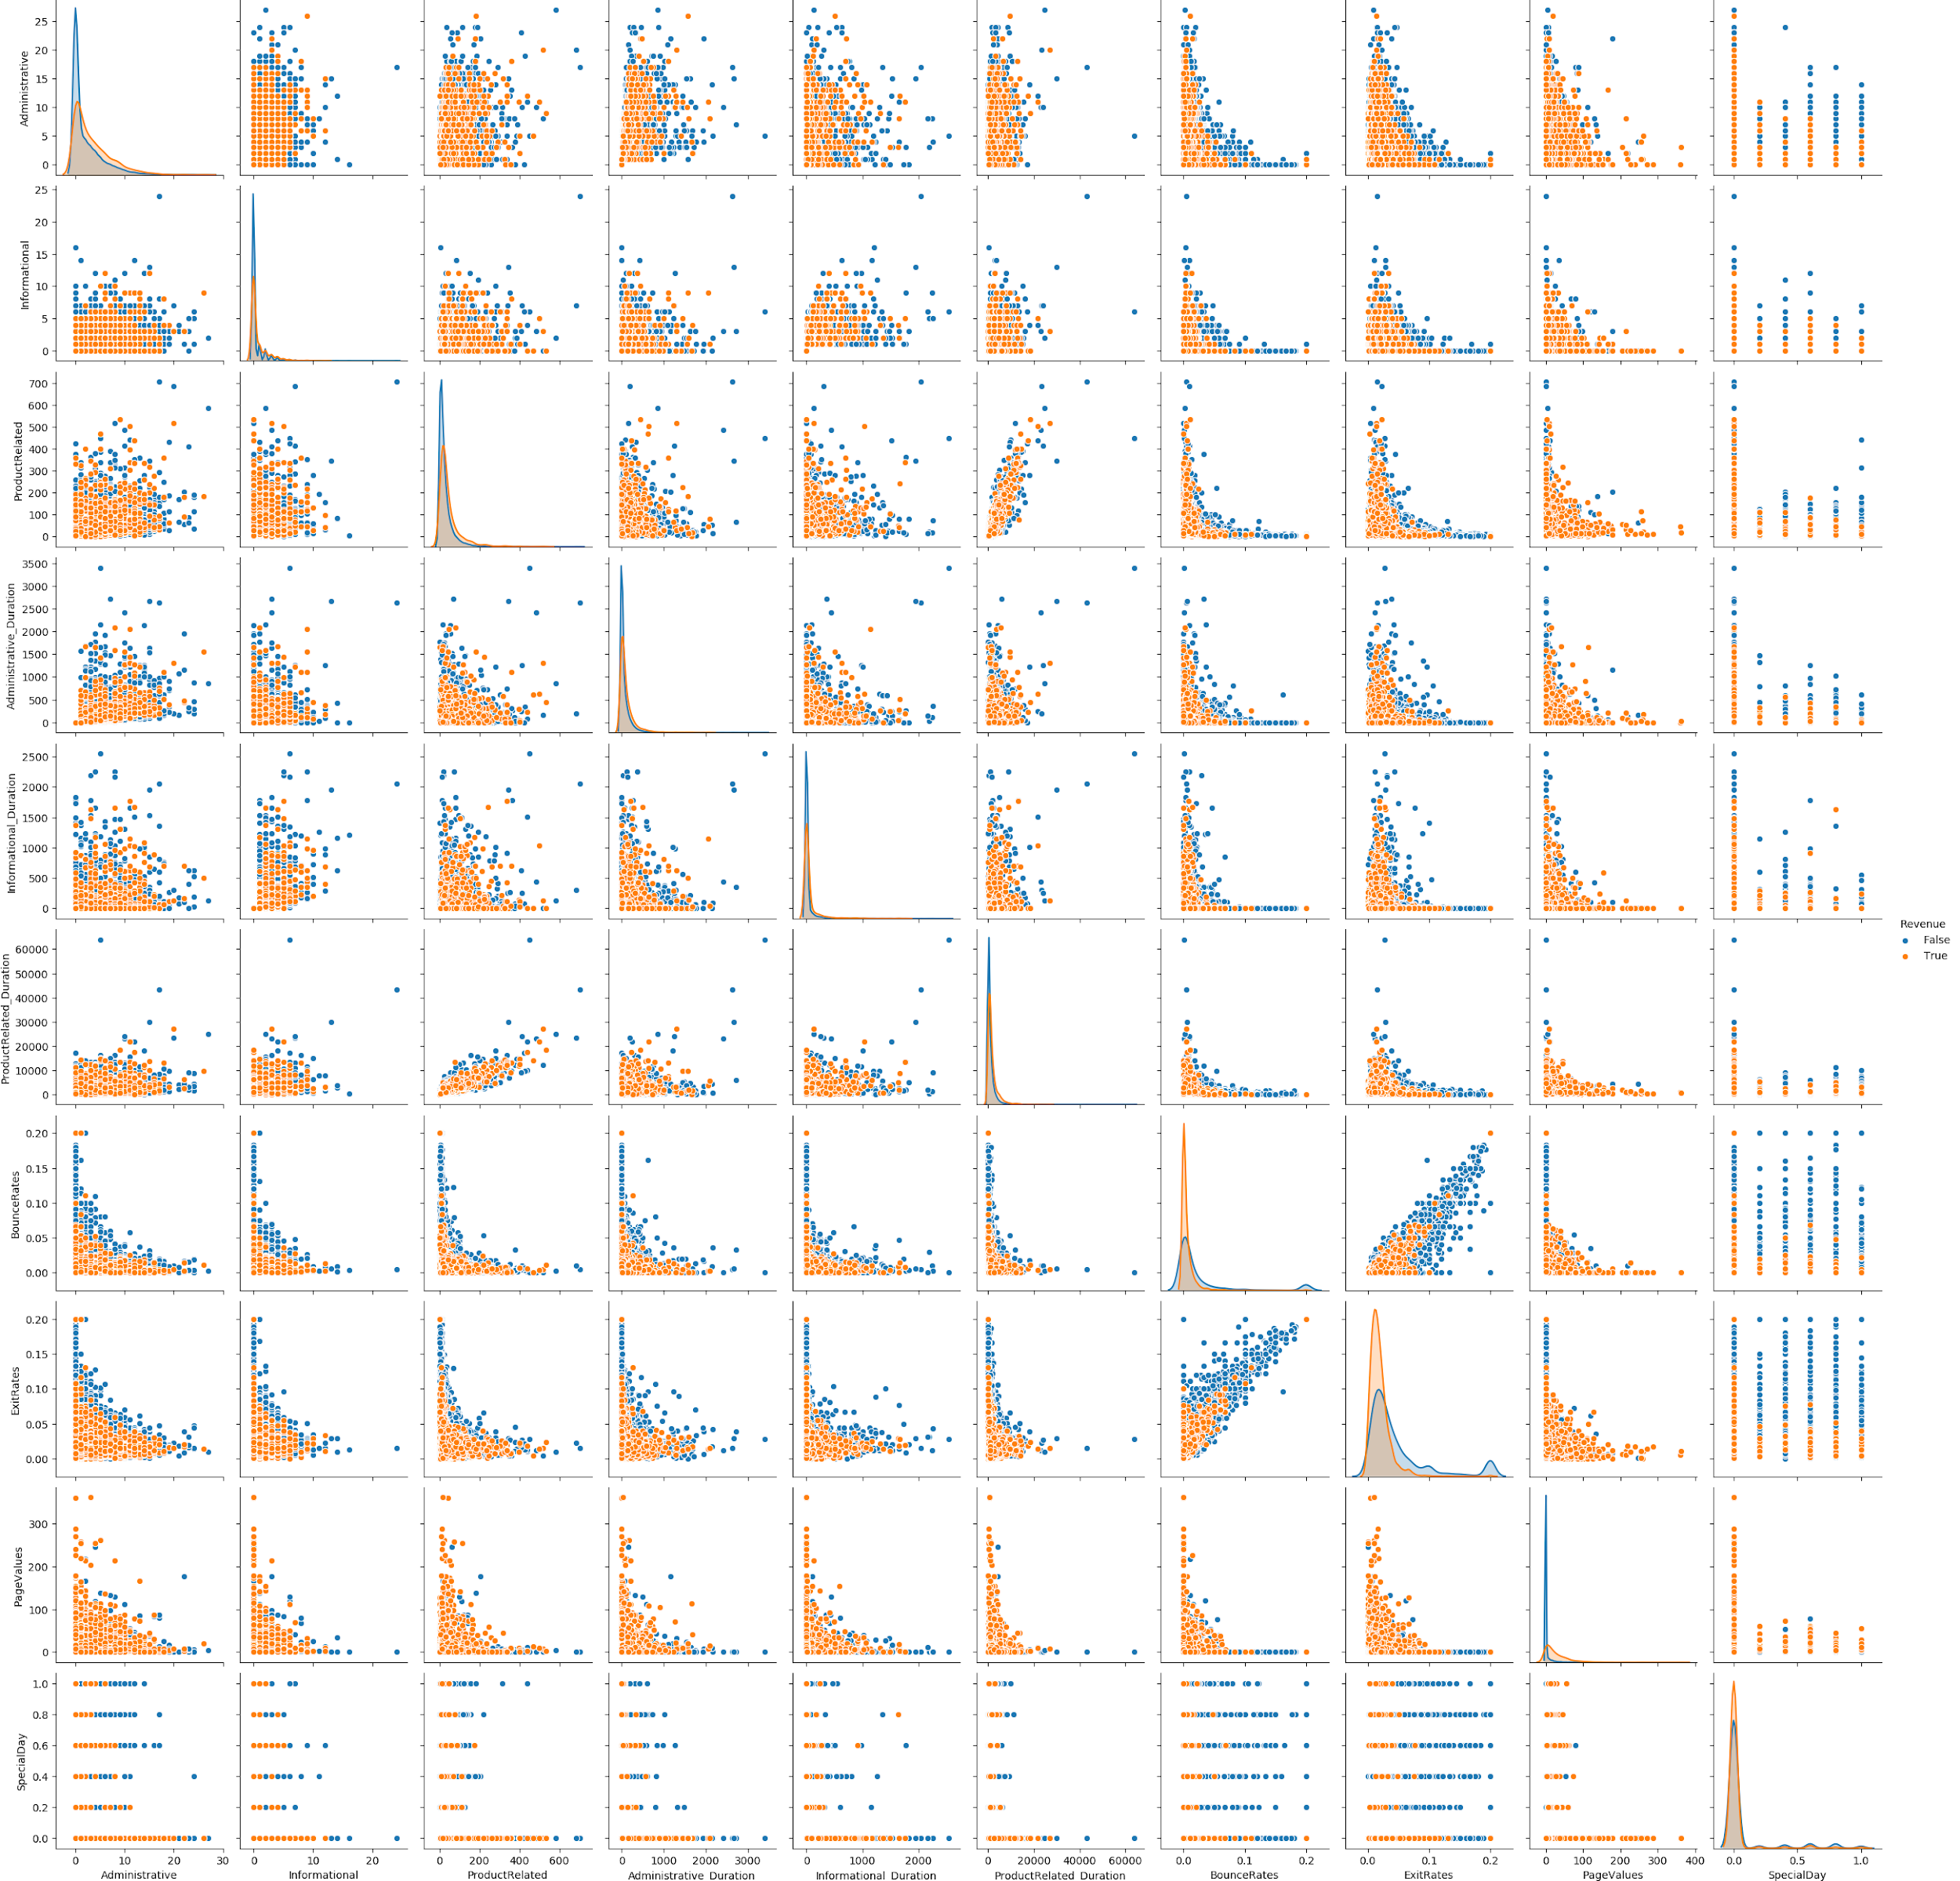
EDA - Pairwise Relationships
ExitRates and BounceRates Highly Correlated. PageValues discriminates over Revenue.

Slide 28
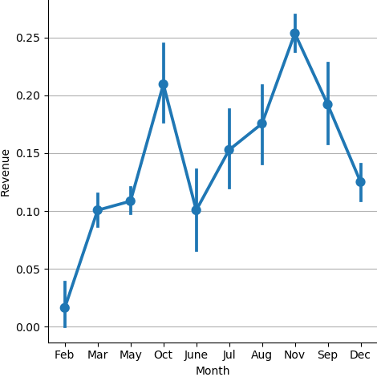
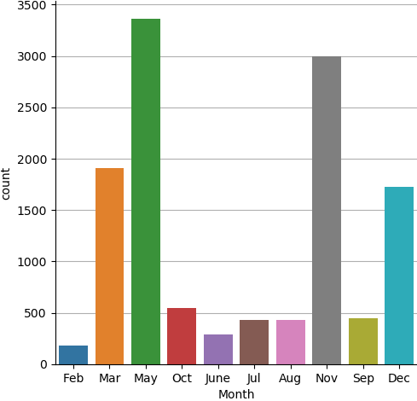
EDA - Month
Highest Visits in May Yet Low Conversion. Highest Conversion Rate in Nov.

Slide 29
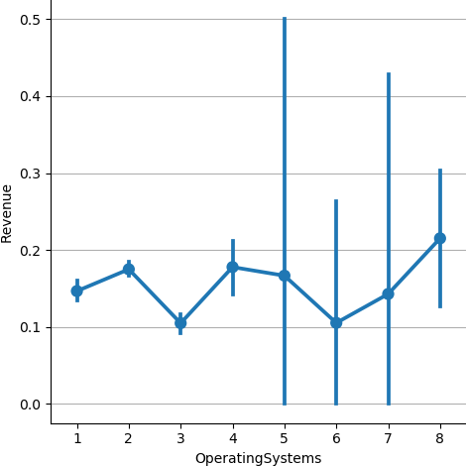
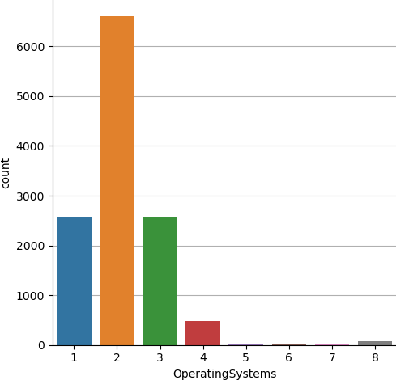
EDA - Operating System
With most visits, OS 2 has one of the best conversion rates with low error.

Slide 30
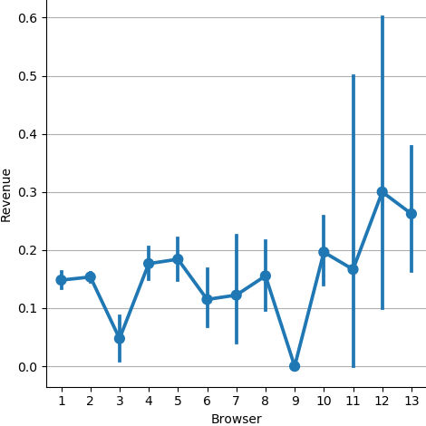
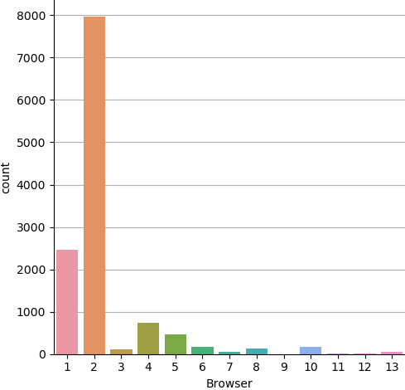
EDA - Browser
Browser 2 is the preferred choice of browser among visitors.

Slide 31
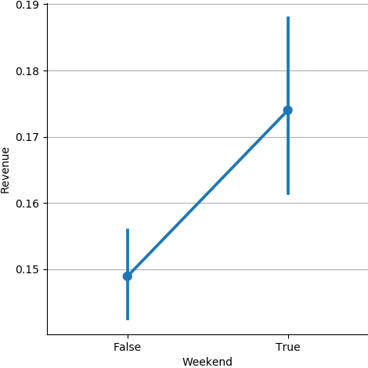
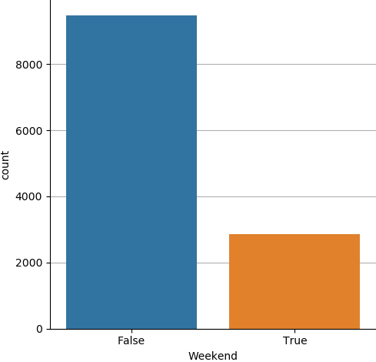
EDA - Weekend
P(Revenue) ~ P(No Revenue). Most visits on weekends.

Slide 32
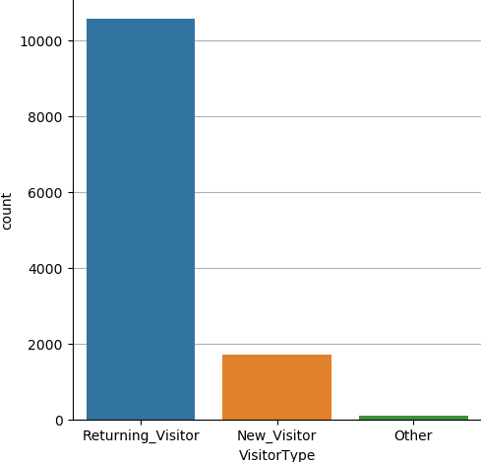
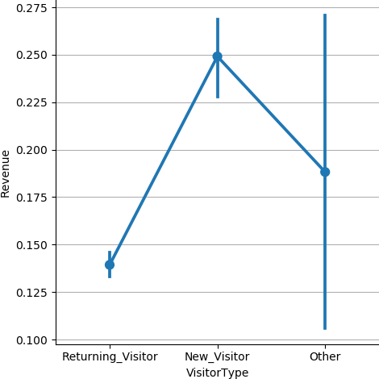
EDA - VisitorType
Despite Most Visits by Returning_Visitor, New_Visitor Most Likely To Purchase.

Slide 33
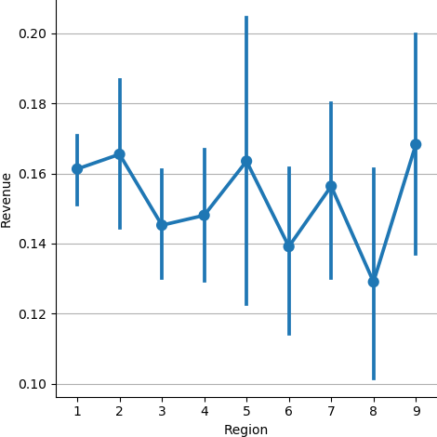
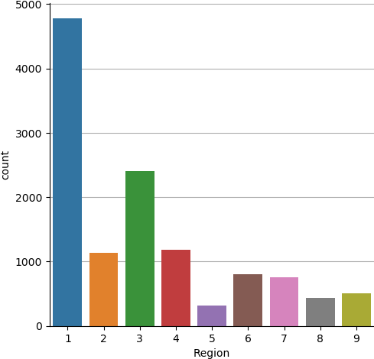
EDA - Region
With most visits, Region 1 has one of the best conversion rates with low error.

Slide 34
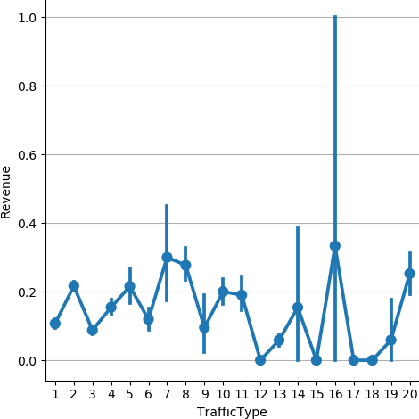
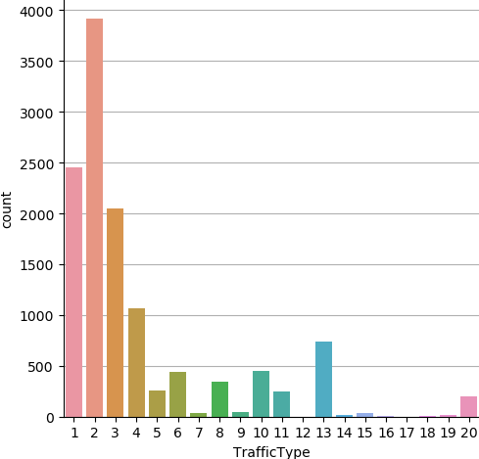
EDA - TrafficType
With most visits, type 2 has one of the best conversion rates with low error.

Slide 35
Feature Extraction
<page_type> and <page_type>_Durations were correlated, where <page_type> is either of Administrative, Informational.
Therefore, these features were combined and tested. Eg. A+Ad = Administrative + Administrative_Duration.
Since, ProductRelated and ProductRelated_Duration were highly correlated, ProductRelated_Duration was dropped.
ExitRates was also dropped due to high correlation with BounceRates.
However, performance on Validation Set was inferior to A+I+PR, Ad+Id+PRd scheme and hence they were not evaluated on Test Set.

Slide 36
Preprocessing/Model Selection
Categorical variables Month, VisitorType, Weekend and Revenue were Level Encoded .
All numerical features were scaled to zero mean and unit variance.
OneHot encoding was tried but level encoding gave better results.
Model parameters were selected using 5 fold Cross Validation.

Slide 37
Feature Selection
An instance of RandomForestClassifier with default parameters was used for selecting features from the 17 Level Encoded features.
RandomForestClassifier was chosen for Feature Selection cause RFCs are non-linear models.
For each of the classifiers built, ‘mean’ and ‘median’ thresholds were tried for SelectFromModel while selecting features.
‘mean’ threshold selected less features.
‘median’ threhold selected more features.

Slide 38
CV Results - Random Forest Classifier
___RandomForestClassifier___
BEST PARAMS: {'class_weight': None, 'max_depth': 10, 'n_estimators': 75}
0.869 (+/-0.013) for {'class_weight': None, 'max_depth': 2, 'n_estimators': 5}
0.881 (+/-0.017) for {'class_weight': None, 'max_depth': 2, 'n_estimators': 50}
0.864 (+/-0.007) for {'class_weight': None, 'max_depth': 2, 'n_estimators': 75}
0.852 (+/-0.006) for {'class_weight': None, 'max_depth': 2, 'n_estimators': 100}
0.894 (+/-0.012) for {'class_weight': None, 'max_depth': 10, 'n_estimators': 5}
0.904 (+/-0.009) for {'class_weight': None, 'max_depth': 10, 'n_estimators': 50}
0.905 (+/-0.009) for {'class_weight': None, 'max_depth': 10, 'n_estimators': 75}
0.905 (+/-0.01) for {'class_weight': None, 'max_depth': 10, 'n_estimators': 100}
0.894 (+/-0.01) for {'class_weight': None, 'max_depth': 20, 'n_estimators': 5}
0.9 (+/-0.013) for {'class_weight': None, 'max_depth': 20, 'n_estimators': 50}
0.9 (+/-0.012) for {'class_weight': None, 'max_depth': 20, 'n_estimators': 75}
0.901 (+/-0.013) for {'class_weight': None, 'max_depth': 20, 'n_estimators': 100}
0.887 (+/-0.008) for {'class_weight': None, 'max_depth': None, 'n_estimators': 5}
0.899 (+/-0.015) for {'class_weight': None, 'max_depth': None, 'n_estimators': 50}
0.898 (+/-0.011) for {'class_weight': None, 'max_depth': None, 'n_estimators': 75}
0.898 (+/-0.013) for {'class_weight': None, 'max_depth': None, 'n_estimators': 100}
0.876 (+/-0.02) for {'class_weight': 'balanced', 'max_depth': 2, 'n_estimators': 5}
0.874 (+/-0.02) for {'class_weight': 'balanced', 'max_depth': 2, 'n_estimators': 50}
0.874 (+/-0.02) for {'class_weight': 'balanced', 'max_depth': 2, 'n_estimators': 75}
0.874 (+/-0.02) for {'class_weight': 'balanced', 'max_depth': 2, 'n_estimators': 100}
0.881 (+/-0.016) for {'class_weight': 'balanced', 'max_depth': 10, 'n_estimators': 5}
0.89 (+/-0.016) for {'class_weight': 'balanced', 'max_depth': 10, 'n_estimators': 50}
0.89 (+/-0.013) for {'class_weight': 'balanced', 'max_depth': 10, 'n_estimators': 75}
0.89 (+/-0.013) for {'class_weight': 'balanced', 'max_depth': 10, 'n_estimators': 100}
0.893 (+/-0.014) for {'class_weight': 'balanced', 'max_depth': 20, 'n_estimators': 5}
0.899 (+/-0.012) for {'class_weight': 'balanced', 'max_depth': 20, 'n_estimators': 50}
0.9 (+/-0.009) for {'class_weight': 'balanced', 'max_depth': 20, 'n_estimators': 75}
0.9 (+/-0.009) for {'class_weight': 'balanced', 'max_depth': 20, 'n_estimators': 100}
0.89 (+/-0.007) for {'class_weight': 'balanced', 'max_depth': None, 'n_estimators': 5}
0.899 (+/-0.013) for {'class_weight': 'balanced', 'max_depth': None, 'n_estimators': 50}
0.9 (+/-0.014) for {'class_weight': 'balanced', 'max_depth': None, 'n_estimators': 75}
0.899 (+/-0.014) for {'class_weight': 'balanced', 'max_depth': None, 'n_estimators': 100}
0.876 (+/-0.02) for {'class_weight': 'balanced_subsample', 'max_depth': 2, 'n_estimators': 5}
0.874 (+/-0.02) for {'class_weight': 'balanced_subsample', 'max_depth': 2, 'n_estimators': 50}
0.874 (+/-0.02) for {'class_weight': 'balanced_subsample', 'max_depth': 2, 'n_estimators': 75}
0.874 (+/-0.02) for {'class_weight': 'balanced_subsample', 'max_depth': 2, 'n_estimators': 100}
0.88 (+/-0.023) for {'class_weight': 'balanced_subsample', 'max_depth': 10, 'n_estimators': 5}
0.89 (+/-0.014) for {'class_weight': 'balanced_subsample', 'max_depth': 10, 'n_estimators': 50}
0.891 (+/-0.015) for {'class_weight': 'balanced_subsample', 'max_depth': 10, 'n_estimators': 75}
0.89 (+/-0.017) for {'class_weight': 'balanced_subsample', 'max_depth': 10, 'n_estimators': 100}
0.892 (+/-0.017) for {'class_weight': 'balanced_subsample', 'max_depth': 20, 'n_estimators': 5}
0.899 (+/-0.014) for {'class_weight': 'balanced_subsample', 'max_depth': 20, 'n_estimators': 50}
0.9 (+/-0.013) for {'class_weight': 'balanced_subsample', 'max_depth': 20, 'n_estimators': 75}
0.9 (+/-0.011) for {'class_weight': 'balanced_subsample', 'max_depth': 20, 'n_estimators': 100}
0.891 (+/-0.015) for {'class_weight': 'balanced_subsample', 'max_depth': None, 'n_estimators': 5}
0.898 (+/-0.014) for {'class_weight': 'balanced_subsample', 'max_depth': None, 'n_estimators': 50}
0.898 (+/-0.016) for {'class_weight': 'balanced_subsample', 'max_depth': None, 'n_estimators': 75}
0.899 (+/-0.015) for {'class_weight': 'balanced_subsample', 'max_depth': None, 'n_estimators': 100}
Columns selected for median threshold Index(['BounceRates', 'PageValues', 'Month', 'OperatingSystems', 'Browser',
'Weekend'],
dtype='object')
Feature Selection threshold type: median
ROC AUC - Validation Set: 0.9303883490267408
Classification report - Validation Set:
precision recall f1-score support
0 0.93 0.96 0.94 2084
1 0.74 0.59 0.66 382
accuracy 0.90 2466
macro avg 0.83 0.78 0.80 2466
weighted avg 0.90 0.90 0.90 2466
Best estimator:
# of features: 6
Features Importance: [0.09371218 0.5936792 0.09457548 0.11967652 0.05835713 0.03999949]
ROC AUC - Test Set: 0.9191758404300182
Classification report - Test Set:
precision recall f1-score support
0 0.92 0.96 0.94 2085
1 0.74 0.55 0.63 381
accuracy 0.90 2466
macro avg 0.83 0.76 0.79 2466
weighted avg 0.89 0.90 0.89 2466

Slide 39
CV Results - K Nearest Neighbors
___KNeighborsClassifier___
BEST PARAMS: {'n_neighbors': 18, 'p': 2, 'weights': 'uniform'}
0.853 (+/-0.014) for {'n_neighbors': 1, 'p': 1, 'weights': 'uniform'}
0.853 (+/-0.014) for {'n_neighbors': 1, 'p': 1, 'weights': 'distance'}
0.853 (+/-0.012) for {'n_neighbors': 1, 'p': 2, 'weights': 'uniform'}
0.853 (+/-0.012) for {'n_neighbors': 1, 'p': 2, 'weights': 'distance'}
0.876 (+/-0.007) for {'n_neighbors': 2, 'p': 1, 'weights': 'uniform'}
0.853 (+/-0.014) for {'n_neighbors': 2, 'p': 1, 'weights': 'distance'}
0.874 (+/-0.007) for {'n_neighbors': 2, 'p': 2, 'weights': 'uniform'}
0.853 (+/-0.012) for {'n_neighbors': 2, 'p': 2, 'weights': 'distance'}
0.881 (+/-0.019) for {'n_neighbors': 3, 'p': 1, 'weights': 'uniform'}
0.871 (+/-0.014) for {'n_neighbors': 3, 'p': 1, 'weights': 'distance'}
0.882 (+/-0.012) for {'n_neighbors': 3, 'p': 2, 'weights': 'uniform'}
0.874 (+/-0.014) for {'n_neighbors': 3, 'p': 2, 'weights': 'distance'}
0.886 (+/-0.011) for {'n_neighbors': 4, 'p': 1, 'weights': 'uniform'}
0.878 (+/-0.009) for {'n_neighbors': 4, 'p': 1, 'weights': 'distance'}
0.884 (+/-0.011) for {'n_neighbors': 4, 'p': 2, 'weights': 'uniform'}
0.878 (+/-0.009) for {'n_neighbors': 4, 'p': 2, 'weights': 'distance'}
0.887 (+/-0.011) for {'n_neighbors': 5, 'p': 1, 'weights': 'uniform'}
0.88 (+/-0.01) for {'n_neighbors': 5, 'p': 1, 'weights': 'distance'}
0.887 (+/-0.012) for {'n_neighbors': 5, 'p': 2, 'weights': 'uniform'}
0.883 (+/-0.012) for {'n_neighbors': 5, 'p': 2, 'weights': 'distance'}
0.889 (+/-0.011) for {'n_neighbors': 6, 'p': 1, 'weights': 'uniform'}
0.883 (+/-0.009) for {'n_neighbors': 6, 'p': 1, 'weights': 'distance'}
0.886 (+/-0.013) for {'n_neighbors': 6, 'p': 2, 'weights': 'uniform'}
0.882 (+/-0.01) for {'n_neighbors': 6, 'p': 2, 'weights': 'distance'}
0.891 (+/-0.008) for {'n_neighbors': 7, 'p': 1, 'weights': 'uniform'}
0.884 (+/-0.012) for {'n_neighbors': 7, 'p': 1, 'weights': 'distance'}
0.887 (+/-0.008) for {'n_neighbors': 7, 'p': 2, 'weights': 'uniform'}
0.882 (+/-0.01) for {'n_neighbors': 7, 'p': 2, 'weights': 'distance'}
0.891 (+/-0.009) for {'n_neighbors': 8, 'p': 1, 'weights': 'uniform'}
0.885 (+/-0.009) for {'n_neighbors': 8, 'p': 1, 'weights': 'distance'}
0.887 (+/-0.009) for {'n_neighbors': 8, 'p': 2, 'weights': 'uniform'}
0.884 (+/-0.01) for {'n_neighbors': 8, 'p': 2, 'weights': 'distance'}
0.891 (+/-0.008) for {'n_neighbors': 9, 'p': 1, 'weights': 'uniform'}
0.887 (+/-0.008) for {'n_neighbors': 9, 'p': 1, 'weights': 'distance'}
0.888 (+/-0.009) for {'n_neighbors': 9, 'p': 2, 'weights': 'uniform'}
0.884 (+/-0.009) for {'n_neighbors': 9, 'p': 2, 'weights': 'distance'}
0.892 (+/-0.009) for {'n_neighbors': 10, 'p': 1, 'weights': 'uniform'}
0.887 (+/-0.011) for {'n_neighbors': 10, 'p': 1, 'weights': 'distance'}
0.887 (+/-0.007) for {'n_neighbors': 10, 'p': 2, 'weights': 'uniform'}
0.884 (+/-0.007) for {'n_neighbors': 10, 'p': 2, 'weights': 'distance'}
0.893 (+/-0.007) for {'n_neighbors': 11, 'p': 1, 'weights': 'uniform'}
0.888 (+/-0.01) for {'n_neighbors': 11, 'p': 1, 'weights': 'distance'}
0.886 (+/-0.009) for {'n_neighbors': 11, 'p': 2, 'weights': 'uniform'}
0.883 (+/-0.01) for {'n_neighbors': 11, 'p': 2, 'weights': 'distance'}
0.891 (+/-0.008) for {'n_neighbors': 12, 'p': 1, 'weights': 'uniform'}
0.887 (+/-0.008) for {'n_neighbors': 12, 'p': 1, 'weights': 'distance'}
0.887 (+/-0.006) for {'n_neighbors': 12, 'p': 2, 'weights': 'uniform'}
0.884 (+/-0.011) for {'n_neighbors': 12, 'p': 2, 'weights': 'distance'}
0.892 (+/-0.007) for {'n_neighbors': 13, 'p': 1, 'weights': 'uniform'}
0.888 (+/-0.01) for {'n_neighbors': 13, 'p': 1, 'weights': 'distance'}
0.888 (+/-0.006) for {'n_neighbors': 13, 'p': 2, 'weights': 'uniform'}
0.885 (+/-0.01) for {'n_neighbors': 13, 'p': 2, 'weights': 'distance'}
0.893 (+/-0.011) for {'n_neighbors': 14, 'p': 1, 'weights': 'uniform'}
0.888 (+/-0.013) for {'n_neighbors': 14, 'p': 1, 'weights': 'distance'}
0.889 (+/-0.006) for {'n_neighbors': 14, 'p': 2, 'weights': 'uniform'}
0.885 (+/-0.011) for {'n_neighbors': 14, 'p': 2, 'weights': 'distance'}
0.893 (+/-0.011) for {'n_neighbors': 15, 'p': 1, 'weights': 'uniform'}
0.888 (+/-0.009) for {'n_neighbors': 15, 'p': 1, 'weights': 'distance'}
0.891 (+/-0.009) for {'n_neighbors': 15, 'p': 2, 'weights': 'uniform'}
0.887 (+/-0.011) for {'n_neighbors': 15, 'p': 2, 'weights': 'distance'}
0.892 (+/-0.011) for {'n_neighbors': 16, 'p': 1, 'weights': 'uniform'}
0.889 (+/-0.009) for {'n_neighbors': 16, 'p': 1, 'weights': 'distance'}
0.892 (+/-0.008) for {'n_neighbors': 16, 'p': 2, 'weights': 'uniform'}
0.887 (+/-0.01) for {'n_neighbors': 16, 'p': 2, 'weights': 'distance'}
0.892 (+/-0.009) for {'n_neighbors': 17, 'p': 1, 'weights': 'uniform'}
0.889 (+/-0.011) for {'n_neighbors': 17, 'p': 1, 'weights': 'distance'}
0.892 (+/-0.007) for {'n_neighbors': 17, 'p': 2, 'weights': 'uniform'}
0.889 (+/-0.011) for {'n_neighbors': 17, 'p': 2, 'weights': 'distance'}
0.891 (+/-0.012) for {'n_neighbors': 18, 'p': 1, 'weights': 'uniform'}
0.889 (+/-0.011) for {'n_neighbors': 18, 'p': 1, 'weights': 'distance'}
0.893 (+/-0.01) for {'n_neighbors': 18, 'p': 2, 'weights': 'uniform'}
0.889 (+/-0.011) for {'n_neighbors': 18, 'p': 2, 'weights': 'distance'}
0.891 (+/-0.011) for {'n_neighbors': 19, 'p': 1, 'weights': 'uniform'}
0.889 (+/-0.013) for {'n_neighbors': 19, 'p': 1, 'weights': 'distance'}
0.892 (+/-0.006) for {'n_neighbors': 19, 'p': 2, 'weights': 'uniform'}
0.89 (+/-0.012) for {'n_neighbors': 19, 'p': 2, 'weights': 'distance'}
Columns selected for mean threshold Index(['BounceRates', 'PageValues', 'Month', 'OperatingSystems'], dtype='object')
Feature Selection threshold type: mean
ROC AUC - Validation Set: 0.8714859412527258
Classification report - Validation Set:
precision recall f1-score support
0 0.91 0.96 0.94 2084
1 0.69 0.51 0.59 382
accuracy 0.89 2466
macro avg 0.80 0.73 0.76 2466
weighted avg 0.88 0.89 0.88 2466

Slide 40
CV Results - Logistic Regression
___LogisticRegression___
BEST PARAMS: {'C': 0.45000000000000007, 'class_weight': None}
0.883 (+/-0.01) for {'C': 0.1, 'class_weight': None}
0.875 (+/-0.017) for {'C': 0.1, 'class_weight': 'balanced'}
0.883 (+/-0.01) for {'C': 0.15000000000000002, 'class_weight': None}
0.875 (+/-0.017) for {'C': 0.15000000000000002, 'class_weight': 'balanced'}
0.883 (+/-0.01) for {'C': 0.20000000000000004, 'class_weight': None}
0.876 (+/-0.017) for {'C': 0.20000000000000004, 'class_weight': 'balanced'}
0.883 (+/-0.011) for {'C': 0.25000000000000006, 'class_weight': None}
0.876 (+/-0.017) for {'C': 0.25000000000000006, 'class_weight': 'balanced'}
0.884 (+/-0.01) for {'C': 0.30000000000000004, 'class_weight': None}
0.876 (+/-0.017) for {'C': 0.30000000000000004, 'class_weight': 'balanced'}
0.884 (+/-0.01) for {'C': 0.3500000000000001, 'class_weight': None}
0.876 (+/-0.017) for {'C': 0.3500000000000001, 'class_weight': 'balanced'}
0.884 (+/-0.01) for {'C': 0.40000000000000013, 'class_weight': None}
0.876 (+/-0.017) for {'C': 0.40000000000000013, 'class_weight': 'balanced'}
0.884 (+/-0.011) for {'C': 0.45000000000000007, 'class_weight': None}
0.876 (+/-0.017) for {'C': 0.45000000000000007, 'class_weight': 'balanced'}
0.884 (+/-0.011) for {'C': 0.5000000000000001, 'class_weight': None}
0.876 (+/-0.017) for {'C': 0.5000000000000001, 'class_weight': 'balanced'}
0.884 (+/-0.011) for {'C': 0.5500000000000002, 'class_weight': None}
0.875 (+/-0.017) for {'C': 0.5500000000000002, 'class_weight': 'balanced'}
0.884 (+/-0.011) for {'C': 0.6000000000000002, 'class_weight': None}
0.875 (+/-0.017) for {'C': 0.6000000000000002, 'class_weight': 'balanced'}
0.884 (+/-0.011) for {'C': 0.6500000000000001, 'class_weight': None}
0.875 (+/-0.017) for {'C': 0.6500000000000001, 'class_weight': 'balanced'}
0.884 (+/-0.011) for {'C': 0.7000000000000002, 'class_weight': None}
0.875 (+/-0.017) for {'C': 0.7000000000000002, 'class_weight': 'balanced'}
0.884 (+/-0.011) for {'C': 0.7500000000000002, 'class_weight': None}
0.875 (+/-0.017) for {'C': 0.7500000000000002, 'class_weight': 'balanced'}
0.884 (+/-0.011) for {'C': 0.8000000000000002, 'class_weight': None}
0.875 (+/-0.017) for {'C': 0.8000000000000002, 'class_weight': 'balanced'}
0.884 (+/-0.011) for {'C': 0.8500000000000002, 'class_weight': None}
0.875 (+/-0.017) for {'C': 0.8500000000000002, 'class_weight': 'balanced'}
0.884 (+/-0.011) for {'C': 0.9000000000000002, 'class_weight': None}
0.875 (+/-0.017) for {'C': 0.9000000000000002, 'class_weight': 'balanced'}
0.884 (+/-0.011) for {'C': 0.9500000000000003, 'class_weight': None}
0.875 (+/-0.017) for {'C': 0.9500000000000003, 'class_weight': 'balanced'}
0.884 (+/-0.011) for {'C': 1.0000000000000004, 'class_weight': None}
0.875 (+/-0.017) for {'C': 1.0000000000000004, 'class_weight': 'balanced'}
Columns selected for mean threshold Index(['BounceRates', 'PageValues', 'Month', 'OperatingSystems'], dtype='object')
Feature Selection threshold type: mean
ROC AUC - Validation Set: 0.8841221071037372
Classification report - Validation Set:
precision recall f1-score support
0 0.89 0.98 0.93 2084
1 0.74 0.36 0.49 382
accuracy 0.88 2466
macro avg 0.82 0.67 0.71 2466
weighted avg 0.87 0.88 0.86 2466
Best estimator:
Coefficients: [[-0.88421985 1.4743059 0.24827604 0.05178001]]
Intercept: [-2.16493176]

Slide 41
Languages & Libraries Used
Language: Python 3
Libraries:
Scikit-learn
Seaborn
Matplotlib
Pandas
Numpy

