Slide 1
Task

Slide 2

AGENDA
Introduction
Problem Statement
Solution & Code Walkthrough
Extraction
Transformation
Load
Visualization
Live Demo
Shortcomings & Future Changes

Slide 3

Problem Statement
Functional:
Writing Extract-Transform-Load application to manipulate & Consolidate the data presented at local UK Traffic commissioner authority
Data is present in different URLs but having the same structure (same number of columns with same name)
Able to distinguish the data between “Goods Vehicle” and “Public Service Vehicle”
Application should consolidate the data from 8 offices
Data to be stored in the structured database to apply the visualization
Provide the data intelligence based on “Vehicles Specified”
Technical:
Use Python to write the logic of extraction and transformation
Use any database to store structured database – MySql Workbench
Use any visualization tool – MS Power BI & Python libraries

Slide 4
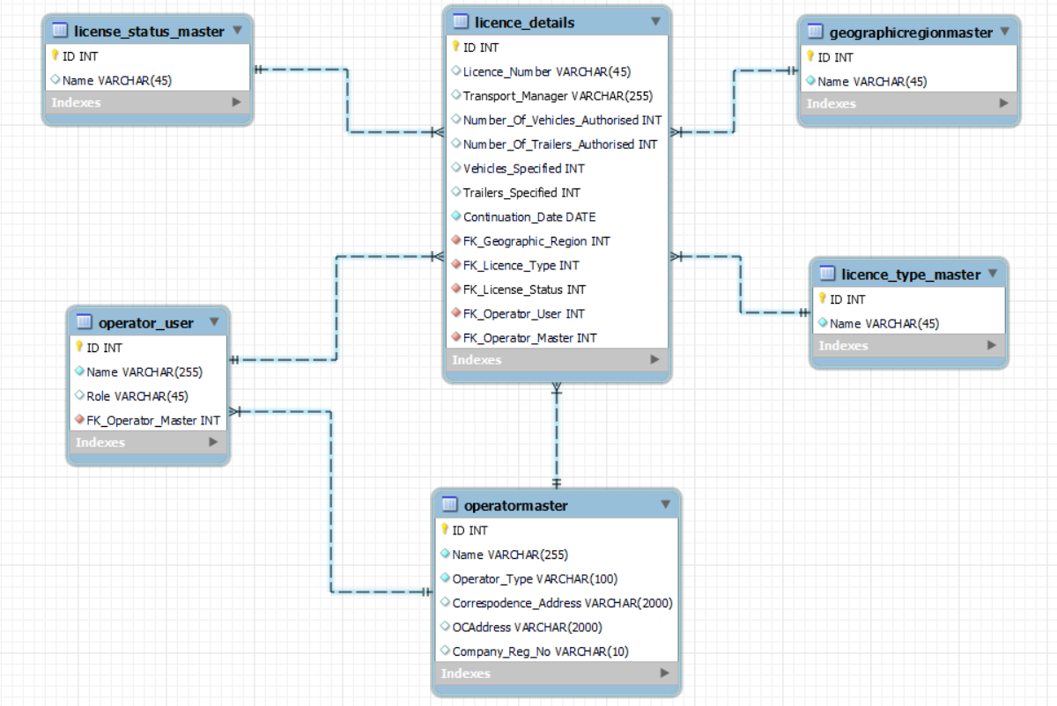
Solution & Code Walkthrough
TRANSFORM
Decompose the data in the following ERD Structure
EXTRACT
Retrieving the CSV from URL – used Beautiful Soup to locate the CSV file in HTML tag
In memory data consolidation of 8 files to reduce the duration
Removing the duplicate & NULL records
Then store the file locally
LOAD
Master Data: Check if existing record doesn’t exist then insert and get latest primary key OR used existing one
Insert into License_Details with all FK data

Slide 5
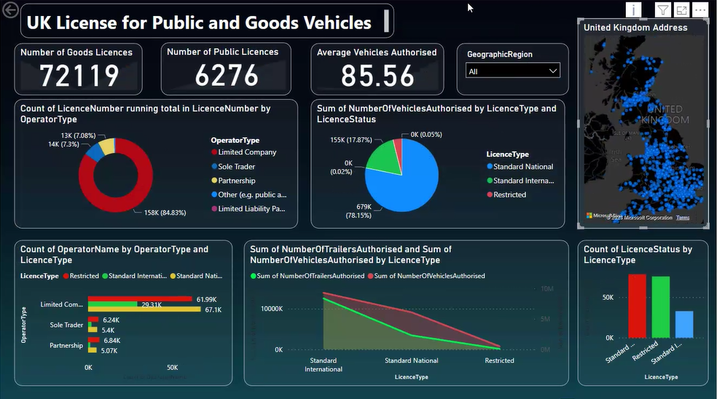
Visualization (Business Intelligence)
Key Factors
Creating the dashboard using MS Power BI
Showing license count with different criteria
Geography filter
Microsoft Bing Map Integration
Operator Insight
License Office Insight
Dataset analysis on “Whole Data”, can be developed for the weekly dashboard as well

Slide 6

Live Demo
Prerequisite:
Empty the database
Chunk Data of 500 rows.

Slide 7

Shortcomings & Future Changes
Performance of the solution can be improved by using Apache Parquet where the file manipulation can be done – Column as Rows
Personal laptop doesn’t have high compute power. Testing server with better CPU configuration may improve the performance
List of the duplicate records are not stored
Failed operations logging not implemented
Fault tolerance logic is not implemented
Company(Operator) details can be extended using company house API

Slide 8
Thank You

