Slide 1
PERMAFROST AREA MONITORING USING POLSAR
GNR 618 Course Project
Submitted By:
Karan Chittora (180040050)
Ritvik Sharma (180040083)
Sahil Singh (180040087)
Sumit Suresh Shere (180040108)

Slide 2
Contents
Introduction
Methodology
Results
Discussion
Conclusion
References

Slide 3
INTRODUCTION

Slide 4
INTRODUCTION
Permafrost is any type of ground frozen continuously for more than two years.
It extends down beneath earth’s surface from few feet to more than a mile.
Water trapped in sediments, soils, and cracks and pores of rocks freezes and turns to ice when temperature drop below 0ºC.
If the ground freezes and thaws every year, it is called as seasonally frozen.

Slide 5
INTRODUCTION
PolSARPro:
Polarimetric SAR Data Processing and Education Toolbox
Supports the scientific exploitation of polarimetric SAR data
Specialized in the analysis of fully-polarimetric data (HH, HV, VH, VV)
SNAP:
Can load SAR data, pre-process it, calibrate it, filter it, terrain correct it, and so on
PolSARPro & SNAP

Slide 6
INTRODUCTION
Unsupervised Classification
Unsupervised classification helps in identifying and aggregating pixels with similar features.
it automatically determines what classes exist in the data and how best each pixel can be grouped.
K-means Clustering
K-Means is a clustering algorithm divides observations into k clusters.
it can be easily used in a classification where we divide data into clusters that can be equal to or more than the number of classes
Unsupervised Classification - K-means Clustering

Slide 7
INTRODUCTION
Supervised Classification
Supervised image classification is a procedure for identifying spectrally similar areas on an image.
It requires training data that are typical and homogeneous and the application of a set of methods, or decision rules
Maximum Likelihood Classifier
Maximum likelihood classification assumes that the statistics for each class in each band are normally distributed
It calculates the probability that a given pixel belongs to a specific class.
Supervised Classification - Maximum Likelihood Classifier

Slide 8
METHODOLOGY

Slide 9
METHODOLOGY
Radiometric Calibration
For quantitative use of SAR data, it is essential that the data should first be calibrated.
Calibration radiometrically corrects a SAR image so that the pixel values truly represent the radar backscatter of the reflecting surface.
Polarimetric Processing
Whenever electromagnetic radiation is reflected from a surface, it becomes polarised to a degree, dependent upon the surface structure
With Polarimetric Processing, it is possible to reveal a detail about the surface that cannot be obtained by any other imaging technique

Slide 10
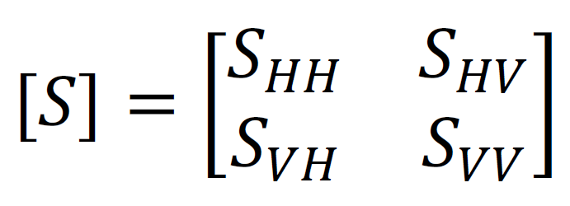
METHODOLOGY
Polarimetric Matrix Generation
A radar wave of a specific polarization, when interacts with the target surface, experiences change in its polarization state
The wave reradiated from the target surface after this interaction will have response not only in horizontal polarization but also in vertical polarization as well
In terms of SAR polarimetry, these responses from the backscattered wave in each polarization channel are stored in the form of 2 x 2 scattering matrix
The scattering matrix describes the information of the pure target exhibiting a particular scattering mechanism.

Slide 11
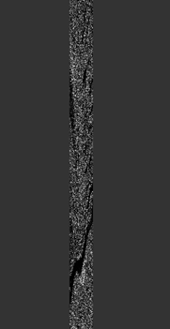
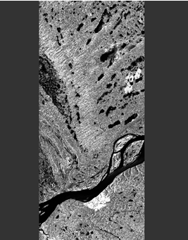
T11 Band after Matrix Generation
Before Multilooking
After Multilooking

Slide 12
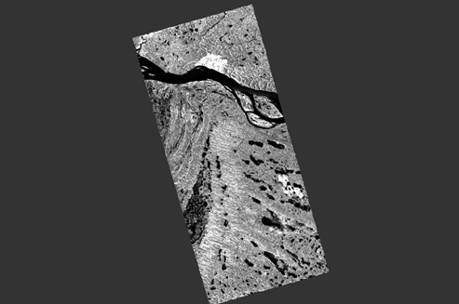
METHODOLOGY
Terrain Correction
Terrain Correction geocodes the image by correcting SAR geometric distortions using a digital elevation model (DEM) and producing a map projected product
Geocoding converts an image from slant range or ground range geometry into a map coordinate system
T11 Band After Terrain Correction

Slide 13
METHODOLOGY
Polarimetric Decomposition
Polarimetric decompositions allow the separation of different scattering contributions and can be used to extract information about the scattering process
The objective of the decompositions is to express the measured scattering matrix by the radar as the combination of the scattering responses of simpler objects
[𝑆] = Σ 𝐶_{i}[𝑆]_{i}
For PolSAR images including urban areas, the reflection symmetry condition does not hold. Thus, the well-established four-component Yamaguchi model is used

Slide 14
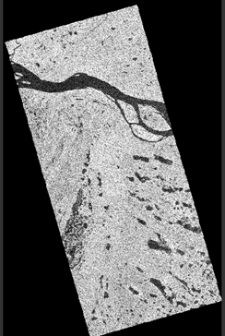
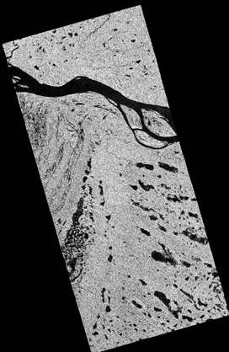
Images after Decomposition
Yamaguchi Decomposition
Singh i6SD Decomposition

Slide 15
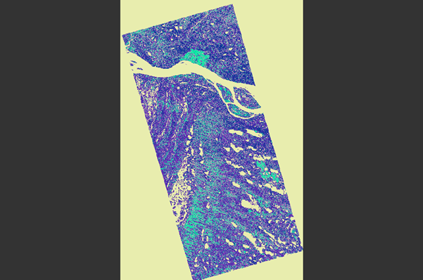
METHODOLOGY
K-Means Cluster Analysis
The objective of K-means is to group similar data points together and discover underlying patterns.
The K-means algorithm in data mining starts with a first group of randomly selected centroids, which are used as the beginning points for every cluster, and then performs iterative (repetitive) calculations to optimize the positions of the centroids.
T33 class indices image after k-means clustering

Slide 16
METHODOLOGY
K-means Cluster Analysis
The classifier undertakes various iterations with random cluster centers of the multidimensional feature space to find pixels of similar properties.
The output is a product with a single band, where each pixel is assigned to one of the classes (clusters)
Maximum Likelihood Classifier
Maximum Likelihood is a supervised classification method derived from the Bayes theorem
calculates the probability that a given pixel belongs to a specific class
Each pixel is assigned to the class that has the highest probability (that is, the maximum likelihood)

Slide 17
RESULTS

Slide 18
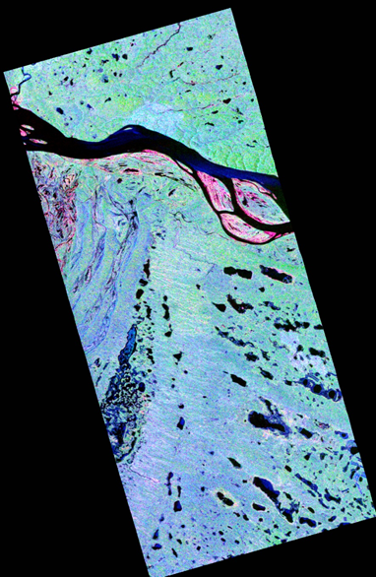
RESULTS
The image obtained after the Range-Doppler Terrain Correction needed to be decomposed before classification. We performed Yamaguchi Decomposition in SNAP, but for better output Singh i6SD decomposition was performed in the PolSARPro software. The output obtained after creating a RGB image with Blue, Green and Red input as Odd, Vol and Dbl layers respectively of i6SD decomposed image is shown

Slide 19
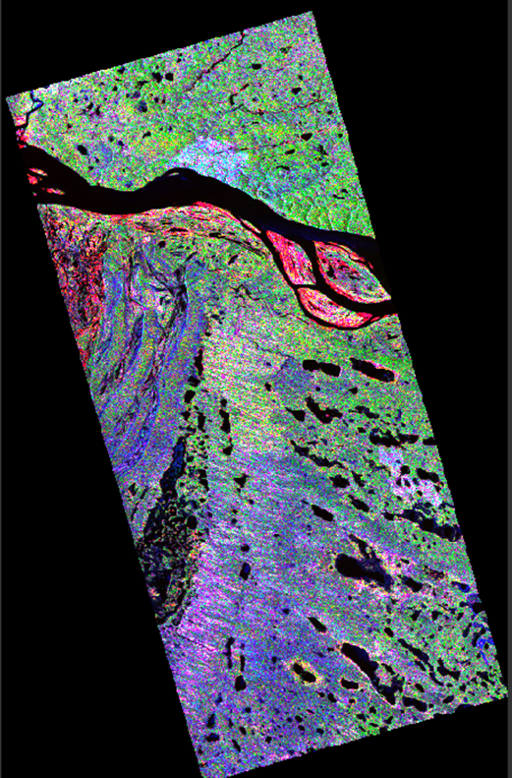
RESULTS
The final image obtained from the T33 Matrix with clear differentiation of various landscape features

Slide 20
DISCUSSION

Slide 21
DISCUSSION
The SAR data provided consisted of four polarizations – HH, HV, VH, VV
The processing was done using SNAP software to make the image easier to analyze using operations like Multi-looking, Terrain Correction, decomposition, etc.
In the final image obtained, we can clearly classify various landscape features of the Permafrost.
There is a large water body passing in the middle.
Shrubs, vegetation, ponds, wet snow, etc. in small regions above the water body.
The reddish colored layer comprises of the land surface or rocks.
Below the large water body, the major part is snow covered area along with vegetation and small water bodies like lakes, ponds etc.

Slide 22
CONCLUSION

Slide 23
CONCLUSION
Permafrost is a permanently frozen layer on or under Earth's surface consisting of soil, gravel, and sand, usually bound together by ice.
Permafrost covers approximately 22.8 million square kilometers (about 8.8 million square miles) in Earth's Northern Hemisphere.
The Sentinel Application Platform (SNAP) basic function includes: opening a product, exploring the product components such as bands, masks, and tie point grids.
The PolSARpro software is controlled through a user-friendly, intuitive graphical interface, which enables the user to select a function, set its parameters, and then run it.
Experimental results on real PolSAR dataset demonstrate the proposed methods are signiﬁcantly effective.
The Clustering classiﬁcation model could achieve impressive classiﬁcation performance compared to the comparison algorithm.
The results might be further improved by researching the deep networking order to extract more valid PolSAR classiﬁcation features.

Slide 24
REFERENCES
W. Gareth Rees - Remote sensing of snow and ice-Taylor & Francis (2006).
Lecture Slides - GNR618 - Prof. Gulab Singh - IIT Bombay
http://step.esa.int/docs/tutorials/S1TBX%20Landcover%20classification%20with%20Sentinel-1%20GRD.pdf
http://step.esa.int/docs/tutorials/S1TBX%20Polarimetry%20with%20Radarsat-2%20Tutorial_v2.pdf
https://ieeexplore.ieee.org/iel7/6287639/8274985/08412178.pdf
https://sites.google.com/site/dataclusteringalgorithms/k-means-clustering-algorithm
https://www.researchgate.net/publication/326474084_POLSAR_image_classification_via_Clustering-WAE_classification_model

Slide 25
THANK YOU

