Slide 1

HUMAN RESOURCE MANAGEMENT SYSTEM
Supervisor:
Mr. Avay Kafle
Birendra Memorial College
A BSc.CSIT Final Year Project
Birendra Memorial College
Institute of Science and Technology
Dharan, Nepal
By:
Aastha Bajracharya (21420/075)
Kiran Nepal (21427/075)
Sandesh Adhikari (21437/075)

Slide 2
ABSTRACT:
Human Resource Management System (HRMS) is a software suite that provides a complete solution for managing HR processes throughout an employee’s career. This project aims to design and develop an HRMS for a fictitious organization that can be used to manage employee data, attendance, payroll, and performance analysis. The system is designed to be web-based, allowing employees to access their information from anywhere with an internet connection. The project utilizes a range of technologies, including Flutter, Python, Django, MySQL, and APIs..

Slide 3






OUTLINES:
Introduction
Background Study
System Analysis
System Design
Implementation and Testing
Conclusion and Future Recommendations

Slide 4


INTRODUCTION:
An HRMS is a suite of software programs to manage human resources and associated procedures into one package.
Some key points to describe our project:
Centralized Organizational platform
Automated Attendance using Face Recognition Technology
Focused on improving the productivity and efficiency of an organization

Slide 5
Absence of proper HRM software, create huge effect on managing resources in effective way.
PROBLEM STATEMENT:
Absence of work discipline and punctuality may lead to shrink in employee performance.
Flaws in the data organization can create huge loss for the organization.

Slide 6

To mark the attendance of the employee with the use of Face Recognition Technology.
OBJECTIVES:
To help businesses manage and store employee data in a centralized location.

Slide 7
Scope
To develop system that automates HR process​
Provide Centralized Database ​
Limitation
Not able to detect attendance beyond the premises​
System cannot be scalable to other business with different requirements​
Track and Access Employee performance​
May not be able to covers all the HR functions.​
SCOPE AND LIMITATION:

Slide 8
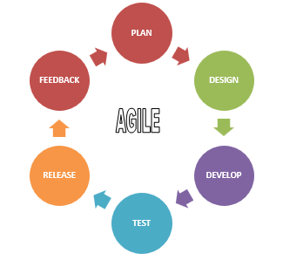
The project was developed by following Agile Software Development Approach.
As it is flexible and iterative approach that focuses on customer satisfaction and allows for continuous improvement throughout the project lifecycle.
METHODOLOGY:

Slide 9
The HRMS project is developing a system that manages employee data and attendance using face recognition technology. HRMS systems play a critical role in managing an organization's workforce by ensuring the right people are in the right roles.
Face recognition technology matches an individual's facial features with a database of known faces, allowing for automated attendance.
Agile methodology is used to provide flexibility, collaboration, and continuous improvement.
BACKGROUND STUDY:

Slide 10
System analysis studies the system, identifying requirements, solving problems, identifying opportunities.
It includes:
Requirement Analysis
SYSTEM ANALYSIS:
Feasibility Analysis

Slide 11
Functional
Requirements
Registration
Non-Functional Requirements
Accessibility
Login
Attendance
Designation
Maintainability
Scalability
Portability
Face Recognition
REQUIREMENT ANALYSIS:

Slide 12
Technical: System used Flutter. Python, Django, as programming languages and MYSQL as a database, which are readily available with extensive development support.
Operational: System is user-friendly and easy to adopt. Therefore, the organization will easily accept the system as the system is an effective and efficient solution for managing all HR tasks.
KEY CONSIDERATIONS IN FEASIBILITY STUDY:
Economic: System is economically feasible as all the technologies used were already available
Schedule: System was developed with in the certain allocated time period.

Slide 13
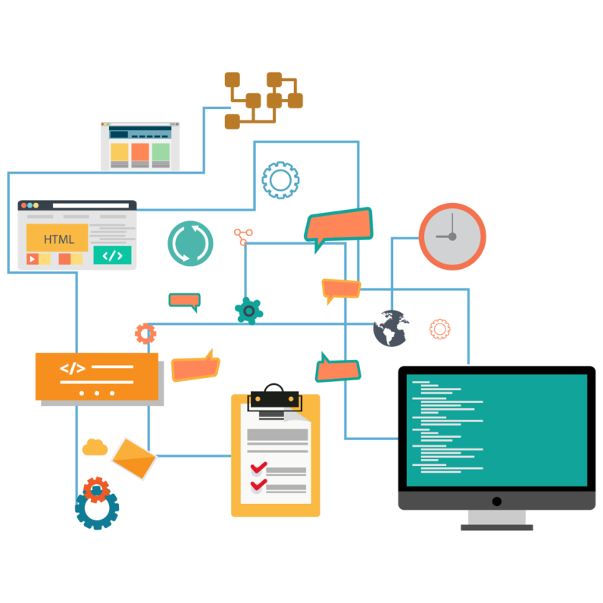
The system specifications from the analysis phase are transformed into a more detailed and structured representation of the system during the design phase.
SYSTEM DESIGN:

Slide 14
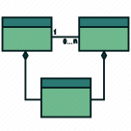





Class and Object Diagram
State Diagram
MAIN DELIVERABLES OF SYSTEM DESIGN:
Sequence Diagrams
Activity Diagram
Component Diagram
Deployment Diagram

Slide 15
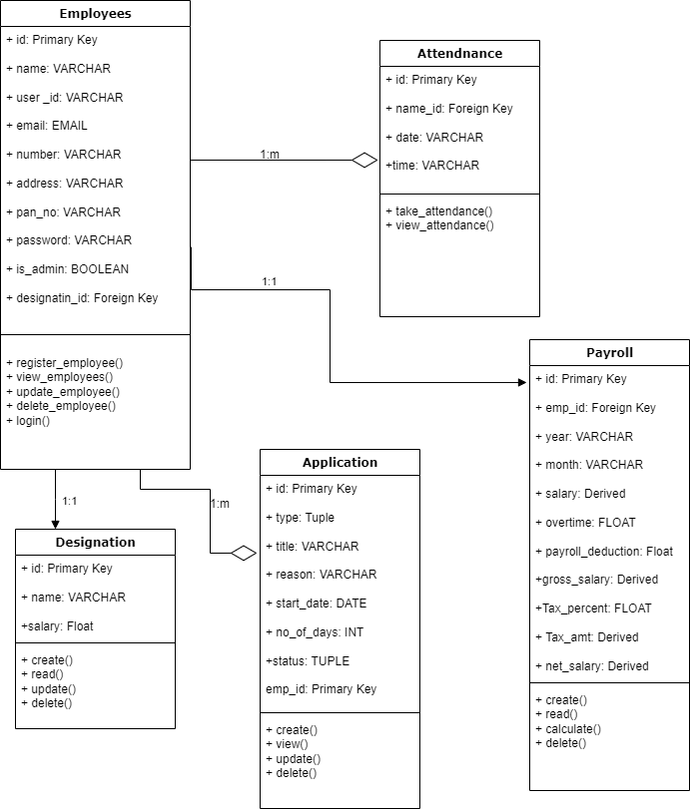
HRMS Class Diagram

Slide 16
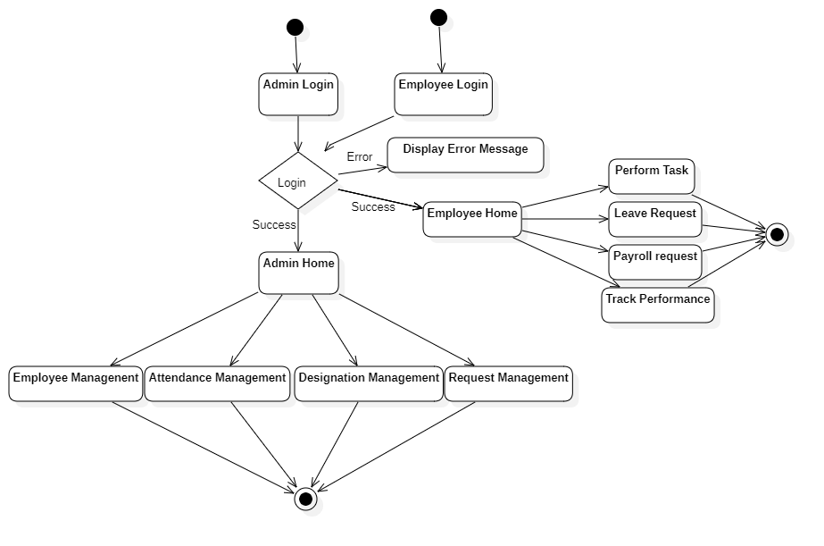
HRMS State Diagram

Slide 17
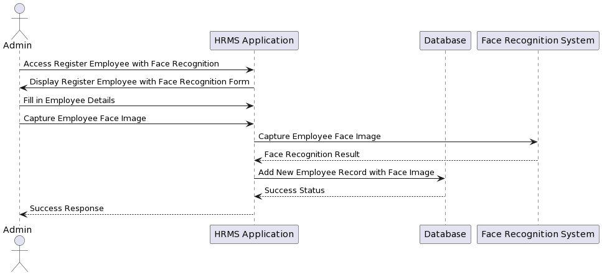
Employee Registration with Face Recognition Sequence Diagram

Slide 18
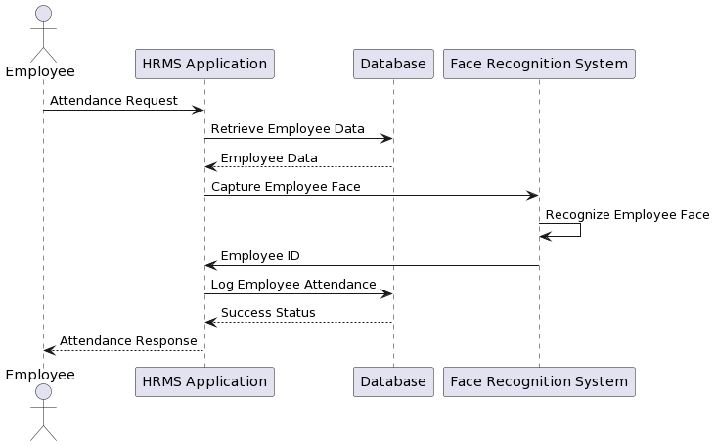
Attendance with Face Recognition Sequence Diagram

Slide 19
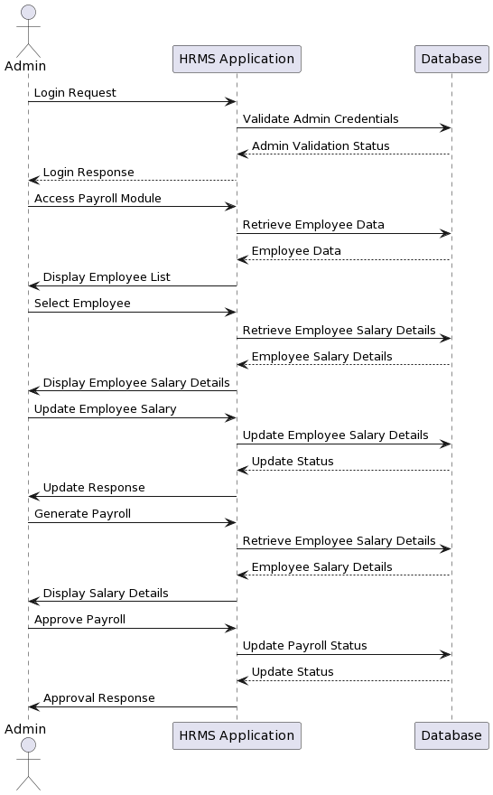
Admin Payroll Management Sequence Diagram

Slide 20
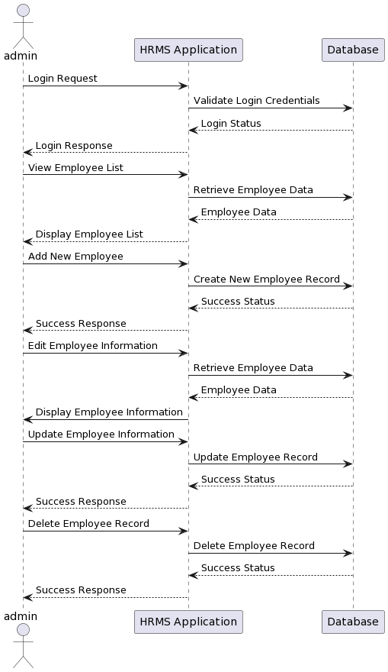
Admin Employee Management Sequence Diagram

Slide 21
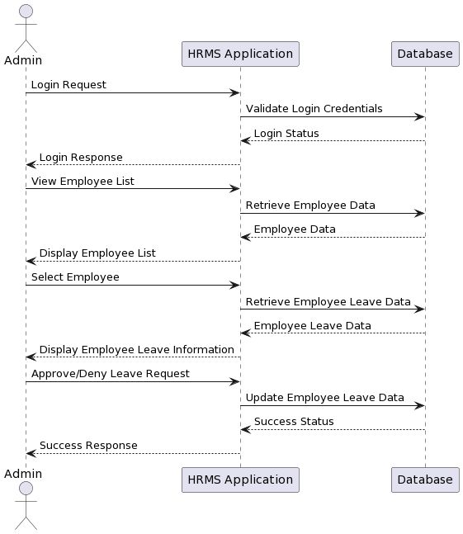
Admin Leave Management Sequence Diagram

Slide 22
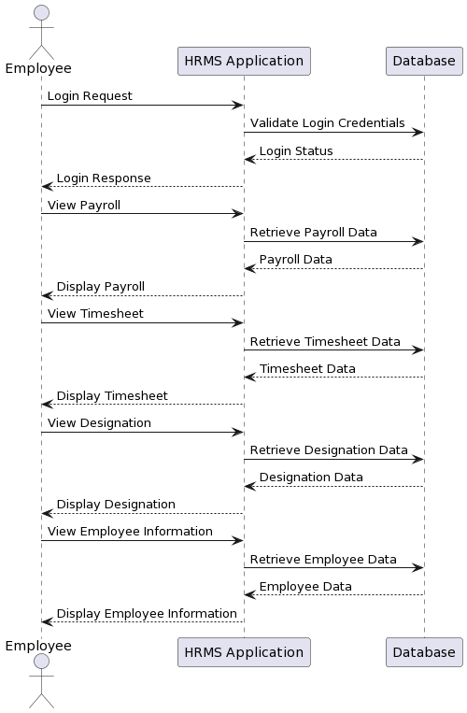
Employee View Payroll, Timesheet, Designation and Employee Information Sequence Diagram

Slide 23
Employee Apply for Leave Sequence Diagram

Slide 24
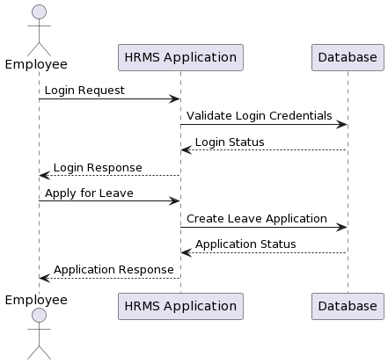
Employee Apply for Leave Sequence Diagram

Slide 25
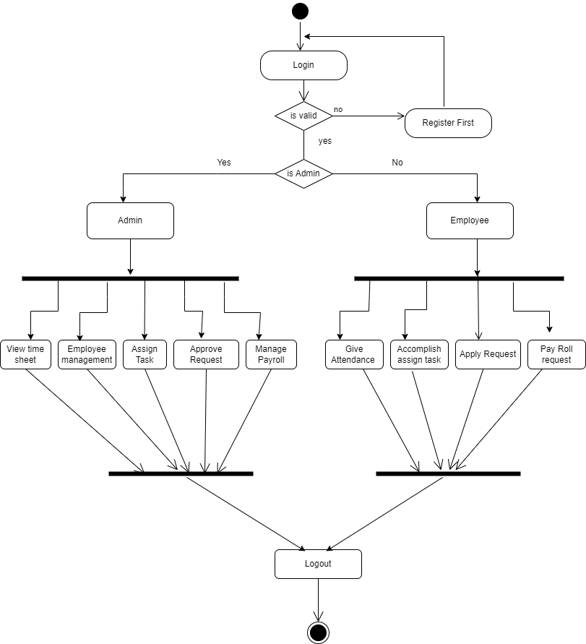
HRMS Activity Diagram

Slide 26
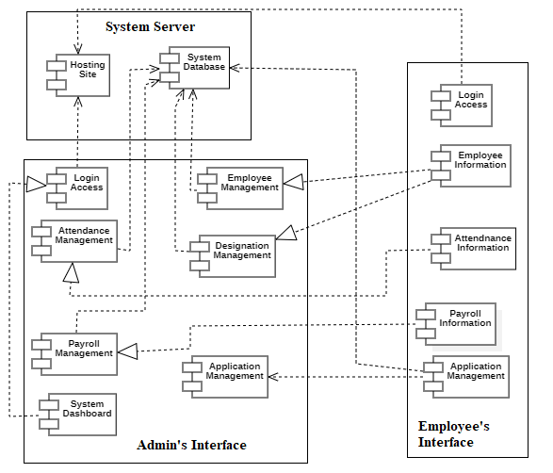
HRMS Component Diagram

Slide 27
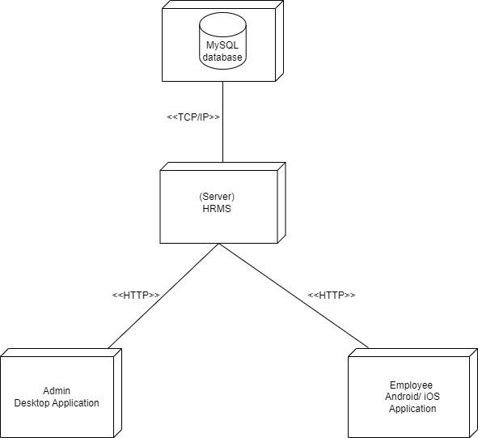
HRMS Deployment Diagram

Slide 28
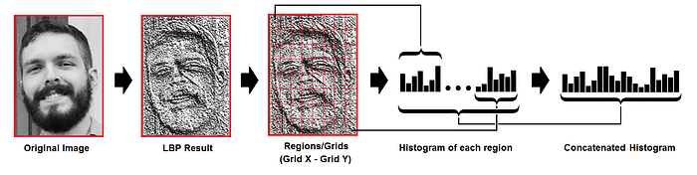
LBPH ALGORITHM:
Local Binary Pattern Histogram (LBPH) is a texture-based feature extraction technique used in computer vision applications.
It divides the image into small regions, calculates the Local Binary Pattern (LBP) features for each pixel within each region, and then constructs a histogram of the frequency of occurrence of the different LBP patterns. It is simple, efficient, and robust to illumination changes.
ALGORITHM USED:

Slide 29

The implementation phase is the final step of the software development lifecycle and requires careful planning and execution to ensure a smooth transition from design status to production and developing status.
SOFTWARE IMPLEMENTATION:

Slide 30









Flutter
Python
Django
MySQL
TOOLS USED:
APIs
StarUML
Draw.io
PlantUML
Office 365

Slide 31
Software testing of the HRMS project was done to identify defects , errors or vulnerabilities.
It comprises Verification and Validation.
Software testing includes:
SOFTWARE TESTING :
Unit Testing
System Testing

Slide 32
UNIT TESTING :
Two different unit of the system were tested individually.
Table of Unit Testing Test Case 1
Table of Unit Testing Test Case 2
Test Case1 | Input | Output | Test Result
Employee ID Input | Employee ID - 123 | Employee details such as name, designation, department, etc. | The employee details were displayed correctly.
Test Case2 | Input | Output | Test Result
Payroll Processing Error Handling | Invalid input such as negative salary or invalid employee ID | Error message indicating the issue with the input | The system correctly displayed an error message when invalid input was provided.

Slide 33
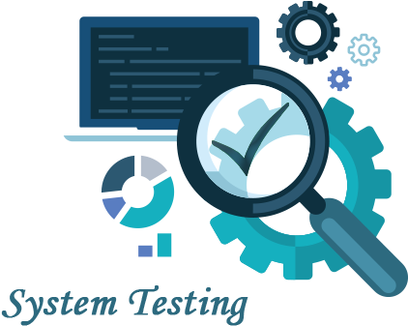
After the successful completion of unit testing, the system as a whole was tested to ensure the correct system.
The test results were positive, that the system was working perfectly and has met the system requirements which were analyzed during the analysis and requirement phase.
SYSTEM TESTING :

Slide 34
The HRMS project has the potential to significantly improve the efficiency and effectiveness of the company's HR processes.
It successfully facilitates easy access to information and automates various Human Resource Management tasks resulting in a more efficient and structured organizational environment.
CONCLUSION:

Slide 35
Upgrading system for remote login to track attendance.
Employee task assignment and tracking the progress of the assignment
FUTURE RECOMMENDATIONS
Address evaluator bias by using multiple evaluators and implementing measures.
Explore expanding project to cover more HR functions & automate tasks.

Slide 36
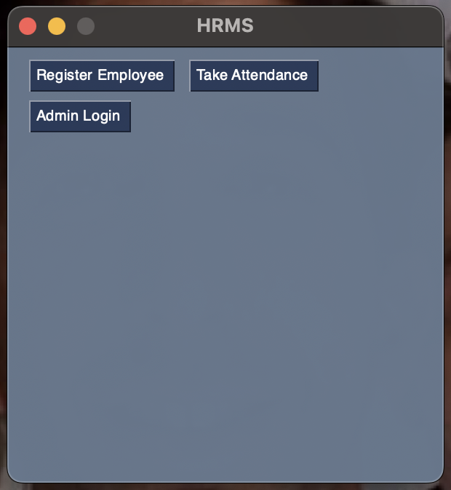
HRMS Admin Panel

Slide 37
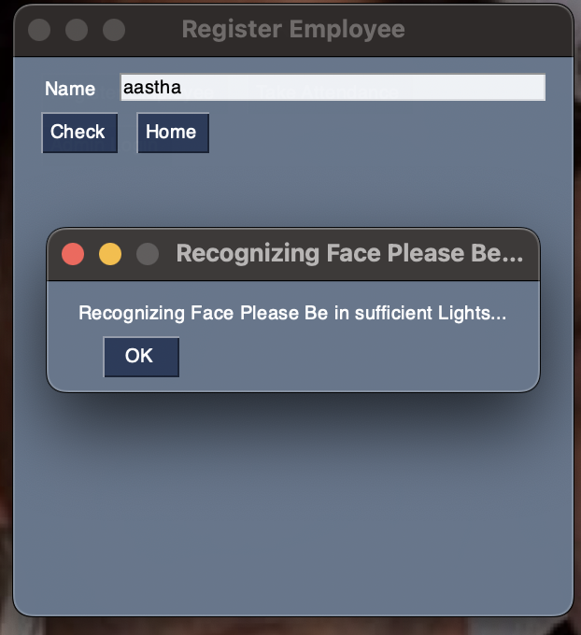
Taking attendance using Face Recognizing

Slide 38
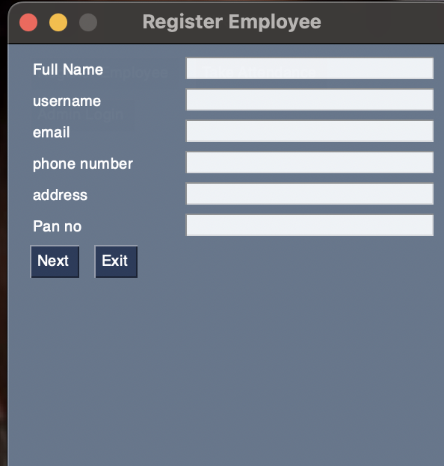
Employee Registration

Slide 39
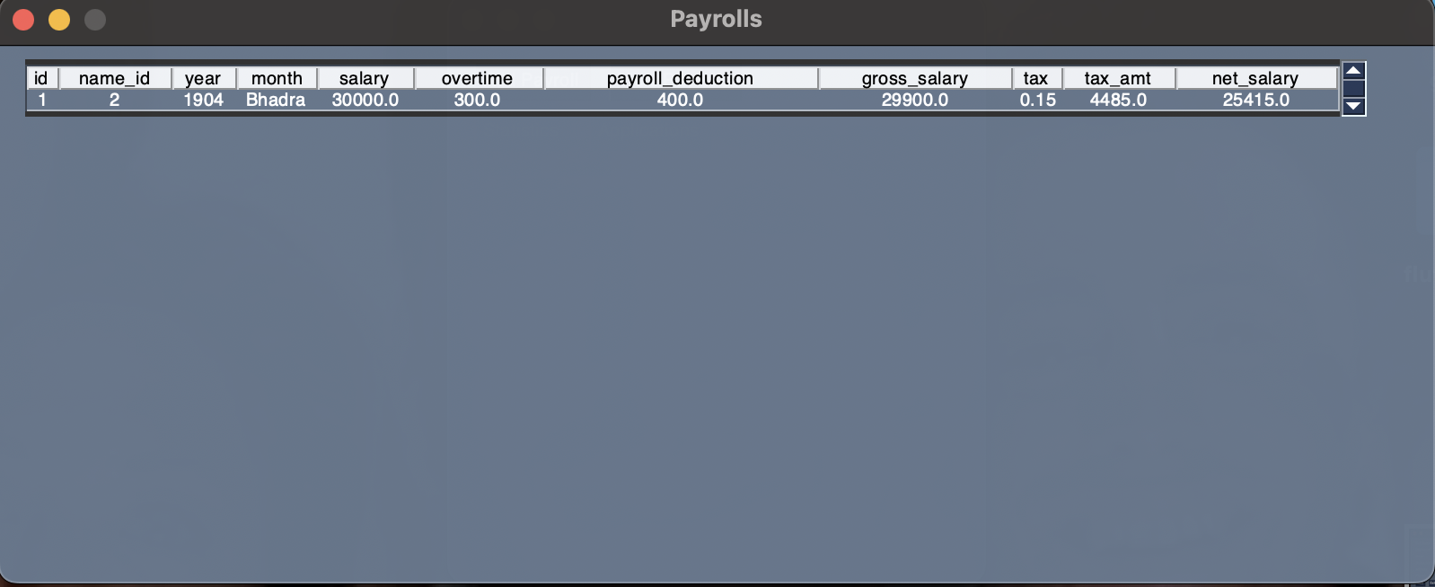
Pay Roll Calculation

Slide 40
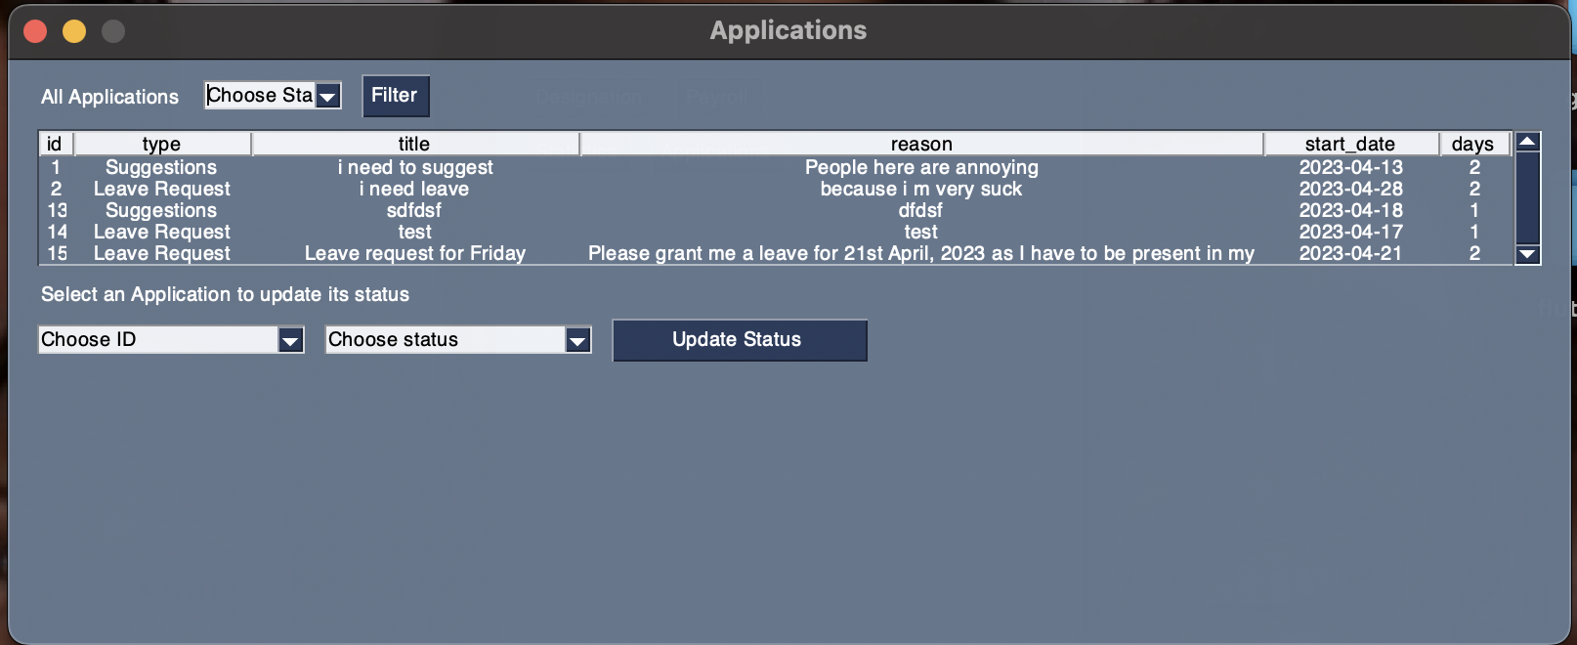
Application Handling

Slide 41
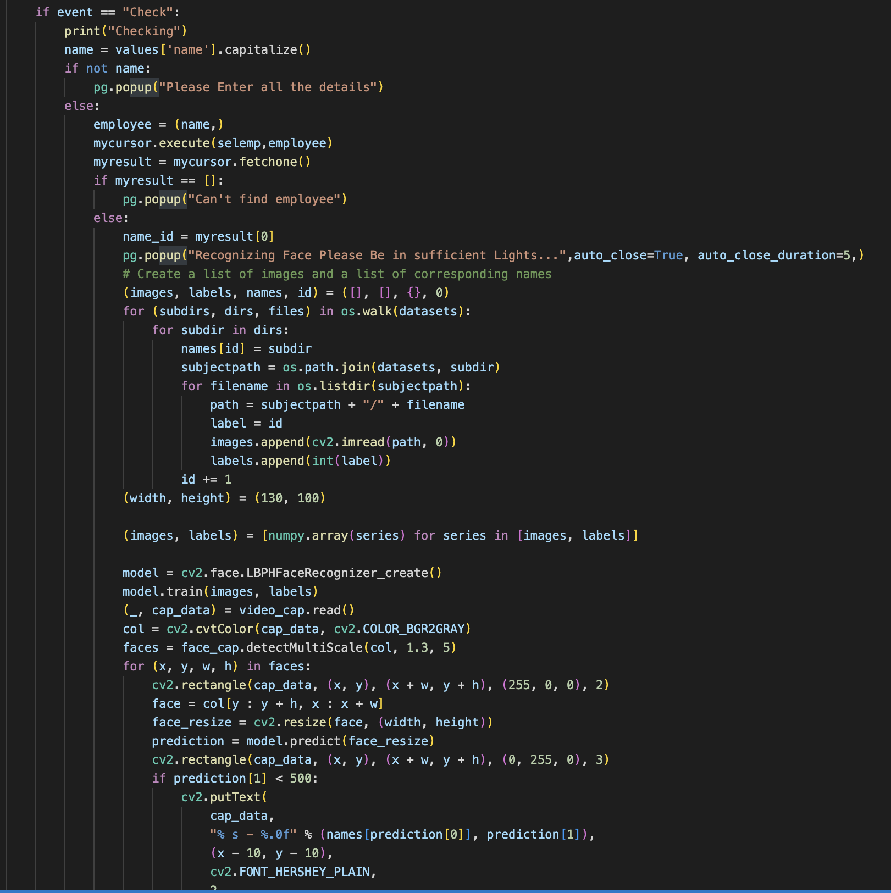
Code for Face Recognition - 1

Slide 42
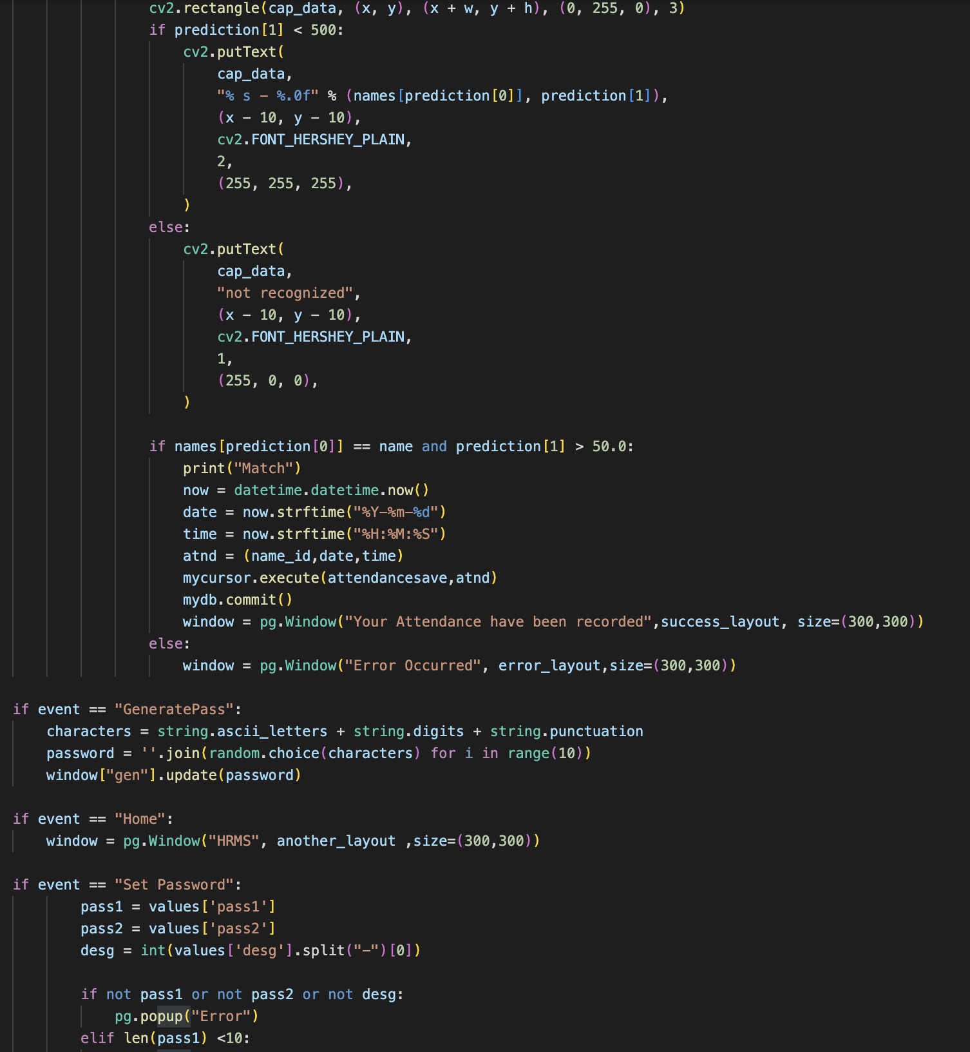
Code for Face Recognition - 2

Slide 43

Employee Mobile app Login Interface

Slide 44
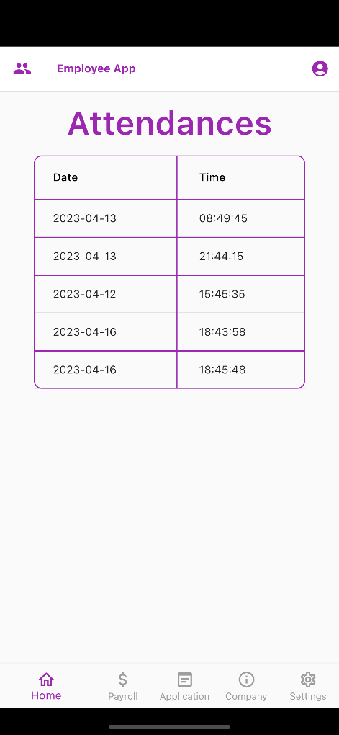
Employee Mobile App Home Interface

Slide 45
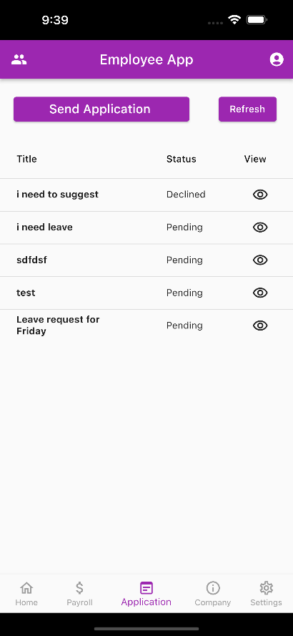
Employee Mobile App Application Interface

Slide 46
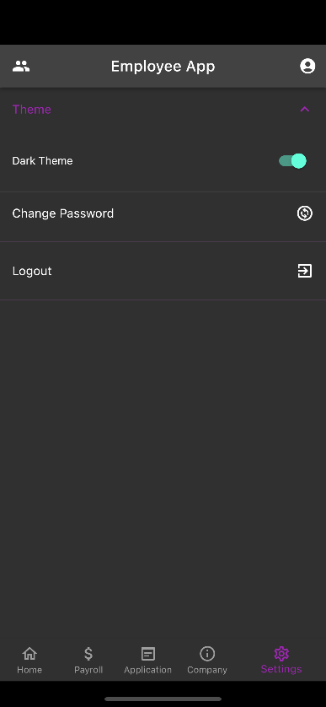
Employee Mobile App Settings Interface

Slide 47
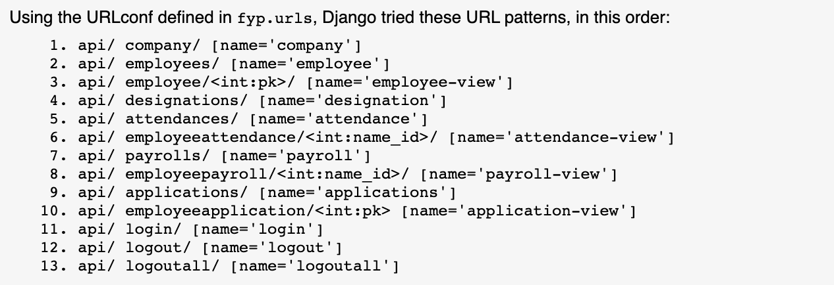
List of APIs

Slide 48
References
[1] L. H. Al-Hmouze, “The impact of electronic human resource management (E-HRM) application on organizational performance,” Middle East University, 2016. [Online]. Available: http://meu.edu.jo/
[2] S. Hosain, “The Impact of E-HRM on Organizational Performance: Evidence from Selective Service Sectors of Bangladesh,” International Journal of Human Resources Management (IJHRM), vol. 6, no. 3, pp. 1-14, Apr-May 2017.
[3] T. V. Bondarouk and H. J. M. Ruël, “Electronic Human Resource Management: challenges in the digital era,” International Journal of Human Resource Management, vol. 20, no. 3, pp. 505-514, Mar. 2009.
[4] A. Varadaraj and B. M. Al Wadi, “A Study on Contribution of Digital Human Resource Management towards Organizational Performance,” International Journal of Management Science and Business Administration, vol. 7, no. 5, pp. 43-51, Jul. 2021.
[5] M. Cohn, Agile Estimating and Planning, Upper Saddle River, NJ: Prentice Hall, 2005.
[6] K. Schwaber, Agile Project Management with Scrum, Redmond, WA: Microsoft Press, 2004.

Slide 49
References
[7] S. Tanwar, S. Tyagi, N. Kumar and M. S. Obaidat, “Ethical, legal, and social implications of biometric technologies,” in Biometric-based physical and cybersecurity systems, 2019, pp. 535-569.
[8] M. Irfan, N. Khurshid, J. Khurshid and A. M. Khokhar, “Human resource development and organisational performance: Evidence from Pakistan,” SA Journal of Human Resource Management, vol. 21, 2023. [Online]. Available: https://doi.org/10.4102/sajhrm.v21i0.2020
[9] Z. Almutawa, N. Muenjohn and J. Zhang, “The effect of human resource management system on employees’ commitment,” The Journal of Developing Areas, vol. 50, no. 6, pp. 17-29, 2016.
[10] Li, Tsai-Cheng, Huan-Wen Wu, and Tiz-Shiang Wu. “The study of biometrics technology applied in attendance management system.” In 2012 Third International Conference on Digital Manufacturing & Automation, pp. 943-947. IEEE, 2012.

Slide 50
References
[11] P. Y. Abdullah et al., “HRM system using cloud computing for Small and Medium Enterprises (SMEs),” Technology Reports of Kansai University, vol. 62, no. 04, pp. 1977-1987, 2020.
[12] Guru, K., S. Raja, A. Umadevi, M. Ashok, and Kumar Ramasamy. "Modern approaches in HR analytics towards predictive decision-making for competitive advantage." In Artificial Intelligence, Machine Learning, and Data Science Technologies, pp. 249-267. CRC Press, 2021.
[13] H. Zafar, “Human resource information systems: Information security concerns for organizations,” Human Resource Management Review, vol. 23, no. 1, pp. 105-113, 2013
[14] G. F. Pfleeger and J. L. Atlee, Software Engineering: Theory and Practice, 4th ed. Upper Saddle River, NJ: Pearson Education, Inc., 2010.
[15] R. S. Pressman, Software Engineering: A Practitioner's Approach, 8th ed. New York, NY: McGraw-Hill, 2015.
[16] X. Zhao and C. Wei, “A real-time face recognition system based on the improved LBPH algorithm,” 2017 IEEE 2nd International Conference on Signal and Image Processing (ICSIP), Beijing, 2017, pp. 72-76.

Slide 51
References
[17] Section.io Engineering Education, “Understanding Facial Recognition Using Local Binary Pattern Histogram Algorithm,” [Online]. Available: https://www.section.io/engineering-education/understanding-facial-recognition-using-local-binary-pattern-histogram-algorithm/.
[18] T. Hamilton, “Software Testing Tutorial,” Guru99, 28-Jan-2023. [Online]. Available: https://www.guru99.com/software-testing.html.
[19] "Unit testing," Software testing, Jun. 16, 2021. [Online]. Available: https://www.softwaretestinghelp.com/unit-testing-tutorial/.

Slide 52
THANK YOU

