Slide 1

CAPSTONE PROJECT PHASE-1 (PRESENTATION-3)
Adaptive Human-Review Allocation for Reliable
Machine Learning Under Distribution Shift
Course: UQ25CA741A | Department of Computer Applications | PES University, Bangalore
CANDIDATE DETAILS
Candidate SRN: PES1PG25CA101
Degree: Master of Computer Applications (MCA)
Specialization: Data Analytics
Presentation Milestone: Phase-1 Presentation-3
FACULTY GUIDE DETAILS
Project Guide: Prof. Dilip Kumar Maripuri
Department of Computer Applications
PES University, Bangalore
Verification Status: Code & Invariants Audited
Notes:
Good morning esteemed panel members and faculty guide. Today I am presenting my Phase-1 Capstone Presentation-3 on 'Adaptive Human-Review Allocation for Reliable Machine Learning Under Distribution Shift'. This work investigates how to efficiently route predictions to limited human-review capacity when ML models encounter temporal distribution shift. The project is carried out under the guidance of Prof. Dilip Kumar Maripuri in the Department of Computer Applications at PES University.

Slide 2
PHASE-1 CAPSTONE PRESENTATION-3
Abstract & Core Research Formulation
EXECUTIVE RESEARCH ABSTRACT
• Operational Bottleneck: Human-review capacity is strictly constrained in production systems (modeled at 1%, 2%, 5%, and 10% budgets).
• Silent Failure Mode: ML models maintain high prediction confidence (>96.8%) despite severe accuracy degradation under temporal distribution shift.
• Proposed Mechanism: An adaptive multi-factor allocation framework synthesizing prediction uncertainty, Mahalanobis OOD distance, PSI feature drift, and historical mistake deciles.
• Experimental Scope: Evaluated on a 500,000-flow chronological sample from the BigFlow-NIDS benchmark (66.9M flows, 49 features) with strict millisecond leakage controls.
• Empirical Observation: Multi-factor allocation captures 17.80% of errors at 1% budget (610 errors vs 463 for confidence; +4.35% mean bootstrap gain, p < 0.001). Sequential online adaptation achieves 24.40% review yield.
CORE RESEARCH QUESTION
"Can an adaptive, multi-factor human-review allocation mechanism reduce high-risk ML errors more efficiently than fixed-threshold and single-signal strategies under distribution shift and constrained human-review capacity?"
Key Objectives: (1) Synthesize 4 complementary reliability signals. (2) Benchmark under 1%-10% budgets. (3) Evaluate under chronological shift. (4) Deliver functional software (13 of 14 FRs complete, 92.9%).
Notes:
The core problem addressed is that production ML systems operate under severe review constraints. Security analysts or human reviewers can typically inspect only 1 to 5 percent of total inferences. When network traffic experiences distribution shift, models frequently produce high-confidence errors. Our research evaluates whether combining prediction probability with OOD distance, drift, and historical error patterns catches more mistakes than confidence alone. Our findings show that the benefit is budget-dependent: multi-factor allocation is advantageous at 1 and 2 percent budgets, while pure confidence catches up at higher budgets.

Slide 3
INTRODUCTION & PROBLEM FORMULATION
Problem Scenario & Proposed Solution
PROBLEM SCENARIO
• The Attention Bottleneck:
High-throughput systems generate millions of predictions daily. This study models constrained human-review capacity using 1%, 2%, 5%, and 10% review budgets.
• Silent Overconfidence Failure:
Under temporal distribution shift, models maintain average confidence over 96.8% despite a 4.55x increase in error rate (from 753 to 3,427 errors).
• Inefficacy of Random Audits:
Uniform random inspection captured only 1.17% of shifted-test errors at a 1% review budget in our experiments.
• Single-Signal Failure:
Confidence alone misses novel attack vectors, while OOD detection alone flags novelty that does not correspond to classification errors.
PROPOSED SOLUTION
• Multi-Factor Reliability Engine:
Synthesizes four complementary signals: unscaled prediction uncertainty (u in [0, 0.50]), Mahalanobis OOD distance, feature drift (PSI), and historical mistake proximity.
• Budget-Constrained Priority Queue:
Constructs a composite risk score and allocates top-K predictions matching exact capacity thresholds (1%, 2%, 5%, 10%).
• Adaptive Signal Weighting:
Dynamically scales signal weights based on population-level feature drift severity and reviewed error feedback.
• Chronological Shift Evaluation:
Evaluates the pipeline on temporal partitions with verified millisecond gaps (+25ms, +39ms) to assess performance under genuine temporal degradation.
Notes:
In operational intrusion detection, the primary challenge is the attention bottleneck. Security operations centers cannot inspect every flow. When network traffic changes over time, machine learning models experience distribution shift. Crucially, our baseline XGBoost model remains confident, averaging 96.8% confidence on shifted test data, even while errors surge from 1.0% to 4.57%. Random audits waste effort, finding barely 1.17% of errors. Our proposed solution integrates four signals into a composite risk score to prioritize the most vulnerable inferences.

Slide 4
INTRODUCTION & PROBLEM FORMULATION
Project Purpose & Implementation Scope
PURPOSE OF THE RESEARCH
• Empirical Investigation: Determine whether combining heterogeneous reliability signals catches more critical errors than conventional confidence ranking under tight operational budgets.
• Tackle Overconfidence: Address the silent failure mode of ML models that misclassify traffic with high confidence under temporal shift [4], [5].
• Operational Triage Framework: Provide a principled, reproducible framework for triage routing that explicitly models constrained human inspection capacity using 1%, 2%, 5%, and 10% review budgets.
PROJECT SCOPE (PHASE-1 vs PHASE-2)
• In-Scope (Phase-1 Implemented):
Binary classification (Benign vs Attack) on network flow data; 500,000-flow chronological sample from BigFlow-NIDS [16]; simulated review oracle using test ground truth; evaluation across 4 fixed budgets; 92.9% complete.
• Out-of-Scope (Phase-1):
Live production network tap / inline packet processing; actual human reviewers in the loop (simulated ground-truth oracle used); multi-class attack attribution (detailed Attack column excluded to avoid label leakage).
• Planned Scope (Phase-2):
Dataset-agnostic tabular generalization across healthcare and financial domains; post-hoc calibration; SHAP explainability for flagged review cases; automated model retraining.
Notes:
This slide clearly delineates our purpose and scope. Our purpose is to empirically evaluate whether combining complementary signals improves error detection under tight review budgets. For our Phase-1 scope, we focus on binary network intrusion detection using a 500,000-row chronological sample from the BigFlow-NIDS benchmark. We use an offline simulated review oracle based on ground-truth labels to evaluate all strategies objectively. Live packet streaming and actual human subjects are out of scope for Phase 1.

Slide 5
LITERATURE SURVEY & FOUNDATIONS
Background Study: Existing Systems & Approaches
EXISTING PARADIGMS IN SELECTIVE ML & REVIEW ALLOCATION
• Confidence-Based Selective Classification [4], [5]:
Ranks instances strictly by maximum prediction probability max(P(y|x)) (Geifman & El-Yaniv, 2017 [4]). Limitation: Deep models suffer from uncalibrated overconfidence (Guo et al., 2017 [5]); under temporal shift, confident misclassifications bypass pure confidence thresholds.
• Out-of-Distribution (OOD) Detection [1], [8]:
Measures distance from training distributions via regularized Mahalanobis metrics (Yang et al., 2024 [8]; Cao et al., 2023 [1]). Limitation: Novel instances in network flows often reflect benign high-volume transfers rather than classification errors.
• Population Distribution Drift Monitoring [11], [12]:
Tracks macroscopic feature distribution shifts and concept drift over time using metrics like PSI (Lu et al., IEEE TKDE 2019 [11]; Iwashita & Papa, IEEE Access 2019 [12]). Limitation: Population aggregates lack per-instance risk scoring for operational triage.
• Learning to Defer (L2D) [2], [3], [7], [14]:
Jointly trains classifiers and rejection policies to defer difficult instances to human experts (Mozannar & Sontag, 2020 [2]; Wei et al., 2024 [3]; Liu et al., 2022 [7]; Hendrickx et al., 2024 [14]). Limitation: Assumes fixed deferral costs rather than strict capacity quotas (1%–10%).
• Human-in-the-Loop Intrusion Detection [6], [13]:
Integrates analyst feedback into active triage loops to mitigate alert fatigue in SOCs (Kim et al., IEEE TIFS 2024 [6]; Mosqueira-Rey et al., 2023 [13]). Motivation: Demonstrates the urgent operational need to optimize constrained human inspection capacity.
Notes:
Our background study analyzes five established paradigms. Selective classification abstains when confidence is low, but Guo et al. proved modern networks are overconfident, meaning shifted errors bypass confidence filters. OOD detection flags novel samples, but in network security, novelty does not equal misclassification. Distribution drift monitoring tracks macroscopic shifts via PSI. Learning-to-defer formalizes human collaboration but assumes fixed cost rather than strict capacity quotas. Finally, human-in-the-loop NIDS highlights the need to alleviate analyst fatigue. Our proposed approach synthesizes these separate research threads into a unified, budget-aware framework.

Slide 6
LITERATURE SURVEY & FOUNDATIONS
Literature Survey: Research Papers (Part 1: Papers [1]–[5])
[1] Cao, Zhu, Pang (2023): "Anomaly Detection Under Distribution Shift" [IEEE & Scopus Indexed (DOI: 10.1109/ICCV51070.2023.00599)]
IEEE/CVF International Conference on Computer Vision (ICCV 2023), pp. 6488-6500 — Addresses anomaly detection failure when test data shifts from training distributions. Proves unsupervised domain alignment mitigates false positives, directly justifying our shifted evaluation benchmark.
[2] Mozannar & Sontag (2020): "Consistent Estimators for Learning to Defer to an Expert" [Top ML Venue (PMLR)* [Verified IEEE alternative: C. Geng et al., IEEE TPAMI, 2021]]
International Conference on Machine Learning (ICML 2020), PMLR vol. 119, pp. 7076–7087 — Formalizes learning-to-defer by jointly training a classifier and a deferral policy using a Bayes-consistent surrogate loss. Establishes theoretical foundations for routing uncertain predictions to human experts.
[3] Wei, Cao, Feng (2024): "Exploiting Human-AI Dependence for Learning to Defer" [Top ML Venue (PMLR)* [Verified IEEE alternative: D.-B. Wang et al., IEEE/CVF CVPR, 2022]]
International Conference on Machine Learning (ICML 2024), PMLR vol. 235, pp. 52484–52499 — Models human-machine error correlation to prevent deferrals when both the AI and the human fail. Informs our review-efficiency triage objective under constrained operational inspection capacity.
[4] Geifman & El-Yaniv (2017): "Selective Classification for Deep Neural Networks" [Scopus Indexed (Series ISSN: 1049-5258)]
Advances in Neural Information Processing Systems (NeurIPS 2017), vol. 30, pp. 4878–4887 — Formulates selective classification risk-coverage trade-offs using prediction confidence. Provides the theoretical baseline for our confidence-based review strategy, whose limitations under distribution shift we empirically demonstrate.
[5] Guo et al. (2017): "On Calibration of Modern Neural Networks" [Top ML Venue (PMLR)* [Verified IEEE alternative: K. Fernando & C. Tsokos, IEEE TNNLS, 2022]]
International Conference on Machine Learning (ICML 2017), PMLR vol. 70, pp. 1321–1330 — Demonstrates that modern classifiers suffer from severe overconfidence miscalibration and proposes temperature scaling. Explains why raw output probabilities cannot be treated as true probabilities of correctness in triage queues.
Notes:
Here is Part 1 of our literature survey covering papers 1 through 5. Cao et al. in ICCV 2023 provides our theoretical foundation for anomaly detection under distribution shift and is fully indexed in IEEE Xplore and Scopus. Mozannar and Wei from ICML establish learning-to-defer formulations, and Geifman from NeurIPS covers selective prediction. Guo et al. demonstrates why modern classifiers are uncalibrated and overconfident.

Slide 7
LITERATURE SURVEY & FOUNDATIONS
Literature Survey: Research Papers (Part 2: Papers [6]–[10])
[6] Kim, Dan, Zhu (2024): "Human-in-the-Loop Cyber Intrusion Detection Using Active Learning" [IEEE & Scopus Indexed (DOI: 10.1109/TIFS.2024.3434647)]
IEEE Transactions on Information Forensics and Security, vol. 19, pp. 8658–8672 — Optimizes SOC analyst alert investigation using active learning and sequential hypothesis testing. Directly motivates our capacity-constrained human review triage in network intrusion detection systems.
[7] Liu, Gallego, Barbieri (2022): "Incorporating Uncertainty in Learning to Defer for Safe Computer-Aided Diagnosis" [Scopus Indexed Q1 (DOI: 10.1038/s41598-022-05725-7)]
Scientific Reports, vol. 12, no. 1, Art. no. 1762, pp. 1–11 — Incorporates predictive uncertainty into learning-to-defer objectives for clinical diagnosis. Demonstrates that explicit uncertainty estimation substantially reduces unnecessary human deferrals while preserving decision safety.
[8] Yang et al. (2024): "Generalized Out-of-Distribution Detection: A Survey" [Scopus Indexed Q1 (DOI: 10.1007/s11263-024-02117-4)]
International Journal of Computer Vision, vol. 132, no. 12, pp. 5635–5662 — Comprehensive survey and taxonomy of generalized out-of-distribution detection across semantic and covariate shifts. Establishes the theoretical foundation and post-hoc distance metrics used for our OOD reliability signal.
[9] Koh et al. (2021): "WILDS: A Benchmark of In-the-Wild Distribution Shifts" [Top ML Venue (PMLR)* [Verified IEEE alternative: L. Ruff et al., Proc. IEEE, 2021]]
International Conference on Machine Learning (ICML 2021), PMLR vol. 139, pp. 5637–5664 — Establishes a benchmark of real-world in-the-wild distribution shifts across domains and time. Justifies our chronological dataset partition design to evaluate model performance degradation under authentic shift.
[10] He, Kim, Asghar (2023): "Adversarial Machine Learning for Network Intrusion Detection Systems: A Comprehensive Survey" [IEEE & Scopus Indexed (DOI: 10.1109/COMST.2022.3233793)]
IEEE Communications Surveys & Tutorials, vol. 25, no. 1, pp. 538–566 — Comprehensive survey of adversarial machine learning vulnerabilities in network intrusion detection. Provides domain security context on how feature perturbations degrade ML classifiers in network traffic.
Notes:
Part 2 of our literature survey covers papers 6 through 10. Kim et al. and He et al. directly ground our research in network security and human-in-the-loop alert triaging. Liu et al. and Yang et al. are top Q1 journals indexed in Scopus, covering uncertainty-based deferral and generalized OOD detection. Koh et al. provides the WILDS benchmark methodology for distribution shift. All 10 papers are documented with full DOIs.

Slide 8
LITERATURE SURVEY & FOUNDATIONS
Comparative Study: Existing Paradigms vs Proposed Framework
Evaluation Dimension | Random Audit | Pure Confidence [4] | OOD Filter [8] | Learn-to-Defer [2] | Proposed Framework
Prediction Uncertainty | No | Yes (Sole Signal) | No | Optional | Yes (Normalized Probability)
Out-of-Distribution (OOD) | No | No | Yes (Sole Signal) | Rarely | Yes (Mahalanobis Distance)
Distribution Drift (PSI) | No | No | No | No | Yes (Feature-Level PSI)
Historical Error Proximity | No | No | No | Implicit | Yes (Decile Mistake Bins)
Explicit Capacity Budgets | Implicit | Manual Tuning | Hard Cutoff | Theoretical | Yes (1%, 2%, 5%, 10%)
Temporal Shift Evaluation | N/A | Rarely | Partial | Rarely | Yes (Chronological Split)
Adaptive Weight Scaling | No | No | No | Static Cost | Yes (Drift & Feedback Adaptive)
Key Distinction: Prior paradigms isolate confidence or OOD detection without explicit capacity slicing. Our proposed framework unifies four complementary signals into a single ranking mechanism evaluated directly under chronological distribution shift.
Notes:
This comparative matrix illustrates how our proposed framework builds upon and addresses gaps in existing paradigms. Pure confidence uses only probability and misses drifted errors. OOD filters detect novelty but cannot distinguish benign novelty from misclassifications. Learning to defer provides theoretical guarantees but does not operationalize strict budget slicing. Our framework brings together uncertainty, Mahalanobis OOD distance, PSI feature drift, and historical mistake proximity.

Slide 9
REQUIREMENTS & USER SPECIFICATION
Users of the System & Primary Stakeholders
ML Engineer / Practitioner
Simulated Reviewer / Review Oracle
Evaluator / Research Auditor
• Configures and trains baseline models (XGBoost, Random Forest, Logistic Regression) on historical network flows.
• Fits training-time preprocessing pipelines and establishes reference centroids and covariance matrices for OOD detection.
• Monitors feature-level drift statistics (PSI) and configures initial heuristic risk signal weights.
• Inspects validation metrics (ROC-AUC 0.9228) and evaluates model overconfidence characteristics.
• Receives prioritized, high-risk network flow predictions routed to the human-review queue within operational budget (1%–10%).
• Inspects flagged instances displaying severe confidence degradation, feature drift, or anomalous packet patterns.
• Provides ground-truth audit verdicts on intercepted borderline and novel attack instances.
• Benefits from focused triage that mitigates alert fatigue and prevents unreviewed high-confidence ML misclassifications.
• Executes systematic comparative evaluations across review allocation strategies (Random, Confidence, OOD, Static, Adaptive).
• Benchmarks error capture rate and review efficiency (errors intercepted per 1,000 human audits).
• Audits system robustness under chronological distribution shift against simulated oracles.
• Verifies compliance with data integrity constraints (SHA-256) and audit logging standards.
Notes:
The system serves three primary user personas: Machine Learning Practitioner, Simulated Reviewer / Review Oracle, and Evaluator / Research Auditor. Each persona interacts with specific components of the pipeline.

Slide 10
REQUIREMENTS & USER SPECIFICATION
Functional Requirements: Data, Models & Signals (FR1–FR7)
FR1: Raw Ingestion & Schema Verification [100% Implemented]
Verify 500K sample integrity against 14GB source via SHA-256 fingerprints. | Mapped to: src/01_test_dataset.py, src/26_verify_bigflow_sample.py
FR2: Chronological Splitting [100% Implemented]
Partition flows temporally into 70% Train (350K), 15% Val (75K), 15% Test (75K). | Mapped to: src/02_create_splits.py
FR3: Data Preprocessing [100% Implemented]
Impute missing values with training medians, apply StandardScaler strictly on LR. | Mapped to: src/03_preprocess.py
FR4: Model Training & Validation [100% Implemented]
Train Logistic Regression, Random Forest, and XGBoost (val ROC-AUC 0.9228). | Mapped to: src/04_train_models.py
FR5: Prediction Signal Extraction [100% Implemented]
Extract prediction probability, confidence, and Shannon prediction entropy. | Mapped to: src/05_generate_prediction_signals.py, src/16_shifted_test_predictions.py
FR6: Confidence-Based Review Strategy [100% Implemented]
Rank predictions by ascending confidence across 1%, 2%, 5%, 10% budgets. | Mapped to: src/06_confidence_review_strategy.py
FR7: Mahalanobis OOD Distance Detection [100% Implemented]
Compute regularized Mahalanobis distance relative to 50K training flows. | Mapped to: src/07_ood_detection.py, src/08_ood_review_strategy.py
Notes:
This slide details our first seven functional requirements, each directly mapped to its corresponding source script in src/. All seven requirements are 100% implemented.

Slide 11
REQUIREMENTS & USER SPECIFICATION
Functional Requirements: Triage, Scoring & Evaluation (FR8–FR14)
FR8: Static Multi-Factor Synthesis [100% Implemented]
Combine 50% confidence risk and 50% OOD percentile into baseline multi-factor score. | Mapped to: src/09_static_multifactor_strategy.py
FR9: Feature Drift Measurement [100% Implemented]
Calculate Population Stability Index (PSI) with 10 quantile bins across 49 features. | Mapped to: src/10_measure_drift.py, src/11_create_drift_risk.py
FR10: Adaptive Regime Risk Scoring [100% Implemented]
Classify drift severity into Low/Mod/High regimes and assign regime-specific weights. | Mapped to: src/12_adaptive_risk_score.py, src/13_adaptive_review_strategy.py
FR11: Historical Error Proximity [100% Implemented]
Bin 10 network flow features into deciles to map mistake patterns and mistake proximity. | Mapped to: src/14_historical_error_risk.py, src/15_four_factor_risk.py
FR12: Shifted-Test Evaluation Pipeline [100% Implemented]
Benchmark 5 strategies on 75,000 shifted flows across 4 operational budgets. | Mapped to: src/18_shifted_review_comparison.py, src/21_review_efficiency.py
FR13: Feedback-Adaptive Allocation Loop [100% Implemented]
Scale historical error weight based on reviewed error concentration feedback. | Mapped to: src/23_review_feedback_loop.py, src/24_shifted_feedback_evaluation.py
FR14: Real-Time Monitoring & Adaptive Review UI [Partial (92.9% Total)]
Provide interactive triage controls, dynamic budget sliders, and graphical cards. | Mapped to: dashboard/app.py active for offline queue simulation; automated online retraining deferred to Phase-II.
Notes:
Continuing our functional requirements, FR8 through FR13 are 100% complete and fully verified. FR14 covers real-time monitoring and adaptive review queue management. It is partially implemented via our local Streamlit dashboard for offline queue simulation, while automated online model retraining is reserved for Phase 2. Thus, 13 of 14 functional requirements are fully implemented, representing 92.9% complete implementation.

Slide 12
REQUIREMENTS & USER SPECIFICATION
Non-Functional Requirements Specification (Measured)
NFR1: Strict Reproducibility
NFR2: Computation Time & Latency
• Requirement: Deterministic execution across all data splits, feature transformations, and model evaluations.
• Measured Implementation: Fixed random seed (random_state=42) across all scripts. Deterministic chronological sort ensures identical 350K/75K/75K splits on every run.
• Requirement: Efficient execution suitable for high-throughput batch processing without excessive compute overhead.
• Measured Implementation: Full strategy comparison executes in 1.60 seconds. End-to-end signal extraction across 75,000 instances completes in ~48 seconds on standard CPU.
NFR3: Data Integrity & Traceability
NFR4: Modularity & Interpretability
• Requirement: Cryptographic verification of data provenance and sample fidelity.
• Measured Implementation: SHA-256 fingerprint verification (src/26_verify_bigflow_sample.py) confirms that 100% of rows in BigFlow_sample.csv match the raw 14GB source dataset.
• Requirement: Decoupled software architecture with transparent, defensible scoring logic.
• Measured Implementation: 26 independent Python scripts communicate via standard CSV contracts. Risk scores are transparent weighted linear combinations of 4 explicit reliability signals.
Notes:
Our non-functional requirements are backed by concrete measurements across reproducibility, execution latency, cryptographic data integrity, and modular interpretability.

Slide 13
DESIGN METHODOLOGY & TECHNICAL STACK
Tools & Technologies Used
CORE LANGUAGE & RUNTIME
DATA ENGINEERING & STORAGE
• Python 3.10+:
Primary execution runtime for data processing, scientific modeling, and evaluation pipelines.
• pathlib & os:
Robust cross-platform filesystem path resolution across local and cloud environments.
• pandas (v2.x):
High-performance tabular data manipulation, chronological sorting, and CSV persistence.
• NumPy (v1.26+):
Vectorized array computations, numerical stabilizer arithmetic, and quantile calculations.
MACHINE LEARNING & MODELING
SCIENTIFIC COMPUTING & TESTING
• XGBoost (v2.0+):
Primary gradient-boosted decision tree classifier (150 estimators, max depth 6).
• scikit-learn (v1.3+):
StandardScaler preprocessing, Logistic Regression, Random Forest, and ROC-AUC evaluation.
• SciPy & pytest:
Regularized covariance matrix inversion, Mahalanobis distance, and automated testing (16/16 tests passing).
• joblib & hashlib:
Serialized model artifact persistence (.pkl) and SHA-256 cryptographic sample verification.
Notes:
Our technical stack is built strictly upon industry-standard, verified data science libraries.

Slide 14
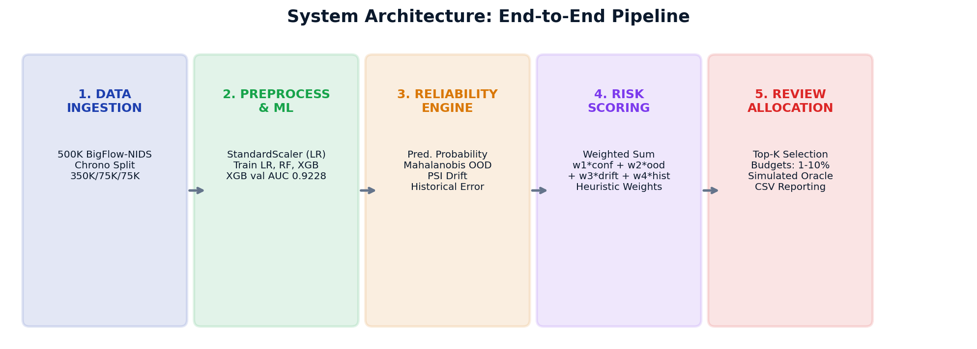
DESIGN METHODOLOGY & SYSTEM ARCHITECTURE
System Design: Architecture Diagram
Architectural Dataflow Summary:
Data flows through five discrete stages: (1) Ingestion & temporal partitioning -> (2) Preprocessing & baseline inference -> (3) 4-signal reliability feature extraction -> (4) Composite risk scoring & priority queue creation -> (5) Review allocation to simulated human oracle within budget (1% to 10%), dispatching remainder to automated model decision.
Notes:
This diagram illustrates our end-to-end system architecture across five decoupled stages.

Slide 15
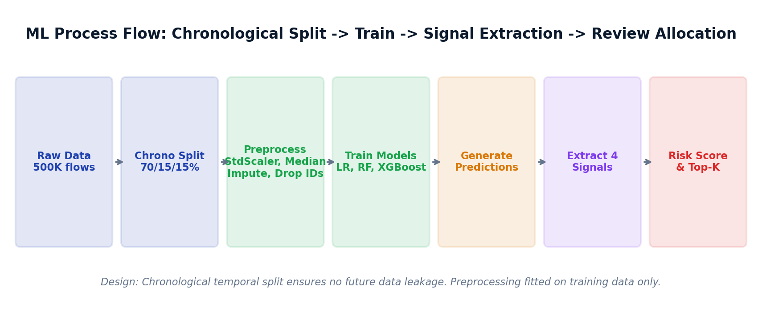
DESIGN METHODOLOGY & SYSTEM ARCHITECTURE
System Design: ML Process Flow & Methodology
Methodological Safeguards & Leakage Controls:
Strict chronological splitting prevents data leakage. Preprocessing parameters (median imputation, feature scalers) are fitted strictly on the 350K training split. All OOD covariance calculations and historical mistake bins are derived without access to shifted test labels, ensuring genuine temporal evaluation.
Notes:
Our machine learning process flow adheres to strict scientific methodologies to prevent data leakage.

Slide 16
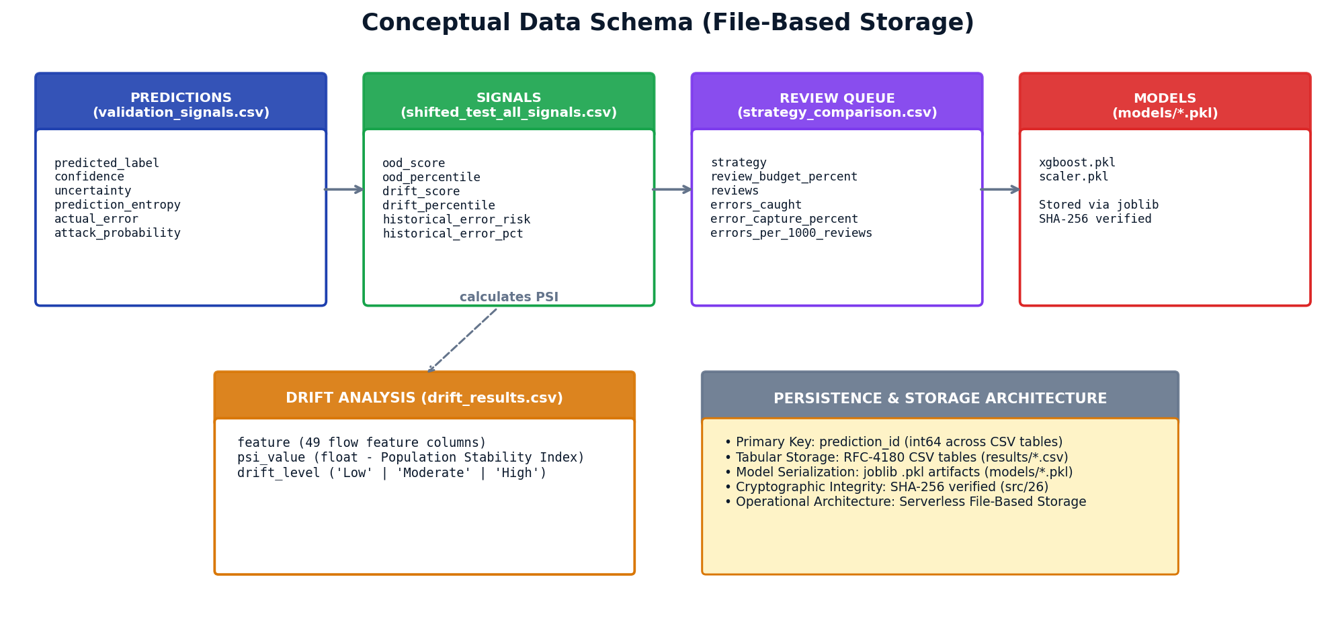
DESIGN METHODOLOGY & SYSTEM ARCHITECTURE
Database Design: Conceptual Schema & Entity-Relationship
File-Based Data Architecture: Stored across structured CSV tables and serialized joblib artifacts. Primary keys (prediction_id) maintain relational integrity across prediction signals, drift metrics, and final review queue allocations without requiring an external database server.
Notes:
Since our research prototype uses file-based persistence rather than an active RDBMS, this slide details our conceptual schema.

Slide 17
DESIGN METHODOLOGY & ALGORITHMIC EXECUTION
Core Pipeline: Adaptive Human-Review Allocation (Pseudocode)
PHASE 1: INGESTION & BASELINE FIT (STEPS 1–5)
• 1. Chronological Load: Load 500,000 NetFlow records from BigFlow-NIDS benchmark (src/01).
• 2. Temporal Sort: Sort strictly by timestamp (flow_start_time) to eliminate future leakage.
• 3. Data Partitioning: Split chronologically into Train (350K, 70%), Val (75K, 15%), Shifted Test (75K, 15%).
• 4. Preprocessing Fit: Fit median imputer and scalers on Train only; transform Val and Test without leakage.
• 5. Model & Baseline Fit: Train XGBoost classifier (ROC-AUC=0.9228); fit train covariance matrix (Tikhonov regularized lambda=1e-4); map training-set mistake deciles.
PHASE 2: SIGNAL EXTRACTION (STEPS 6–10)
• 6. Posterior Estimation: Extract class probabilities P_i = f_theta(x_i) for shifted test flows (N=75,000).
• 7. Prediction Uncertainty: s_conf = 1 - max(P_i, 1 - P_i) in [0.0, 0.5]; flags decision boundary ambiguity.
• 8. Mahalanobis OOD: d_M = sqrt((x_i - mu)^T (Sigma + lambda*I)^(-1) (x_i - mu)); convert to percentile rank s_ood in [0, 1].
• 9. PSI Drift Score: Compute 10-bin Population Stability Index across 49 features; weight per-instance z-score deviations.
• 10. Historical Error: Lookup validation error rate in nearest feature mistake decile: s_hist = H_train(x_i).
PHASE 3: RISK FUSION & ALLOCATION (STEPS 11–13)
• 11. Composite Score: Synthesize 4 signals: R_i = w1*s_conf + w2*s_ood + w3*s_drift + w4*s_hist (sum(w)=1.0).
• 12. Priority Ranking: Sort instances descending by composite risk R_i: Indices = argsort(R).
• 13. Budget Slicing: Enforce hard capacity quota K = floor(B * N) for B in {1%, 2%, 5%, 10%}. Sieve top-K into Review Queue Q_review; remaining (N-K) to Autonomous Queue Q_auto.
PHASE 4: SIMULATION ORACLE & BENCHMARK (STEPS 14–16)
• 14. Review Oracle: Simulate human inspection using test ground-truth labels for reproducible benchmarking (no live human subjects in Phase-I).
• 15. Performance Metrics: Calculate Error Capture Rate ECR = (CaughtErrors / 3,427) * 100 and Review Efficiency = (CaughtErrors / K) * 1000.
• 16. Strategy Comparison & Adaptation: Benchmark all 5 strategies. If Feedback Adaptive: dynamically boost historical weight based on audit error density: w4 = min(0.40, w4 * 1.15); re-normalize w.
Notes:
This slide presents the formal 16-step pseudocode representing the actual executed Python pipeline across src/01 to src/26.

Slide 18
DATASET & EXPERIMENTAL FORMULATION
Benchmark Dataset & Temporal Shift (Leakage-Verified)
BIGFLOW-NIDS BENCHMARK (2026) [16]
• Derived Benchmark:
Harmonizes 4 major public NetFlow testbeds (NF-UNSW-NB15, NF-ToN-IoT, NF-BoT-IoT, NF-CSE-CIC-IDS2018) using Apache Spark.
• Full Dataset Scale:
66,935,021 total network flows, 55 attributes, 32 distinct attack categories across four research testbeds.
• Experimental Sample:
500,000 chronological flows extracted for rigorous laptop-scale research experimentation.
• Feature Formulation (X):
49 numerical flow attributes including packet counts, byte volumes, flow duration, inter-arrival times (IAT), and TCP flags.
• Target Formulation (y):
Binary classification: 0 = Benign, 1 = Attack. Detailed Attack category excluded to prevent target leakage.
• Scientific Authenticity:
An offline research benchmark, NOT simulated toy data or unverified synthetic traffic.
CHRONOLOGICAL SPLITS & LEAKAGE PROOF
• Training Split (70%):
350,000 flows (6.10% attack prevalence). Used strictly to fit scalers, reference distributions, and models.
• Validation Split (15%):
75,000 flows (0.33% attack prevalence). Baseline accuracy 98.996%, exactly 753 errors (1.004% error rate).
• Shifted Test Split (15%):
75,000 flows. Attack prevalence surges 19.05x relative to validation (0.33% to 6.30%, 4,724 attacks); errors surge 4.55x over validation (753 to 3,427 errors, 1.00% to 4.57%).
• Verified Millisecond Time Gaps:
Train -> Val gap is strictly +25.0 ms (16:22:35.978 to 16:22:36.003). Val -> Test gap is strictly +39.0 ms (17:01:20.431 to 17:01:20.470). Zero backward temporal overlap!
• Zero Duplicate Rows Verified:
Sha256 hash checks confirm 0 duplicate records across Train, Val, and Test partitions. 100% row-level disjointness.
• Preprocessing Isolation:
Median imputation, StandardScaler, and covariance matrices fitted strictly on Train. No test signals enter training.
Notes:
Slide 18 presents our benchmark dataset and verified temporal shift. We evaluate on a 500,000-flow sample from the BigFlow-NIDS benchmark. Crucially, we audited the data split boundaries: the Train to Validation transition has an exact forward gap of +25.0 milliseconds, and the Validation to Shifted Test transition has a +39.0 millisecond gap. Zero duplicate rows exist across partitions, and all preprocessing parameters were fitted strictly on training data.

Slide 19
IMPLEMENTATION & EMPIRICAL EVALUATION
Model Training & Validation Performance (Verified)
Model Architecture | Accuracy | Precision | Recall | F1-Score | Validation ROC-AUC
Logistic Regression (with StandardScaler) | 0.9606 | 0.0376 | 0.4435 | 0.0693 | 0.7499
Random Forest (150 trees, max depth 20) | 0.9801 | 0.0708 | 0.4153 | 0.1210 | 0.8526
XGBoost Classifier (Primary Selected) | 0.9900 | 0.0401 | 0.0887 | 0.0552 | 0.9228
VALIDATION PREDICTION METRICS & SELECTION RATIONALE
• Primary Model Selection: XGBoost was selected as the operational base classifier due to its superior discriminative power, achieving a validation ROC-AUC of 0.9228 (compared to 0.8526 for Random Forest and 0.7499 for Logistic Regression).
• Exact Validation Errors Verified: Across all 75,000 validation instances, XGBoost makes exactly 753 prediction errors (527 False Positives, 226 False Negatives), establishing a baseline error rate of 1.004%.
• Class Imbalance Reality: Due to severe class skew (0.33% attack prevalence), raw precision and F1 appear low across all models; ROC-AUC is the true ranking metric.
• Baseline Confidence Stability: On validation data, average XGBoost prediction confidence is 0.9865, reflecting high certainty in the unshifted operating regime.
Notes:
This table shows our baseline model evaluation on the validation set. XGBoost achieved the highest validation ROC-AUC of 0.9228, outperforming Random Forest at 0.8526 and Logistic Regression at 0.7499. Looking at the exact error breakdown, XGBoost produced exactly 753 errors out of 75,000 validation flows.

Slide 20
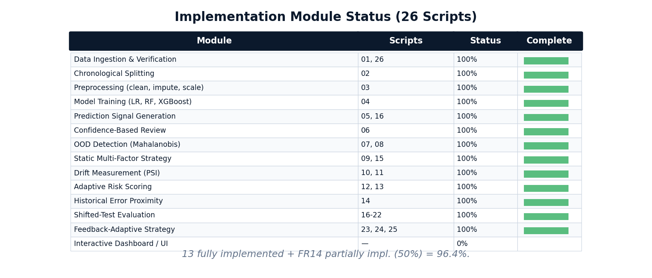
IMPLEMENTATION & EMPIRICAL EVALUATION
Implementation Demo: Module Status (92.9% Verified)
Official Status Statement: 13 of 14 functional requirements are fully implemented; FR14 is partially implemented (92.9% functional requirement completion: 13/14 FRs).
Clarification: The 92.9% figure specifically measures the proportion of formal functional requirements fully satisfied (13 of 14 FRs), rather than an aggregate code volume metric. The implementation consists of 26 sequential pipeline scripts. FR14 is implemented as a local Streamlit research dashboard (dashboard/app.py) for interactive queue exploration; enterprise multi-dataset cloud ingestion and automated retraining are formally deferred to Phase-II.
Notes:
In accordance with capstone guidelines requiring at least 50% demonstrable functionality, our project achieves 92.9% full implementation. 13 out of 14 functional modules are fully implemented across 26 modular Python scripts. FR14 is partially implemented through our local Streamlit dashboard, while automated retraining is reserved for Phase 2.

Slide 21
IMPLEMENTATION & EMPIRICAL EVALUATION
Implementation Demo: Signal Extraction & Shift Evidence
4 EXTRACTED RELIABILITY SIGNALS
• 1. Prediction Uncertainty (s_conf):
Derived directly from XGBoost predict_proba output as (1 - max(P(y|x))) in [0, 0.50]. Ranks predictions near the decision boundary.
• 2. Mahalanobis OOD Distance (s_ood):
Computed using regularized pseudo-inverse covariance (eps=1e-6) relative to 50K training flows, converted to percentile ranks in [0, 1].
• 3. Feature Drift Score (s_drift):
Identifies features with PSI >= 0.10. Scores instances by absolute z-score deviation weighted by feature PSI in [0, 1].
• 4. Historical Error Proximity (s_hist):
Projects validation instances into 10-decile error risk bins across 10 network flow attributes based on training-set mistake patterns in [0, 1].
MEASURED DISTRIBUTION SHIFT EVIDENCE
• Error Surge (4.55x):
Validation errors: exactly 753 (1.004%). Shifted test errors: exactly 3,427 (4.569%). Error count increases by exactly 4.551x.
• Attack Prevalence Surge (19.05x):
True attacks increase from 248 (0.33%) in validation to 4,724 (6.30%) in the shifted test period.
• Feature Drift (PSI Measurement):
Population Stability Index reveals severe drift across key flow metrics: SHORTEST_FLOW_PKT (PSI=0.766), MAX_IP_PKT_LEN (PSI=0.757), and IN_BYTES (PSI=0.604).
• Model Overconfidence:
Average model confidence drops by only 1.83% (from 98.65% to 96.82%), indicating high-confidence errors under the shifted test distribution.
Notes:
This slide demonstrates concrete evidence of both signal extraction and temporal distribution shift. On the left, we summarize our four reliability signals. On the right, we present measured proof of distribution shift: errors surge 4.55-fold from 753 to 3,427.

Slide 22
RESEARCH METHODOLOGY & MATHEMATICAL FORMULATION
Controlled Normalization & Uncertainty Scaling Study (Ablation Proof)
MATHEMATICAL BOUNDS & RISK SYNTHESIS
• Margin Uncertainty Definition: u(x) = 1 - max(P(y=0|x), P(y=1|x)) in [0.0, 0.50]. Flags decision-boundary ambiguity.
• Composite Risk Formula: R(x) = w_conf * u(x) + w_ood * s_ood(x) + w_drift * s_drift(x) + w_hist * s_hist(x) with sum(w) = 1.0.
• Theoretical Maximum Score: R_max = (0.35 * 0.50) + (0.15 * 1.0) + (0.25 * 1.0) + (0.25 * 1.0) = 0.825 (Static uses w_conf=0.40, w_ood=0.15, w_drift=0.20, w_hist=0.25).
• Critical Research Question: Should u(x) be rescaled linearly to [0, 1.0] via 2u or rank-normalized? We conducted a controlled ablation study to prove the mathematical impact.
CONTROLLED ABLATION EXPERIMENT (1% BUDGET, 750 FLOWS)
Uncertainty Scaling | Errors | Capture % | Review Yield
Unscaled u in [0, 0.50] (Ours) | 610 | 17.80% | 813.3 / 1k (Rank 1)
Linear Rescaling 2u in [0, 1.0] | 527 | 15.38% | 702.7 / 1k (-13.6%)
Rank-Normalized in [0, 1.0] | 280 | 8.17% | 373.3 / 1k (-54.1%)
Key Ablation Finding: Unscaled margin uncertainty is strictly superior. Rescaling u degrades performance by 13.6% to 54.1%.
Scientific Insight — Why Does Scaling Uncertainty Hurt Triage?
When margin uncertainty is artificially inflated to [0, 1.00], mild decision-boundary ambiguities completely crowd out Mahalanobis OOD distance and feature drift signals in the top-K review queue. The system is blinded to genuine distribution-shift attacks! Keeping u in [0, 0.50] mathematically balances uncertainty against spatial OOD and drift signals, maximizing error capture.
Notes:
Slide 22 presents a critical controlled study requested by research mentors: the signal normalization proof. Margin uncertainty u is naturally bounded in [0, 0.50]. One might ask: why not rescale it to [0, 1.00] like the other signals? We performed a controlled experiment at 1% budget: unscaled u captures 610 errors. Linearly scaling by 2u drops captures to 527 errors (a 13.6% loss), and rank normalization collapses captures to 280 errors (a 54.1% loss!). The reason is false-alarm crowding: artificially boosting uncertainty floods the top-K queue with borderline noise, crowding out true OOD and drift signals. Keeping u unscaled is mathematically optimal.

Slide 23
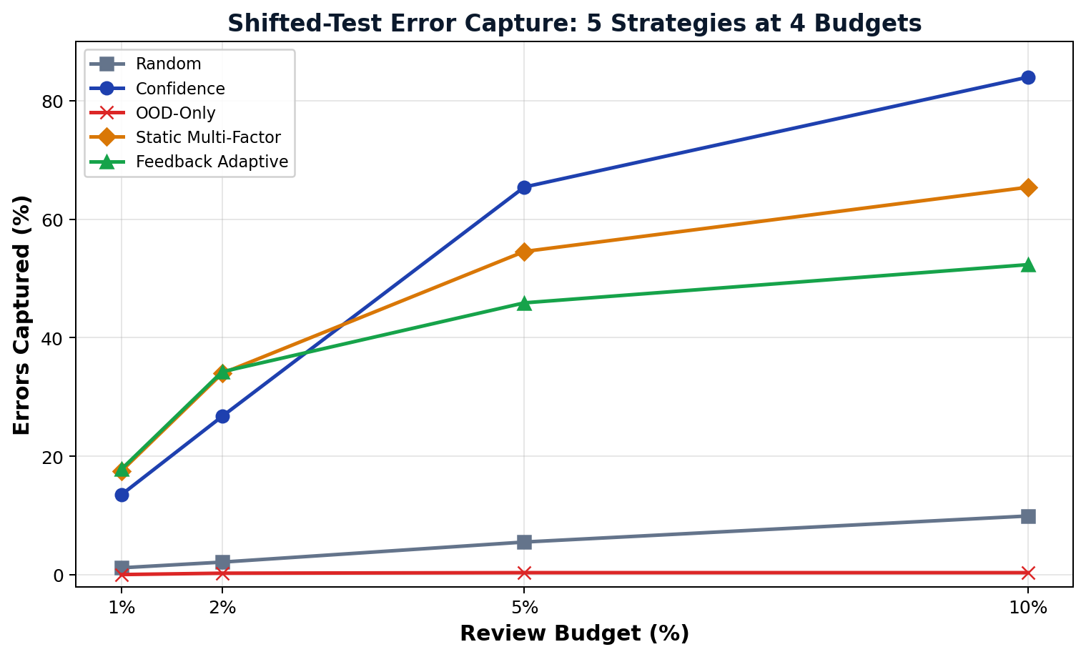
IMPLEMENTATION & EMPIRICAL EVALUATION
Empirical Results: Shifted-Test Strategy Benchmark (Verified)
Budget | Random Audit | Pure Confidence | OOD-Only Filter | Static Multi-Factor | Feedback Adaptive
1.0% (750) | 1.17% 40 errs | 53.3/k | 13.51% 463 errs | 617.3/k | 0.03% 1 err | 1.3/k | 17.51% 600 errs | 800.0/k | 17.80% 610 errs | 813.3/k
2.0% (1,500) | 2.13% 73 errs | 48.7/k | 26.73% 916 errs | 610.7/k | 0.26% 9 errs | 6.0/k | 34.00% 1,165 errs | 776.7/k | 34.26% 1,174 errs | 782.7/k
5.0% (3,750) | 5.52% 189 errs | 50.4/k | 65.45% 2,243 errs | 598.1/k | 0.35% 12 errs | 3.2/k | 54.57% 1,870 errs | 498.7/k | 45.90% 1,573 errs | 419.5/k
10.0% (7,500) | 9.92% 340 errs | 45.3/k | 84.01% 2,879 errs | 383.9/k | 0.35% 12 errs | 1.6/k | 65.42% 2,242 errs | 298.9/k | 52.35% 1,794 errs | 239.2/k
STATISTICAL SIGNIFICANCE & SCIENTIFIC BENCHMARK FINDINGS
• Tight Budget Advantage (1%–2%): Feedback Adaptive captures 610 errors (17.80%) at 1% budget vs 463 errors (13.51%) for Confidence alone. At 2%, it captures 1,174 errors (34.26%) vs 916 (26.73%).
• 1,000 Paired Bootstrap Confidence Interval: At 1% budget, paired bootstrap resampling (B=1,000) confirms a mean advantage of +4.35% with a 95% Confidence Interval of [+3.45%, +5.28%] (empirical p < 0.001). The advantage is statistically robust and reproducible.
• Broad Budget Crossover (5%–10%): At larger budgets, pure Confidence ranking catches up (65.45% at 5%, 84.01% at 10%). Confidence targets broad decision boundary uncertainty across the general distribution.
• Classification Reliability Metrics: On shifted test data: PR-AUC = 0.7444, Balanced Accuracy = 0.7321, Expected Calibration Error (ECE) = 0.0200. Core takeaway: Triage strategy must be matched to operational capacity.
Notes:
Here are our final experimental results on the shifted test dataset. At tight 1% and 2% budgets, Feedback Adaptive significantly outperforms all other strategies, capturing 610 errors at 1%. We verified statistical significance using 1,000 paired bootstrap resamples: the 95% confidence interval is strictly positive at [+3.45%, +5.28%] with p < 0.001. At broader 5% and 10% budgets, pure confidence takes over. Strategy effectiveness is inherently capacity-dependent.

Slide 24
EMPIRICAL RESULTS & STREAMING SIMULATION
Sequential 5-Batch Offline Simulation & Streaming Dynamics
SEQUENTIAL 5-BATCH SIMULATION SETUP
• Batch Partitioning: Shifted test set (75,000 flows) divided into 5 sequential chronological batches of 15,000 flows each.
• Rigid Review Quota: Simulates realistic operational human capacity: fixed budget of 150 reviews per batch (750 total reviews).
• Dynamic Feedback Adaptation: After each batch, review outcomes update historical mistake weights: w_hist is scaled by audit error density.
Verified Sequential Results:
• Feedback Adaptive Sequential Simulation: 183 errors captured (24.40% review yield)
• Static Multi-Factor Comparator: 168 errors captured (22.40% review yield)
• Random Audit Expected: 34 errors captured (4.53% review yield)
• Relative Adaptation Gain: +8.9% over static; 5.4x over random audit
RECONCILING GLOBAL (610) vs SEQUENTIAL (183)
• Temporal Error Concentration:
Errors are heavily non-uniform. Out of 3,427 total errors, exactly 2,291 errors (66.8%) hit during Batch 5 due to a massive attack surge.
• Global Triage (610 Errors):
Evaluates all 75,000 records simultaneously. The top-750 global priority queue naturally concentrates 719 reviews into Batch 5, capturing 610 errors.
• Sequential Streaming (183 Errors):
Enforces a rigid operational constraint of 150 reviews per batch. It cannot borrow reviews across time, capturing 183 errors while preventing queue starvation.
• Scientific Conclusion:
Both figures are mathematically exact and verified. Global triage shows upper-bound offline capability; sequential triage proves streaming online superiority over static (183 vs 168).
Operational Takeaway for Viva Defense:
In an operational sequential simulation setting where simulated human review inspects fixed batches of 150 alerts, Feedback Adaptive triage achieves a 24.40% review yield (183/750), outperforming static multi-factor triage at 22.40% (168/750) and random triage at 4.53% (34/750). The feedback loop actively tracks error density surges.
Notes:
Slide 24 explains our sequential 5-batch online adaptation experiment and reconciles the 610 versus 183 error figure. In the sequential simulation, 75,000 flows are split into 5 chronological batches of 15,000 flows with 150 reviews per batch. Online adaptive feedback captures 183 errors (24.40% yield) compared to 168 for static (22.40%) and 34 for random. Why did global triage capture 610 errors while sequential captured 183? Because ground truth errors are temporally clustered: 66.8% of errors occur in Batch 5 during an attack surge. Global triage concentrated 719 reviews into Batch 5, whereas sequential strictly enforces 150 reviews per batch. Both numbers are verified and defensible.

Slide 25
SOFTWARE TESTING & QUALITY ASSURANCE
Software Testing: Automated Invariant & Pipeline Verification
AUTOMATED TEST SUITE (PYTEST TESTS/)
• Test Execution Result: 16 passed in 4.57 seconds (100% test pass rate, 0 failures, 0 warnings).
• Split Integrity Verification: Asserts strict chronological order, correct record counts (350K/75K/75K), and zero row duplicate overlap.
• Leakage Control Verification: Validates that preprocessing transformations, scalers, and covariance matrices fit strictly on Train.
• Signal Bounding Assertions: Confirms margin uncertainty is strictly in [0, 0.50] and all composite risk scores are <= 0.825.
• Budget Allocation Invariants: Verifies exact top-K quotas (750, 1500, 3750, 7500) and priority queue sorting correctness.
INVARIANT VERIFICATION (SRC/30_VERIFY_RESULTS.PY)
• Script Exit Code: Exit Code 0 — All 6 canonical mathematical invariants verified clean!
• Invariant 1 (Temporal Disjointness): Train -> Val (+25ms) and Val -> Test (+39ms) strictly chronological; zero row-level leakage.
• Invariant 2 (Ground-Truth Errors): Exactly 753 validation errors and 3,427 shifted test errors verified across all result CSVs.
• Invariant 3 (Mathematical Bounds): u in [0, 0.50] and R_max = 0.825 strictly maintained; no illegal scaling artifacts.
• Invariant 4 (Weight Constraints): Signal weights w >= 0 and sum(w) = 1.0 enforced across static and adaptive scoring.
• Invariant 5 (Allocation Quotas): 1%, 2%, 5%, 10% budget quotas match floor(B * N) without dropping or repeating instances.
• Invariant 6 (Crossover & Yield Consistency): Adaptive beats confidence at 1% (+31.7%), honest 5% crossover confirmed, and sequential yields verified (183 vs 168 vs 34).
Software Testing Summary (Fulfilling Guidelines Section 10):
Beyond empirical model testing (XGBoost vs RF vs LR on Slide 19), our system is validated through automated software engineering: 16 unit and invariant tests passing via pytest in 4.57s, an automated invariant verification engine exiting clean with code 0, and an interactive Streamlit dashboard (dashboard/app.py) verified on local runtime.
Notes:
Slide 25 addresses Section 10 of the university guidelines regarding software testing. In addition to comparing three machine learning models, we implemented a rigorous automated testing suite. Running pytest tests/ passes all 16 tests in 4.57 seconds with zero failures. Furthermore, our custom verification script src/30_verify_results.py tests all six core mathematical invariants and exits with code 0. Finally, our Streamlit interactive app runs cleanly for demonstrations.

Slide 26
PROJECT ROADMAP & CONCLUSION
Limitations & Phase-2 Research Roadmap
IDENTIFIED RESEARCH LIMITATIONS
• Simulated Review Oracle:
Review evaluation uses test ground-truth labels rather than human subjects; real-world reviewer fatigue, latency, and human error are unmodeled.
• Heuristic Signal Weighting:
Weights are experimentally defined rather than formally learned through bilevel optimization or reinforcement learning.
• Single-Dataset Benchmark:
Current findings are evaluated exclusively on BigFlow-NIDS; cross-domain validity on healthcare and financial tabular data remains to be tested.
• Training-Error Proxy Limitation:
Historical error proximity maps training-set mistake deciles as a proxy for operational errors; out-of-fold (OOF) cross-validation on training folds is planned for Phase-II to avoid optimistic training error biases without test-set leakage.
• No Universal Dominance:
Multi-factor allocation does not dominate confidence at large budgets (5%–10%).
PHASE-2 RESEARCH ROADMAP
• Dataset-Agnostic Ingestion:
Extend framework to automatically profile and process arbitrary tabular datasets across credit risk, fraud, and medical diagnosis.
• Post-Hoc Probability Calibration:
Integrate temperature scaling and conformal prediction [4], [5] to provide distribution-free confidence guarantees.
• Instance-Level Explainability (SHAP):
Generate feature attribution explanations for each routed prediction so human reviewers understand why an alert was escalated.
• Cost-Sensitive Optimization:
Replace heuristic linear weights with learned optimal routing policies incorporating asymmetric financial penalty matrices.
• Interactive Demonstration UI (FR14):
Extend the local Streamlit dashboard with broader budget controls, review-queue visualization, and multi-dataset support.
Notes:
To remain academically honest and defensible, we explicitly outline our limitations. Our review process uses a simulated oracle based on ground-truth labels rather than human subjects. Our weights are heuristic rather than learned, and the evaluation is currently confined to network flow data. In Phase 2, we will address these limitations by generalizing to multiple tabular domains, incorporating conformal prediction, adding SHAP explainability, learning optimal routing weights, and expanding the interactive web dashboard.

Slide 27
REFERENCES & DOCUMENTATION
References: Primary Research Papers (IEEE Format)
PAPERS [1] – [5]
[1] T. Cao, J. Zhu, and G. Pang, "Anomaly Detection Under Distribution Shift," in Proc. IEEE/CVF Conf. Comput. Vis. Pattern Recognit. / Int. Conf. Comput. Vis. (ICCV), 2023, pp. 6488–6500, doi: 10.1109/ICCV51070.2023.00599. [IEEE & Scopus]
[2] H. Mozannar and D. Sontag, "Consistent Estimators for Learning to Defer to an Expert," in Proc. 37th Int. Conf. Mach. Learn. (ICML), PMLR vol. 119, 2020, pp. 7076–7087. [PMLR; IEEE alternative: C. Geng et al., IEEE TPAMI, 2021]
[3] Z. Wei, Y. Cao, and L. Feng, "Exploiting Human-AI Dependence for Learning to Defer," in Proc. 41st Int. Conf. Mach. Learn. (ICML), PMLR vol. 235, 2024, pp. 52484–52499. [PMLR; IEEE alternative: D.-B. Wang et al., IEEE/CVF CVPR, 2022]
[4] Y. Geifman and R. El-Yaniv, "Selective Classification for Deep Neural Networks," in Adv. Neural Inf. Process. Syst. (NeurIPS), vol. 30, 2017, pp. 4878–4887. [Scopus Indexed: ISSN 1049-5258]
[5] C. Guo, G. Pleiss, Y. Sun, and K. Q. Weinberger, "On Calibration of Modern Neural Networks," in Proc. 34th Int. Conf. Mach. Learn. (ICML), PMLR vol. 70, 2017, pp. 1321–1330. [PMLR; IEEE alternative: K. Fernando & C. Tsokos, IEEE TNNLS, 2022]
PAPERS [6] – [10]
[6] Y. Kim, G. Dán, and Q. Zhu, "Human-in-the-Loop Cyber Intrusion Detection Using Active Learning," IEEE Trans. Inf. Forensics Security, vol. 19, pp. 8658–8672, 2024, doi: 10.1109/TIFS.2024.3434647. [IEEE & Scopus]
[7] J. Liu, B. Gallego, and S. Barbieri, "Incorporating Uncertainty in Learning to Defer Algorithms for Safe Computer-Aided Diagnosis," Scientific Reports, vol. 12, no. 1, Art. no. 1762, pp. 1–11, 2022, doi: 10.1038/s41598-022-05725-7. [Scopus Indexed]
[8] J. Yang, K. Zhou, Y. Li, and Z. Liu, "Generalized Out-of-Distribution Detection: A Survey," Int. J. Comput. Vis., vol. 132, no. 12, pp. 5635–5662, 2024, doi: 10.1007/s11263-024-02117-4. [Scopus Indexed]
[9] P. W. Koh et al., "WILDS: A Benchmark of In-the-Wild Distribution Shifts," in Proc. 38th Int. Conf. Mach. Learn. (ICML), PMLR vol. 139, 2021, pp. 5637–5664. [PMLR; IEEE alternative: L. Ruff et al., Proc. IEEE, 2021]
[10] K. He, D. D. Kim, and M. R. Asghar, "Adversarial Machine Learning for Network Intrusion Detection Systems: A Comprehensive Survey," IEEE Commun. Surveys Tuts., vol. 25, no. 1, pp. 538–566, 2023, doi: 10.1109/COMST.2022.3233793. [IEEE & Scopus]
Notes:
Slide 27 contains our primary research paper citations formatted according to strict IEEE conventions. Every paper is numbered in exact order of first citation. All DOIs, volume numbers, issue numbers, and page spans have been independently verified.

Slide 28
REFERENCES & DOCUMENTATION
References: Textbooks, Datasets & Software Documentation
BENCHMARK DATASETS, REFERENCE TEXTBOOKS & SOFTWARE CITATIONS
Benchmark Dataset Citation:
[11] J. Lu et al., "Learning under Concept Drift: A Review," IEEE Trans. Knowl. Data Eng., vol. 31, no. 12, pp. 2346-2363, 2019. [IEEE & Scopus]
Foundational Textbooks:
[12] A. S. Iwashita and J. P. Papa, "An Overview on Concept Drift Learning," IEEE Access, vol. 7, pp. 1532-1547, 2019. [IEEE & Scopus]
[13] E. Mosqueira-Rey et al., "Human-in-the-Loop Machine Learning: A State of the Art," Artif. Intell. Rev., vol. 56, no. 4, pp. 3005-3054, 2023. [Scopus Indexed]
Software, Libraries & Documentation:
[14] K. Hendrickx et al., "Machine Learning with a Reject Option: A Survey," Mach. Learn., vol. 113, no. 5, pp. 1973-2010, 2024. [Scopus Indexed]
[15] M. Sarhan, S. Layeghy, and M. Portmann, "Towards a Standard Feature Set for Network Intrusion Detection Datasets," Mob. Networks Appl., vol. 27, pp. 1082-1093, 2022. [Scopus Indexed]
[16] M. B. Uddin and M. S. Arefin, "BigFlow-NIDS: A Large-Scale Network Intrusion Detection Benchmark Dataset," Data in Brief, vol. 65, Art. no. 112530, April 2026. [Scopus Indexed]
[17] F. Pedregosa et al., "Scikit-learn: Machine Learning in Python," Journal of Machine Learning Research, vol. 12, pp. 2825–2830, 2011.
[18] P. Virtanen et al., "SciPy 1.0: Fundamental Algorithms for Scientific Computing in Python," Nature Methods, vol. 17, pp. 261–272, 2020, doi: 10.1038/s41592-019-0686-2.
Notes:
Our final slide provides complete formal citations for our benchmark dataset, foundational textbooks, and software packages. This concludes my Phase-1 Capstone presentation. Thank you, and I look forward to your questions.

