Slide 1

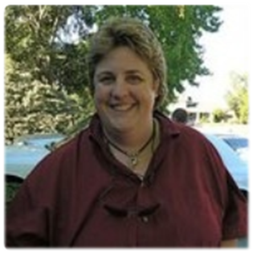
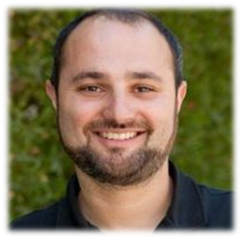
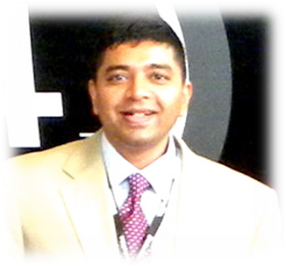

Passion for discovery
Rajagopal Sathyamurthi
Kris Robison
Team - NOVA
Daniel Schwartz
DJ Ursal

Slide 2
Goal
Our Focus is to help explore, learn and share Asteroid information in an interactive way to inspire and guide present and future generations.
Team - NOVA

Slide 3
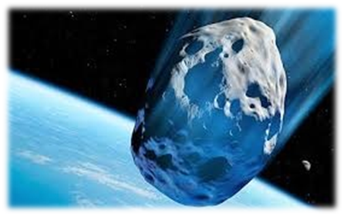
DEMO
Finding Asteroids Before They Find Us!
Team - NOVA

Slide 4
Design Approach
Explore - Click and Drag
Learn - Get More info
Share - Social Media
Team - NOVA
Notes:
Click and Drag on any chart to filter, become a explorer

Slide 5
Technical Approach
Leverage - MPC Data +API
Mash up - Sentry Risk Table (NASA)
Componentized - Mobile, Web App
Team - NOVA
Notes:
Near Earth Object Program – NASA
Minor Planet Center - Data

Slide 6

Team - NOVA

