Slide 1

ATTENTION these are all HANDS drawn
using Powerpoint basic shapes
(eg: rectangles, circles, triangles)
!
ATTENTION I used th following ICONs
From the Powerpoint ICON library
!
_______
_______
_______
_______
_______
WARNING

Slide 2
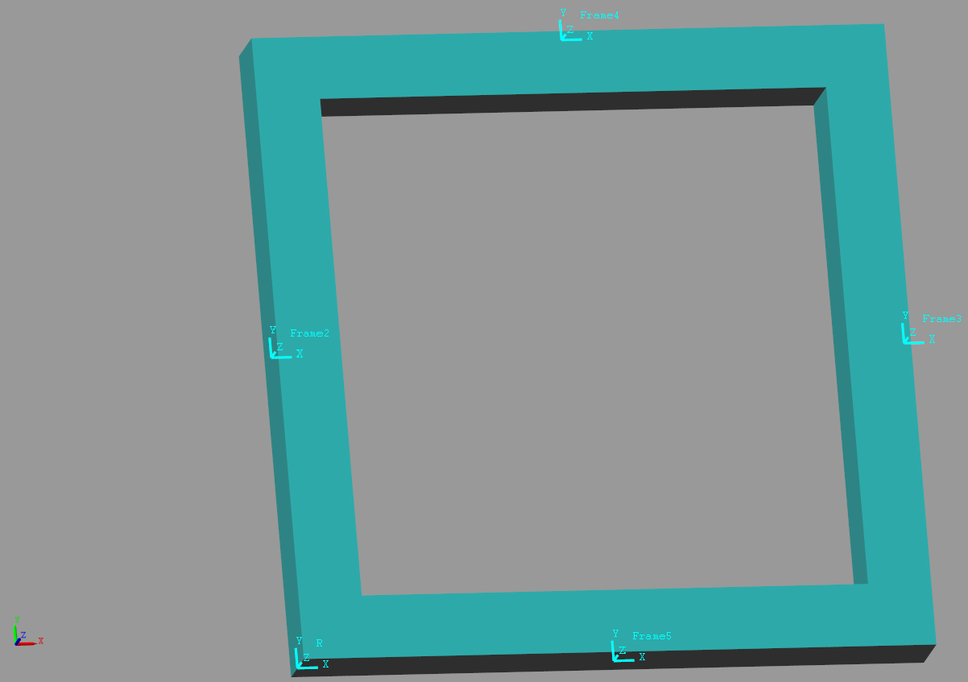
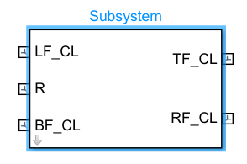

Slide 3
O
Y
X

Slide 4
Y
X
O
L_ix_h
L_y_O2h
tx_h
L_x_c
L_rx_c
L_iy_h
tx_c
D
L_y_c
L_y_s
D_c
tx_s
ty_c
A
ty_h
B
C

Slide 5
L_x_c
L_x_c
L_rx_c
L_rx_c
Y
tx_c
tx_c
X
L_y_c
L_y_c
D_c
D_c
ty_c
ty_c
Y
Y
X
X
Z

Slide 6
Y
Local frame
X
C
Desired frame
Z
Y
vec_C_relative_to_O
O
X
Z

Slide 7
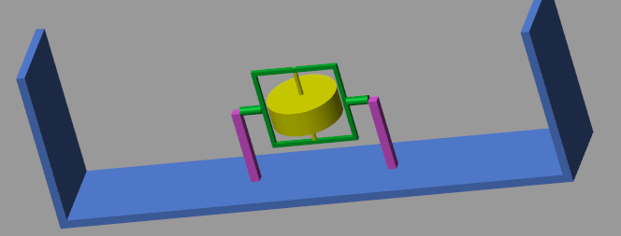
cage
disk
hull
stand

Slide 8
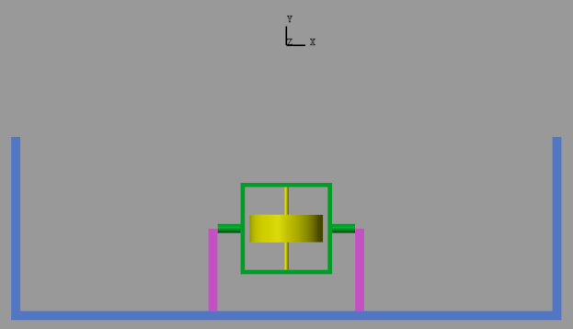

Y
X
Body fixed
H-Frame
O

Slide 9
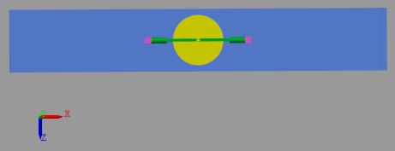
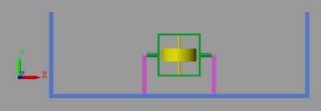
cage
disk
hull
stand

Slide 10
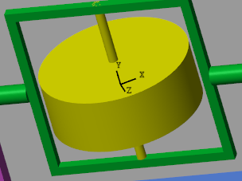
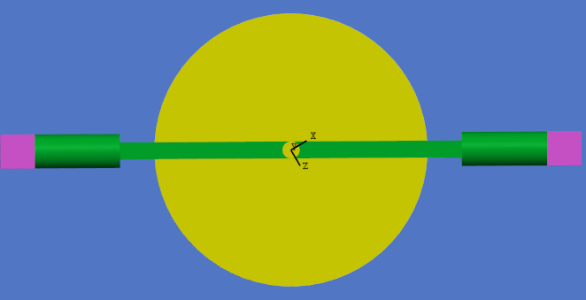
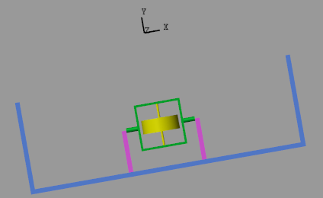
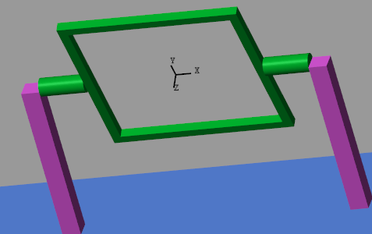

Slide 11


Body fixed
D-Frame
X
$$β$$
Body fixed
D-Frame
Z
Body fixed
H-Frame
Y
$$θ$$
X
O
Body fixed
H-Frame

Slide 12







Figure 2a:
$$Y^{W}$$
H-frame
Body fixed
H-Frame
$$Y^{H}$$
O
$$X^{H}$$
$$τ_{Hull}$$
$$θ$$
O
RZ
$$X^{W}$$
$$ω_{1}^{H}=\left(\begin{matrix}0 \\ 0 \\ \dot{θ}\end{matrix}\right)$$

Slide 13
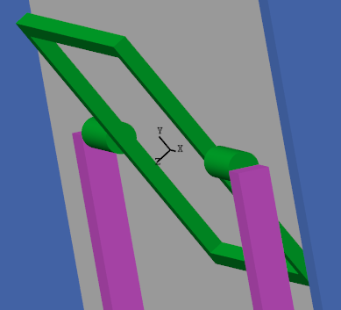






Figure 2b:
$$Y^{H}$$
$$Y^{C}$$
C-frame
$$φ$$
Body fixed
C-Frame
$$Z^{H}$$
RX
$$Z^{C}$$
$$ω_{2}^{C}=\left(\begin{matrix}\dot{φ} \\ 0 \\ 0\end{matrix}\right)$$

Slide 14








Figure 2c:
$$τ_{Disk}$$
Body fixed
D-Frame
X
$$Z^{C}$$
RY
$$β$$
$$β$$
Body fixed
D-Frame
$$Z^{D}$$
Z
D-frame
$$X^{C}$$
$$X^{D}$$
$$ω_{3}^{D}=\left(\begin{matrix}0 \\ \dot{β} \\ 0\end{matrix}\right)$$

Slide 15
Y
X
O
L_y_O2h
tx_h
L_iy_h
3.
1.
2.
L_ix_h
A
ty_h

Slide 16
Y
X
O
L_y_O2h
L_iy_h
Y
X
Z
D
L_y_s
A
ty_h

Slide 17
Y
X
L_y_O2h
O
Y
L_iy_h
X
Z
D
L_y_s
ty_h
A

Slide 18







{W-frame}
$$X^{H}$$
$$Y^{H}$$
$$θ$$
$$θ$$
O
O
$$θ$$
$$θ$$
L
CoM Hull
CoM Cage
and DISK
$$y_{CG}$$
{PE=0}

Slide 19



{H-frame}
Y
X
Y
X
$$θ$$
$$θ$$
$$τ_{Hull}$$
O
O
Hull CG

Slide 20

















{H-frame}
{C-frame}
{D-frame}
$$Y^{H}$$
$$τ_{Disk}$$
$$Y^{C}$$
$$Y^{H}$$
$$φ$$
$$Z^{C}$$
RY
$$β$$
$$Z^{H}$$
D
$$X^{H}$$
$$Z^{H}$$
RX
$$Z^{D}$$
$$X^{C}$$
$$X^{D}$$
$$Z^{C}$$
$$ω_{2}^{C}=\left(\begin{matrix}\dot{φ} \\ 0 \\ 0\end{matrix}\right)$$
$$ω_{1}^{H}=\left(\begin{matrix}0 \\ 0 \\ \dot{θ}\end{matrix}\right)$$
$$ω_{3}^{D}=\left(\begin{matrix}0 \\ \dot{β} \\ 0\end{matrix}\right)$$

Slide 21













$$Y^{W}$$
O
$$Y^{H}$$
$$X^{H}$$
$$τ_{Hull}$$
$$θ$$
O
RZ
$$X^{W}$$
$$τ_{Disk}$$
$$τ_{Disk}$$
$$Z^{C}$$
RY
$$β$$
$$Z^{D}$$
$$X^{C}$$
$$X^{D}$$

Slide 22

$$τ_{Disk}$$
$$τ_{Disk}$$
$$Z^{C}$$
RY
$$β$$
$$Z^{D}$$
$$X^{C}$$
$$X^{D}$$

Slide 23
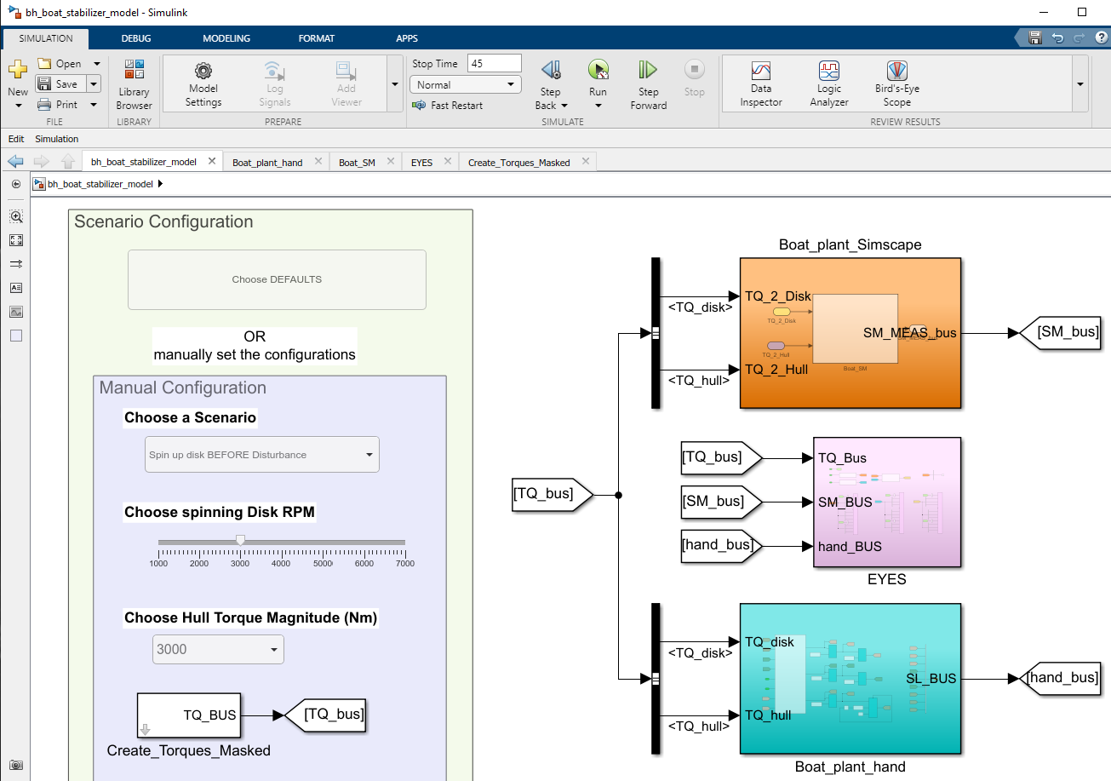
The Simscape
model
Scenario Configuration
parameters
The Hand
derived
model

Slide 24
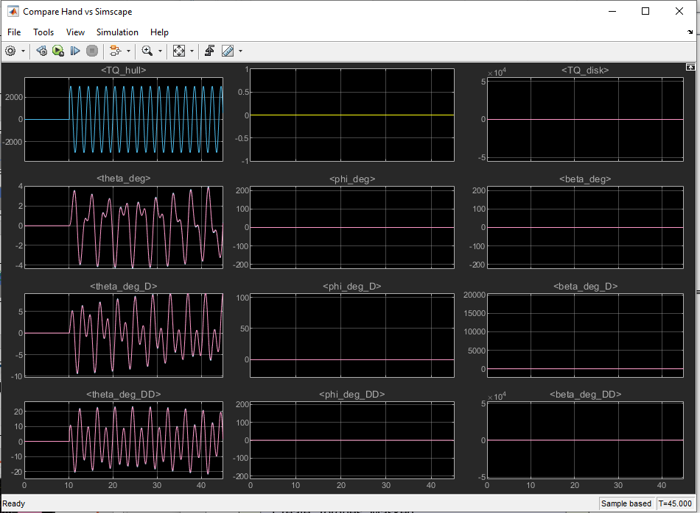

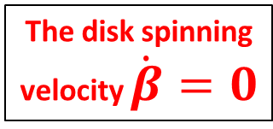
The disturbance torque
applied to the hull
The hull rocking angle
$θ$
The disk spinning
velocity $\dot{β}=0$

Slide 25
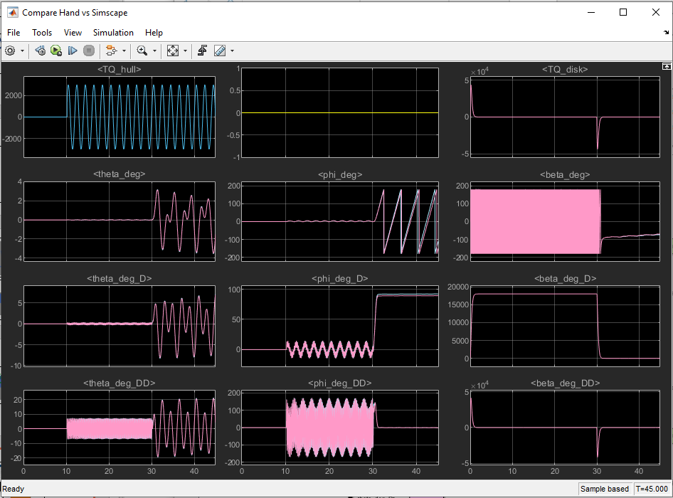

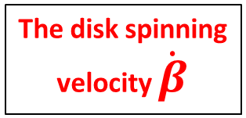
The disturbance torque
applied to the hull
The hull rocking angle
$θ$
The disk spinning
velocity $\dot{β}$

Slide 26
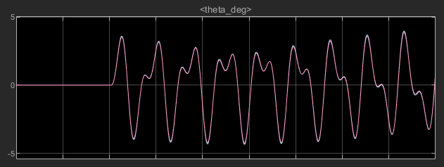
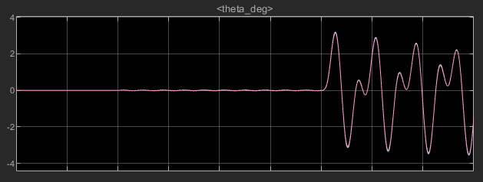


The hull “rocking” angle
Stabilization disabled
Y
X
$$θ$$
O
$$θ$$
Stabilization disabled
Stabilization ENABLED

Slide 27
