Slide 1
MOVIE DATA ANALYSIS PROJECT

Slide 2
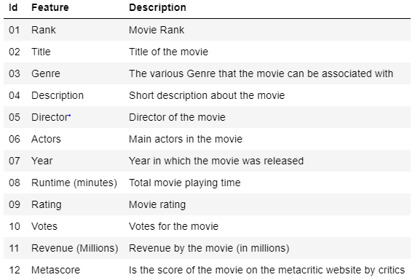
Welcome to this exploration of Hollywood movies!
We will sift through over 1,000 movie title in order to discover valuable relationships between variables such as revenues (determined by box office sales), genres, and viewer ratings.This Data is acquired via various sources. Data contains information's about various movies released between 2006 and 2016 .

Slide 3
Some pre-requisite before we go into analysis: 1. DATASET contains 1000 rows and 12 columns. 2. Dataset had 128 null values in Revenue(Million) columns and 64 null values in Metascore columns 3. As Metascore and Rating both depicts are reviews I’ve replaced the null values by its adjacent Rating value after multiplying it by 10. 4. Row containing Null values In Revenue(Million) is Dropped the is saved in new Dataset which is used in relevant to Revenue of the films. 5. One zero value is replaced by np.Nan value .

Slide 4
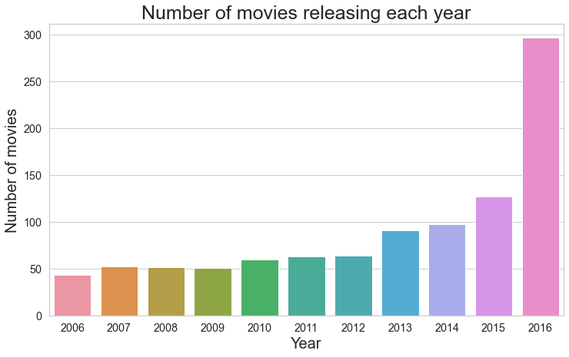
Which year has the most number of movie releases? Has the number of movies released per year has changed ?
It can be seen that that Number of movies are increasing with each progressing year.
More than half of the movies are released in last three years(2014-2916)

Slide 5
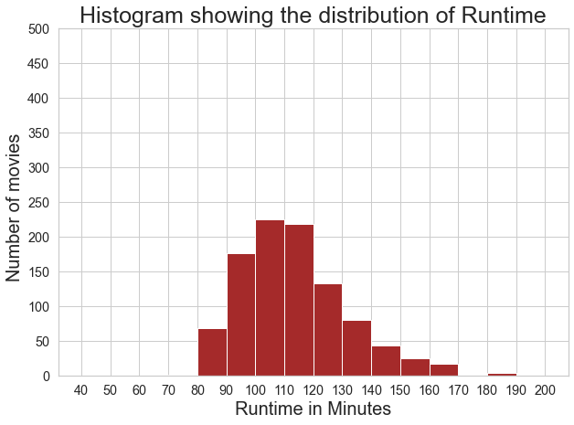
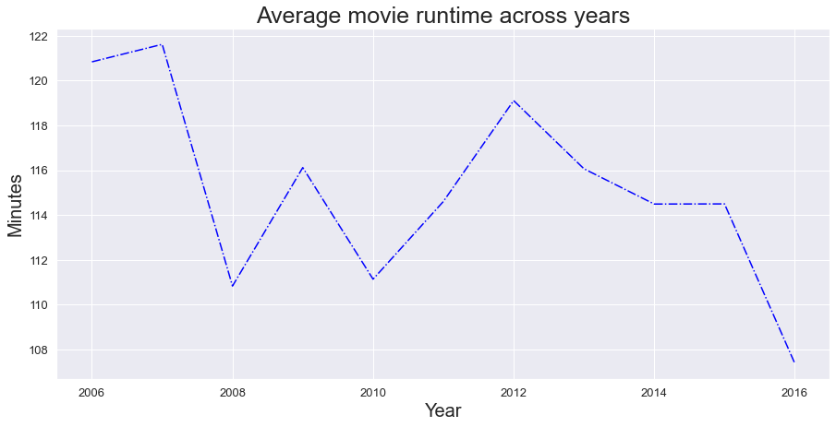
How Runtime of movies has changed over years ? Also how Runtime is Distributed?
We can se that most movies has Runtime between 100 - 110 minutes range
As depicted Average movie Runtime across year is between 107 - 120 Minutes
2016 has the lowest Runtime avg of 107 minutes wrt 2006 with avg Runtime of more than 121 Minutes

Slide 6
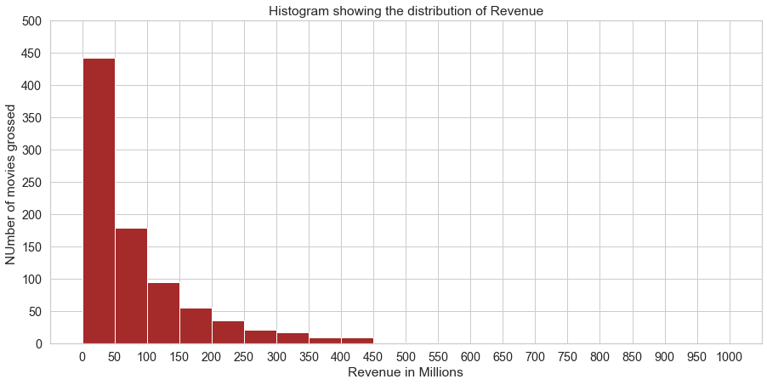
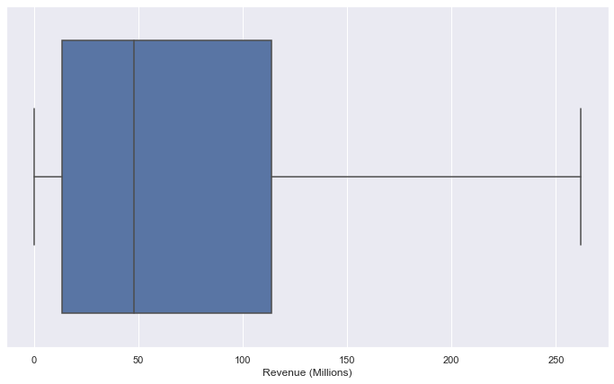
How Revenue is distributed ?
Here we can see that majority of the movies has Revenue under 50$ Million.
Through Boxplot we can see that more than 75% of movies has Revenue under 120$ range though very handful of movies have very high Revenue which is pulling the mean away from Median.
Revenue (Millions) is right skewed as mean is 82.9 is way high than median 47.8.

Slide 7
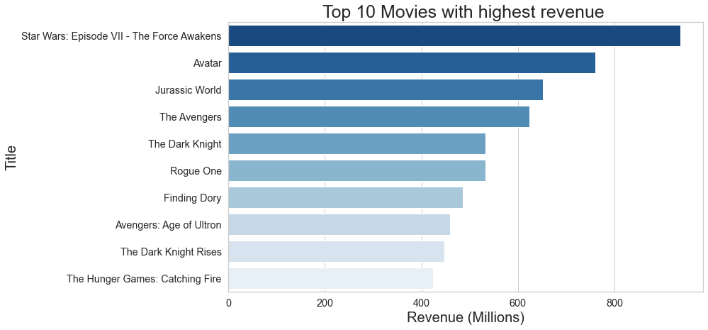
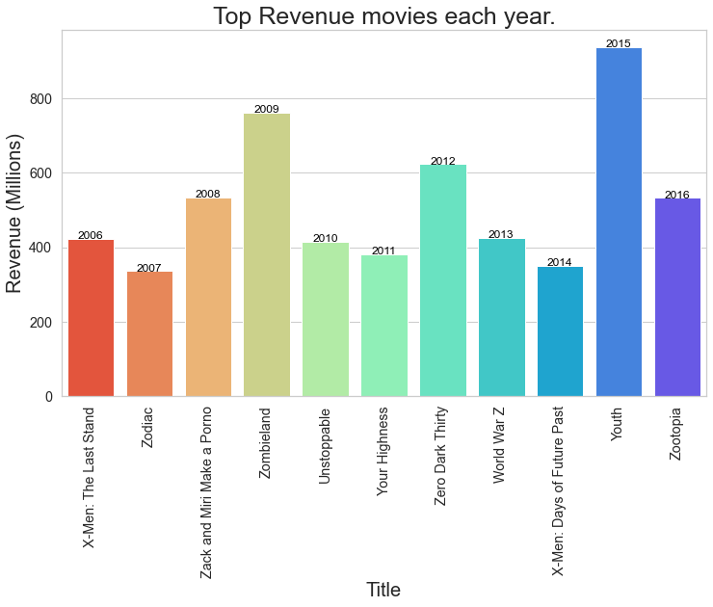
Which are Top 10 highest Revenue earning movies ? Also highest revenue movie in each year?
The Highest Revenue Movie is Star Wars: Episode VII - The Force Awakens which has earned 936.63 Millions in Revenue and has Rating and Metascore of 8.1 and 81 respectively.

Slide 8
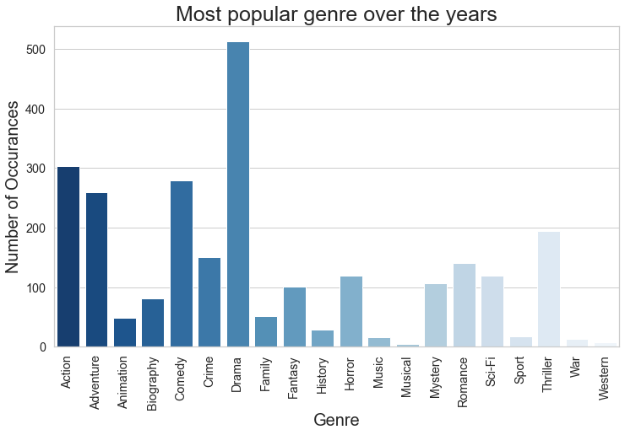
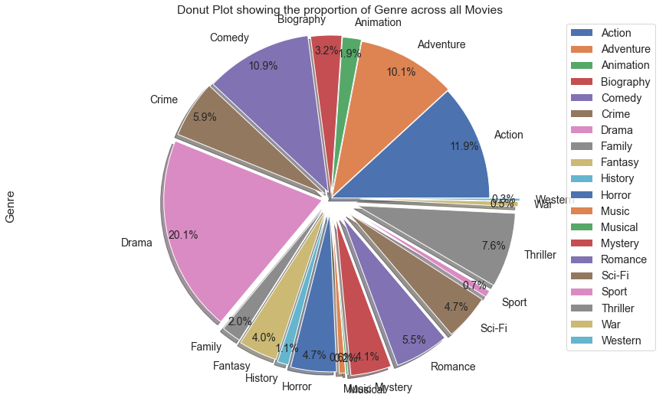
Which is the most popular Genre over the years?
Drama, Comedy, Adventure, and Action are the most popular genres in general. The pie chart is a better visual since we can assess that these top 4 genres make up about 50% of all movies.
War, Music, Westerns and Sports are the least popular genres.

Slide 9
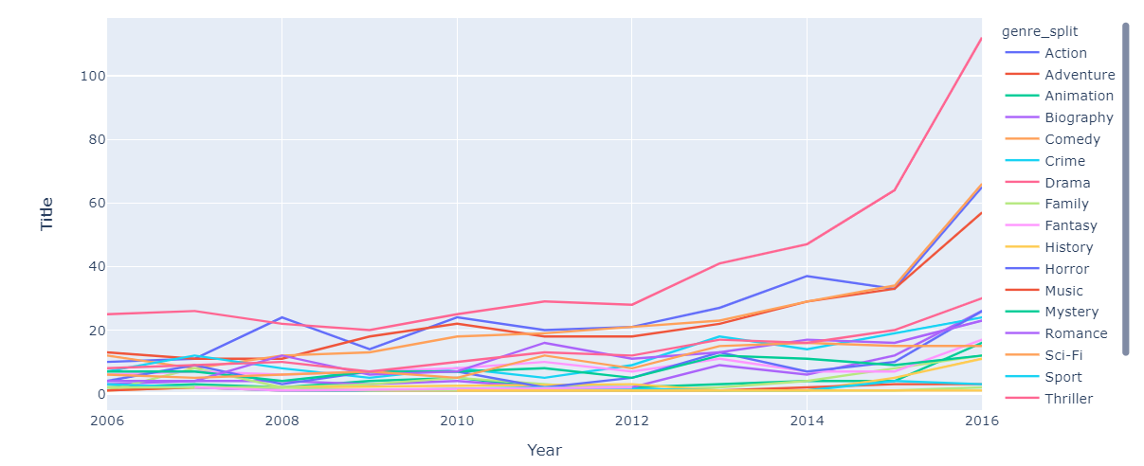
Explore share of genres of movies across years? Also find which Genre bring in the most revenues?
It can be seen there is a drastic rise in number of movies made per year and genre which were made most are Drama, Action, Adventure and comedy

Slide 10
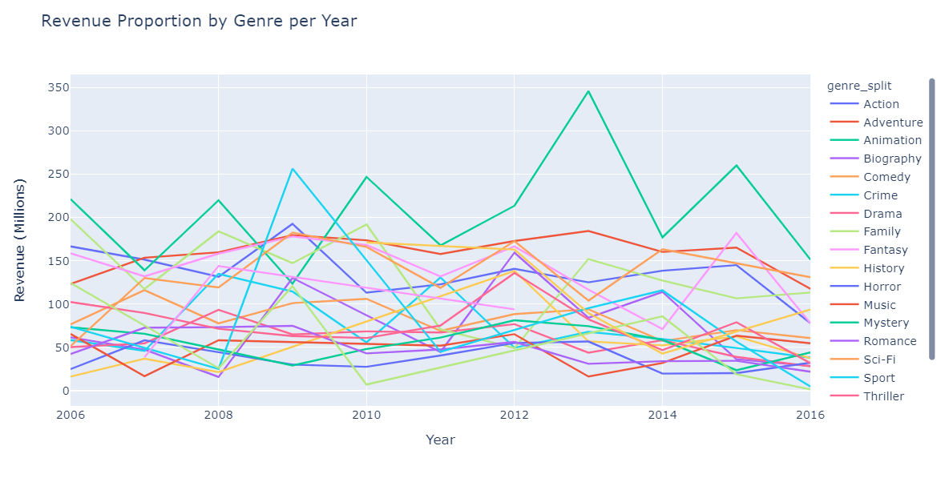
Animation has the highest return rate with average revenue of 151.08 million in 2016. Sci FI and Adventure are other two high yielding Genres as well.

Slide 11
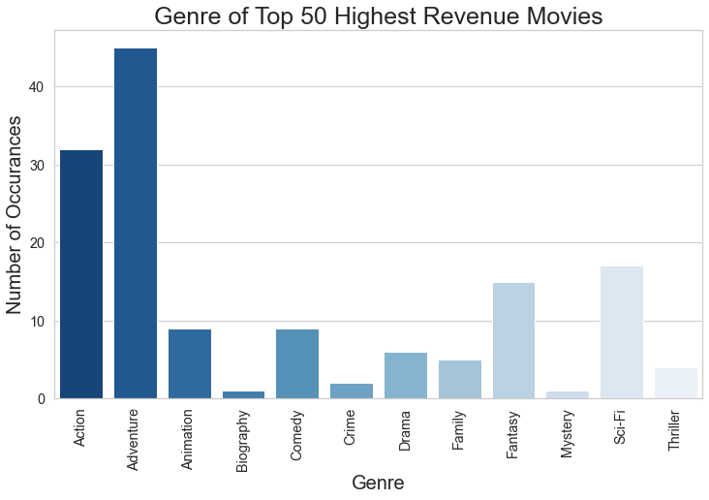
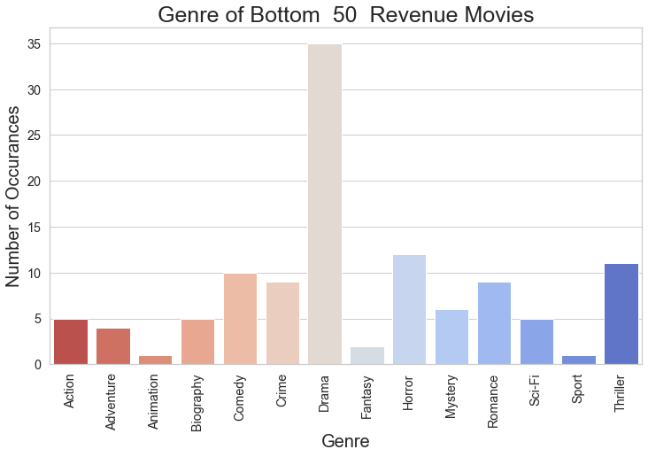
What is Genre of Top 50 Highest and Lowest Revenue movies ?
Most High Revenue Movies are in Action , Adventure, sci-fi , Fantasy and comedy genre.
Majority of bottom 50 movies are in DRAMA genre.
It can be noticed though Drama has the most made movie genre but when it comes to high revenue movies Action , Adventure and Sci-Fi movies earn high revenues against any other genre.

Slide 12
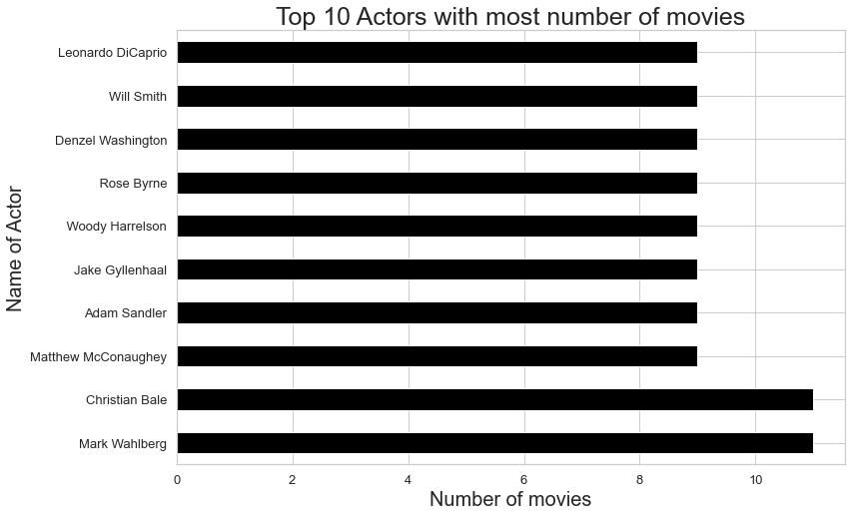
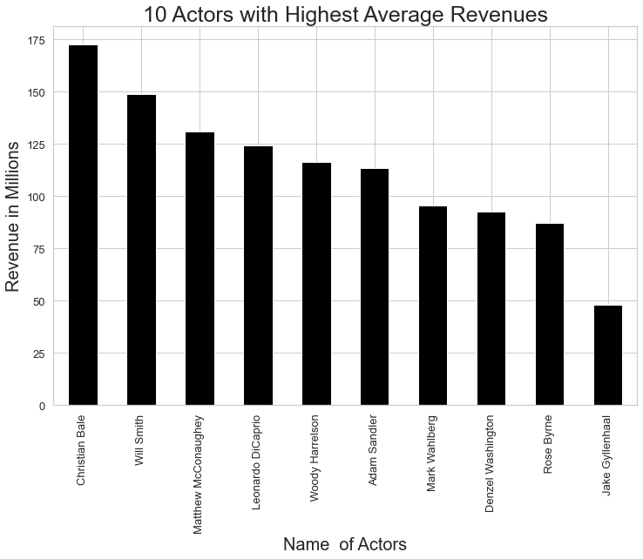
Which Actor has done most number of movies ? Also find out most dependable actors with highest average revenue who has done minimum 5 movies with minimum revenue of 10 million ?
It can be observed that Mark Wahlberg and Christian Bale has done 11 movies.
Christian Bale is topping both the list making his the most dependable actor .
Also it can be noticed that both list has many common name suggesting the Actors who are more successfull end up doing more films than other.

Slide 13
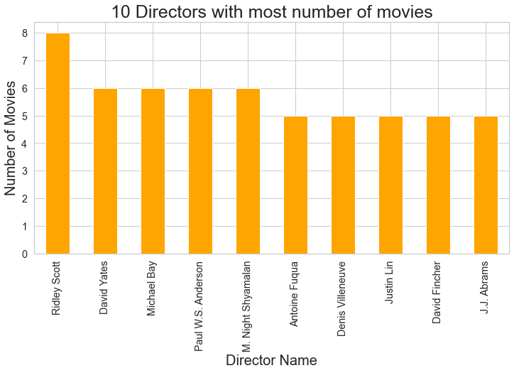
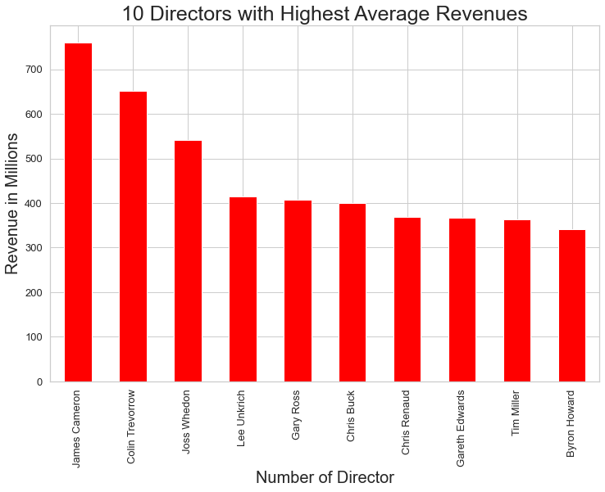
Top 10 Directors with most number of movies? Which Directors are the safest bet?
Ridley Scott has made 8 Movies which is highest along with Michael Bay , M. Night Shyamalan ,David Yates , Paul W.S. Anderson who has made 6 movies each.
James Cameron has high returns along with Colin Trevorrow and Joss Whedon who has more than 5 movies with minimum revenue of 10 million dollars.

Slide 14
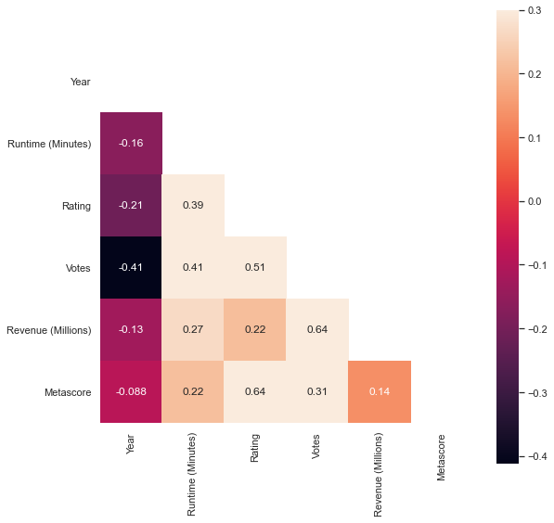
Explore how Revenue is affected by various parameters?
Revenue is positively correlated with Runtime and Ratings.
It is observed that there is decline in Ratings of movies over advertently impacted Votes and Revenues
Year is negatively correlated with all other columns which shows that over the years Ratings, Runtime, Metascore has declined which adverantly pulled the Revenues down as well.
Votes and Revenue has high Correlation of 0.6.

Slide 15
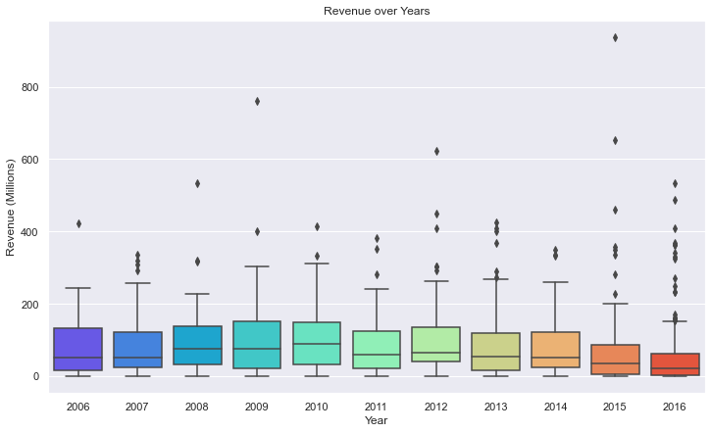
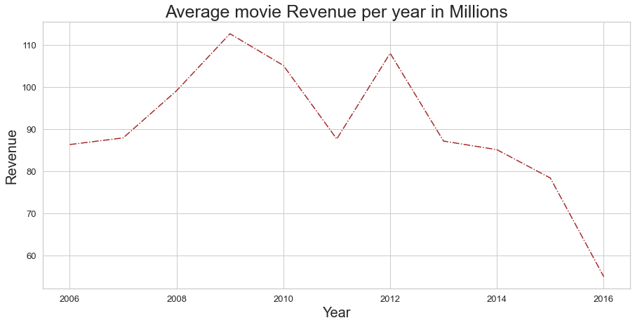
Conclusion:
It can be observed that with each year Avg Revenue is dropping but with rise in Outliers which suggest that some movies are doing exceptionally well while for majority the movie revenue has dropped over the years
Average Revenues in 2006-2016 have decreased 37% appox, from 86.2million to 54.9 million.
Movies with higher revenues are more popular(can be seen from votes counts).

Slide 16
Actionable Insights:
For higher budget Adventure, Action, and Sci-Fi are the genre to go for along with Animation
More Votes equal more Revenues.
People more often end up voting on movies which they like rather than the other way round.
Though one reason of Revenue Dropping can be that number of movies have increased drastically with more than 50% of movies released in last 3 years(2014-2016). So with increased competition Production houses need to make good movies with high yielding genres.

