Slide 1
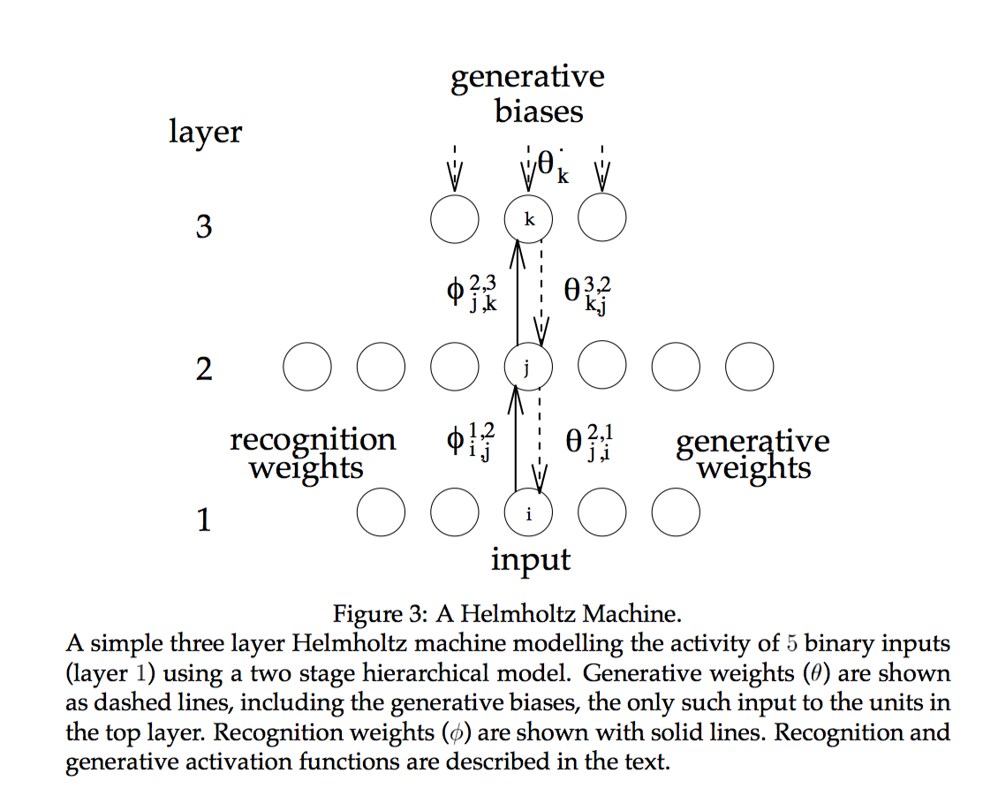
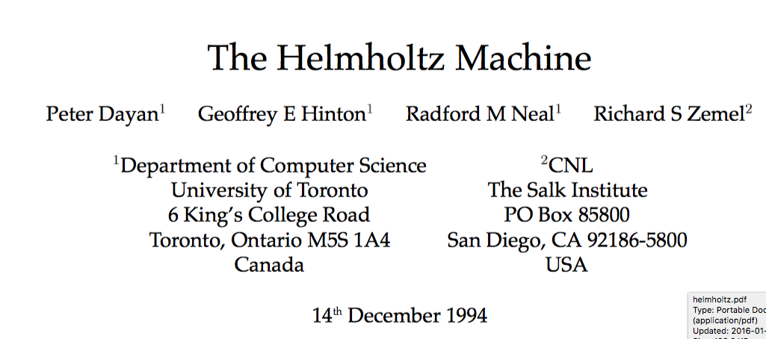
Fast feed-forward, possibly slow feedback
Feed-forward: quickly figure out current state
(observation space -> mental model space)
Feedback: hallucinate
(what if the feedforward computed state is true)

Slide 2
The main idea
Instead of looking for similarity in high dimensional space, try to ‘work’ in lower dimensions and have a way of converting between high and low dimensional representation.
High dimensional: observation space
Low dimensional: mental model space
’Semantic pointers’
I think that we search for similarities in this ‘low-dimensional space’

Slide 3
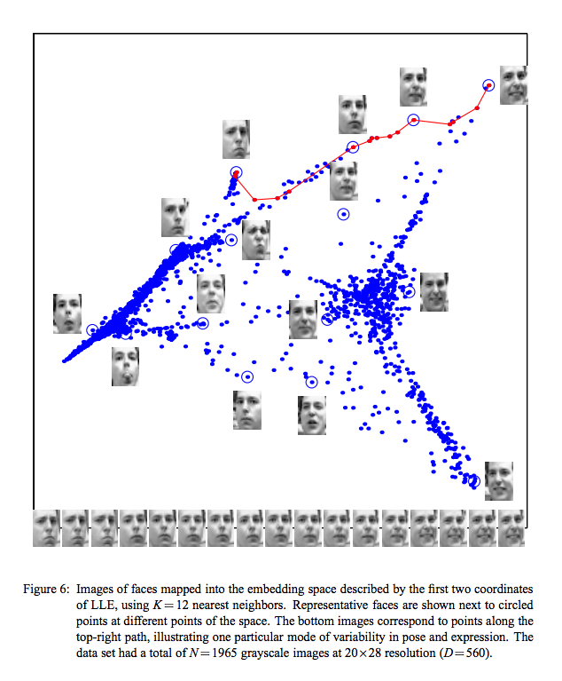
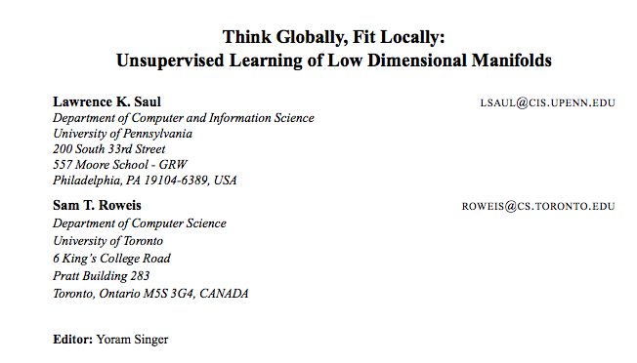
Manifold hypothesis
Real world data/events form a manifold in some low-dimensional space, so that similar things are close

Slide 4
Content-based addressing
I think that it will work for memory addressing
Need to exploit locality

Slide 5
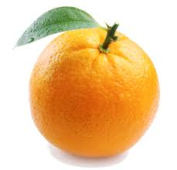
memory
cue

Slide 6
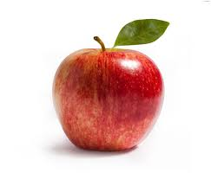

Slide 7
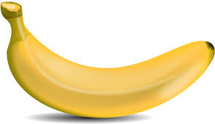

Slide 8
?

Slide 9

?
GOALS:
Given A, quickly find A’ (approximate NN search)
Given B, determine its properties (based on its location it’s easy)
ESCAPE – have something that scales to millions of elements/thousands of sub-regions
A mechanism which we can use to quickly store/retrieve data (minimizing communication cost and exploiting locality)

Slide 10
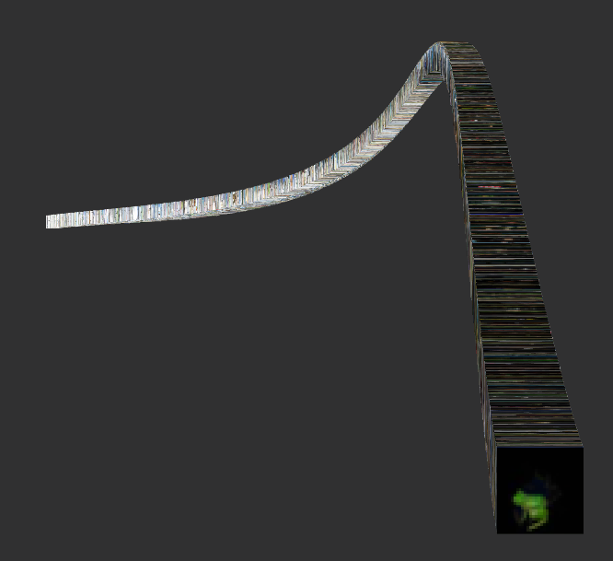
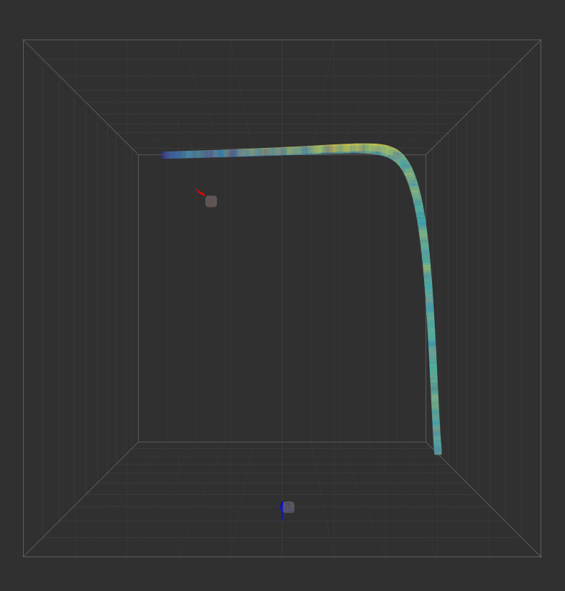
What I did so far
I am able to learn low dimensional (1,2,3 –D) codes for data in real-time, online, unsupervised.
Cifar – 10 in 3D space

Slide 11
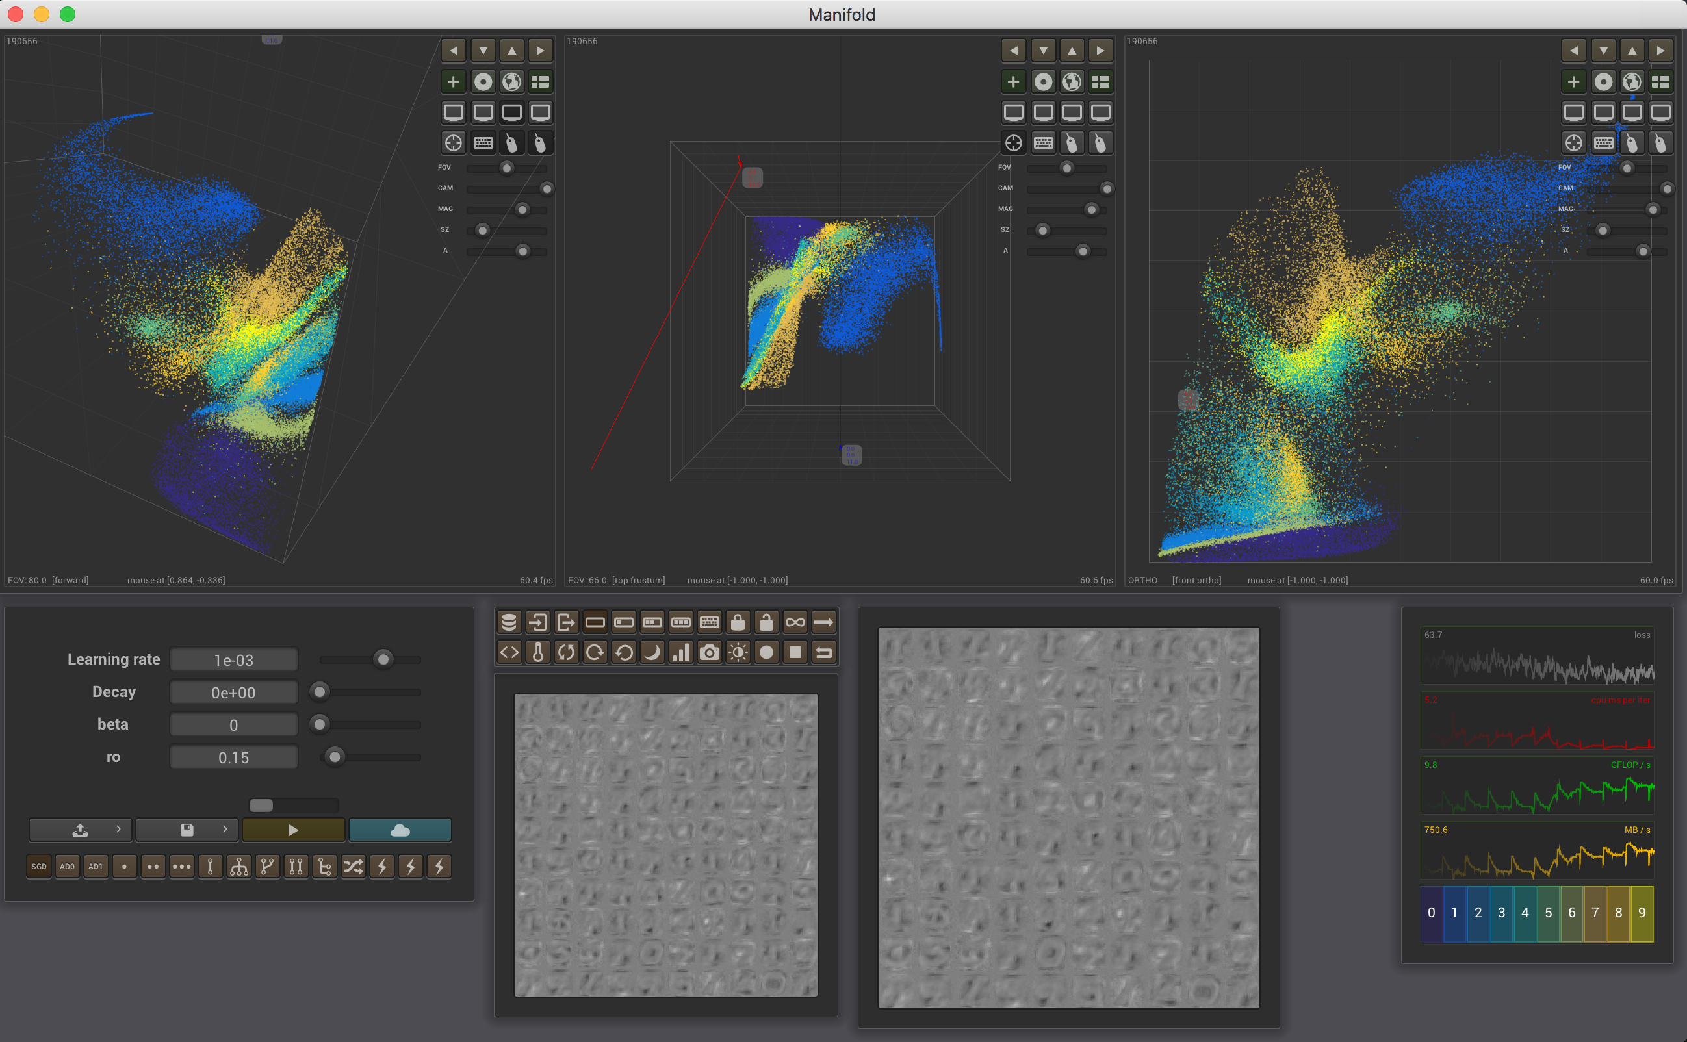
I wrote a tool which works as a manifold microscope

Slide 12
Hierarchy – Flexible topology
Sparse/Dense connections – receptive fields

Slide 13
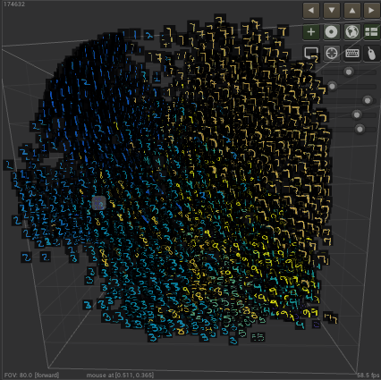
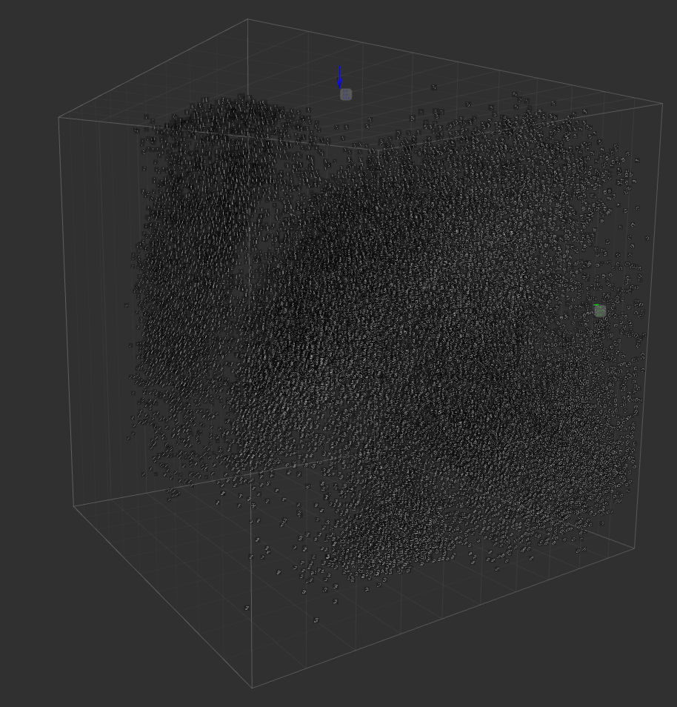
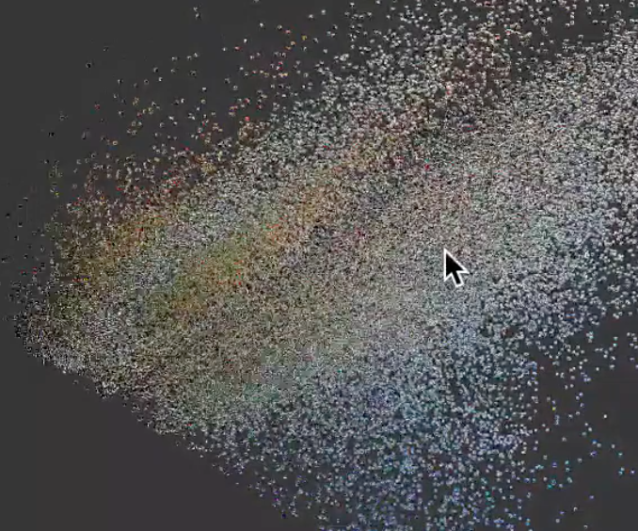
Form connections between
Low-dimentional mental representations
-Receptive fields
-White matter connections are sparse

