Slide 1
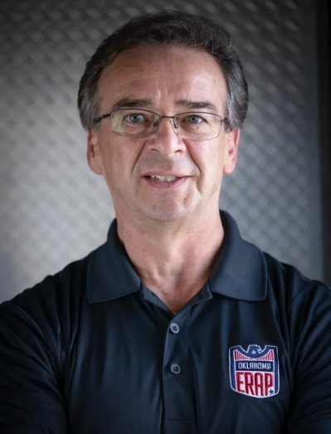
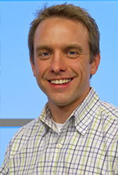
OK Respond and Kidvation are Organizations collaborating to provide a youth Entrepreneurship Program for at risk Middle School Students
Based in Oklahoma City
Collaboration with OKC PD and Police Athletic League (PAL)
Giving at risk students a vison for their future
Douglas White, CEO OK Respond
Brent Wheelbarger, Co-Founder Kidvation Global

Slide 2
OKRespond/ Kidvation looking to expand to more Cities across the United States
Phases:
Insights to Date:
Market Analysis
The total cost for OK Respond to acquire one new Location for program expansion is $500 and 10 work hours
The total cost of running the program for one Cohort in any location is $28,000
Depending on the location the cost may be as low as $2,500
Market Entry: Strategy
Market Entry: Financial Viability

Slide 3




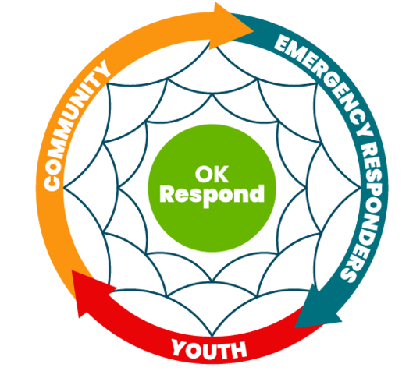
The total Cost for OK Respond to acquire one new Location for Program Expansion is $500 and 10 work hours
Connects to
Pitches to
Approves
Community Relations Office
Potential Partner
Police Chief
Execution
Marketing
Program Pitch
Provide Curriculum + Suppport
Marketing+Partnership
2 hours | 6 hours | 2 hours | $500+ 10 work hours
0 | 0 | 0 | $28,000
OK Respond's costs:
New Location's cost:

Slide 4
An ideal Location with access to the required Infrastructure will face the minimum Cost of $2500 of running the Program
Fixed Costs per Cohort any Location: | $/Cohort
Curriculum | $ -
Snacks | $ 600.00
Printing cost | $ 100.00
Equipment | $ 6,500.00
Community center | $ 4,000.00
Production/prototyping/product launch | $ 1,000.00
PAL officers' salary (five needed) | $ 15,000.00
Grant writer (provided by OK respond) | $ 800.00
Total: | $ 28,000.00
Cash Cost:
$13,000
Minimum Cost:
$2,500
Revenue:
Grants+ Business Donations

Slide 5




Interviews revealed, potential Partners for Expansion are passionate about their Work, have limited Resources and therefore, look for sustainable Partnerships
Creating Sustainable Partnerships
Minimize impact on Department
Impactful Speech
OKC PD Chief Clifton
are Partners
PAL Chapters with infrastructure, provide funding, recruit mentors
Improve underprivileged communities from within, 13 year partnership with OKC PD
OKC PD :19% above national average in police satisfaction
Show Commitment
Gain Trust
Demonstrate Credibility

Slide 6
Further research will focus on continuing informational interviews and developing a financial model
Next Steps:
Define target growth rate
Develop a financial model
Create a final deliverable

