Slide 1
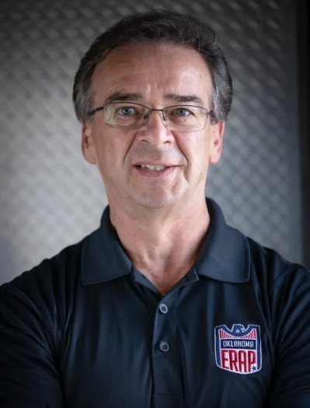
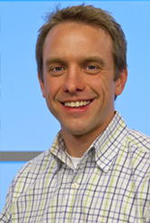
OK Respond and Kidvation collaborate to provide a Youth Entrepreneurship Program.
Collaboration with OKC PD and Police Athletic League
Giving at risk students a vison for their future
Looking to expand to more cities across the US
Douglas White, CEO OK Respond
Brent Wheelbarger, Co-Founder Kidvation Global

Slide 2




The target market for the program are 3500 middle schools and 420 PAL chapters.
Middle Schools in the US in 2022
13,860
Middle Schools in Cities and Suburbs
Over 700 PAL chapters nation wide
8,600
Approx. 60% have Mentorship Programs
5,293
Middle Schools with over 500 Students
Middle Schools with Police Presence
3,500
420 potential partners

Slide 3




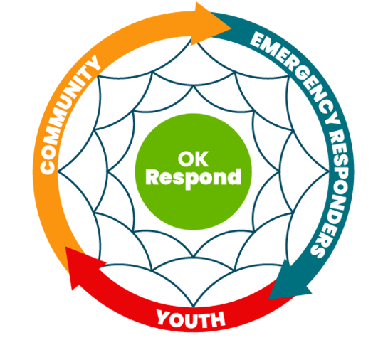
The total cost for OK Respond to acquire one new location is $500 and 20 work hours
Connects to
Pitches to
Approves
Community Relations Office
Potential Partner
Police Chief
Execution
Marketing
Marketing+Partnership
Program Pitch
Provide Curriculum + Suppport
2 hours | 6 hours | 2 hours | $500+ 10 work hours
- | - | - | $28,000
OK Respond's costs:
New Location's cost:

Slide 4
OK Respond can expand to 250 new locations within the first five years.
Year 1:
Hire admin
OK Respond has the budget to hire three additional employees
Year 3:
Hire marketing professional
Year 5:
Hire director
Starting capital of $95,000 required

Slide 5
Kidvation will gain a revenue of $375,000 over the first five years
License needs to renewed every year in every location
Total revenue in first five years:
$375,000

Slide 6
OK Respond and Kidvation can begin to market their program for expansion and funding
Next Steps:
Market the program for expansion
Apply for grants and seek business donations
Hire admin
June 2024
July 2024
September 2024

