Slide 1
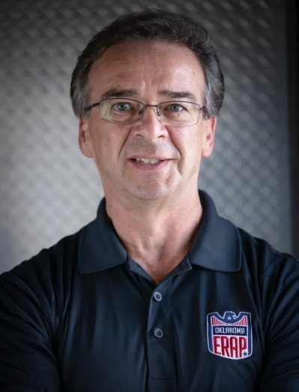

OKRespond and Kidvation are Organizations collaborating to provide a youth Entrepreneurship Program for at risk Middle School Students
Based in Oklahoma City
Collaboration with OKC PD and Police Athletic League (PAL)
Giving at risk students a vison for their future
Douglas White, CEO OKRespond
Brent Wheelbarger, Co-Founder Kidvation Global

Slide 2
The OKRespond/ Kidvation Program is looking to expand to more Cities across the United States
Phases:
Insights to Date:
Market Analysis
The potential target market includes 3493 middle schools and 420 PAL chapters.
The concrete target market consists of 158 middle schools and 4 PAL chapters.
There is comparable program on the market.
Market Entry: Strategy
Market Entry: Financial Viability

Slide 3
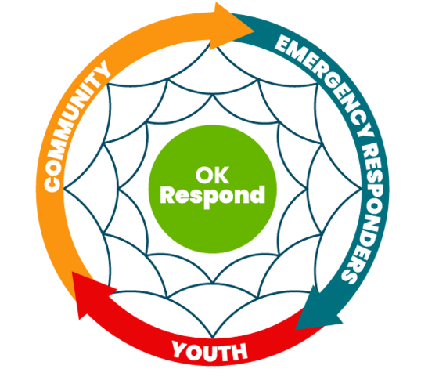

Resources and Guidelines are needed to use Police Presence in Schools to the Benefits of at-risk Students
75%
of gang members joined by the age of 14
291,100 students were subject to school-related arrest in one school year
As the student to certified staff ratios increases, school crime decreases
Notes:
At risk students lack support and a vison to become entrepreneurs. Officers in schools can recruit students for the OKRespond/Kidvation youth entrepreneurship program.

Slide 4




The potential Target Market for the Respond/Kidvation Program are 3493 Middle Schools and 420 PAL Chapters in the United States
Middle Schools in the US in 2022
13 860
Middle Schools in Cities and Suburbs
Over 700 PAL chapters nation wide
8600
Approx. 60% have Mentorship Programs
5293
Middle Schools with over 500 Students
Middle Schools with Police Presence
3493
420 potential partners

Slide 5
309 Middle Schools and 4 PAL Chapters are the concrete Target Market as they fit the Demographics for a seamless Expansion of the Program
Low Youth Crime Rates | High Youth Crime Rates
Little Police Youth Engagement
PAL Chapter established
District of Columbia, Wyoming, Indiana, Alabama
Low Impact
Low Implementation Rate
High Impact
Low Implementation Rate
Low Impact
High Implementation Rate
High Impact
High Implementation Rate
158 public middle schools fall in these areas
4 active PAL chapters fall in these areas

Slide 6

The OKRespond/ Kidvation Entrepreneurship Program offers a unique Curriculum as it is designed by Experts with a focus on Entrepreneurship
 | Mentorship program | Organized curriculum | Entrepreneurship lessons | Designed by field experts
OKRespond/ Kidvation | ✔ | ✔ | ✔ | ✔
PAL California | ✔ | ✔ | ✘ | ✘
PAL Montgomery | ✔ | ✘ | ✘ | ✘
PAL Las Vegas | ✔ | ✘ | ✘ | ✘
PAL Wyoming | ✔ | ✔ | ✘ | ✘

Slide 7
Further research will focus on continuing informational interviews and identifying repeatable Aspects of PAL youth Programs
Next Steps:
Schedule Interviews with potential partners and schools
Identify repeatable aspects of the different programs
Develop a business model

