Slide 1
Automating MongoDB
CloudFormation and Chef

Slide 2
Bryan Kroger
Sr. Automation Engineer at HTC
Previously worked at HP on the HPCloud project, and many many startups.
Big fan of all things cloud and DevOps.
“If it can’t be automated, it shouldn’t exist.”

Slide 3
README
This session is focused on using chef and CloudFormation to automate and scale a large MongoDB shard.

Slide 4
Scope
Automating MongoDB resource creation.
Shards
Config servers
mongos clients
Application clients
Not using repl sets
Having some fun!

Slide 5

Use case
“CloudRim” is a game I created using CloudFormation, based the movie “Pacific Rim”
The Kaijus emerge from the Rift and start destroying cities. The Jaegers are dispatched to fight the monsters.

Slide 6
CloudFormation
Built on the Simple Workflow platform.
Amazon does most of the work.
Auto scaling rocks!
Forces good automation practices.
Resilient design.
Lazy as a Service ( LaaS )

Slide 7
Chef
Is a tool.

Slide 8
CloudFormation Templates
Big things from small bits of JSON…
Auto Scale Groups
EBS Volumes
EBS Attachments
Deploys /etc/chef/dna.json

Slide 9
CloudFormation handoff to chef
CloudFormation allows us to send a little snippet of bash to our new instances. In that bash we call the following:
chef-client -j /etc/chef/dna.json
This gets us to ARI.

Slide 10
Chef and mdadm
/etc/chef/dna.json: run_list, default attributes, raid definitions.
mdadm raid creation
Format array
Mount formatted array
Start services

Slide 11
/etc/chef/dna.json
{
"run_list": [ "role[mongo-core]", "role[ebs-raid]" ],
"raid_groups": [{ "type": 0, "mount_range_start": "b", "name": "mongo_data", "mount_point": "/mnt/data", "num_vols": 20 }]
}
This is how the raid groups are defined and eventually built automatically when the instance is spun up.

Slide 12
Chef LWRP’s for building Jenkins
Everything starts with our ability to “build the thing that builds the things.” This is where chef’s LWRP’s come in:
cloudrim_battle_theater “Ogashi” do
action :jenkins_exec_helpers
az_name "us-east-1b"
git_url "git@my_awesome_domain:operations/deployments.git"
region_name “us-east-1”
domain_name “opsautohtc.com”
end

Slide 13
Workflow
Chef creates and maintains jenkins build jobs.
Jenkins performs orchestration and management tasks in a patterned, reliable, consistent, repeatable way.
CloudFormation does all of the work to maintain the infrastructure ( ELB’s, Compute, etc… ).
Chef does the work to maintain ARI state.

Slide 14
The Kaiju have landed!
NodeJS writes to MongoDB.
Logging is handled by logstash with an ES cluster ( 2 masters, 2 data ).
Hit the server as hard as you can with as many unique sources as you can to win.

Slide 15
We are canceling the apocalypse!!
https://github.com/krogebry/cloudrim

Slide 16
CI / CD
Jenkins is configured to run the build pipelines at given intervals.
CloudFormation does all of the work to manage rollbacks if something goes wrong.
This gives us CI / CD at the database level.

Slide 17
CI / CD at the db level?
Are you nuts? No, my mother had me tested.
This allows us to dynamically scale our shards, and ensure that if someone does something stupid we can recover.
Reslience!!

Slide 18
The chef AWS cookbook
Why not use it?
Because CloudFormation does a better job of creating and attaching the volumes.
Keeping the resource definitions in the same place is a good thing.
Chef is a tool!

Slide 19
Resilience?
the ability of a substance or object to spring back into shape; elasticity.
the capacity to recover quickly from difficulties; toughness.
Planning around the idea of bouncing back from failure is more productive than trying to prevent failure from happening. Failure is inevitable, so plan for it!

Slide 20
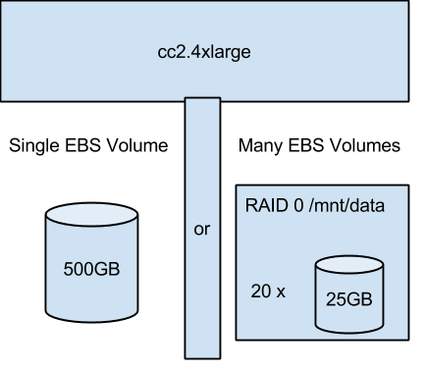

Slide 21
Many blocks...
Pros
Load is distributed over many network attached disks.
Potentially spreading this load over more, different spindles.
Networking is cheap.
Potentially higher I/O performance over all.
Cons
More complicated layout ( which is mostly mitigated by chef and CF, but still a valid concern )
Software RAID overhead.
Introducing more potential for failure.

Slide 22
Single disk
Pros
Manual operations are easier.
Less complication.
Potentially using many spindles on the backend.
No RAID overhead.
Cons
Potential bottleneck if the entire block is allocated on one spindle.

Slide 23
What is the goal?
Fast I/O, of course!
Customers are fickle, latency costs money.
But so does downtime.
Fast I/O = many EBS volumes.
Replication sets give us redundancy.
But chef and jenkins gives us resilience.

Slide 24
Building with Jenkins
Jobs are built with chef.
Build pipelines help maintain state.

