Slide 1

Predictive Maintenance Using IoT Data
Presented By:
Amit Singh Kushwaha (24204041107)
Rohit Kumar (24204041120)
Department of Bioinformatics and Computer Applications
Maulana Azad National Institute of Technology, Bhopal
2024-2026

Slide 2
Introduction
What is Predictive Maintenance Using IoT Data Project?
Why Need it?

Slide 3
Tools Used
Pandas
Numpy
Matplotlib
Seaborn
Scikit-learn
Google Colab
VsCode
Docker
Azure
Streamlit

Slide 4
Steps Performed
Get the Dataset
Preprocess the dataset
Select the Model
Train and Test the Model
Make a Webapp using streamlit
Make image of webapp using Docker
Push image on DockerHub
Create a VM on Azure and configure it
Pull and run the app on VM

Slide 5
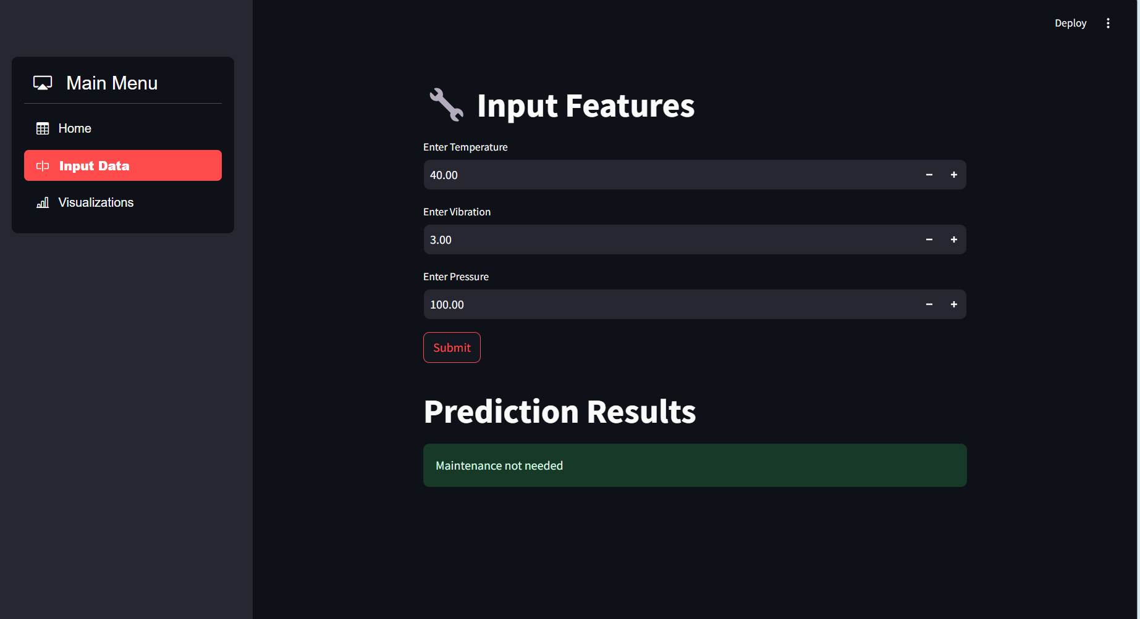
Conclusion
When we run the app we are able to access it through any browser
Since the process is fully automated we need to enter sensor data manually to predict requirement of maintenance
Link to access app:

Slide 6
Future Scope
It can be automated using CI/CD pipeline, means it will be able to check for maintenance whenever new data get
Also an alert system can be integrated that can alert through message if an equipment needed maintenance

Slide 7
Thank You

