Slide 1
JC Parks and Rec Group Exploratory Analysis
Kent Roller, Toby Adebiyi, Adade Yeboah
Kevin Willis, Richard Ojo, Katelyn Williams

Slide 2
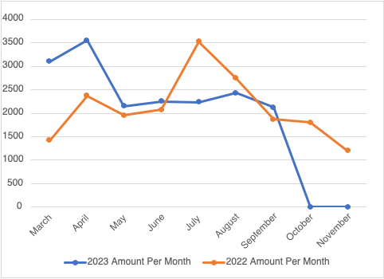
Revenue Earned per Month in 2022 and 2023
This graph shows the direct revenue brought in by the tournaments hosted at Winged Deer Park for the years 2022 and 2023. Tournaments are not held during the months of January, February, and December therefore, no revenue is earned. As seen in the graph, the amount brought in each month in comparison to each year is different. These causes include possible rainouts, the size of the tournament, and the number of fields rented.

Slide 3
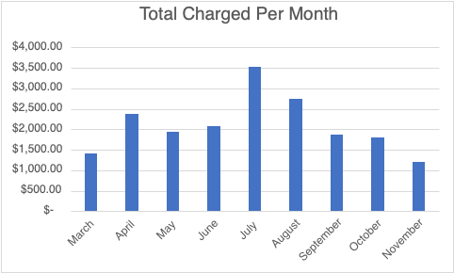
Amount Charged for Tournaments per Month in 2022
This graph represents the total amount charged per month for tournaments held in 2022. Generally, there is a tournament held each weekend of a given month. The tournament director is charged a specified amount. Pricing charged per tournament is not standard among the given data, so it is inferred that many factors affect the mount charged. Tournaments may also be rained out due to weather, thus a lack of revue that was supposed to be earned for a scheduled tournament.

Slide 4
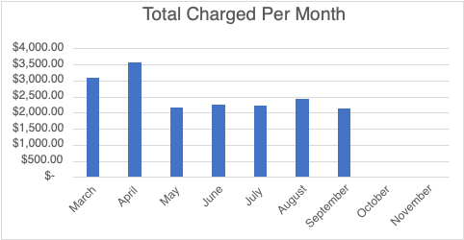
Amount Charged for Tournaments per Month in 2023
This graph represents the total amount charged per month for tournaments held in 2023. Generally, there is a tournament held each weekend of a given month. The tournament director is charged a specified amount. Pricing charged per tournament is not standard among the given data, so it is inferred that many factors affect the amount charged. If a national tournament is held at Winged Deer Park, the fee charged is unknown and not included in this graph.

Slide 5
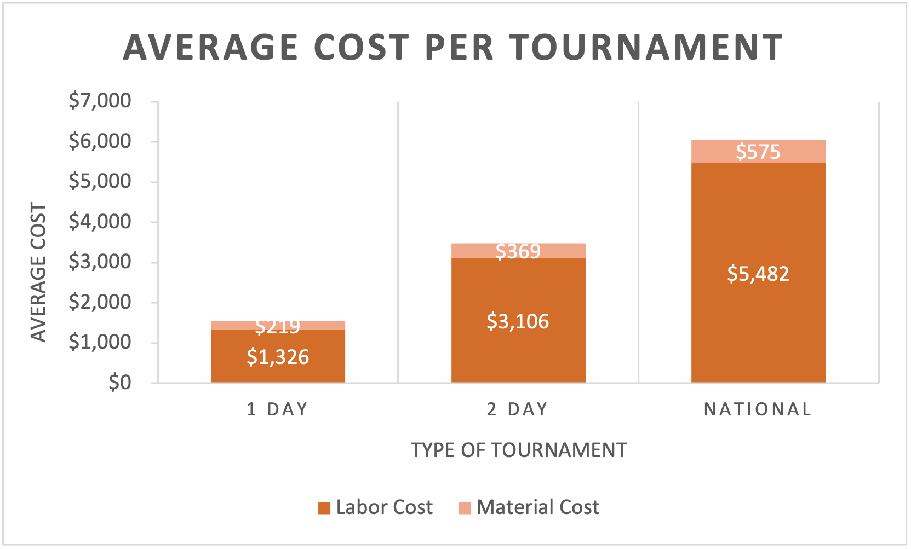
Average Cost per Type of Tournament
This graph represents the average cost for a tournament to be held at Winged Deer Park. The two categories that impact the total cost of a tournament are the labor costs and the material costs. Further, the type of tournament held also impacts the average cost. The types of tournaments include 1-day, 2-day, or national tournaments. The amount of labor and materials needed to prepare the fields is based on the number of days of the tournament. The total average costs per tournament are $1,545, $3,475, and $6,057.

Slide 6
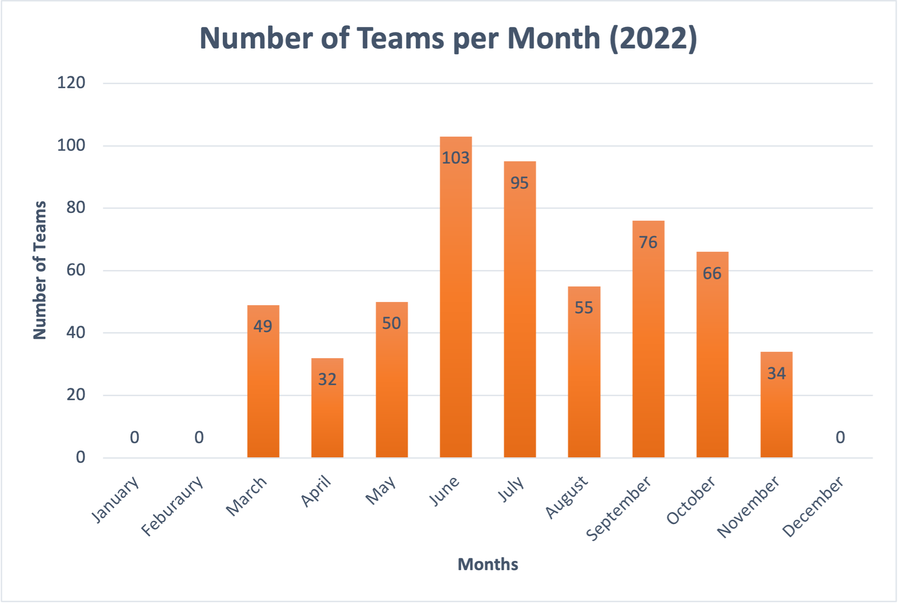
Total Number of Teams in Tournaments per Month in 2022
This graph represents the total number of teams in attendance at a tournament per month in the year 2022. For the year 2022, the total number of teams that attended a tournament at Winged Deer Park is 560. This data will be valuable in helping us determine an estimate of the amount of people attending the tournaments in relation to the number of teams participating.

Slide 7
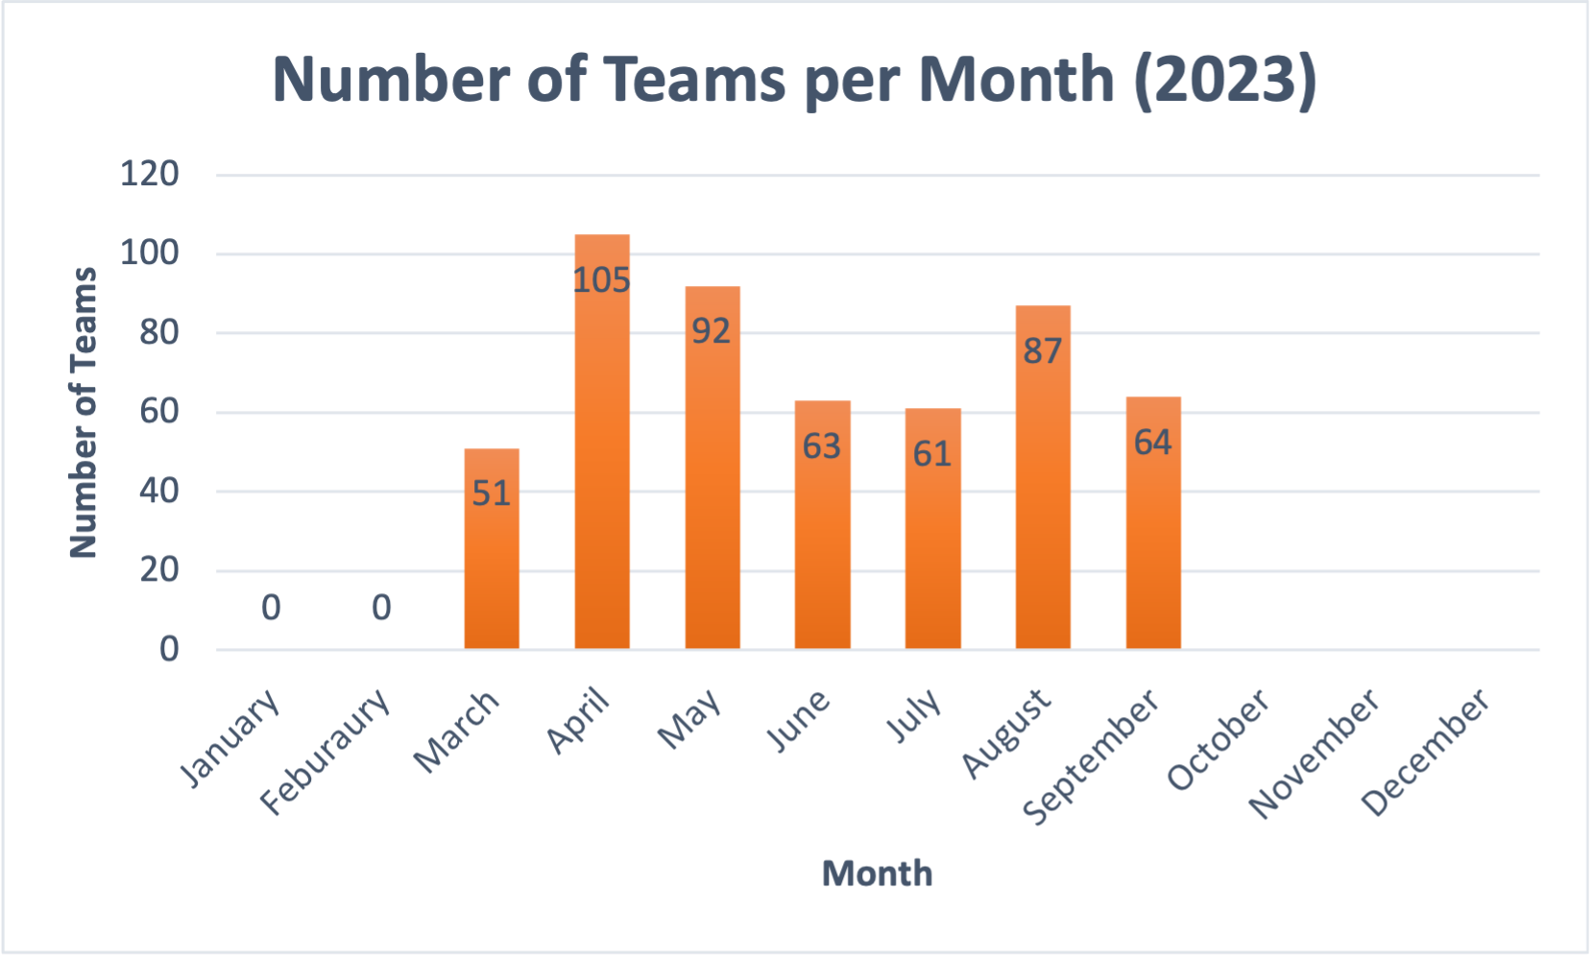
Total Number of Teams in Tournaments per Month in 2023
This graph represents the total number of teams in attendance at a tournament per month in the year 2023. The data is based on the months of January to September, so information on the remaining months of 2023 are currently unknown. For the year 2023, the total number of teams that attended a tournament at Winged Deer Park so far is 523. This data will be valuable in helping us determine an estimate of the amount of people attending the tournaments in relation to the number of teams participating.

Slide 8
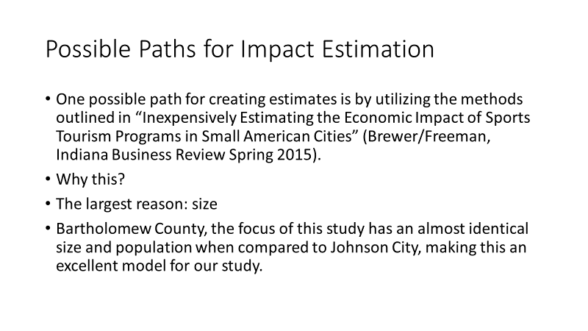
Impact Estimation

Slide 9
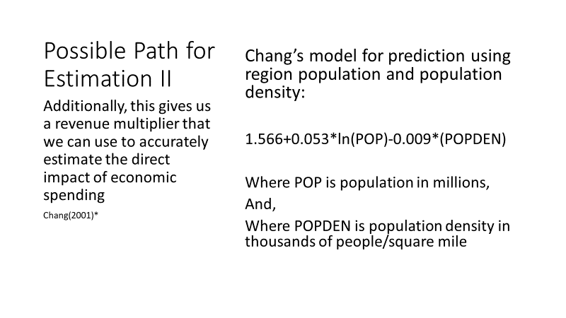
Impact Estimation II

Slide 10
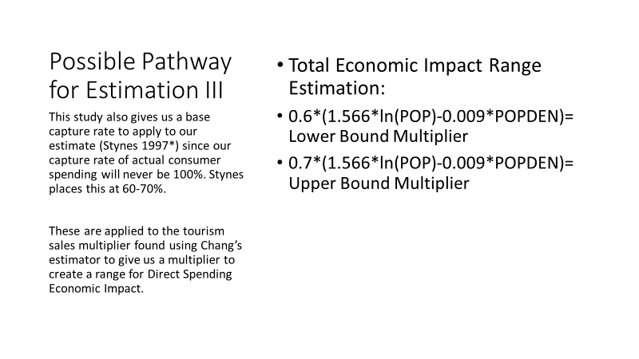
Impact Estimation III

Slide 11
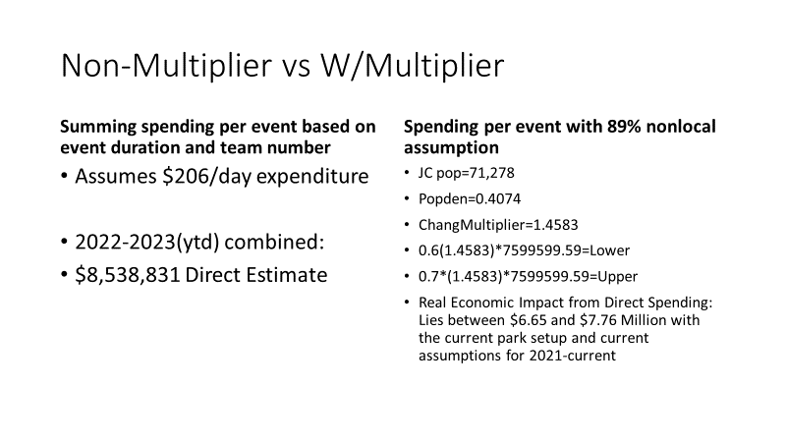
Baseline Estimates

Slide 12
Estimates By Year
2022 Data
2023 Data
•2022
•$4.98 million non-adjusted
•Adjusted Estimate:
•$3.95 million lower
•$4.61million upper
•2023 YTD
•$3.17 million non-adjusted
•Adjusted Estimate:
•$2.78 million lower
•$3.23 million upper

Slide 13
Maintenance Cost Estimations
Natural
FieldTurf brand artificial turf
•Field maintenance total cost 2022: $76,194 (all fields)
•Field maintenance total cost YTD 2023: $67,575 (all fields)
•Cost per hour: $49.72
•
•Scheduling possible: 70 Hours*26 Weeks*10 years=18,200 hours
•Cost analysis of FieldTurf brand artificial turf:
•2022 cost: $5000 (*per field)
•2023 cost: $5000 (*per field)
•Cost per hour: $12.95
•
•Scheduling possible: 100 Hours*44 Weeks*10 years=44,000 hours

