Slide 1
Parallel simulation of SystemC TLM 2.0 models
Master’s Thesis Internship:
Konstantinos Sotiropoulos <kisp@kth.se>
Supervisor:
Bjorn Runaker <bjorn.runaker@intel.com>

Slide 2
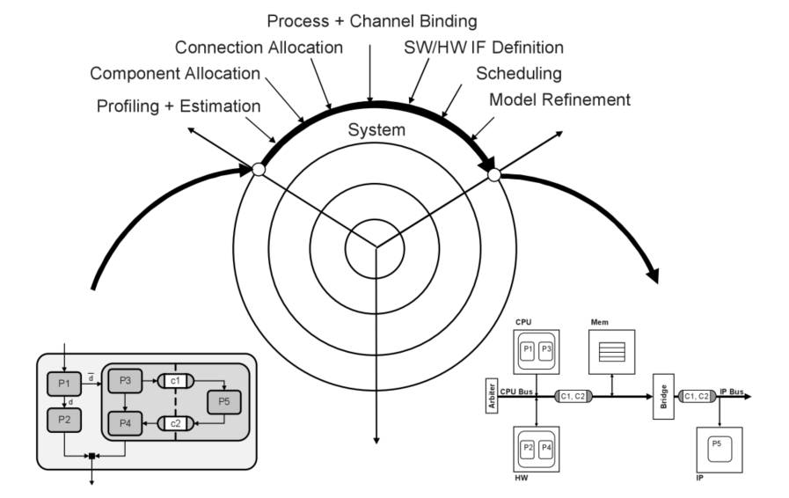
System Level Design
Model Language
SystemC TLM 2.0
Executable Models
Discrete Event Simulator
Fig 1: Gajski & Kuhn’s Y-Chart
Adopted from: Gajski (2009) Embedded System Design

Slide 3
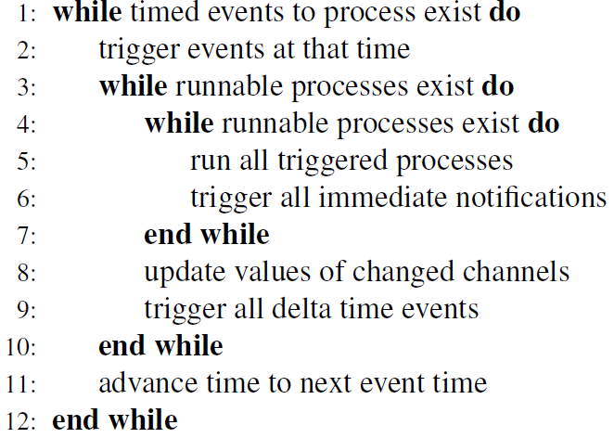
Discrete Event Simulation
Delta Cycles Advance
Line 3
Simulation Time Advance
Line 11
Fig 2: SystemC’s Event Loop
Adopted from: Bunton (2010) SystemC: From the Ground Up

Slide 4
Parallel Discrete Event Simulation
Causality
Naive parallel execution breaks causality
Operational Semantics of PDES
Process Synchronization Algorithms
Fig 3: Processing of event E₂ by P₂ breaks causality.

Slide 5
Problem Statement
This project evaluates the efficiency of existing process synchronization algorithms when applied to the parallel simulation of Loosely-Timed Transaction Level Models.

Slide 6
Objectives
Document
Intermediate report available
Synchronization algorithms for PDES:
Chandy Misra Bryant & Deadlock Detection
A programming framework for expressing the parallel simulation:
Intel MPI
A recoding infrastructure for SystemC TLM:
XML manipulation
A pragmatic Transaction Level Model to experiment on.
TLM = Platform + Application

Slide 7
Platform
TLM Wrapper
Main Memory
OpenRisc ISS
L1 Cache
L2 Cache
Instruction Memory
TLM Wrapper
OpenRisc ISS
L1 Cache
Instruction Memory
Fig 4: A shared memory, cache-coherent, symmetric multiprocessor based on the OpenRisc 1000 ISS

Slide 8
Challenges
Application
Not decided
Timing annotations
Under investigation
ISS is not re-entrant
Problem in creating the standard SystemC TLM

Slide 9
Questions?
Thank you for your time!

