Slide 1
Parallel simulation of SystemC TLM 2.0 models Using xeon phi
Master Thesis Internship
Konstantinos Sotiropoulos
kisp@kth.se

Slide 2
What is SystemC TLM 2.0 ?
Electronic System-Level Desing Language
Implemented as a C++ class library
Operational Semantics given by a Discrete-Event Simulator

Slide 3
Use Case of TLM 2.0 models
Develop and test software
early in the hardware design process
The model must be executable
and able to boot an OS

Slide 4
An Example of a TLM 2.0 model
Interconnect Component (Memory Mapped Bus)
Initiator Module
(Processor)
Target Module
(Memory, Peripherals)

Slide 5
Problem statement
The reference SystemC simulator is sequential
despite parallelism being explicit in the model
Parellel execution must be carefully orchestrated
to preserve causality

Slide 6
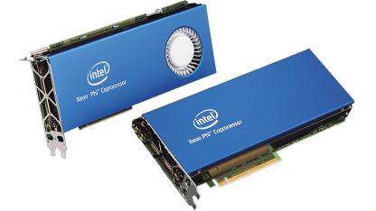
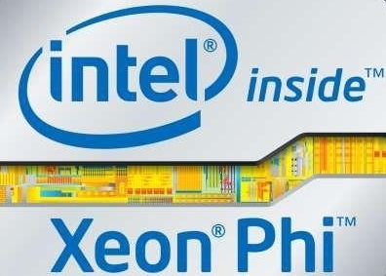
Xeon Phi™
244 threads, 61 physical cores
1.3 GHz core frequency
16 GB DDR3 RAM
352 GB/s max memory bandwidth
Tianhe-2: Inside the world’s fastest supercomputer
New Generation has been launched!
*The previous facts correspond to the 7120P, launched on Q2'14

