Slide 1
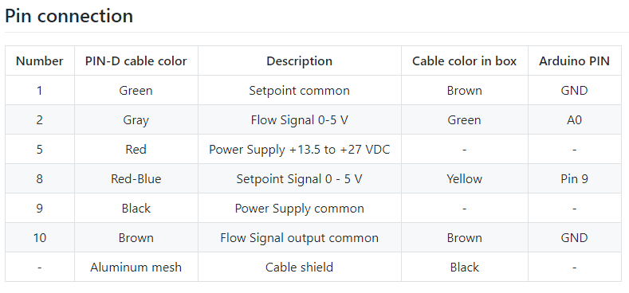
BROOKS mass flow control
BROOKS
Custom cable
Arduino
USB Serial
Control is performed via the dash control, started via LTH_Neutimag\hkromer\17_github\dash_NG\NG_control_v2 and there the index.py with python 3.7.3. It is working in the conda environment “dash_readout”, i.e. on the MPC2278
Twofast-rpi3-4
LAN cable to network
Database (twofast-rpi3-0)
Table: flow_meter_control
Columns: (setpoint_voltage, id)

