Slide 1
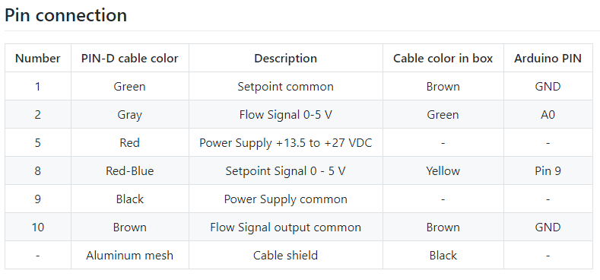
BROOKS mass flow readout
BROOKS
Custom cable
Arduino
USB Serial
Readout is started via the script flow_meter_readout_V0.py in ~/Documents/dash_NG/flow_meter/
Use the correct conda environment by running the .sh in /home/pi/Documents/run_flow_meter_readout.sh
Use Start_flow_meter_readout.py in LTH_Neutimag\hkromer\17_github\phd_python\01_neutron_generator_control to start script via SSH
Twofast-rpi3-4
LAN cable to network
Database (twofast-rpi3-0)
Table: flow_meter_readout_live
Columns: (time, read_voltage, id)
Every night at 3 AM the flow_meter_readout_live table is appended into the table flow_meter_readout_storage

