Slide 1
Data Tasks
Heiko Kromer
September 2020

Slide 2


Outline
Introduction
Pipeline overview
Pre-processing
Normalisation
Integration
Take-away messages

Slide 3
Outline
Introduction
Pipeline overview
Pre-processing
Normalisation
Integration
Take-away messages

Slide 4


Introduction – Task description
Efficient onboarding of new suppliers into e-commerce shop
INPUT
TARGET
supplier_car.json
Target Data.xlsx

Slide 5

Introduction – Key facts
INPUT
TARGET
supplier_car.json
Target Data.xlsx
# records | # columns | % missing values
21906 | 9 | up to 4% in ModelText
# records | # columns | % missing values
7252 | 18 | up to 90% in zip
Long format
1153 IDs (automobiles) and 19 attributes
Wide format
7252 automobiles and 18 attributes

Slide 6

Introduction – Hypothesis
Attribute color refers to the body color of the car
Client can also handle motorcycles (supplier data contains a Harley-Davidson)
Km attribute in the supplier data is the mileage that car was driven
New cars get zero mileage (supplier data contains new cars with Km values from 1 to 500)
Target data contains lots of information in variant (e.g. 4WD, manual or automatic transmission); It is not clear what the client expects in the model_variant attribute; The assumption is that only information on the car model are relevant here and not additional properties
Client is only concerned about manufacturing information and not registration information, the latter is given in the input dataset but not the former

Slide 7
Outline
Introduction
Pipeline overview
Pre-processing
Normalisation
Integration
Take-away messages

Slide 8
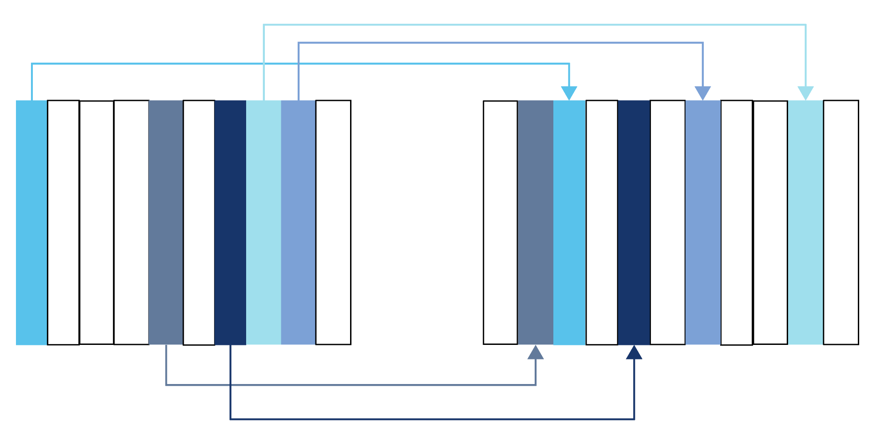
Pipeline overview
1. Pre-processing
2. Normalisation
3. Integration
INPUT
TARGET
INPUT
TARGET
Grün mét.
Green
AUDI
Audi

Slide 9
3. Pre-processing
Transformation of supplier data to achieve the
same granularity as the target data.
Data Tasks $∙$ Heiko Kromer $∙$ September 2020

Slide 10

Pre-processing
main_preprocess.py
INPUT
groupby_id_and_pivot()
Preprocessed
dataframe

Slide 11
Pre-processing
Function: groupby_id_and_pivot()
ID | Attribute Names | Attribute Values
608 | BodyColorText | schwarz mét.
608 | City | Zuzwil
608 | Km | 134600
895 | BodyColorText | silber mét.
895 | City | Zuzwil
895 | Km | 125000
ID | BodyColorText | City | Km
608 | schwarz mét. | Zuzwil | 134600
895 | silber mét. | Zuzwil | 12500
(wide format)
(long format)
Attributes to be kept (MakeText, TypeName, …)

Slide 12
4. Normalisation
INPUT
TARGET
Grün mét.
Green
AUDI
Audi
Normalisation of input attributes where an
attribute value is different but actually is the
same as the target attribute

Slide 13
Normalisation
main_normaliser.py
Normalised
dataframe
Preprocessed
dataframe
normalise_color()
normalise_make()
get_country_from_city()
Target data
Target data

Slide 14
Normalisation
Function: normalise_color()
Cleaning:
Remove mét. if present
Translate color
to english
Find exact
match in target dataset
BodyColorText | Cleaned color | Translation | Normalised color
anthrazit | anthrazit | anthracite | Other
anthrazit mét. | anthrazit | anthracite | Other
gold | gold | gold | Gold
gold mét. | gold | gold | Gold
violett | violett | violet | Other

Slide 15
Normalisation
Function: normalise_ make()
Find similarity between
MakeText (preprocessed
dataset) and make (target)
entries
Find similarity between
MakeText (preprocessed
dataset) and make (target)
entries
Define similarity threshold
below which make
will be “Other”, otherwise take
most similar make
MakeText (preprocessed) | Most similar make (target) | Similarity score | Normalised make (threshold=0.879)
AUDI | Audi | 1.0 | Audi
AUTOBIANCHI | Autobianchi | 1.0 | Autobianchi
DeLorean | Delage | 0.827 | Other
PORSCHE | Porsche | 1.0 | Porsche
FORD (USA) | Ford | 0.88 | Ford

Slide 16

Normalisation
Function: get_country_from_city()
city
Country short name
e.g. CH
ID | BodyColorText | City | Km | Identified country
608 | schwarz mét. | Zuzwil | 134600 | CH
895 | silber mét. | Zuzwil | 12500 | CH
Geopandas

Slide 17
Normalisation – What else we can do BodyTypeText to carType
Translate BodyTypeText to English
Find matching metric in target attribute carType
Examples:
BodyTypeText | Translation | Corresponding carType
SUV / Geländewagen | SUV | SUV
Limousine | Saloon / Sedan | Saloon
Cabriolet | Convertible | Convertible / Roadster

Slide 18
Normalisation – What else we can do ConditionTypeText to condition
Translate ConditionTypeText to English
Find matching metric in target attribute condition using industry specific domain knowledge*
Examples:
ConditionTypeText | Translation | Matching condition
New | New | New
Occasion | Used | Used or used with guarantee*

Slide 19
Normalisation – What else we can do Km to mileage
Clarify new car Km attribute, in the input dataset new cars have Km between 1 and 500
Update mileage_unit attribute accordingly (assuming that Km means mileage is in kilometer)
Examples:
ID | ConditionTypeText | Km | Corresponding mileage | Identified mileage_unit
108 | Neu | 100 | 0 | kilometer
161 | Neu | 200 | 0 | kilometer
200 | Neu | 450 | 0 | kilometer

Slide 20
Normalisation – What else we can do ConsumptionTotalText to fuel_consumption_unit
Extract l_km_consumption attribute from the input dataset where applicable
Examples:
ID | ConsumptionTotalText | Inferred fuel_consumption_unit
6 | null | null
8 | 16.5 l/100km | l_km_consumption
864 | 12.9 l/100km | l_km_consumption

Slide 21
Normalisation – What else we can do ModelText, ModelTypeText, and TypeName to model and model_variant
ModelTypeText contains ModelText at the beginning, can be removed
That was already done for 143 IDs in TypeName
Must be clarified what the client wants in the model_variant attribute (see Take-aways)
Examples:
ID | ModelText | ModelTypeText | TypeName | Identified model | Identified model_variant
6 | MUSTANG | Mustang Shelby GT500 | Shelby GT500 | Mustang | Shelby GT500
815 | C 63 AMG | C 63 AMG BLACK SERIES | BLACK SERIES | C 63 AMG | Black Series
952 | X5 | X5 4.4i | X5 4.4i | X5 | 4.4i

Slide 22
5. Integration
INPUT
TARGET
Transform the normalized supplier data with
a specific data schema into a new dataset with
target data schema

Slide 23
Integration
Integrated supplier
data
main_integrator.py
Normalised
dataframe
rename_columns()
append_supplier_to_target()
save_xlsx()
drop_columns()
Normalised
dataframe
Preprocessed
dataframe
Target data

Slide 24
Integration
Function: rename_color()
Rename attributes to match target schema
Function: drop_color()
Delete attributes that have no match, e.g.:
Attribute name before | Attribute name after
BodyTypeText | carType
ConditionTypeText | condition
City | city
ModelText | model
ModelTypeText | model_variant
Km | mileage
Country | country
Dropped attributes
DriveTypeText
TransmissionTypeText
FirstRegMonth
FirstRegYear
Ccm
Seats
( … )

Slide 25

Integration
Function: append_supplier_to_target()
Append processed supplier data to the target dataset
Replace NaN with null
Processed
supplier data
Null
Target data
Integrated dataset

Slide 26
Integration
Function: save_xlsx()
Save each step of the pipeline in a separate sheet of an xlsx file with autofilters in the header
Preprocessed
dataframe
Normalised
dataframe
Integrated
dataframe

Slide 27
Outline
Introduction
Pipeline overview
Pre-processing
Normalisation
Integration
Take-away messages

Slide 28
Take-away – Summary
Automated pre-processing, normalisation, and integration of supplier data into your e-commerce dataset
Dataset contained 1152 cars, one motorcycle
11 attributes can be integrated from the supplier into your target dataset, 9 out of those were considered in this project
We identified several opportunities to take action and improve your existing target data attributes
We make your data consumable

Slide 29
Take-away – What else we can do for you Data cleaning
city | Normalised city
D-56276 Großmaischeid | Großmaischeid
PADOVA | Padova
Zurich (n=1) or Zürich (n=5) | Zürich
Cleaning of the target attributes
For example city:
For example manufacture_month and _year:
_month values ranges from 0 to 12
_year has values 0 and 63

Slide 30
Take-away – What else we can do for you Data mining and machine learning models
Target dataset
Using existing customer data, predict fuel consumption for cars
Identify additional properties based on unstructured model_variant attribute, e.g. 4WD, manual, or automatic transmission
Matching between customers and car: Customer must provide some information and a model would based on given information and other data sources (demographics, socioecomics) recommend a car
Get additional attributes for a car by news sources, social media, or other databases; Features could be “family friendly” or “low number of accidents in past X years”
Supplier dataset
Predict car prices to help with pricing strategy

Slide 31
Data Tasks
Heiko Kromer
September 2020

