Slide 1
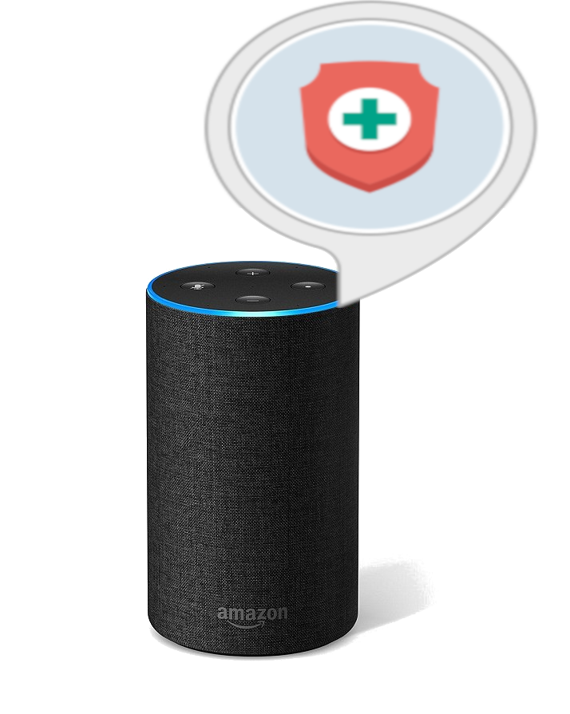
Dr. Who?
The future of medical appointments

Slide 2
Goal: Provide an Alexa Skill suited for medical appointment scheduling
Objectives:
Easy to use
Flexible
Responsive
Effective
Challenges:
Communication between user and Alexa
Communication between Alexa and data centre

Slide 3
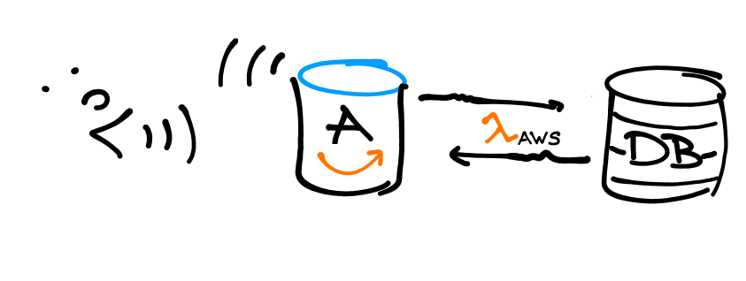

Slide 4
Essentials
Input:
Medical specialization needed
Prefered location
Possible date of appointment
Output:
Scheduled appointment

Slide 5
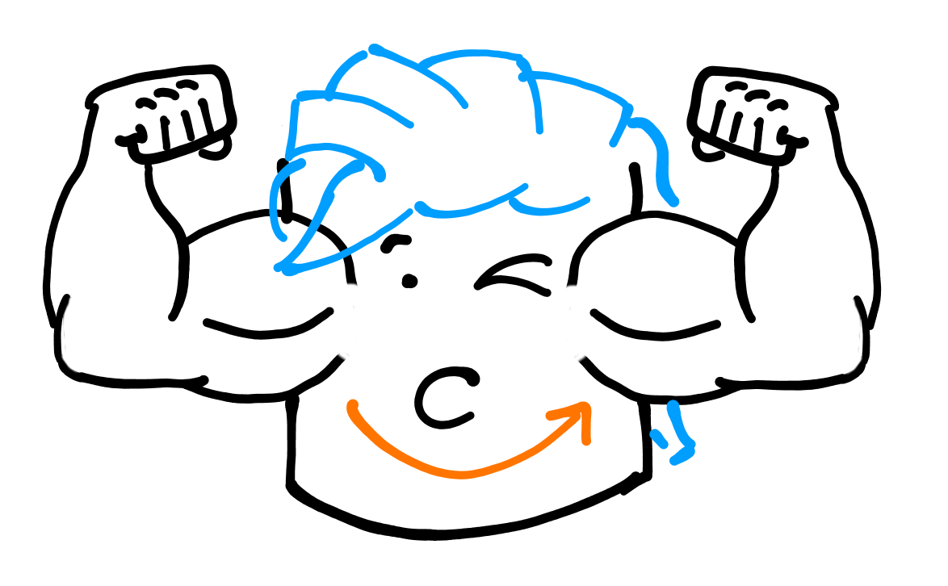

Slide 6

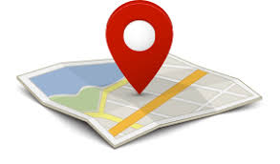






Out look
Favorites
Geolocation
Travel time calculation
Calendar integration
Rating
Best fit prediction
Relational database
Diagnosis

