Slide 1
Sample DSA Workflow
Microsoft East Region Azure HiPo Team

Slide 2
Discovery
* Customer Introduction
* Understand customer current state
* Understand customer’s business and technical goals and objectives
* Go/No Go: Is ths a good Azure HiPo acct?
* 2-3 hours of in-person customer meetings
* Output: Customer-ready spreadsheet listing customer priorities and OneNote with meeting notes
Envisioning
* Report back to customer with clear depiction of current state and future state options
* Provide briefings, demos, overview and background on Azure tech and migration options
* 3-4 hours of customer in-person and remote meetings, highlight “Art of the Possible”.
* Output: Presentation showing current state, future state, tech overviews and business impact
ADS
* Use customer feedback from Envisioning and gather technical resources and stakeholders in customer or MSFT meeting room for open discussion / whiteboarding
* Present options, pros/cons, listen to customer requirements, concerns, questions and priorities
* Output: OneNote notes from meeting, architectural proposal artifacts (Visio, Project plan), demos, POC
Delivery
* Present customer with final deliverables from Solution Architect team: Visio diagrams depicting future state, high-level project plan showing objectives, not a granular WBS-level GANTT
* Discuss with customer options for partnering with team to build SOW, details plans for moving into production (SI partners, MCS, etc.)
* Output: May a small-scale pilot on customer’s non-production Azure subscription

Slide 3
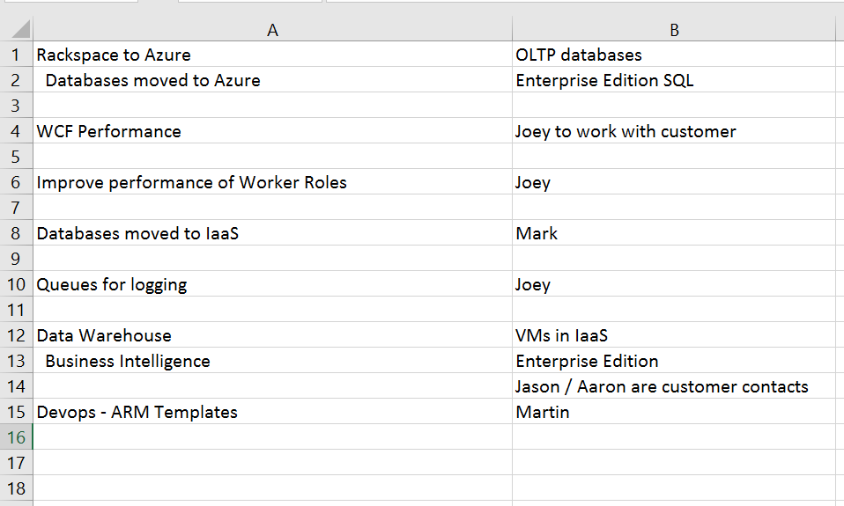
Sample Deliverables: Priority List
Simple listing of customer’s top priorities from discovery meeting with notes

Slide 4
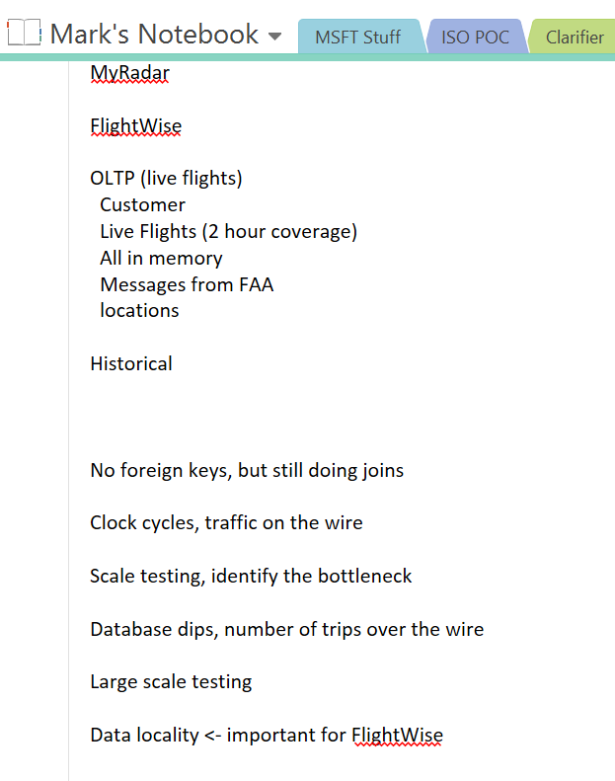
Sample Deliverables: OneNote customer Notes
Capture notes during discover, envisioning and ADS. It’s a good idea to share your Notebook with your MSFT internal team.

Slide 5
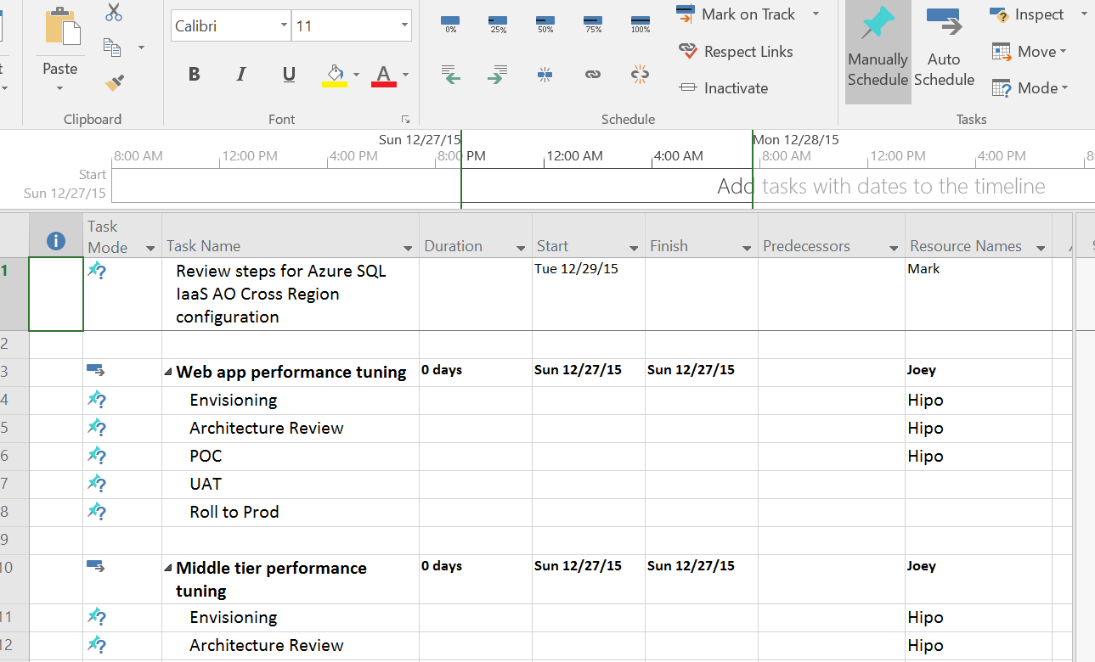
Sample Deliverables: High-Level Objective Project Plan
Produce a brief high-level project plan, not a detailed WBS.
This shows the customer that we are giving thought to how they will materialize the art-of-the-possible into a real production environment.

Slide 6
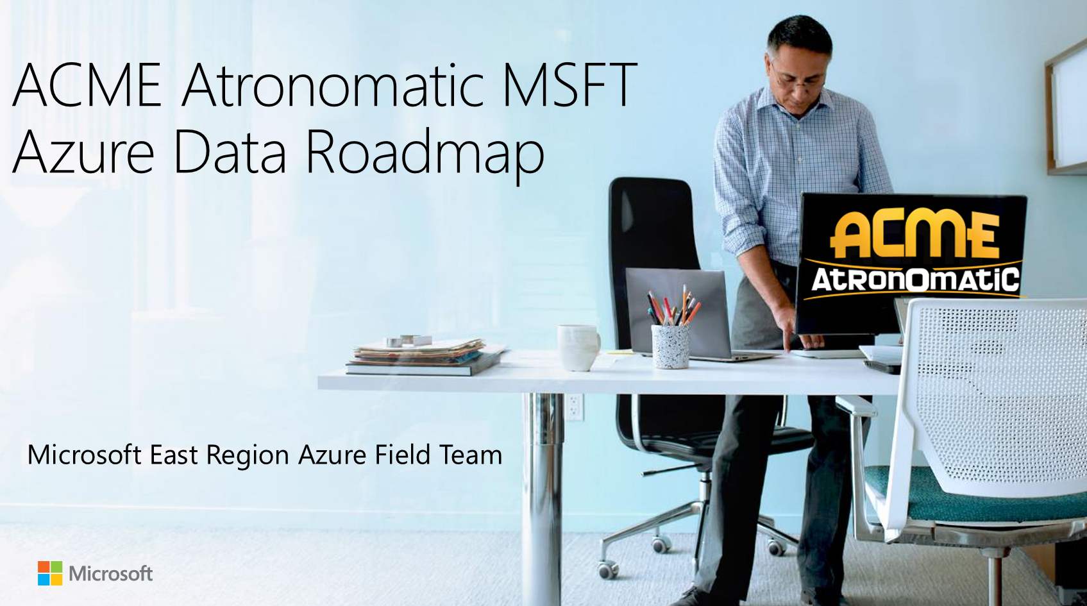
Sample Deliverables: Proposal Deck
Put together a few slides that capture the customer’s business & technical objectives, current state, future state, and “art of the possible” next-gen ideas

Slide 7
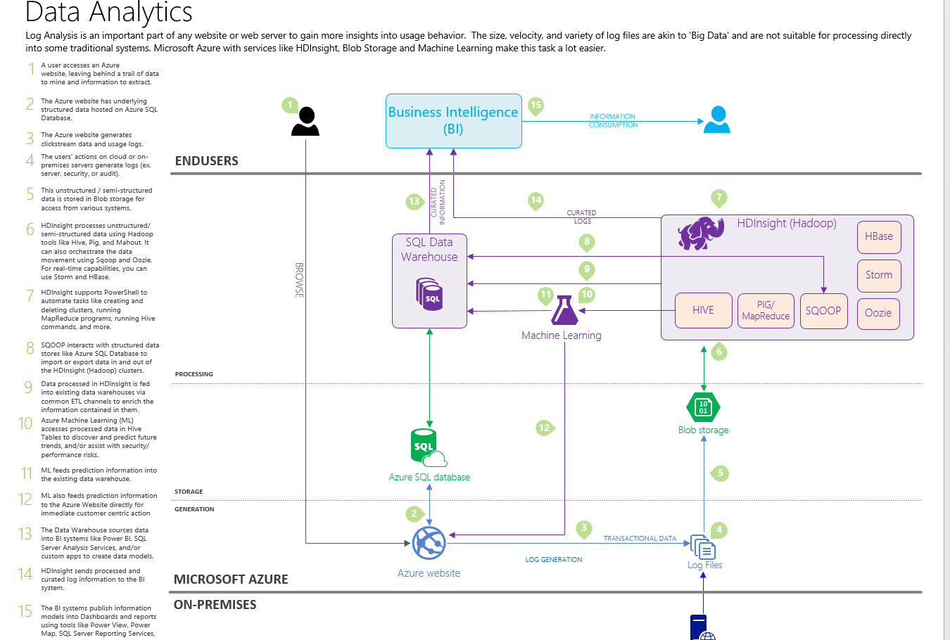
Sample Deliverables: Architectural Diagrams
Once you and the customer have agreed on a path forward, capture that direction in a Visio diagram and present it to them to ensure that you are on the same page as they consider options for moving into production

Slide 8


