Slide 1






Department Of Computer Science
Specialized in Data Science
Matching with your soulmate
Exploring Diverse Dimensions of Love!
Course: Object-Oriented Programming (python)
Term 2, Academic Year 2024 - 2025
Submitted to: Lect. Han Leangsiv
Submission date: Sunday 23rd March 2025
Members:
Khy Pichsereyvathanak: Control flow and user data
Chum Phalla: Algorithm of matching
Soeun Sokchetra : Clean data and User interface

Slide 2

1
Introduction
1.
Problem Statement
People find matches traditionally through blind dates, which takes a lot of time and effort, and a lot of the times, they don't find a compatible match.
2.
Objective
Our project is to match people based on their zodiac signs, age, personalities, height, and common hobbies using data science principles and object-oriented programming (OOP).

Slide 3





Methodology
2
1.
Tools Used
Communication
Coding
Data Collection

Slide 4
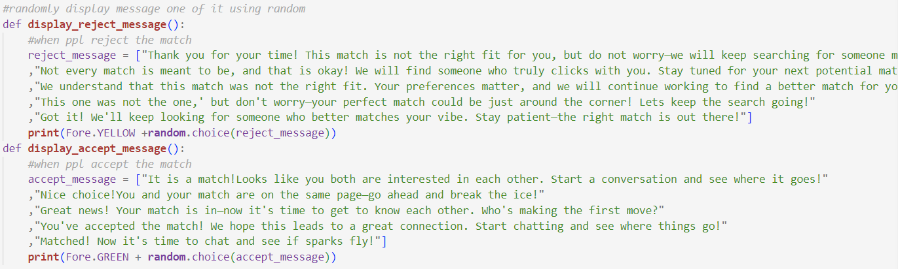
Methodology
3
2.
Libraries Used: random

Slide 5
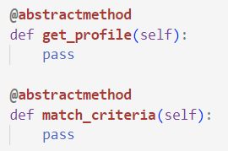
Methodology
4
2.
Libraries Used: abc

Slide 6
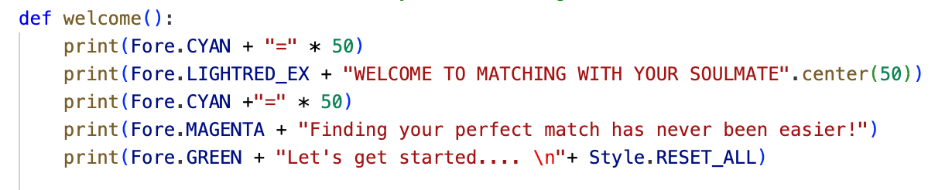
Methodology
5
2.
Libraries Used: colorama
used for adding color to text in the terminal.

Slide 7

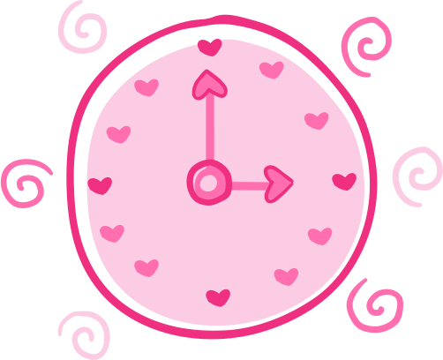
Implementation
6
Data Collection
Storing men and women files in two separate files for data comparison.
Matching algorithm
We scored the compatibility from 0 to 100% according to a user’s preference.
Process
When users start to find matches, we have a function to read data in a men and women text file and then calculate the percentage of matching. The match percentage must be at least 50% for suggestion.

Slide 8
GitHub
7
https://github.com/kronos-optimize/G1_T2_Project

Slide 9

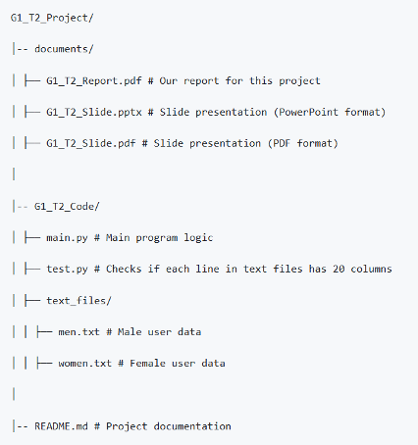
8
Project structure

Slide 10
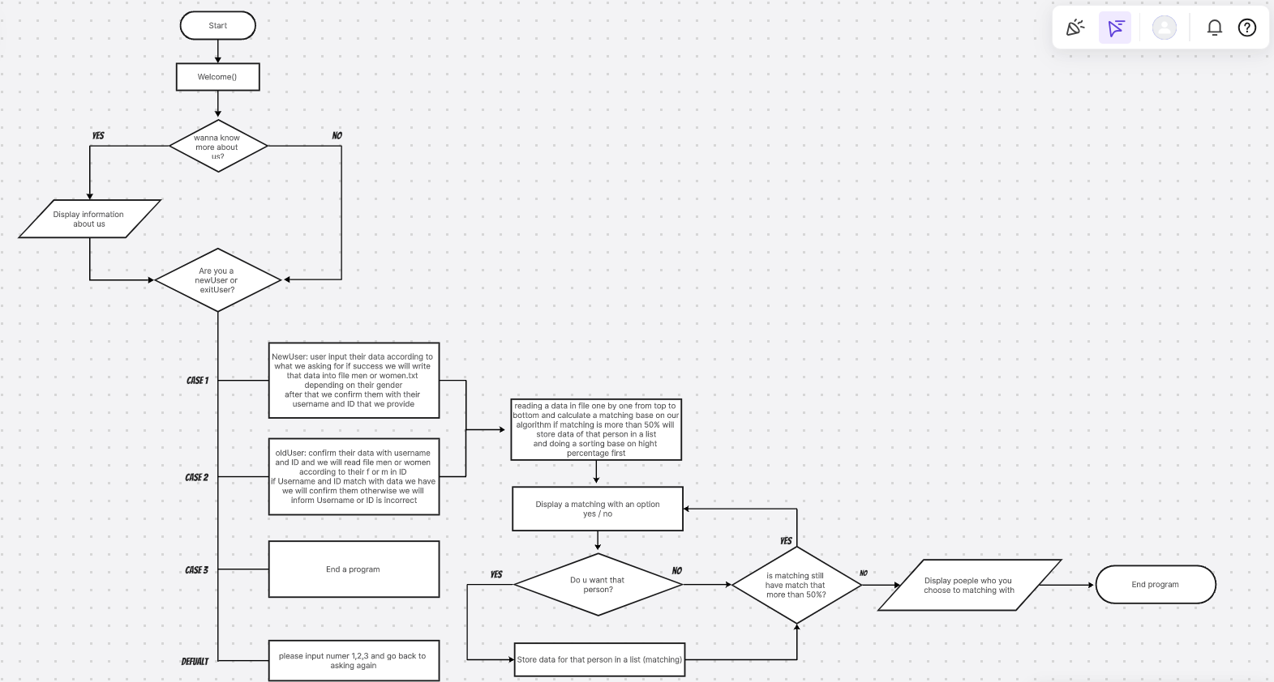
Workflow
9

Slide 11
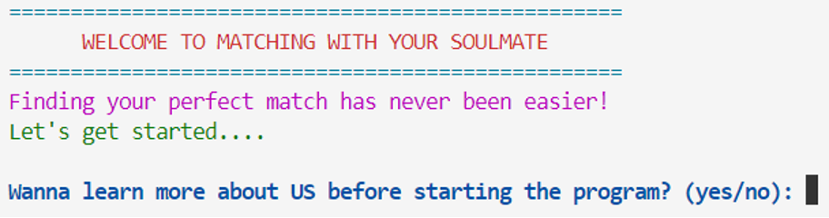
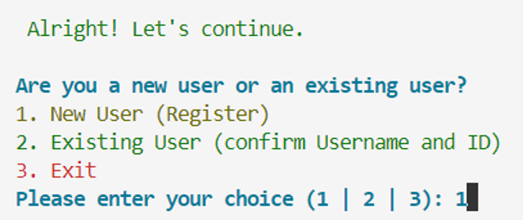
result
10
Welcome page and options
1.

Slide 12
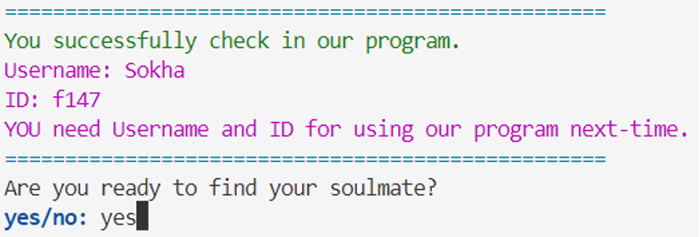
result
11
After user verification:
2

Slide 13
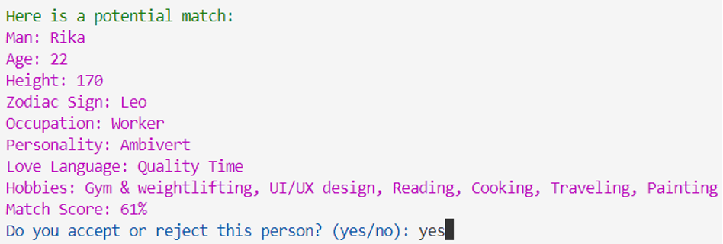
result
12
Suggested match for user:

Slide 14
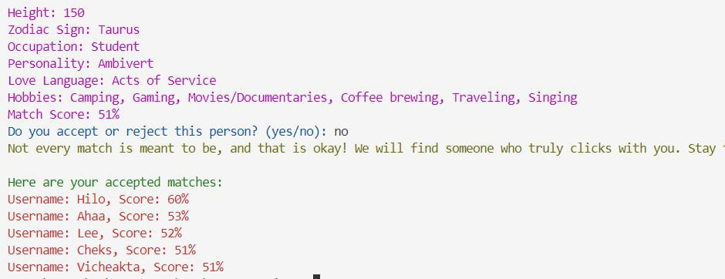
result
13
Final result:
3

Slide 15
14
This project highlighted the importance of networking, privacy challenges in data collection, and the need for logical reasoning in matchmaking algorithms. Despite challenges, our passion made the process engaging and insightful.
conclusion

Slide 16


15
future work
1. Administrative Dashboard
2. Enhanced Matching Criteria
3. Web-Based Platform
4. GUI Improvements

Slide 17



Thank You!
Hopefully your love life is beautiful

