Slide 1
UE20CS390A – Capstone Project Review #3

Slide 2
Quick Glance
Project Title: Sports Video Summarization
Project ID: 43
Project Guide: Prof Kokila P
Katta Lohith Krishna Kumar-PES2UG20CS158
Kanikaram Roopasreesai-PES2UG20CS154
Koyya Deekshitha-PES2UG20CS167
Maneesh Nand Reddy Kondaiahgari-PES2UG20CS186

Slide 3



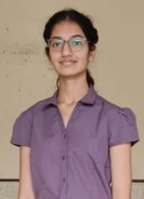
Our Team
Roopasreesai K
Lohith K
Maneesh K
Deekshitha K

Slide 4
Outline
Problem Statement
Summary of Literature Survey
Suggestions from Review-2
Design Approach
Proposed Architecture
Design Description
Technologies Used
Project Progress
References

Slide 5
Problem Statement
Sports video summarization is an emerging field that aims to condense long and complex sports videos into a short, concise summary. This technology can be useful for users who want to quickly catch up on the key moments from a game or event and for coaches and analysts who need to review footage to identify areas for improvement.

Slide 6
Summary of Literature Survey in Review 2
The paper's main objective is to identify and profile different types of actions in sports videos. The proposed method consists of LSTM and the attention layer takes the input of events of action and predicts the likelihood of this action to be selected in the summary.
This paper aims to develop an approach to build a highlight recognition framework, The proposed method comprises two models. A 3D CNN for feature extraction and an LSTM network to model temporal evolution generates a set of highlights at different timestamps and predicts the rank to highlights All high-ranked highlights were concatenated to form a summarized video.
In this paper the authors proposed an approach for summarizing videos based on a combination of convolutional neural networks (CNNs), sparse autoencoders, and random forest classifiers. The proposed approach involves extracting key frames from the input video using multiple CNNs, followed by feature extraction using sparse autoencoders. The resulting features are then fed into a random forest classifier to identify the most representative frames for the video summary. Using several datasets and showing that it outperforms several state-of-the-art methods in terms of accuracy and efficiency.

Slide 7
Suggestions from Review 2
To design the outline of the architecture.
To explore better Feature Extractor.
To research on datasets.

Slide 8
Design Details
Briefly describe all the platforms, systems, and processes that it depends on and comprise any vital changes that need to be made to them.
Below are some examples but it is not an exhaustive list:
Novelty, Innovativeness, Interoperability, Performance, Security, Reliability, Maintainability, Portability, Legacy to Modernization, Reusability, Application Compatibility.
Note: Applicable to Research project

Slide 9
Design Approach
Existing Approach and results obtained:
In the Existing System highlights are generated by a pre-trained AI-ML model which generates highlights. It used visual information and audio information and calculates a threshold and summarizes highlights based on that Information.
This model fails as the crowd shouts even when the entry of a player and some defense sequence crowd observes silently. So this model won’t recognize the second event as a highlight.

Slide 10
Proposed Methodology / Approach
Is there a need for changing the approach?
Yes, there is a need to change this approach as when the highlights are required in a short duration, the existing system will fail to give importance to particular frame.

Slide 11
Design Details
Novelty: The Novelty of this project is to automate the process of summarization and to generate highlights on basis of how important a particular highlight is. The model gives a weight value to the frames from which we can say how much is a particular highlight important. The weight values help in selecting the duration of the output summary as required. The Novelty makes this model unique from the other existing model approaches.
Reusability: With some tweaks to the training data and code, this model can be used again to produce highlights for other games or sports.
Performance: The Deep learning technique considers both spatial and temporal features and the machine learning technology gives weight to each frame efficiently. So, the model is expected to achieve good performance.
Legacy to Modernization: This model generates automated highlights whereas the old systems are done manually.

Slide 12
Design Details
Interoperability: As the Model is being executed on Google Collab. The Model can run on other Operating Systems if Google Collab is available to be used on that particular Operating System.
Reliability: This Model will be able to produce the expected result.

Slide 13
Proposed Methodology
Details of the new approach- benefits/drawbacks:
The approach which we are proposing to use will consider the importance of each highlight by giving a bias value to each highlight (frame).
So when generating a summarization video this model will take the important highlights and generate the summary.
There can be a problem with latency as we are giving bias value to each frame and generating a summary.

Slide 14
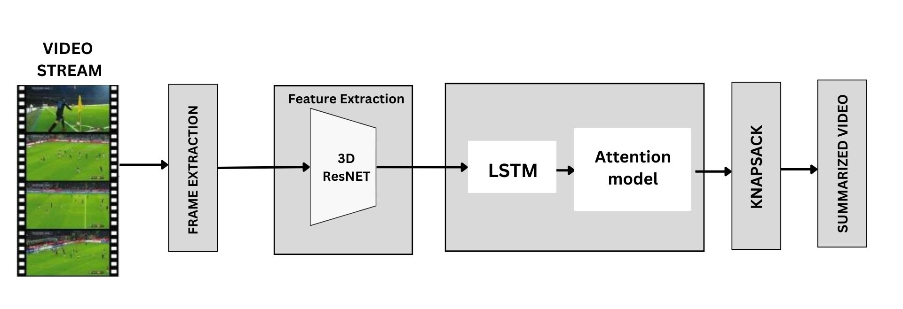
Architecture Diagram

Slide 15
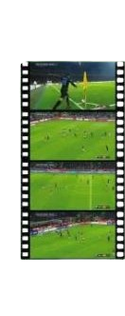
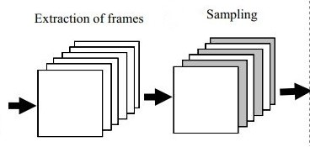
Video Segmentation

Slide 16
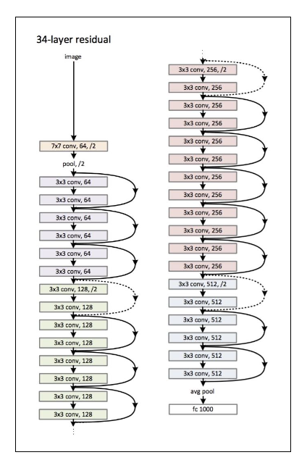
3D ResNet
3D ResNet is a CNN model used to extract features from frames(images).
It gives the output as a feature vector.
Skip Connections are used to overcome the vanishing gradient problem.
The Output of every convolution layer is typically a feature map that is flattened(compressed) to 1D space which is named a Feature Vectors.

Slide 17
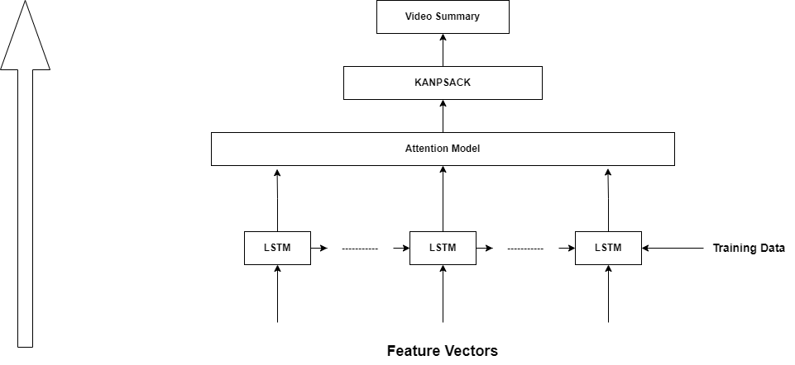
LSTM based Attention Layer

Slide 18
Design Description(if applicable)
Add as many slides as required to cover the following aspects:
Master Class Diagram
Use-Case Diagram
#ER Diagram
#User Interface Diagrams/ Use Case Diagrams
#Report Layouts
#External Interfaces.

Slide 19
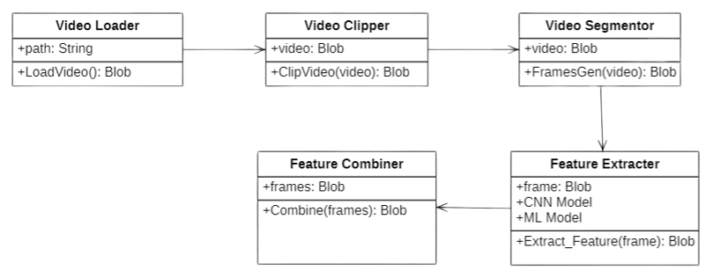
Master Class Diagram

Slide 20
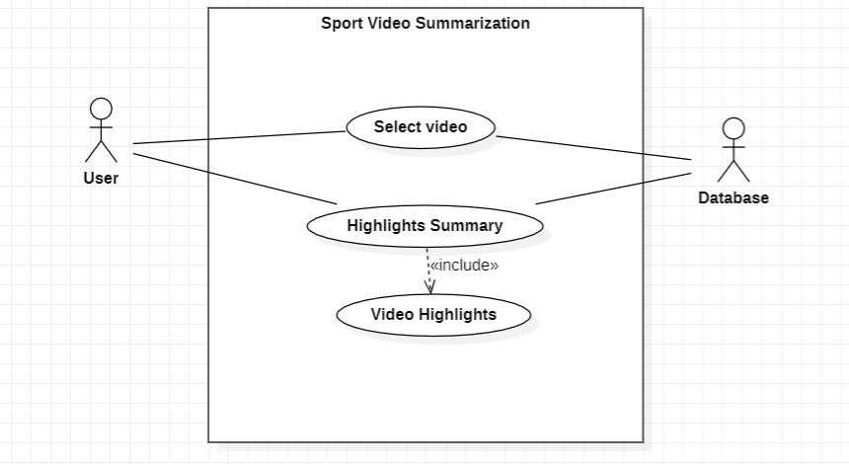
Use-Case Diagram

Slide 21
Technologies Used
Key Frame extraction is done using Multi-CNN Models.
Programming Languages like Python.
Image feature extraction is done through pre-trained models like 3D ResNet.
Google Collab is used for execution purposes.

Slide 22
Project Progress
Literature Survey.
We have acquired a dataset and got access to use that dataset. Now we are analyzing the dataset if it works for our Model or not.

Slide 23
Any Other Information
Any other Information to add-on
Note: Changes can be made in the template, with the consent of the guide for inclusion of any other information.

Slide 24
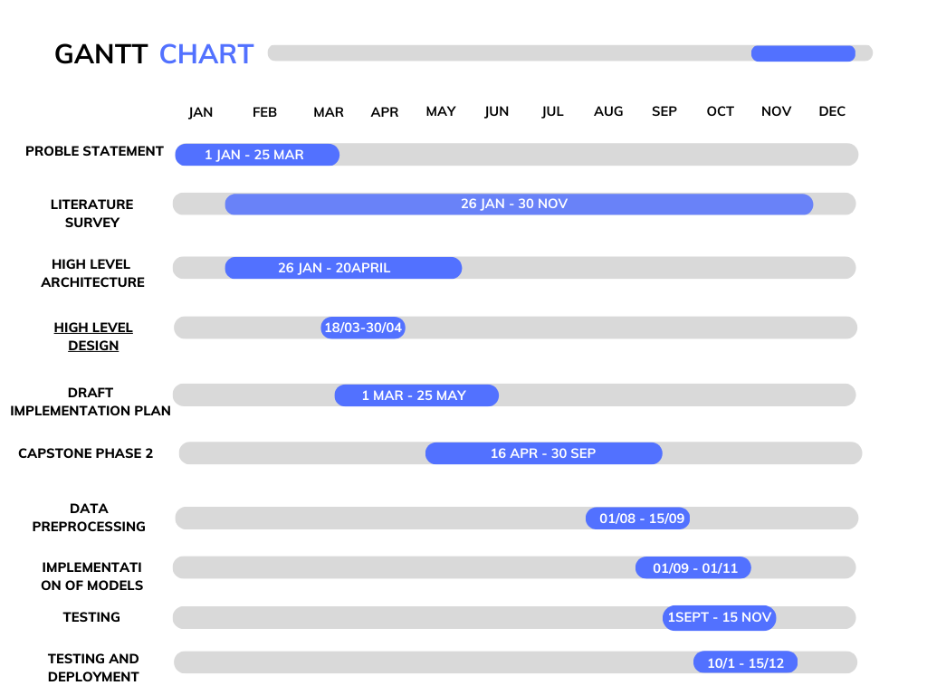
Capstone (Phase-I & Phase-II) Project Timeline

Slide 25
Summarization
This Model will generate video highlights while considering the importance of each frame i.e., by giving it a bias value to each frame and extracting the highlights based on those bias values.
This Model is expected to return concise highlights which are much related to the key moments in the game.

Slide 26
References
[1]Nair, M.S., Mohan, J. Static video summarization using multi-CNN with sparse autoencoder and random forest classifier. SIViP 15, 735–742 (2021). https://doi.org/10.1007/s11760-020-01791-4
[2]R. Agyeman, R. Muhammad and G. S. Choi, "Soccer Video Summarization Using Deep Learning," 2019 IEEE Conference on Multimedia Information Processing and Retrieval (MIPR), San Jose, CA, USA, 2019, pp. 270-273, doi: 10.1109/MIPR.2019.00055.
[3]M. Sanabria, F. Precioso and T. Menguy, "Profiling Actions for Sport Video Summarization: An attention signal analysis," 2020 IEEE 22nd International Workshop on Multimedia Signal Processing (MMSP), Tampere, Finland, 2020, pp. 1-6, doi: 10.1109/MMSP48831.2020.9287062.
[4] M. E. Anjum, S. F. Ali, M. T. Hassan and M. Adnan, "Video summarization: Sports highlights generation," INMIC, Lahore, Pakistan, 2013, pp. 142-147, doi:10.1109/INMIC.2013.6731340.
[5] J. Han, Y. Zhang and Z. Sun, "Key Frame Extraction Based on Sports Statistical Characteristics," 2022 IEEE Asia-Pacific Conference on Image Processing, Electronics and Computers (IPEC), Dalian, China, 2022, pp. 908-911, doi: 10.1109/IPEC54454.2022.9777583.
[6] K. Davila, F. Xu, S. Setlur and V. Govindaraju, "FCN-LectureNet: Extractive Summarization of Whiteboard and Chalkboard Lecture Videos," in IEEE Access, vol. 9, pp. 104469-104484, 2021, doi: 10.1109/ACCESS.2021.3099427.
[7] H. Boukadida, S. -A. Berrani and P. Gros, "Automatically Creating Adaptive Video Summaries Using Constraint Satisfaction Programming: Application to Sport Content," in IEEE Transactions on Circuits and Systems for Video Technology, vol. 27, no. 4, pp. 920-934, April 2017, doi: 10.1109/TCSVT.2015.2513678.

Slide 27
References
[8] M. Merler et al., "Automatic Curation of Sports Highlights Using Multimodal Excitement Features," in IEEE Transactions on Multimedia, vol. 21, no. 5, pp. 1147-1160, May 2019, doi: 10.1109/TMM.2018.2876046.
[9] R. Agyeman, R. Muhammad and G. S. Choi, "Soccer Video Summarization Using Deep Learning," 2019 IEEE Conference on Multimedia Information Processing and Retrieval (MIPR), San Jose, CA, USA, 2019, pp. 270-273, doi: 10.1109/MIPR.2019.00055.
[10] G. Mujtaba, A. Malik and E. -S. Ryu, "LTC-SUM: Lightweight Client-Driven Personalized Video Summarization Framework Using 2D CNN," in IEEE Access, vol. 10, pp. 103041-103055, 2022, doi: 10.1109/ACCESS.2022.3209275.
[11] D. Xu, H. Fu, L. Wu, M. Jian, D. Wang and X. Liu, "Group Activity Recognition by Using Effective Multiple Modality Relation Representation With Temporal-Spatial Attention," in IEEE Access, vol. 8, pp. 65689-65698, 2020, doi: 10.1109/ACCESS.2020.2979742.
[12] C. Lin and Y. Chen, "Sports Video Summarization with Limited Labeling Datasets Based on 3D Neural Networks," 2019 16th IEEE International Conference on Advanced Video and Signal Based Surveillance (AVSS), Taipei, Taiwan, 2019, pp. 1-6, doi: 10.1109/AVSS.2019.8909872.
[13] M. Sanabria, F. Precioso and T. Menguy, "Profiling Actions for Sport Video Summarization: An attention signal analysis," 2020 IEEE 22nd International Workshop on Multimedia Signal Processing (MMSP), Tampere, Finland, 2020, pp. 1-6, doi: 10.1109/MMSP48831.2020.9287062.
[14] M. Tavassolipour, M. Karimian and S. Kasaei, "Event Detection and Summarization in Soccer Videos Using Bayesian Network and Copula," in IEEE Transactions on Circuits and Systems for Video Technology, vol. 24, no. 2, pp. 291-304, Feb. 2014, doi: 10.1109/TCSVT.2013.2243640

Slide 28
References
[15] A. Tejero-de-Pablos, Y. Nakashima, T. Sato, N. Yokoya, M. Linna and E. Rahtu, "Summarization of User-Generated Sports Video by Using Deep Action Recognition Features," in IEEE Transactions on Multimedia, vol. 20, no. 8, pp. 2000-2011, Aug. 2018, doi: 10.1109/TMM.2018.2794265
[16] Godi, M., Rota, P., Setti, F. (2017). Indirect Match Highlights Detection with Deep Convolutional Neural Networks. In: Battiato, S., Farinella, G., Leo, M., Gallo, G. (eds) New Trends in Image Analysis and Processing – ICIAP 2017. ICIAP 2017. Lecture Notes in Computer Science(), vol 10590. Springer, Cham
[17] C. Yan, X. Li and G. Li, "A New Action Recognition Framework for Video Highlights Summarization in Sporting Events," 2021 16th International Conference on Computer Science & Education (ICCSE), Lancaster, United Kingdom, 2021, pp. 653-666, doi: 10.1109/ICCSE51940.2021.9569708
[18] M. Z. Khan, S. Jabeen, S. ul Hassan, M. A. Hassan and M. U. G. Khan, "Video Summarization using CNN and Bidirectional LSTM by Utilizing Scene Boundary Detection," 2019 International Conference on Applied and Engineering Mathematics (ICAEM), Taxila, Pakistan, 2019, pp. 197-202, doi: 10.1109/ICAEM.2019.8853663
[19] DeMenthon, D., Kobla, V., & Doermann, D. (1998, September). Video summarization by curve simplification. In Proceedings of the sixth ACM international conference on Multimedia (pp. 211-218)
[20] Chianese, A., Miscioscia, R., Moscato, V., Parlato, S., & Picariello, A. (2004, August). A fuzzy approach to video scene detection and its application for soccer matches. In Proceedings of the 4th International Conference on Intelligent Systems Design and Application

Slide 29
References
[21] F. Chen and C. De Vleeschouwer, "Formulating Team-Sport Video Summarization as a Resource Allocation Problem," in IEEE Transactions on Circuits and Systems for Video Technology, vol. 21, no. 2, pp. 193-205, Feb. 2011, doi: 10.1109/TCSVT.2011.2106271.
[22] C. Yan, X. Li and G. Li, "A New Action Recognition Framework for Video Highlights Summarization in Sporting Events," 2021 16th International Conference on Computer Science & Education (ICCSE), Lancaster, United Kingdom, 2021, pp. 653-666, doi: 10.1109/ICCSE51940.2021.9569708.
[23] P. Kadam et al., "Recent Challenges and Opportunities in Video Summarization With Machine Learning Algorithms," in IEEE Access, vol. 10, pp. 122762-122785, 2022, doi: 10.1109/ACCESS.2022.3223379.

Slide 30
Thank You

