Slide 1

BLOCKBUSTERS
BLOCKBUSTERS
BLOCKBUSTER

Slide 2
Overview
A giant in the entertainment industry, blockbusters revolutionizing video rentals with its convenient and expansive selection. However, the company failed to adapt to changing consumer preferences and technological advancements, ultimately leading to its downfall.

Slide 3
Business Understanding
Blockbuster's core business model relied on physical media rentals, charging customers late fees and generating profit through margins on each rental. This model thrived in the VHS era but struggled to compete with the rise of DVDs and streaming services offering greater convenience and lower costs.

Slide 4
Data Understanding
Data Understanding:
Analyzing historical data reveals key trends:
Declining rental revenue: As streaming services gained traction, rental demand for physical media plummeted.
Increased late fees: While initially a source of revenue, late fees alienated customers and contributed to negative brand perception.
Shifting customer demographics: Younger generations embraced streaming, leaving Blockbuster's target audience shrinking

Slide 5
Data Analysis
From the provided work able to work with the different file formats ,and getting to the following graphs were made . This are readings from the files that will help in building up recommendations on what to do in the upcoming year and project thus being successful

Slide 6
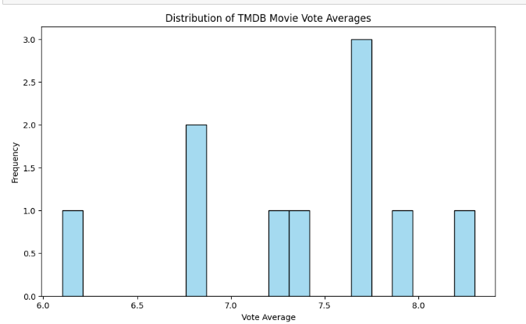
Data visualization

Slide 7
From the slide of vote count against frequency, from the diagram we learn that our average votes comes to a handful of people voting for the various movies as one with the highest frequency being 3

Slide 8
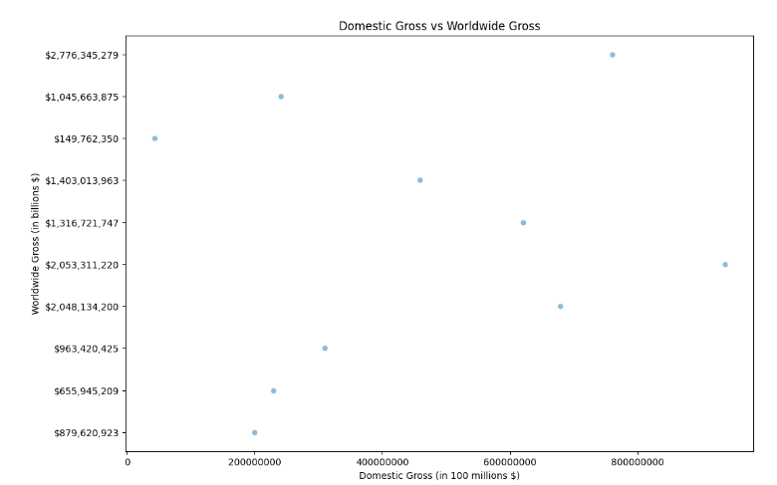
DOMESTIC VS WORLDWIDE GROSS

Slide 9
From the slide we get a look on the comparison of the files are between the domestic gross and the worldwide gross which show that we have had more worldwide gross than the local of the films

Slide 10
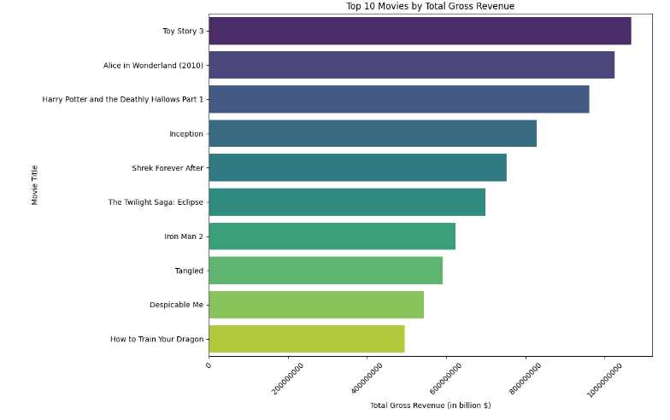
Top 10 by gross

Slide 11
It’s a messaure of the top movies that have summed up to bring profits to the company and add value to the company the top being toy story with over 100,000,000$ over the year .

Slide 12
Reccomendation
Since things are becoming digital , the company should open a site where there are monthly or yearly subscription to compete with major companies like Netflix and hulu
Bringing back the movies that already has 1 or 2 movies like toy story for a more part
Adding of the production budget as more movies have been having a higher profit and vote count than the ones with low

Slide 13
END
All in all this is just a start up to build for the future as the company grows . Thank you

